Slide 1
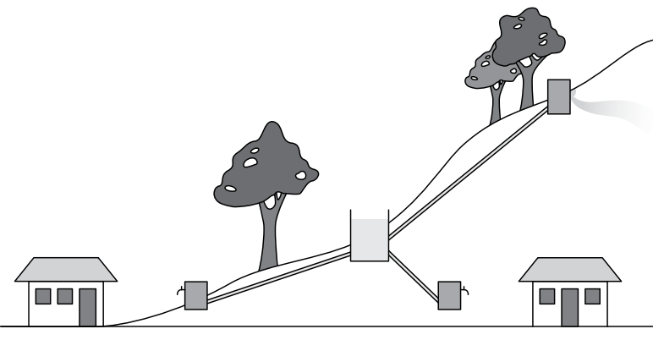
Keeping the water flowing:
ENPHO Field Test Kit
Image source: http://www.wateraidamerica.org/sites/default/files/attachments/Gravity%20fed%20schemes.pdf

Slide 2
ENPHO WATER TEST KIT

Slide 3
kl/ro
g]kfnsf] clwsf+z kfgL hfFr ug]{ k|of]uzfnfx? sf7df8f}+df s]lGb«t 5g\ .
kfgL hfFrsf nflu l56f] eGbf l56f] pko'Qm ljlwn] ;'/lIft ?kdf k|of]uzfnf k'¥ofpg hl6n x'g ;S5 .
PGkmf]n] kfgL k/LIf0fsf nflu lkmN8 6]i6 ls6sf] ljsf; u/]sf] 5, h;n] ;xh ?kdf kfgLsf] !) kf/fldltx? 6]i6 -hfFr_ ug{ ;lsG5 .

Slide 4
kf/fldltx?
sf]lnkmd{ 5÷5}g efon
lk|m /]l;8\o'n Snf]l/g
lk=Pr=
Tffkqmd
cdf]lgof
cfO{/g
gfO{6«]6
km:km]6
Snf]/fO{8
xf8{g];

Slide 5
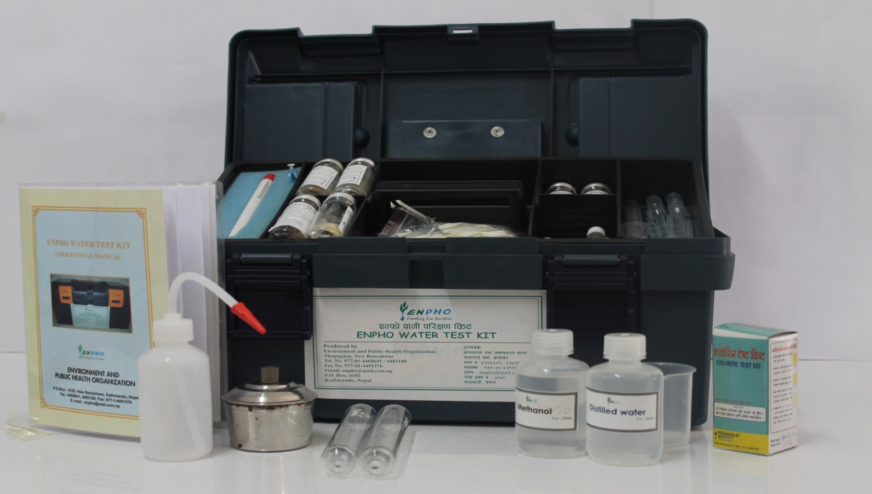
ENPHO WATER TEST KIT
Notes:
Name apparatus included in the test kit:
Operational manual, wash bottle, spirit lamp, test tube, reagents, beaker, thermometer,

Slide 6
Apparatus included in test kit…
Vial- to do testing
Syringe- to measure the reagents
Beaker
test-tube- to do testing
Dropper- to add reagents dropwise
wash bottle- to clean after testing
Holder- to hold test tube while heating
operational manual
Reagents and etc.

Slide 7
kfgL k/LIf0f–ls6sf] lgDg ljif]ztfx? 5g\ M
!_ lkmN8df af]s]/ lx8\g ;lhnf] .
@_ l/Ph]G6x? ;lsPdf k'gM eg{ ;lsg] .
#_ ;:tf] / ;'ne .
$_ k|of]u ug{ ;lhnf] / ;fwf/0f tflnd lnP/ s'g}klg JolQmn] hfFr ug{ ;Sg] .
%_ of] kl/If0faf6 s'g} klg lkpg] kfgLsf] u'0f:t/sf] cf+sng ug{ ;lsG5.

Slide 8
PGkmf] lkmN8÷6]i6 ls6 k|of]u ug'{ cl3 Wofg lbg'kg]{ s'/fx?
!_ lkmN8 ls6 k|of]u ug'{ cl3 lbO{Psf] lgb]{zg k'l:tsf /fd|/L k9\g' xf];\ .
@_ kfgL k/LIf0f ubf{ lgb]{zg k'l:tsfdf lbOPsf] h:t} x/]s kf/fldltx? Nfx/df Ps Ps ub{} k/LIf0f ug'{ xf];\ .
#_ lkmN8 ls6n] x]bf{ ;kmf b]lvg] kfgL dfq kl/If0f ug{ ;lsG5 , To;}n] wldnf] kfgLnfO{ lyu|ofP/ dfq k/LIf0f ug{'xf];\ .
$_ x/]s kf/fldlt k/LIf0f ubf{ lgb]{zg k'l:tsfdf elgPsf] ;fdfg k|of]u u/L ;kmf :yfgdf /fvL lgb]{zg k'l:tsfdf lbOPsf] ljlwx? ckgfO{ k/LIf0f ug'{xf];\ .
%_ Pp6f kf/fldltsf] k/LIf0f k"/f gu/L csf]{ kf/fldlt k/LIf0fnfO{ cfjZos ;fdfgx? ls6 aS;af6 aflx/ lemSg' x'Fb}g .

Slide 9
PGkmf] lkmN8 ls6 k|of]u ug'{ cl3 Wofg lbg'kg]{ s'/fx?========
^_ Pp6f kf/fldltsf] k/LIf0f k"/f ePkl5 To;df k|of]u ePsf ;a} cfjZos ;fdfgx? ;kmf;Fu Kfvfn]/ ls6–aS;df oyf:yfgdf /fVg'xf];\ .
&_ l;l/~h, 8«k/, 6]i6–6\o'a / efon -l;;fsf] kfgL /fVg] ef8f_ klg k/LIf0f k"/f ePkl5 ;kmf kfgLn] kvfNg' kb{5 .
*_ /;fogsf] l/Ph]G6 af]tnx? Kflg k|of]u eP kl5 t'?Gt aGb ug'{xf];\ .
(_ /;fogsf] l/Ph]G6 af]tnsf] lasf]{x? klg Ps csf]{df g;f6\g'xf];\ .
!)_ /;fog l/Ph]G6x? klg Ps csf]{df gld;fpg'xf];\ .

Slide 10
PGkmf] lkmN8 ls6 k|of]u ug'{ cl3 Wofg lbg'kg]{ s'/fx?========
!!_ /;fog l/Ph]G6x? / ls6nfO{ l;wf 3fdsf] ls/0fdf kg{ glbg'xf];\ .
!@_ kl/If0f ug{ cl3 / k"/f ePkl5 cfKfm\gf] xft ;fa'g kfgLn] /fd|f];Fu w'g'xf];\ .
!#_ PGkmf] lkmN8–ls6nfO{ ;w}+ aGb u/L lr;f] / cFWof/f] :yfgdf /fVg'xf];\ .

Slide 11
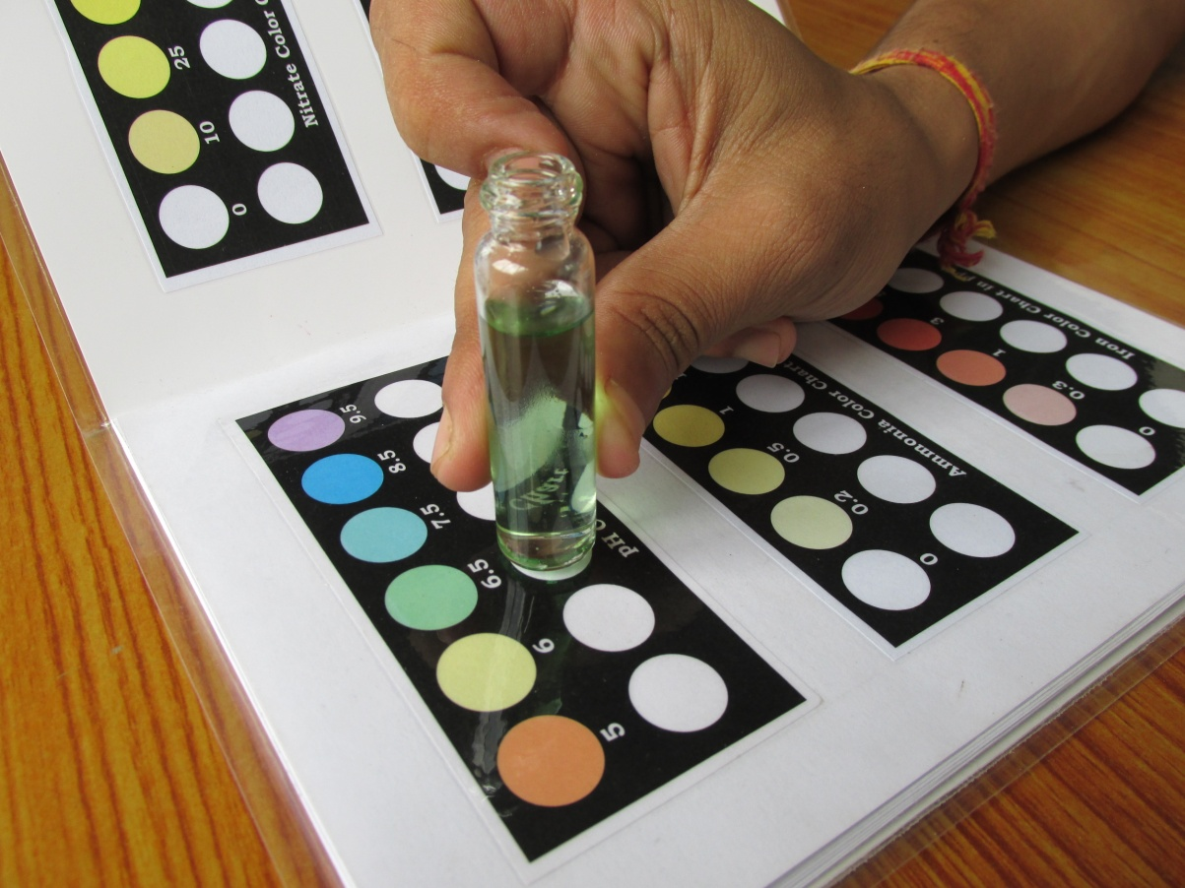
sn/ x]g]{ t/Lsf

Slide 12
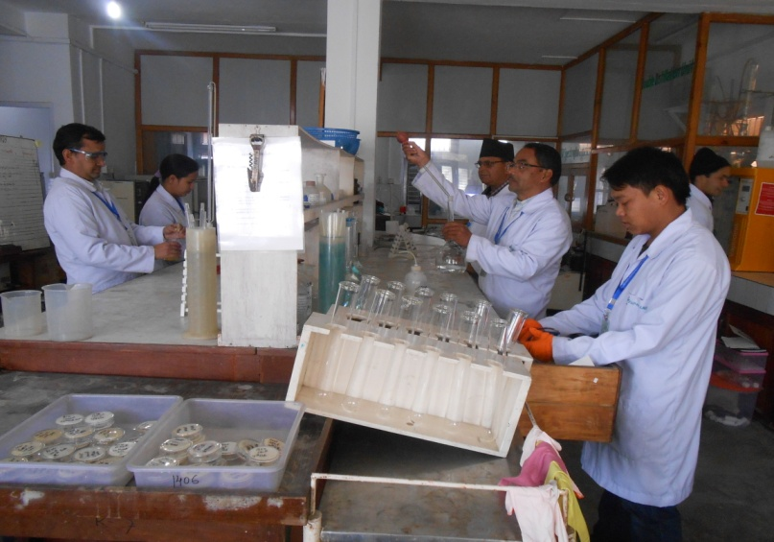
धन्यवाद

