Slide 2
This presentation is for use with
“Lesson Plan: Household Membrane Filters”
in the Household Water Treatment and Safe Storage (HWTS) Trainer Manual
Available at resources.cawst.org

Slide 3
Household Membrane Filters
2018
June

Slide 4
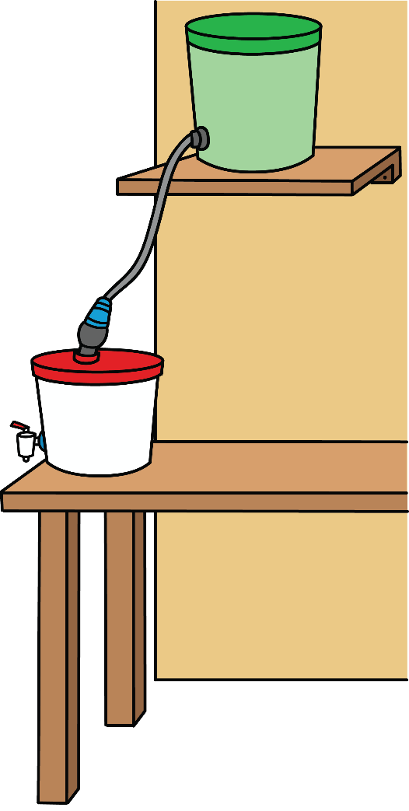
Have You Used Membrane Filters?

Slide 5
Learning Outcomes
Explain what membrane filters are
Describe different membrane filter cartridges and setups
Describe some of the limitations of membrane filters

Slide 6
What Are Membrane Filters?
Membrane: Any type of material with tiny holes (pores) that allow fluids to pass through but prevent the passage of certain particles or chemicals
Membrane filters: Devices that contain a membrane and use a driving force (such as gravity or pumping) to push water through the membrane

Slide 8
Types of Membrane Filters
Membrane filters differ in:
Pore size
Membrane cartridge configuration
Container setup

Slide 9
Pore Size or Particle Size
0.1 nm
1 nm
10 nm
100 nm
1 micron
10 microns
Membrane Type
Particle Type
Reverse
Osmosis
Ulrafiltration
Nanofiltration
Microfiltration
Smaller
Bigger
Bacteria
Salts, Metal Ions
Pesticides
Viruses
Protozoa
Proteins
Helminths

Slide 10
Membrane Cartridge Configuration
Large Tube Membrane
Water moves through the pores of the tube wall (membrane).

Slide 11
Membrane Cartridge Configuration
Spiral-Wound Membrane
Water moves into the cartridge and travels through wrapped layers of membrane to reach a central tube.

Slide 12
Membrane Cartridge Configuration
Hollow Fibre Membrane
Water moves into the cartridge and travels through tiny pores into the hollow fibres.

Slide 13
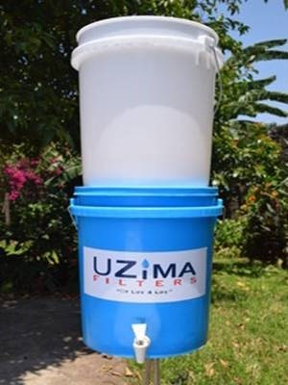
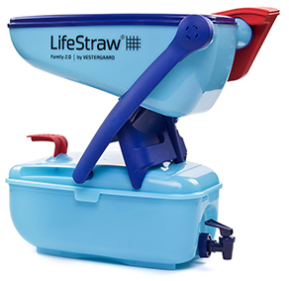
Container Setup: Tabletop (Gravity Driven)

Slide 14
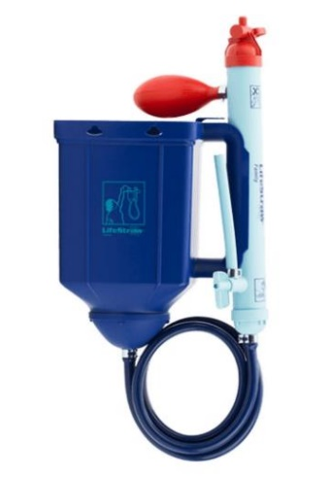
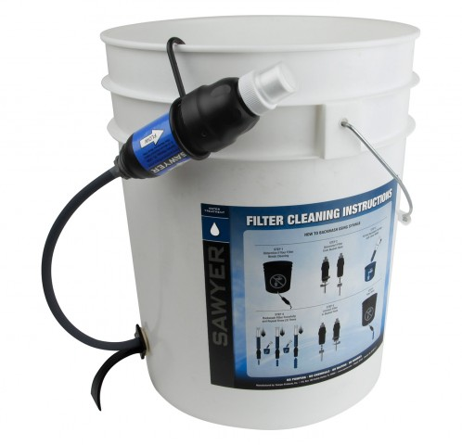
Container Setup: Hanging (Gravity Driven)

Slide 15
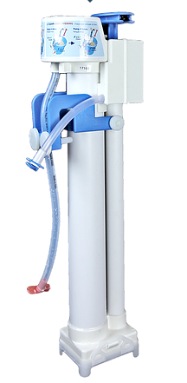
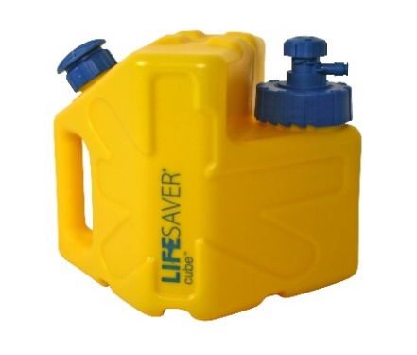
Container Setup: Pump Driven

Slide 16
Considerations and Limitations
Highly variable designs to choose from (different volume, pore size, configuration)
Trade-off between microbiological performance and flow rate
Lifespan: manufacturer-stated vs. real conditions
What’s needed for backwashing, repair, and replacement
Potential for membrane fouling and membrane rupture

Slide 17
Review: Group Discussion
(Membrane Fact Sheets)
1. Given what you learned in this lesson, how would you categorize your filter? Consider:
Pore size (ultrafiltration or microfiltration)
Membrane configuration (your best guess)
Filter setup
2. Would you use this filter? Why or why not?

