Slide 1
12, 2916 – 5th Avenue
Calgary, Alberta, T2A 6K4, Canada
Phone: + 1 (403) 243-3285, Fax: + 1 (403) 243-6199
E-mail: cawst@cawst.org, Website: www.cawst.org
CAWST, the Centre for Affordable Water and Sanitation Technology, is a nonprofit organization that provides training and consulting to organizations working directly with populations in developing countries who lack access to clean water and basic sanitation.
One of CAWST’s core strategies is to make knowledge about water common knowledge. This is achieved, in part, by developing and freely distributing education materials with the intent of increasing the availability of information to those who need it most.
This document is open content and licensed under the Creative Commons Attribution Works 3.0 Unported License. To view a copy of this license, visit http://creativecommons.org/licenses/by/3.0 or send a letter to Creative Commons, 171 Second Street, Suite 300, San Francisco, California 94105, USA.
You are free to:
Share – to copy, distribute and transmit this document
Remix – to adapt this document
Under the following conditions:
Attribution. You must give credit to CAWST as the original source of the document. Please include our website: www.cawst.org
CAWST will produce updated versions of this document periodically. For this reason, we do not recommend hosting this document to download from your website.
CAWST and its directors, employees, contractors, and volunteers do not assume any responsibility for and make no warranty with respect to the results that may be obtained from the use of the information provided.
Stay up-to-date and get support:
Latest updates to this document
Other workshop & training related resources
Support on using this document in your work
CAWST provides mentorship and
coaching on the use of its education
and training resources.

Slide 2
Water Related Diseases

Slide 3
Learning Expectations
1. List common water related diseases.

Slide 4
“So I can’t show you how, exactly, health care is a basic human right. But what I can argue is that no one should have to die of a disease that is treatable.”
– Dr. Paul Farmer

Slide 5
What Are Water Related Diseases?
Diseases from micro-organisms (pathogens) in the water that people drink
Diseases from chemicals in the water that people drink
Diseases from pathogens or insects that have part of their lifecycle in water
Diseases that spread because people do not have enough water for hygiene

Slide 6
Water Related Diseases
Disease | Pathogen | Transmission
Polio | Virus | Ingestion
Hepatitis A | Virus | Ingestion
Hepatitis E | Virus | Ingestion
Rotavirus | Virus | Ingestion
Cholera | Bacteria | Ingestion
Typhoid | Bacteria | Ingestion
Giardia | Protozoa | Ingestion
Cryptosporidiosis | Protozoa | Ingestion
Amoebic Dysentery | Protozoa | Ingestion
Guinea Worm | Worm | Ingestion
Round worm | Worm | Ingestion
Schistosomiasis (Bilharzia) | Worm | Bathing
Trachoma | Bacteria | Poor Hygiene
Scabies | Parasite (Mite) | Poor Hygiene
Malaria, Dengue Fever, Japanese Encephalitis | Protozoa, Virus, Virus | Mosquitoes (breed in stagnant water)

Slide 7
Questions
We are going to look at several water related diseases now. We will ask 4 questions about each disease:
What are the symptoms?
What is it caused by?
How is it transmitted?
How can we prevent it?

Slide 8
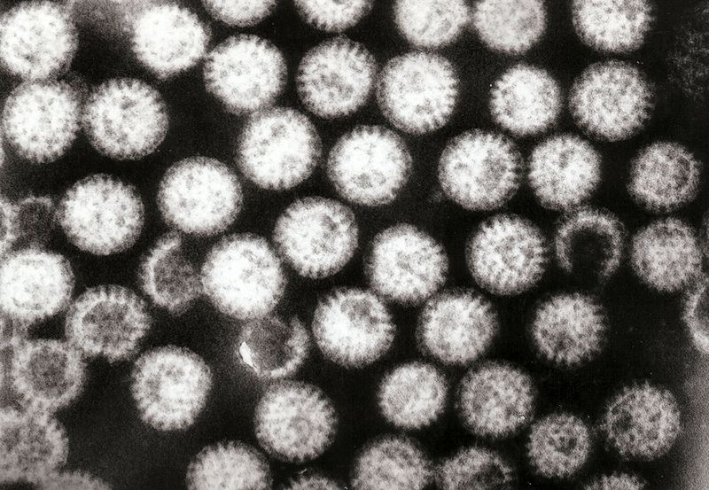
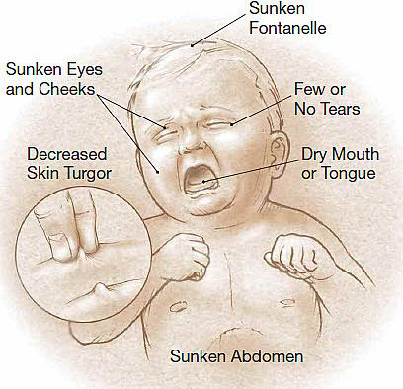
Rotavirus
Credit: wikipedia.org, GrahamColm
Credit: doctortipster.com

Slide 9
Rotavirus
Symptoms:
Watery diarrhea
Vomiting
Low fever
Dehydration
Stomach pain
2. Cause: Virus
Notes:
SCOPE OF PROBLEM:
Rotavirus is the most common cause of severe diarrhoea among infants and young children.
By the age of five, nearly every child in the world has been infected with rotavirus at least once. However, with each infection, immunity develops, and subsequent infections are less severe; adults are rarely affected. Outbreaks of rotavirus A diarrhoea are common among hospitalised infants, young children attending day care centres, and elderly people in nursing homes.
Rotavirus is usually an easily managed disease of childhood, but worldwide more than 450,000 children under five years of age still die from rotavirus infection each year, most of whom live in developing countries, and almost two million more become severely ill.
TRANSMISSION:
The virus is transmitted by the faecal-oral route. It infects and damages the cells that line the small intestine and causes gastroenteritis (which is often called "stomach flu" despite having no relation to influenza). Although rotavirus was discovered in 1973 and accounts for up to 50% of hospitalisations for severe diarrhoea in infants and children, its importance is still not widely known within the public health community, particularly in developing countries. In addition to its impact on human health, rotavirus also infects animals, and is a pathogen of livestock.
THE VIRUS:
There are five species of this virus, referred to as A, B, C, D, and E. Rotavirus A, the most common, causes more than 90% of infections in humans.
SYMPTOMS:
Rotavirus gastroenteritis is a mild to severe disease characterised by vomiting, watery diarrhoea, and low-grade fever.
Once a child is infected by the virus, there is an incubation period of about two days before symptoms appear.
Symptoms often start with vomiting followed by four to eight days of profuse diarrhoea.
Dehydration is more common in rotavirus infection than in most of those caused by bacterial pathogens, and is the most common cause of death related to rotavirus infection.
TREATMENT AND PREVENTION:
Public health campaigns to combat rotavirus focus on providing oral rehydration therapy for infected children and vaccination to prevent the disease.

Slide 10
Rotavirus
3. Transmission:
Water contaminated by feces
Food contaminated by feces
Direct fecal-oral route (e.g. not washing hands)
4. Prevention:
Vaccination
Safe drinking water
Proper hygiene practices
Proper sanitation facilities
Notes:
Interventions:
To prevent the spread of cholera, the following four interventions are essential:
Provision of adequate safe drinking-water
Proper personal hygiene
Proper food hygiene
Hygienic disposal of human excreta.
Treatment of cholera consists mainly in replacement of lost fluids and salts.
The use of oral rehydration salts (ORS) is the quickest and most efficient way of doing this. Most people recover in 3 to 6 days. If the infected person becomes severely dehydrated, intravenous fluids can be given.
Antibiotics are not necessary to successfully treat a cholera patient.

Slide 11
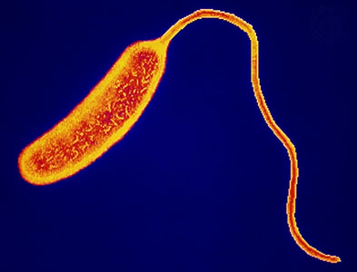
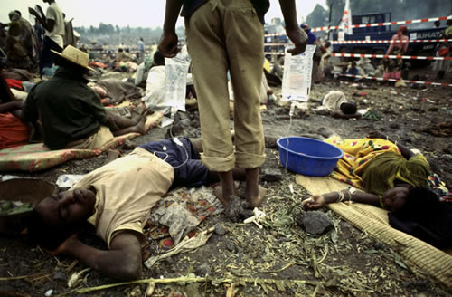
Cholera
kirstyne.wordpress.com
Connect.in.com

Slide 12
Cholera
Symptoms:
Watery diarrhea
Nausea and vomiting
Can lead to death
2. Cause: Bacteria (Vibrio cholerae)
Notes:
Cholera outbreaks can occur sporadically in any part of the world where water supplies, sanitation, food safety and hygiene practices are inadequate.
Overcrowded communities with poor sanitation and unsafe drinking-water supplies are most frequently affected.
The disease and how it affects people:
Cholera is an acute infection of the intestine, which begins suddenly with painless watery diarrhoea, nausea and vomiting. Most people who become infected have very mild diarrhoea or symptom-free infection.
Malnourished people in particular experience more severe symptoms.
Severe cholera cases present with profuse diarrhoea and vomiting.
Severe, untreated cholera can lead to rapid dehydration and death.
If untreated, 50% of people with severe cholera will die, but prompt and adequate treatment reduces this to less than 1% of cases.
The cause:
Cholera is caused by the bacterium Vibrio cholerae.
People become infected after eating food or drinking water that has been contaminated by the faeces of infected persons.
Raw or undercooked seafood may be a source of infection in areas where cholera is prevalent and sanitation is poor.
Vegetables and fruit that have been washed with water contaminated by sewage may also transmit the infection if V. cholerae is present.
Distribution:
Cholera cases and deaths were officially reported to WHO, in the year 2000, from 27 countries in Africa, 9 countries in Latin America, 13 countries in Asia, 2 countries in Europe, and 4 countries in Oceania.
Scope of the Problem:
Control of cholera is a major problem in several Asian countries as well as in Africa.
In the year 2000, some 140,000 cases resulting in approximately 5000 deaths were officially notified to WHO.
Africa accounted for 87% of these cases.
After almost a century of no reported cases of the disease, cholera reached Latin America in 1991; however, the number of cases reported has been steadily declining since 1995.

Slide 13
Cholera
3. Transmission:
Water contaminated by feces
4. Prevention:
Safe drinking water
Proper hygiene practices
Proper sanitation facilities
Notes:
Interventions:
To prevent the spread of cholera, the following four interventions are essential:
Provision of adequate safe drinking-water
Proper personal hygiene
Proper food hygiene
Hygienic disposal of human excreta.
Treatment of cholera consists mainly in replacement of lost fluids and salts.
The use of oral rehydration salts (ORS) is the quickest and most efficient way of doing this. Most people recover in 3 to 6 days. If the infected person becomes severely dehydrated, intravenous fluids can be given.
Antibiotics are not necessary to successfully treat a cholera patient.

Slide 14
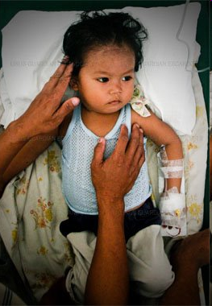
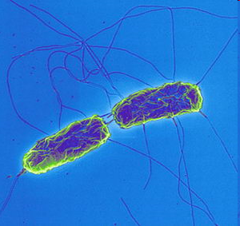
Typhoid
physorg.com
mtxtremist.blogspot.com

Slide 15
Typhoid
Symptoms:
Sustained fever as high as 39°-40° C
Feeling unwell, feeling weak
Headache
Constipation or diarrhea
Rose-coloured spots on the chest area
Enlarged spleen and liver
2. Cause: Bacteria (Salmonella typhi)
Notes:
Typhoid and paratyphoid fevers are infections caused by bacteria which are transmitted from faeces to ingestion.
Clean water, hygiene and good sanitation prevent the spread of typhoid and paratyphoid.
Contaminated water is one of the pathways of transmission of the disease.
The disease and how it affects people:
Typhoid fever is a bacterial infection of the intestinal tract and bloodstream.
Symptoms can be mild or severe and include sustained fever as high as 39°-40° C, malaise, anorexia, headache, constipation or diarrhoea, rose-coloured spots on the chest area and enlarged spleen and liver.
Most people show symptoms 1-3 weeks after exposure.
The cause:
Typhoid and paratyphoid fevers are caused by the bacteria Salmonella typhi and Salmonella paratyphi respectively.
Typhoid and paratyphoid germs are passed in the faeces and urine of infected people.
People become infected after eating food or drinking beverages that have been handled by a person who is infected or by drinking water that has been contaminated by sewage containing the bacteria.
Once the bacteria enter the person’s body they multiply and spread from the intestines, into the bloodstream.
Even after recovery from typhoid, a small number of individuals (called carriers) continue to carry the bacteria.
These people can be a source of infection for others.
The transmission of typhoid and paratyphoid in less-industrialized countries may be due to contaminated food or water. In some countries, shellfish taken from sewage-contaminated beds is an important route of infection.
Where water quality is high, and chlorinated water piped into the house is widely available, transmission is more likely to occur via food contaminated by carriers handling food.
Distribution:
Typhoid is common in less-industrialized countries, principally owing to the problem of unsafe drinking-water, inadequate sewage disposal and flooding.
Scope of the Problem:
The annual incidence of typhoid is estimated to be about 17 million cases worldwide.

Slide 16
Typhoid
3. Transmission:
Water contaminated by feces
Food contaminated by feces
4. Prevention:
Safe drinking water
Proper hygiene practices
Proper sanitation facilities
Notes:
Prevention:
Public health interventions to prevent typhoid include:
Health education about personal hygiene, especially regarding hand-washing after toilet use and before food preparation
Provision of a safe water supply
Proper sanitation systems
Excluding disease carriers from food handling
Control measures to combat typhoid include health education and antibiotic treatment.
A vaccine is available, although it is not routinely recommended except for those who will have prolonged exposure to potentially contaminated food and water in high-risk areas.
The vaccine does not provide full protection from infection.

Slide 17
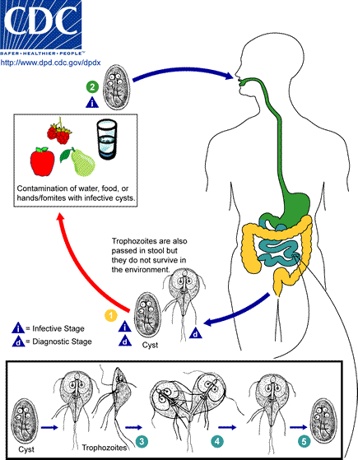
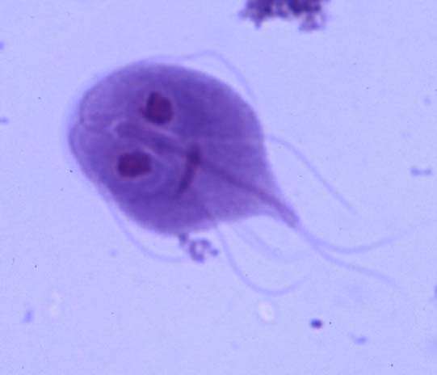
Giardia
biology.unm.edu
Notes:
Point out in the life cycle image that it is ingesting food and water containing the giardia cysts and affects the digestive system.

Slide 18
Giardia
Symptoms:
Diarrhea
Abdominal pain
Bloating, gas/wind
Headache
Low fever
2. Cause: Protozoa (Giardia intestinalis, Giardia lamblia)

Slide 19
Giardia
3. Transmission:
Water contaminated by feces
Food contaminated by feces
Direct fecal-oral route (e.g. not washing hands)
4. Prevention:
Safe drinking water
Proper hygiene practices
Proper sanitation facilities

Slide 20
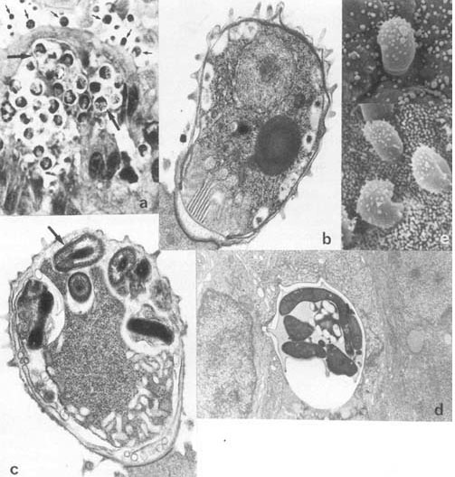
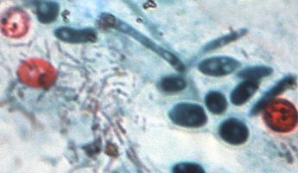
Cryptosporidiosis
ecdc.europa.eu
examiner.com

Slide 21
Cryptosporidiosis
Symptoms:
Diarrhea longer than 10 days in duration
Abdominal pain
Bloating, gas/wind
Vomiting
Weight loss
2. Cause: Protozoa (Cryptosporidium)
Notes:
Cryptosporidiosis is typically an acute short-term infection but can become severe and non-resolving in children and immunocompromised individuals.
In humans, it remains in the lower intestine and may remain for up to five weeks.
The parasite is transmitted by environmentally hardy microbial cysts (oocytes) that, once ingested, excyst in the small intestine and result in an infection of intestinal epithelial tissue.
Cryptosporidium does not utilize an insect vector and is capable of completing its life cycle within a single host, resulting in microbial cyst stages which are excreted in feces and are capable of transmission to a new host.

Slide 22
Cryptosporidiosis
3. Transmission:
Water contaminated by feces
Food contaminated by feces
Direct fecal-oral route (eg., not washing hands)
4. Prevention:
Safe drinking water
Proper hygiene practices
Proper sanitation facilities

Slide 23
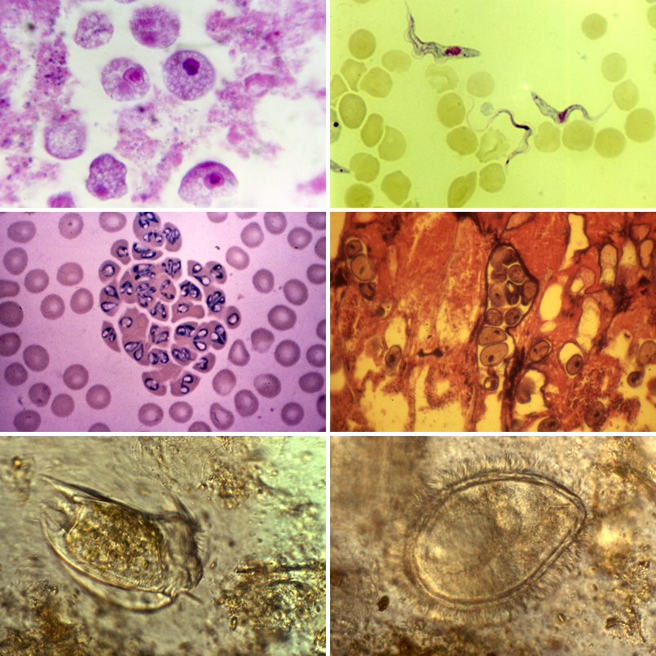
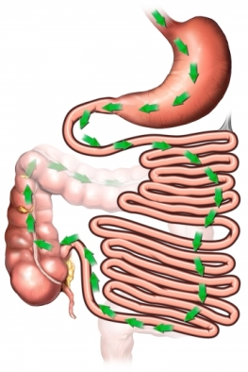
Amoebic Dysentery
aurorahealthcare.org
nhc.ed.ac.uk

Slide 24
Amoebic Dysentry
Symptoms:
Diarrhea
Abdominal pain
Liver infection
Blood in feces
2. Cause: Protozoa (Entamoeba histolytica)

Slide 25
Amoebic Dysentry
3. Transmission:
Water contaminated by feces
Food contaminated by feces
Direct fecal-oral route (eg., not washing hands)
4. Prevention:
Safe drinking water
Proper hygiene practices
Proper sanitation facilities
Notes:
The active trophozoite stage exists only in the host and in fresh loose feces.
Cysts survive outside the host in water, soils and on foods, especially under moist conditions on the latter.
The cysts are readily killed by heat and by freezing temperatures, and survive for only a few months outside of the host.
When cysts are swallowed they cause infections by excysting in the digestive tract.
The trophozoite stage is readily killed in the environment and cannot survive passage thought the acidic stomach to cause infection.

Slide 26
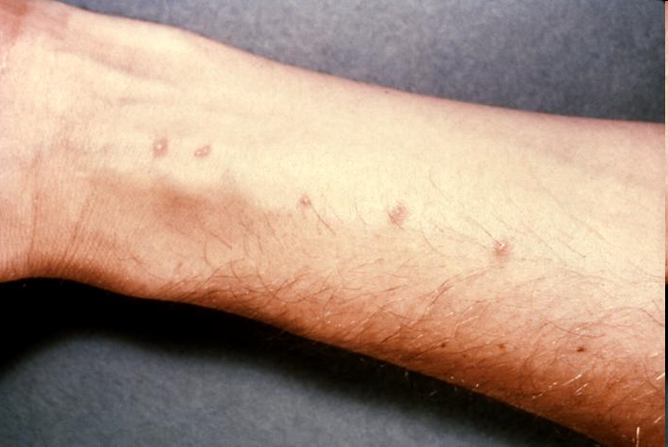
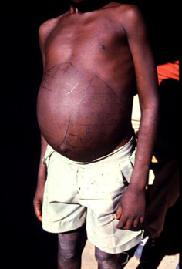
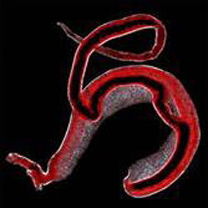
Schistosomiasis (Bilharzia)
www.asb.wchsgis.net
www.path.cam.ac.uk
© Natural History Museum, London
Notes:
Also commonly known as Bilharzia.
Pictures show entry points for larvae passing through skin, and distended belly due to enlargement of spleen.
Long term infection with flat worms living in the veins of the host.
Worms lay eggs which cause damage to various organs. Different strains affect different parts of the body including the liver, the digestive tract, and the urinary tract.
Humans are the main reservoir.
What is schistosomiasis?
Second most important parasitic infection after malaria in terms of public health and economic impact.
Affects the liver, spleen, kidneys, bladder and nervous system and may lead to paralysis
Affects the growth, nutrition, and cognitive development of children

Slide 27
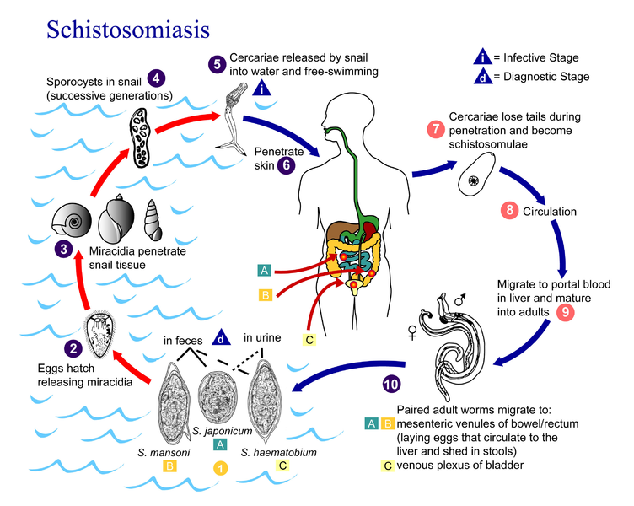
Schistosomiasis (Bilharzia)
Credit: United States Department of Health and Human Services
Notes:
Also commonly known as Bilharzia.
Pictures show entry points for larvae passing through skin, and distended belly due to enlargement of spleen.
Long term infection with flat worms living in the veins of the host.
Worms lay eggs which cause damage to various organs. Different strains affect different parts of the body including the liver, the digestive tract, and the urinary tract.
Humans are the main reservoir.
What is schistosomiasis?
Second most important parasitic infection after malaria in terms of public health and economic impact.
Affects the liver, spleen, kidneys, bladder and nervous system and may lead to paralysis
Affects the growth, nutrition, and cognitive development of children

Slide 28
Schistosomiasis (Bilharzia)
Symptoms:
Rashes and itchy skin following larvae entry
Fever, chills, muscle aches and cough
Blood in urine and stools
Enlarged liver and spleen
2. Cause: Helminth (Schistosoma haematobium)
Notes:
The disease and how it affects people:
Schistosomiasis is a water-based disease which is considered the second most important parasitic infection after malaria in terms of public health and economic impact.
The signs following infection are rashes or itchy skin.
Two months after infection, fever, chills, cough and muscle aches may occur, as the parasites mature.
Untreated infections can result in blood in urine and stools, and enlarged liver and spleen.
In children there is a negative impact in terms of growth, nutritional status and cognitive development.
Chronic infection leads to diseases of the liver, kidneys and bladder.
Occasionally, the nervous system is affected causing seizures, paralysis or spinal cord inflammation.
The cause:
Schistosomiasis infection in humans, the definitive hosts, is caused by three main species of flatworm, namely Schistosoma haematobium, S. japonicum, and S. mansoni.
In Asia, cattle and water buffalo can be important reservoir hosts.
Distribution:
Schistosomiasis is endemic in 76 countries, most of which are in Africa.
Other regions affected are: the Americas (Brazil, Suriname and Venezuela, as well as several Caribbean islands); the Eastern Mediterranean (Islamic Republic of Iran, Iraq, Saudi Arabia, Syrian Arab Republic and Yemen; and eastern Asia (Cambodia, China, Indonesia, Japan, Lao People's Democratic Republic and the Philippines.
Scope of the Problem:
At least 600 million people are at risk of infection and 200 million are infected with schistosomiasis.
Of these 20 million have severe disease and 120 million have symptoms.
An estimated 80% of transmission takes place in sub-Saharan Africa.
Water resource schemes for power generation and irrigation have resulted in a tremendous increase in the transmission and outbreaks of schistosomiasis in several African countries.
In northern Senegal, an area without intestinal schistosomiasis before the building of the Diama dam in 1986, virtually the whole population had become infected by 1994.

Slide 29
Schistosomiasis (Bilharzia)
3. Transmission:
Bathing or walking in water contaminated by urine and feces
Free-swimming worm larvae enter through skin
4. Prevention:
Do not enter contaminated water
Infected people do not enter water
Control snail population in water
Proper sanitation facilities
Proper hygiene education and practices
Notes:
Transmission:
Infection occurs when free-swimming larvae penetrate human skin.
The larvae develop in fresh-water snails.
Humans are infected when they enter larvae-infested water for domestic, occupational and recreational purposes.
After skin penetration, the larvae transform and are carried by the blood to the veins draining the intestines or the bladder where they mature, mate and produce eggs.
Eggs cause damage to various tissues, particularly the bladder and liver.
The reaction to the eggs in tissues causes inflammation and disease.
When infected humans excrete parasite eggs with feces or urine into water, the eggs hatch releasing larvae that in turn infect aquatic snails.
In the snail the parasite transforms and divides into second-generation larvae which are released into fresh water ready to infect humans.
Those who work in irrigation or fishing are at increased risk for schistosomiasis.
With the increase in wilderness or “off-track” tourism, more tourists are becoming infected.
Prevention:
Improved sanitation and potable water minimizes contamination of and reduces contact with fresh water, thus limiting transmission.
Environmental modification preventing snail vectors and limiting human water contact offers long-term control of schistosomiasis.
Health education is a fundamental component that ensures community participation in control interventions.
In areas of high prevalence and intensity of infection, chemotherapy with praziquantel, targeted at school-age children and high-risk groups, offers the most efficient way to achieve the recommended strategy for morbidity control.
Proper health impact assessment of new irrigation schemes and other water resources projects will provide a solid basis for the incorporation of health safeguards at design and construction plans.

Slide 30
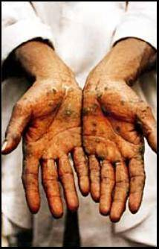
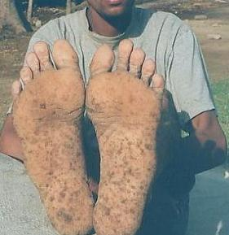
Arsenicosis
Source: Harvard University. “Harvard Arsenic Project.” Internet. Accessed Sep 27, 05. http://phys4.harvard.edu/%7Ewilson/arsenic/arsenic_project_introduction.html

Slide 31
Arsenicosis
Symptoms:
Skin problems
Skin, bladder, kidney, lung cancer
Diabetes
High blood pressure
Reproductive disorders
2. Cause: Chemical - Arsenic
Notes:
What is Arsenicosis?
Arsenicosis is the effect of arsenic poisoning, usually over a long period such as from 5 to 20 years.
Drinking arsenic-rich water over a long period results in various health effects including skin problems (such as colour changes on the skin, and hard patches on the palms and soles of the feet), skin cancer, cancers of the bladder, kidney and lung, and diseases of the blood vessels of the legs and feet, and possibly also diabetes, high blood pressure and reproductive disorders.
What is the scope of the problem?
Unknown
It has been estimated that 35 - 77 million of the total population of 125 million of Bangladesh are at risk of drinking contaminated water. 1 in 100 may die
At least six million people worldwide are blind and 150 million people are in need of treatment.
What is the cause?
Chemical - Arsenic

Slide 32
Arsenicosis
3. Transmission:
Drinking water containing high levels of arsenic
4. Prevention:
Safe drinking water
Deep wells, rainwater or surface water
Testing for presence
Notes:
How is it transmitted?
Through drinking water containing high levels of Arsenic.
WHO's Guideline Value for arsenic in drinking water is 0.01 mg /litre.
Approximately 1 in 100 people who drink water containing 0.05 mg arsenic per litre or more for a long period may eventually die from arsenic related cancers.
Absorption of arsenic through the skin is minimal and thus hand-washing, bathing, laundry, etc. with water containing arsenic do not pose human health risks
How can you treat it?
In the early stages of arsenicosis, drinking arsenic-free water can reverse some of the effects.
How can you prevent it?
Provide safe drinking water:
Deeper wells, rainwater and surface water are often less contaminated.
Use of arsenic removal systems in households
Testing of water for levels of arsenic and informing users.

Slide 33
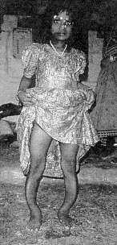
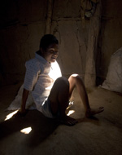
Fluorosis
Source:http://www.unicef.org/india/wes_1428.htm?q=printme
Source: http://www.fannz.org.nz/text/the_case.htm

Slide 34
Fluorosis
Symptoms:
Teeth and bone problems
Skeletal problems
Abdominal pain, nausea and vomiting
2. Cause: Chemical - Fluoride
Notes:
What is Fluorosis?
Ingestion of excess fluoride, most commonly in drinking-water, can cause fluorosis which affects the teeth and bones.
Moderate amounts lead to dental effects characterized by staining and pitting of the teeth
Long-term ingestion of large amounts can lead to skeletal problems. In severe cases, the bone structure may change and ligaments may calcify
Acute high-level exposure to fluoride causes immediate effects of abdominal pain, excessive saliva, nausea and vomiting. Seizures and muscle spasms may also occur.
What is the scope of the problem?
At least six million people worldwide are blind and 150 million people are in need of treatment.
What is the cause?
Chemical - Flouride

Slide 35
Fluorosis
3. Transmission:
Drinking water containing high levels of fluoride
4. Prevention:
Fluoride free drinking water
Testing for presence
Notes:
How is it transmitted?
Through drinking contaminated water
WHO guidelines specify that fluoride levels be no higher than 1.5 mg/L drinking water
However, levels of 0.6 mg/L have been suggested as being a problematic in areas of hot dry climate.
How can you treat it?
In general the effects are not reversible.
How can you prevent it?
Drinking fluoride free water
A few water treatment systems exist but they are difficult and expensive

Slide 36
Review
List any diseases that are caused by pathogens or chemicals found in contaminated water:
Giardia
Cryptosporidiosis
Cholera
Typhoid
Arsenicosis
Notes:
Giardia
Cryptosporidiosis
Cholera
Typhoid
Amoebic Dysentery
Schistosomiasis
Arsenicosis
Fluorosis

Slide 37
Review
2. Why would the biosand filter be useful in the prevention of most of these diseases?
Provide safe drinking water
Removes all types of pathogens
Notes:
Provide safe drinking water

Slide 38
Review
3. What else is essential in the prevention of disease transmission that the biosand filter cannot protect against?
Proper hygiene and sanitation practices
Health, hygiene education programs
Monitoring of programs and filter usage
Notes:
Proper hygiene and sanitation practices

Slide 39
Review
4. What are the 4 types of pathogens and give one example of a water related disease they can cause?
Virus – Hepatitis A & E, Polio, Rotavirus
Bacteria – Cholera, Typhoid
Protozoa – Giardia, Cryptosporidiosis
Helminths – Schistosomiasis (Bilharzia)
Notes:
Proper hygiene and sanitation practices

