Slide 1
12, 2916 – 5th Avenue
Calgary, Alberta, T2A 6K4, Canada
Phone: + 1 (403) 243-3285, Fax: + 1 (403) 243-6199
E-mail: cawst@cawst.org, Website: www.cawst.org
CAWST, the Centre for Affordable Water and Sanitation Technology, is a nonprofit organization that provides training and consulting to organizations working directly with populations in developing countries who lack access to clean water and basic sanitation.
One of CAWST’s core strategies is to make knowledge about water common knowledge. This is achieved, in part, by developing and freely distributing education materials with the intent of increasing the availability of information to those who need it most.
This document is open content and licensed under the Creative Commons Attribution Works 3.0 Unported License. To view a copy of this license, visit http://creativecommons.org/licenses/by/3.0 or send a letter to Creative Commons, 171 Second Street, Suite 300, San Francisco, California 94105, USA.
You are free to:
Share – to copy, distribute and transmit this document
Remix – to adapt this document
Under the following conditions:
Attribution. You must give credit to CAWST as the original source of the document. Please include our website: www.cawst.org
CAWST will produce updated versions of this document periodically. For this reason, we do not recommend hosting this document to download from your website.
CAWST and its directors, employees, contractors, and volunteers do not assume any responsibility for and make no warranty with respect to the results that may be obtained from the use of the information provided.
Stay up-to-date and get support:
Latest updates to this document
Other workshop & training related resources
Support on using this document in your work
CAWST provides mentorship and
coaching on the use of its education
and training resources.

Slide 2
This presentation is used with Lesson Plan 18: Concentration and Unit Conversions in the Drinking Water Quality Testing Trainer Manual.
Available at www.cawst.org/resources

Slide 3
Concentration and Unit Conversions

Slide 4
Learning Expectations
Explain concentration and units.
Calculate unit conversions for different concentrations.

Slide 5
Concentration and Units
Concentration = amount of a component (or chemical) per volume of water, stated in units
Units = standards of measurement
e.g., milligrams, litres
Without units test values are meaningless
e.g., Colony Forming Units/100 mL tell us the number of bacteria in a 100 millilitre volume of water
Notes:
Ask the participants to share types of units they are aware of (e.g., NTUs, mg, L, mL)

Slide 6
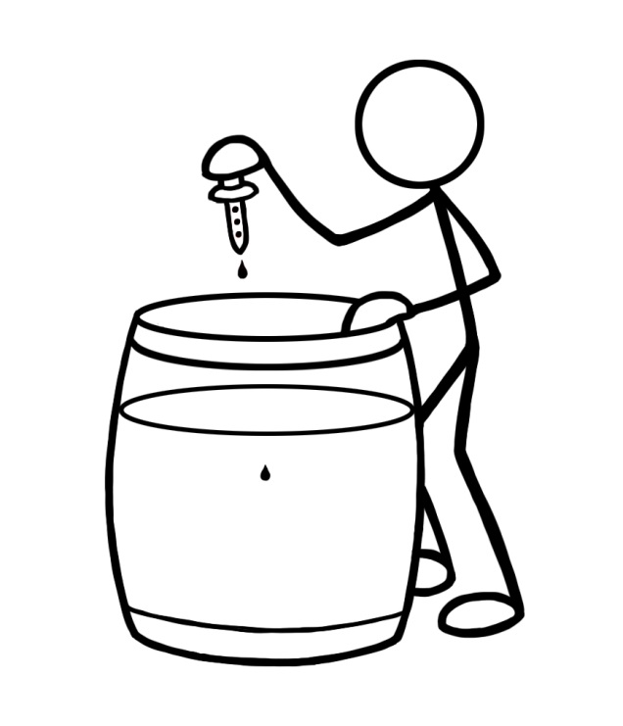
Parts Per Million (ppm)
1 ink drop in 200 L barrel of water =
ink concentration of 1 ppm
1 ppm = 1 mg/L
ppm or mg/L on a lab report means the same thing

Slide 7
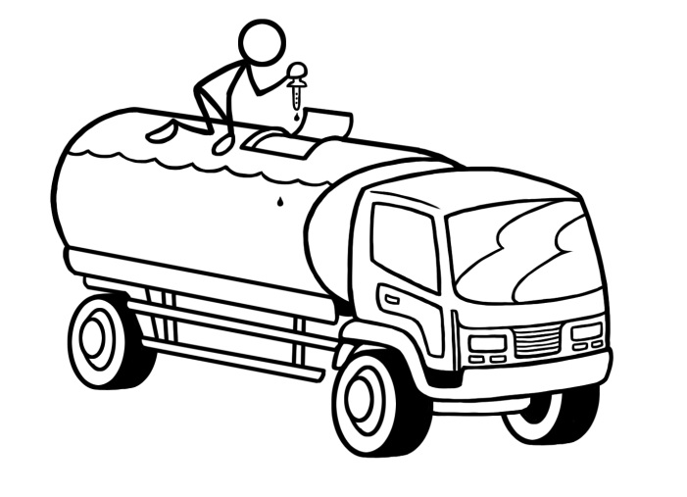
Parts Per Billion (ppb)
1 ink drop in tanker truck used to haul gasoline =
ink concentration of 1 ppb
1 ppb = 1 µg/L
ppb or µg/L on a lab report means the same thing

Slide 8
Unit Conversions Chart
1 ppm = 1 mg/L
1 ppb = 1 µg/L
1 mg/L = 1000 µg/L
1 ppm = 1000 ppb
________________________________________
To convert ppb to ppm divide by 1000
To convert µg/L to mg/L divide by 1000
To convert ppm to ppb multiply by 1000
To convert mg/L to µg/L multiply by 1000
Notes:
1 ppm = 1 mg/L = 1/1 million = 0.000001
1 ppb = 1 μg/L = 1/1 billion = 0.000000001
Explain how to convert from ppm to ppb AND mg/L to µg/L using the chart.
Explain the importance of understanding that ppb is 1,000 times smaller than ppm (i.e., 0.000000001 is 1,000 times smaller than 0.000001)

Slide 9
Unit Conversion Activity
Convert: 0.01 ppm into ppb
Answer: 10 ppb
Convert: 20 µg/L into mg/L
Answer: 0.02 mg/L
Notes:
Divide participants into small groups of 3 or 4 people and do the Concentration and Unit Conversion Activity.

Slide 10
Unit Conversion Activity
The WHO Guideline for Drinking Water is <0.01 mg/L for arsenic.
You are the project manager for an NGO that has implemented a borehole drilling project.
Water quality testing was done on 1 borehole and the lab report states that the arsenic concentration is 8 ppb.
Is the water within the WHO Guideline?
Answer: Yes, the results are equal to 0.008 ppm or 0.008 mg/L and are within the WHO Guideline.

Slide 11
Review
True or False
Is 1 part per million larger than 1 part per billion?
True (= 0.000001 is bigger than 0.000000001)
1 ppb = 1 mg/L
False (1 ppb = 1 µg/L)
1 µg/L = 1 ppb
True
Notes:
You can use the finger review for to pose these questions.
Finger Review Style: One Finger Up True, One Finger Down False

