Slide 1
12, 2916 – 5th Avenue
Calgary, Alberta, T2A 6K4, Canada
Phone: + 1 (403) 243-3285, Fax: + 1 (403) 243-6199
E-mail: cawst@cawst.org, Website: www.cawst.org
CAWST, the Centre for Affordable Water and Sanitation Technology, is a nonprofit organization that provides training and consulting to organizations working directly with populations in developing countries who lack access to clean water and basic sanitation.
One of CAWST’s core strategies is to make knowledge about water common knowledge. This is achieved, in part, by developing and freely distributing education materials with the intent of increasing the availability of information to those who need it most.
This document is open content and licensed under the Creative Commons Attribution Works 3.0 Unported License. To view a copy of this license, visit http://creativecommons.org/licenses/by/3.0 or send a letter to Creative Commons, 171 Second Street, Suite 300, San Francisco, California 94105, USA.
You are free to:
Share – to copy, distribute and transmit this document
Remix – to adapt this document
Under the following conditions:
Attribution. You must give credit to CAWST as the original source of the document. Please include our website: www.cawst.org
CAWST will produce updated versions of this document periodically. For this reason, we do not recommend hosting this document to download from your website.
CAWST and its directors, employees, contractors, and volunteers do not assume any responsibility for and make no warranty with respect to the results that may be obtained from the use of the information provided.
Stay up-to-date and get support:
Latest updates to this document
Other workshop & training related resources
Support on using this document in your work
CAWST provides mentorship and
coaching on the use of its education
and training resources.

Slide 2
This presentation is used with Lesson Plan 10: Introduction to the Biosand Filter in the Biosand Filter for Project Implementers Trainer Manual.
Available at www.cawst.org/resources

Slide 3
Biolayer Development

Slide 4
Learning Expectations
List and explain the importance of the 8 important points to check to see if a biosand filter is working well.

Slide 5
The Biolayer
The biolayer is a key part of the biosand filter
It helps the filter treat water better
It takes about 30 days to grow
Checking that the filter has been used for at least 30 days, so that the biolayer is developed, is one of the 8 key filter performance points that you can check to know that a filter is treating water well.

Slide 6
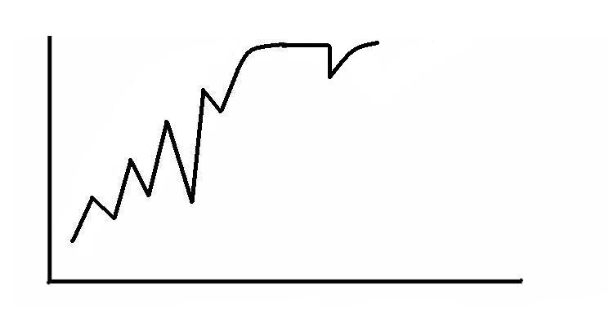
Establishing the Biolayer
After doing a Swirl and Dump, the filter does not work as well for a few days. After a few days, the biolayer grows back again.
99%
Pathogens removed from the water
The removal efficiency will vary, but generally increases, as the biolayer develops over the first 30 days.
0%
0
30
60
Time (days)

Slide 7
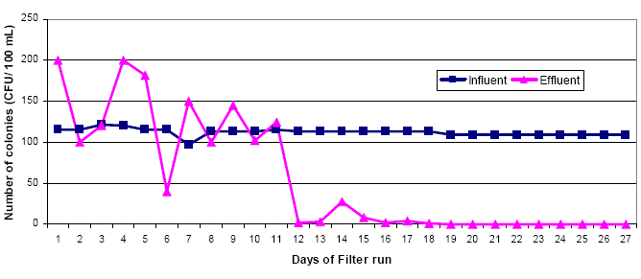
Establishing the Biolayer
The number of bacteria in source water (blue line) and filtered water (pink line) over first 4 weeks
source water = “influent, filtered water = “effluent”
Credit: Sharma, D., Kathmandu University, 2005.
Notes:
This graph shows that removal efficiency may actually be negative during the development of the biolayer (especially if the sand is of poor quality). Over time, the biolayer develops and removal efficiency improves.

Slide 8
Establishing the Biolayer
As dirty water is poured through the filter, micro-organisms in the water begin to live in the top 1-2 cm of the sand. They become the biolayer.
It takes about 30 days to establish a stable “community” of micro-organisms.
In the biolayer, micro-organisms eat some of the pathogens in the water. This helps the filter make the water safer to drink.
Notes:
This graph shows that removal efficiency may actually be negative during the development of the biolayer (especially if the sand is of poor quality). Over time, the biolayer develops and removal efficiency improves.

Slide 9
Types of Micro-organisms
1. Bacteria - primary micro-organisms
2. Diatoms - Rod and cocci shaped
Notes:
“The diatoms are one of the largest and ecologically most significant groups of organisms on Earth. They are also one of the easiest to recognize, because of their unique cell structure, silicified cell wall and life cycle. They occur almost everywhere that is adequately lit (because most species need light for photosynthesis) and wet - in oceans, lakes and rivers; marshes, fens and bogs; damp moss and rock faces; even on the feathers of some diving birds. Some have been captured by other organisms and live as endosymbionts, e.g. in dinoflagellates and foraminifera. Because of their abundance in marine plankton, especially in nutrient-rich areas of the world's oceans, diatoms probably account for as much as 20% of global photosynthetic fixation of carbon (~ 20 Pg carbon fixed per year: Mann 1999), which is more than all the world's tropical rainforests.”
Source: http://tolweb.org/diatoms

Slide 10
Establishing the Biolayer
The following pictures show the growing biolayer.
The pictures are taken through a microscope.
The pictures show many kinds of micro-organisms that grow and live in the biolayer. Not all the micro-organisms help treat the water, but they live in the “community”.
Credit: Joubert and Pillay, Electronic Journal of Biotechnology, 2008
Notes:
This graph shows that removal efficiency may actually be negative during the development of the biolayer (especially if the sand is of poor quality). Over time, the biolayer develops and removal efficiency improves.

Slide 11
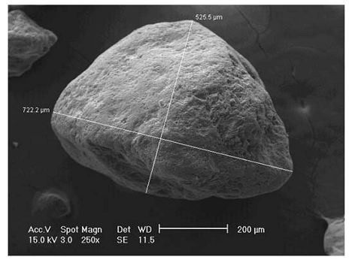
Sand Grain

Slide 12
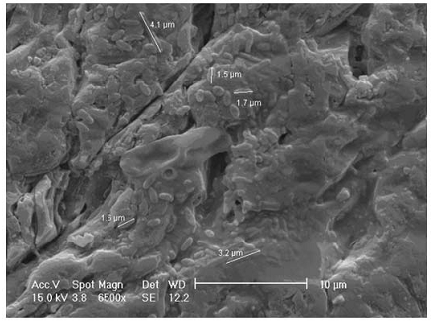
1 week after starting to use BSF

Slide 13
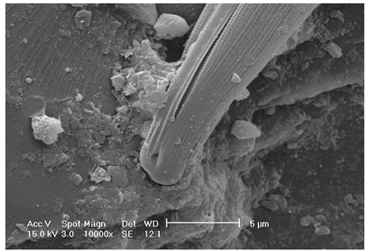
3 weeks

Slide 14
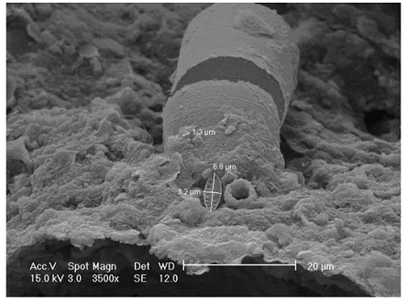
4 weeks

Slide 15
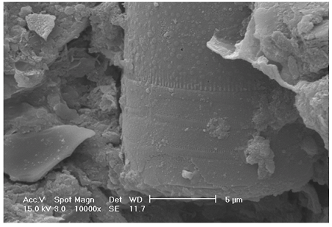
5 weeks
Notes:
– Rod Shaped

Slide 16
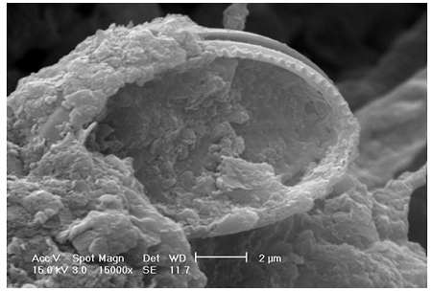
5 weeks
Notes:
– Cocci Shaped

Slide 17
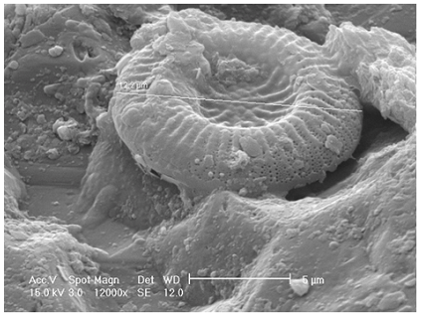
6 weeks

Slide 18
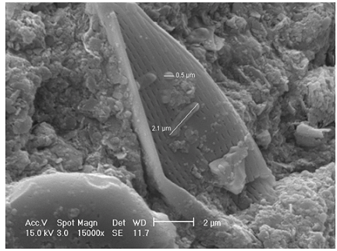
7 weeks
Notes:
- diatoms

Slide 19
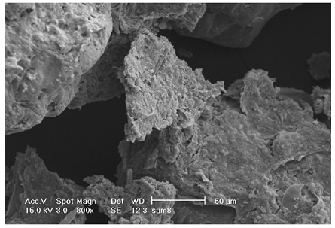
8 weeks – no sand surface visible

Slide 20
Review
Discuss with a partner how the biolayer develops

