Slide 1
2021 | NOVEMBER 03

Slide 2
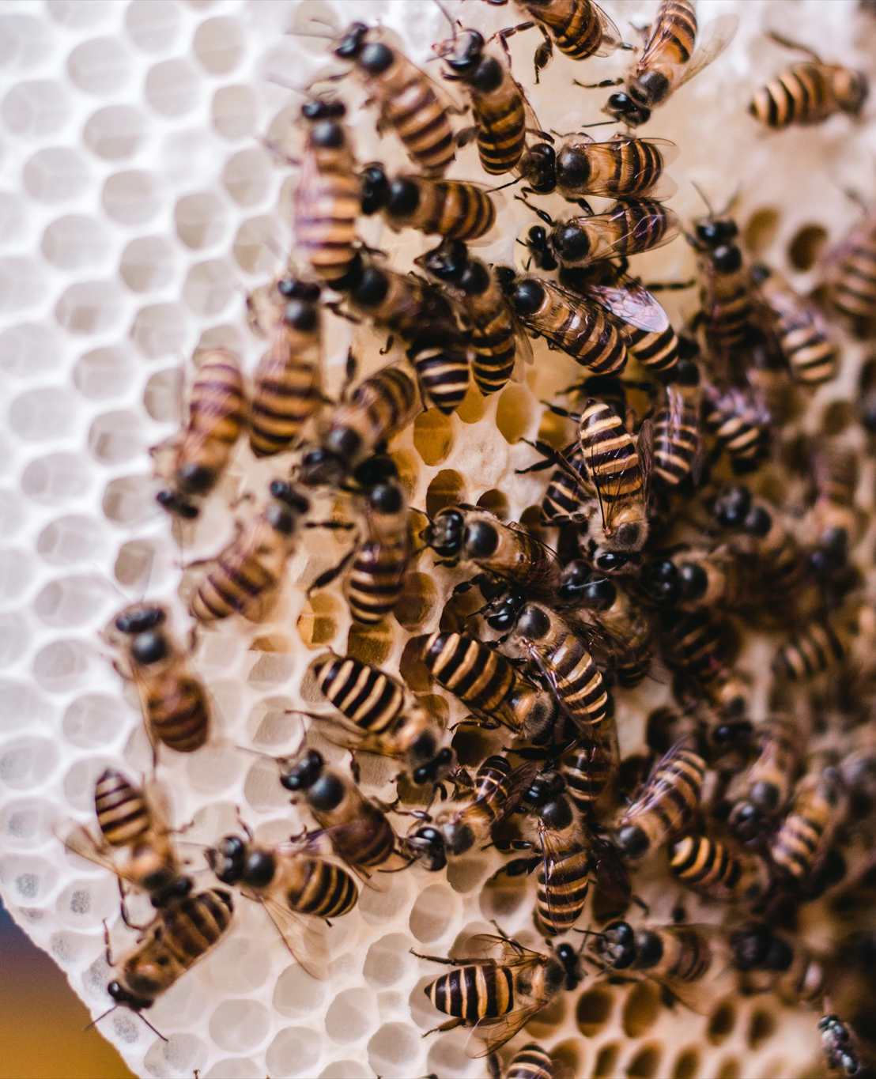
Introduction
What is a colony?
Source: Articulate Content Library

Slide 3
LEARNING
OUTCOMES
Explain the importance of colony counting to DWQT
Discuss essential factors in colony counting
Apply appropriate colony counting techniques

Slide 4
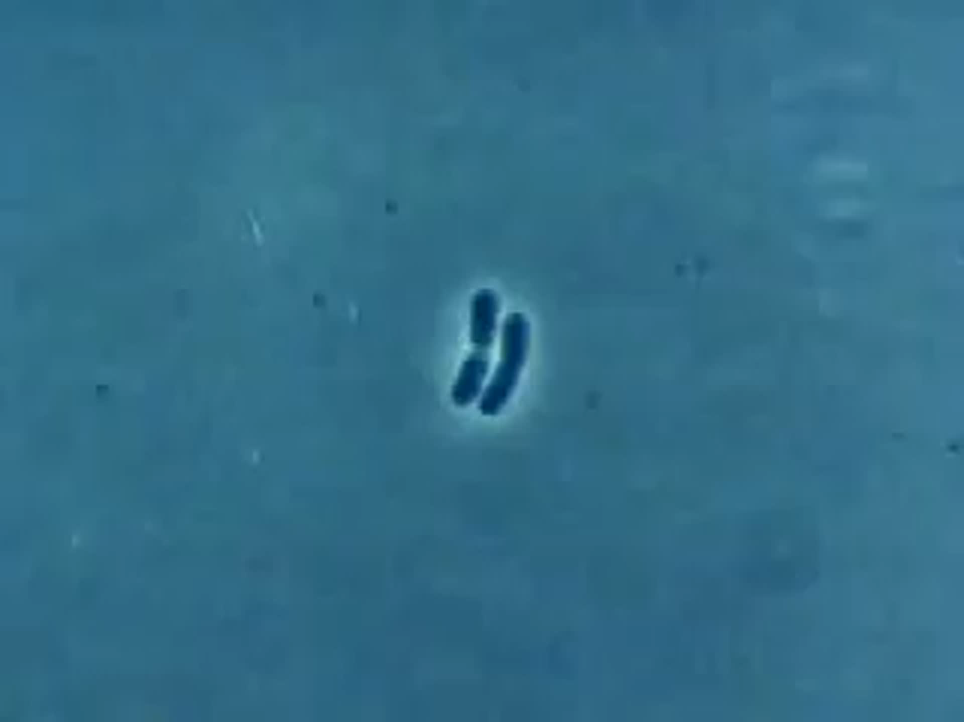
How a bacterial colony forms (video)
Notes:
Video is also available online at www.youtube.com/watch?v=gEwzDydciWc or https://vimeo.com/579445250

Slide 5
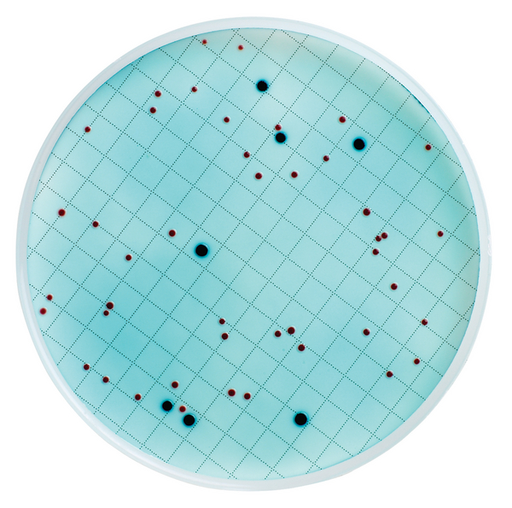
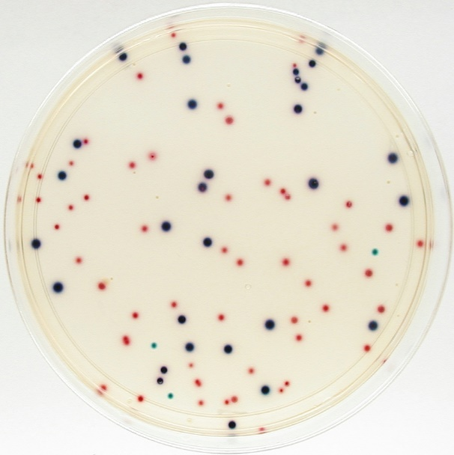
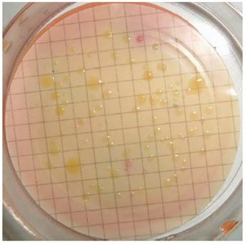
Culture Media
m-ColiBlue24
Media: Light blue liquid
E. coli: Dark blue dots
Coliforms: Red dots
Total Coliforms:
Blue + red dots
Coliscan
Media: Pale yellow, clear liquid
E. coli: Dark blue - purple dots
Coliforms: Pink dots
Total Coliforms:
Blue/purple + pink/red dots
MLSB
Media: Orange/red liquid
E. coli: Yellow dots at 44°C
General Coliforms:
Yellow dots at 37°C
Notes:
Culture media is ‘food’ for growing bacteria.
There are many types of culture media for growing E. coli depending on the country and availability. These are only examples.

Slide 6
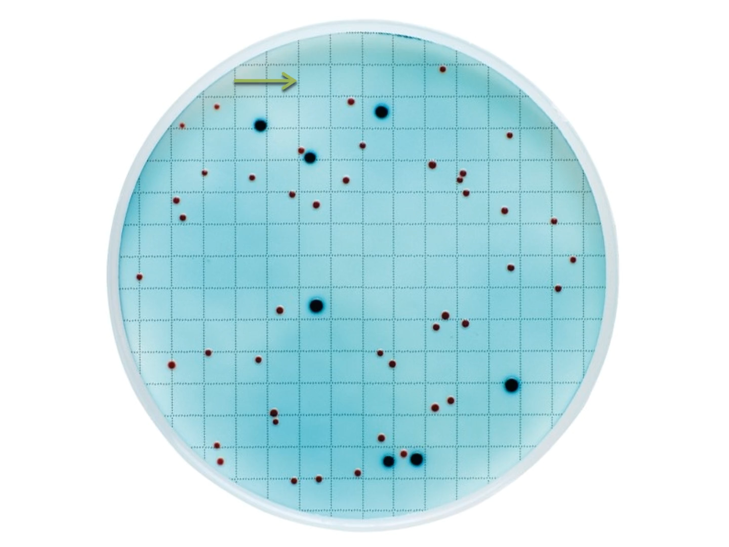
Colony Counting Technique (video)

Slide 7
GROUP
ACTIVITY
Colony counting exercise
Notes:
See Trainer Manual for instructions

Slide 8
GROUP
ACTIVITY
Colony counting demo and practice

Slide 9
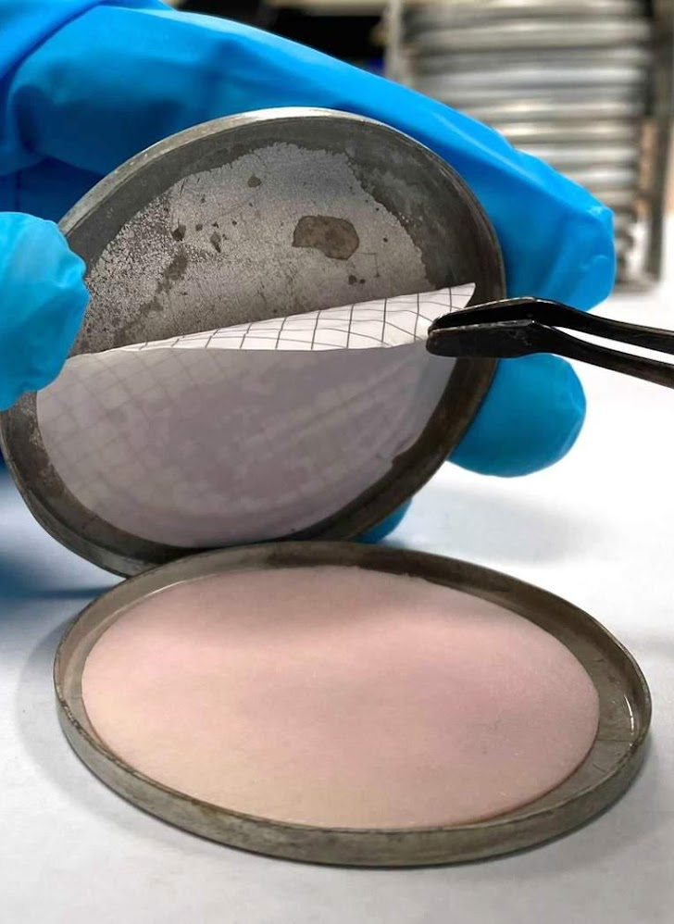
Troubleshooting Tips
Non-coliforms (clear colonies) show contamination from non-fecal sources
Secondary contamination
Too much or too little culture media
Air pockets under the filter
> 200 colonies is considered too numerous to count (TNTC)
Source: CAWST
Notes:
Too much culture media can results in filter paper sticking to the top of the Petri dish

Slide 10
REVIEW
Word in a Hat Review Activity
or
Discussion on the most surprising results from the Colony Counting Group Activity
Notes:
See Trainer Manual for Review activities.

Slide 11





Thank you!
Calgary . Alberta . Canada
+1 403 243 3285
cawst@cawst.org
cawst.org

