Slide 1
Gender perspective in WASH services and facilities
Subash K. C.

Slide 2
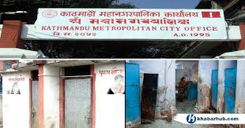
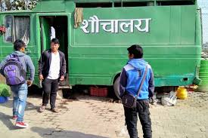
Introduction
Imagine you are responsible staff (say Sanitation Section Chief or Sanitation focal person)
Think about toilet facilities available in public space of municipality?

Slide 3
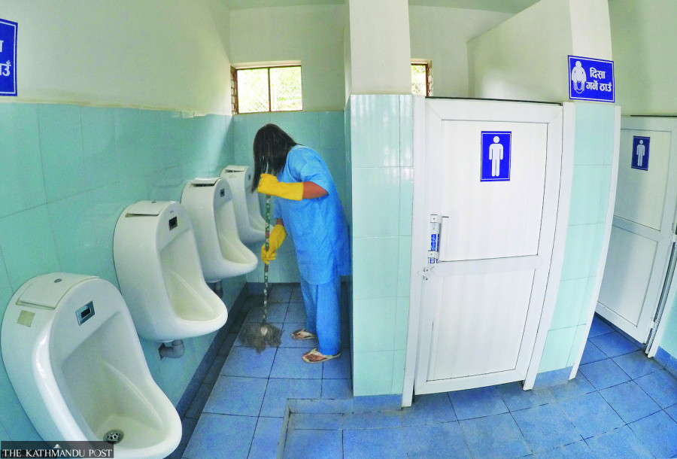
Introduction
What kind of WASH facilities and services are there?
Can you make any changes in public toilet (services and facilities)?
Notes:
Ask?
What kind of WASH facilities and services are there?
Possible answer: in most of the cases public places has separate toilet for men and women but no services for disable people, LGBTQIA+ community, toilet is dirty and wet, no operation and maintenance
Can you make certain changes in public toilet in terms of its services and facilities within your municipality?
Possible answer: User-friendly toilet, handwashing station, O&M services, equal participation of all genders in constructing of sanitation services and facilities
Linking with their responses, tell the participants while providing the sanitation facilities and services in public areas, it is important for an equal participation of gender diverse group, and socially excluded people for implementation of any of the urban sanitation services and facilities. This brings gender perspective in urban sanitation.

Slide 4
Learning Outcome
Clarify the meaning of gender perspective in urban sanitation.
Discuss and list gender issues and barriers related to urban sanitation.

Slide 5
Presentation Outline
Gender perspective
Gender gaps in sanitation
Impact of gender disparities
Possible interventions

Slide 6
Training Structure
1
2
3
4
5
6
7
Training Opening
Gender: Concept and its terminologies
Gender Mainstreaming
Laws and Policies for gender mainstreaming
Gender Perspective in WASH
Mainstreaming Gender in Project Cycle
Training
Closing
Notes:
This training includes

Slide 7
Gender perspective: Group Activity
Think: WASH activities that are conducted within public space in a daily basis ?
4 Groups
5 minutes
Notes:
Inform participant about the sanitation activities conducted in a household in a day (home cleaning, toilet clean, handwashing infrastructure cleaning, toilet construction or maintenance, waste segregation, waste collection, solid waste management, surrounding cleaning, road cleaning, transportation of faecal sludge, etc.)
Similarly, ask the possible sanitation activities that are conducted within public space in a day in daily basis? Note in sticky notes.
Group competition -- Prize for the winner
Example:
public toilet O&M, solid waste management, cleaning of road, transportation of faecal sludge
Link: Men are more driven to technical roles such as driving of FS vehicle, emptying practices, while women are more working on cleaning and collection of waste.

Slide 8
Gender perspective: Group Activity
Women | Men | LGBTIQA+
All gender
Notes:
Arrange activities in the group of men, women and LGBTIQA+.
Discuss the results in a large group and ask that which gender appears to do more sanitation related activities at public level? And why? Possible answer: Men are more driven to technical roles such as driving of FS vehicle, emptying practices, while women are more working on cleaning and collection of waste.
Ask participants if there are any activity that could be done by any specific group only? Possible answer: No
Trainers note:
Anyone can do any sanitation activity and making them aware about these brings an opportunity for equal participation of any gender in urban sanitation services and facilities which can empower an individual financially, economically and sustainably.
The concept of providing opportunities to all, specifically to the disadvantaged groups or a marginalized groups in urban sanitation service provision along with making such facilities and services accessible to all is the main objective of gender perspective in urban sanitation.
Although there have been some initiatives for such opportunities in urban sanitation, there are still issues and gaps and will be discussing more on the topic.

Slide 9
What is the linkage between GEDSI and WASH ?

Slide 10
Why to link gender perspective in sanitation?
Sanitation for All
Commitments and Targets
National and International Indicators
More support for more needy group/individual
Multi-sectoral impacts
Sustainability

Slide 11
GEDSI issues/barriers and
possible interventions in urban sanitation services

Slide 12
GEDSI issues and possible intervention: Group Activity
Discuss about current issues/ barriers in sanitation in terms of gender and social inclusion
4 Groups
7 minutes
Notes:
Discuss about current issues/gaps and barriers in urban sanitation interms of gender and social inclusion
Possible gaps
Physical Burden (household chores are considered to be prime roles of women)
Decision-making roles
Unequal participation in skill-based activities Social and cultural norms
Employment opportunities

Slide 13
Current issues/ barriers in sanitation
Physical Burden (household chores are prime roles of women)
No roles of needy person in decision-making
Safety Concerns (Not safe for all)
Not user-friendly facilities and infrastructure design
Unequal participation in skill-based activities

Slide 14
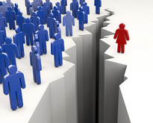
Current issues/ barriers in sanitation
Discriminative social and cultural norms
Accessibility challenge
Inadequate facilities
Poor - Occupational health and safety
Unequal employment opportunities
Not meaningful representation

Slide 15
Impacts ??
Education
Productivity
Violence
Health

Slide 16
Possible Interventions: Group Activity
Discuss about possible interventions for issues and gaps in earlier group activity
4 Groups
7 minutes
Notes:
Discuss about possible interventions for issues and gaps in earlier group activity
Possible gaps
Gender analysis
Capacity Building
Resource Allocation

Slide 17
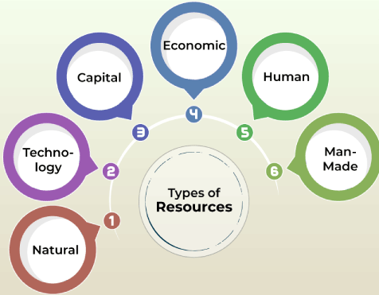
Possible Interventions
Gender Analysis
Participatory Design and Inclusion
Resource Allocation
Inclusive Facilities
Safety and Security
Capacity Building

Slide 18
Possible Interventions
Work Flexibility
Mechanisms
Economic Empowerment
Sex, Age, and Disability Disaggregated (SADD) Data
Data Collection and Monitoring

Slide 19
Review
Write: one/two top-most gender and social inclusion issues/barriers of their area of work along with its possible interventions
Collect 2 to 3 responses

