Slide 1
Tikho and Jenny’s Story
2020
SEP

Slide 2
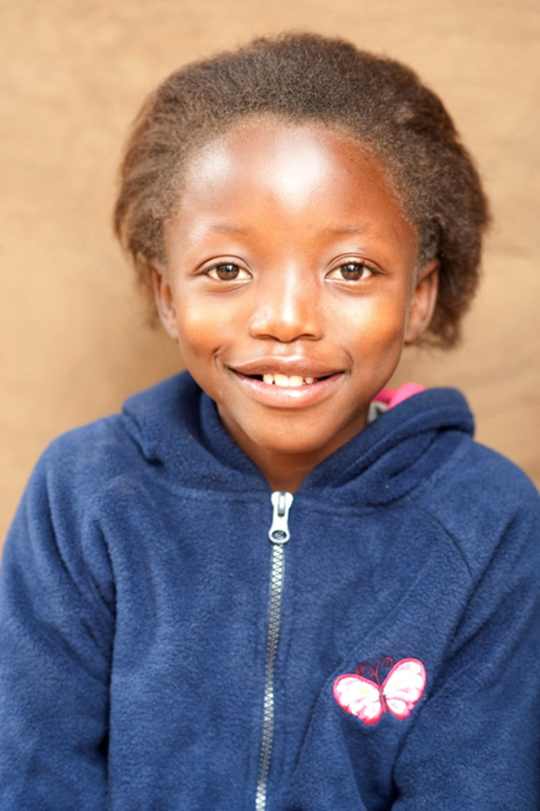
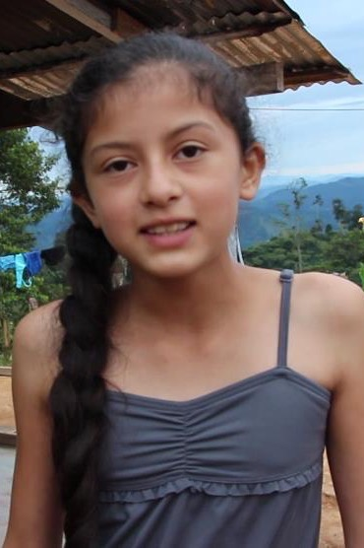
Tikho
Jenny
Notes:
Meet Tikho and Jenny. Tikho is from Zambia and Jenny is from Honduras. Although the two of them live in very different parts of the world both of their communities, are working hard to address challenges they have with water and sanitation. We are going to learn a bit about Tikho, and then about Jenny. Pay attention to see if you can pick out the similarities and differences in their lives. Also think about what you have in common with them.

Slide 3
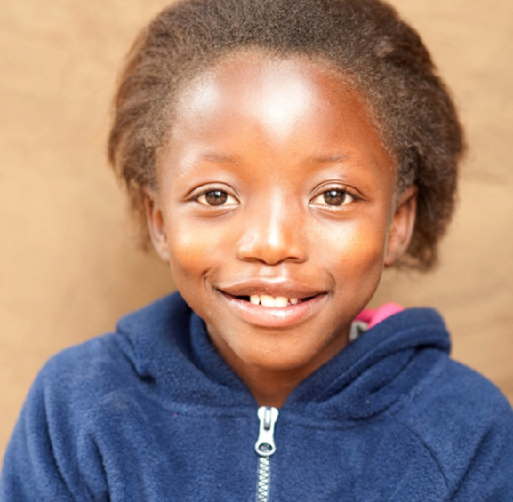
Tikho
Notes:
This is Tikhozenji (Tee-ko-zen-gee) we will call her Tikho (Tee-ko) for short. Tikho is ten years old. She is going to introduce you to her community and what they are doing around the issues of water and sanitation.
Tikho and her mother Gladys helped to create this presentation. They took many of the photos and videos that you will see, and helped to plan what is in the presentation.

Slide 4
Notes:
Imagine that you are traveling to Zambia, a country located in the south eastern corner of Africa. We’re going to travel to a small community called Mapalo, located close to the city of Ndola, in northern Zambia.
If you look on a map, you won’t find a community called Mapalo, you will find a place called Chipulukusu, which means “wicked” or “cursed.” People in the community have renamed their settlement “Mapalo,” which means, “Blessing.” On this tour you will see how they are transforming their community from a curse to a blessing.

Slide 5
Notes:
This is a short video of Tikho introducing herself.

Slide 6
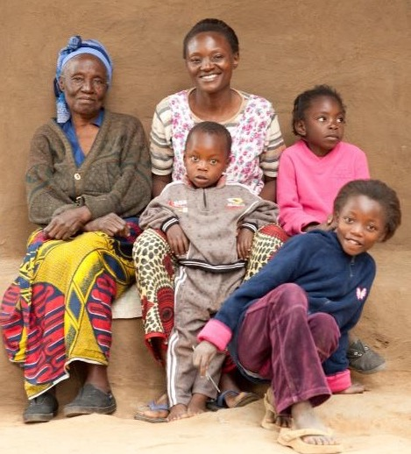
Gladys Tikho’s mom
Tikho’s grandma
Natasha Tikho’s sister
Daniel Tikho’s brother
Tikho
Notes:
This is Tikho’s family. Her mom Gladys is in the middle of the picture, her grandma is on the left and her younger brother Daniel and sister Natasha are sitting in front of their mom.

Slide 7
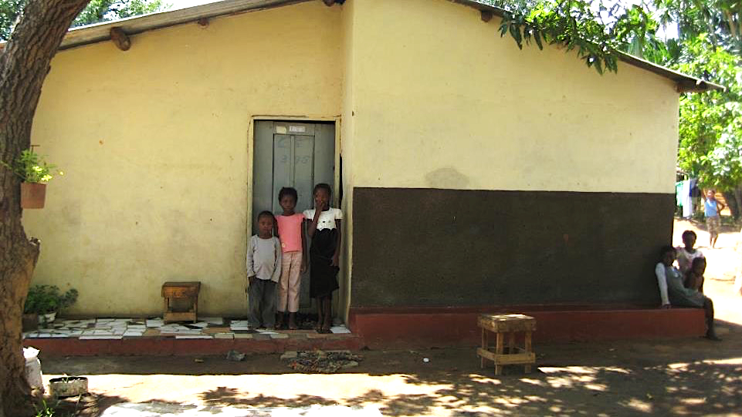
Notes:
This is the house where Tikho lives with her mother, brother and sister. They sleep at this house, but spend most of their time at Tikho’s grandmothers house, which is just a stone’s throw away from their house.

Slide 8
Notes:
Tikho will show you the inside of her house.

Slide 9
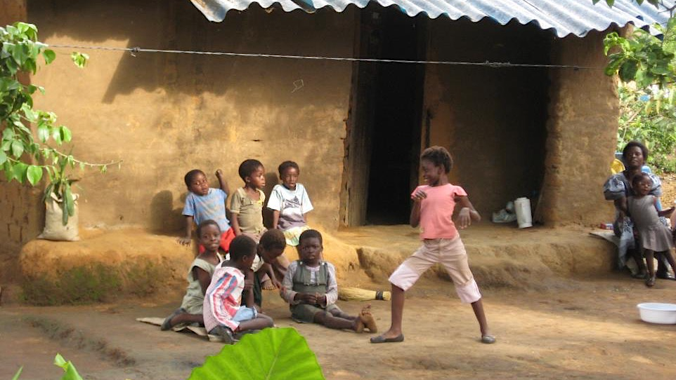
Notes:
This is a photo of Tikho’s sister Natasha, and some of her friends in front of their grandmother’s house where Tikho and her family spend most of their time.

Slide 10
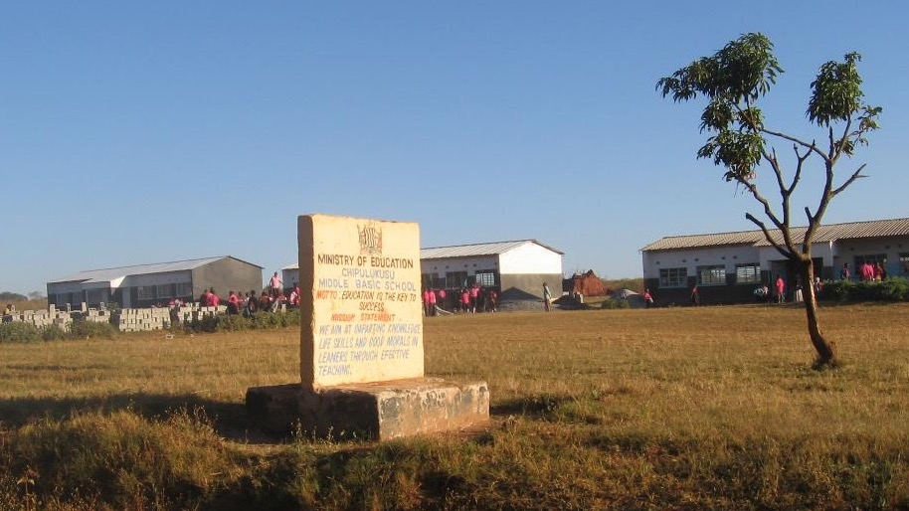
Notes:
This is Chipulukuso Basic School, the place where Tikho goes to school every day.

Slide 11
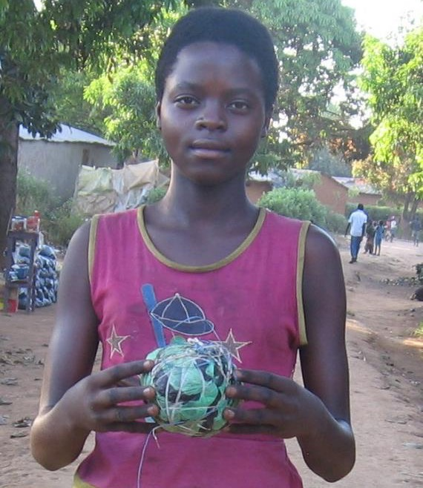
Notes:
After school Tikho likes to play with her friends. This is one of her friends holding a ball. Can anyone guess what the ball is made from?

Slide 12
Notes:
Here’s a video of Tikho and her friends playing dodge ball. Can you spot the ball from the previous slide?

Slide 13
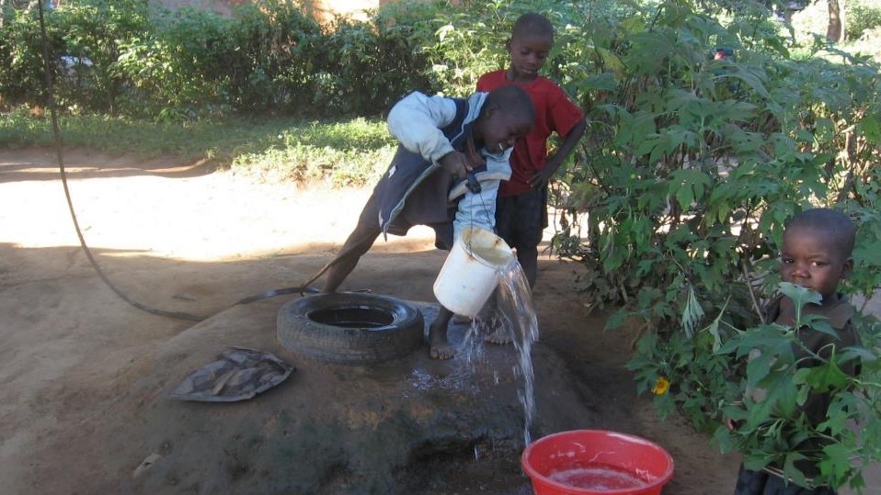
Notes:
Unfortunately, it’s not all play for Tikho. She also has to help out with the chores, just like we do. One of the big chores at Tikho’s home is fetching water. Everyday Tikho and her friends draw water from this hand dug well. Each person in the family uses about 20 litres of water a day, so her sister, mom and herself must gather 100 litres of water per day. That’s about 10 of the buckets that her friend is using to pour in this picture.

Slide 14
Notes:
This is a video that Tikho took of her friend fetching water from one of the hand-dug wells.

Slide 15
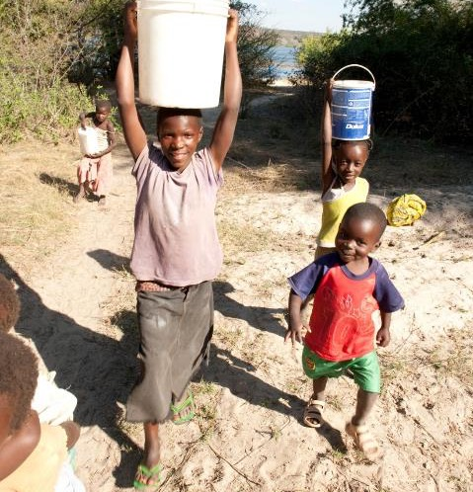
Notes:
Tikho’s friends are lucky that their walk is so short, as many people in other parts of Zambia and the world have to carry their water much greater distances. More than a quarter of the population in several countries of Sub-Saharan Africa takes longer than 30 minutes to make one water collection round trip. In many countries it is usually the children or the women that collect the water. In some places like this one, people have to go to the river to collect water. In some places, they must take great care to avoid the alligators or crocodiles that can also be found be the river.

Slide 16
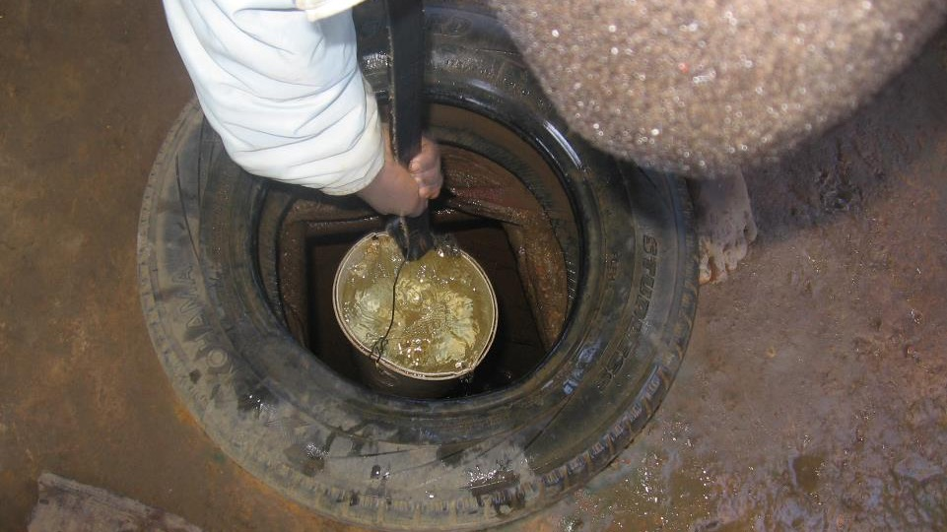
Notes:
One of the problems with the hand dug well that Tikho uses, and others like it, is that it can be easily contaminated. During the rainy season the rain washes things like feces from humans and animals into the well. The feces has germs that can make people sick.
The other problem is that the bucket that is used to draw the water isn’t always clean, so it can also contaminate the water in the well.

Slide 17
Notes:
Tikho’s mom Glady’s will tell you more about what is contaminating their water source.
Do you know what fecal contamination is?

Slide 18
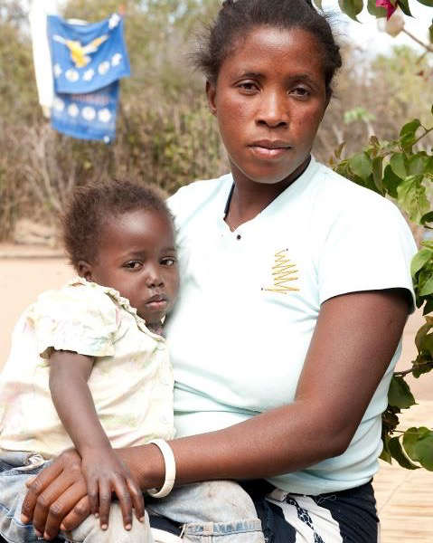
Notes:
In Tikho’s community many people were complaining of diarrhea and stomach aches, and they were getting colds frequently. Tikho’s mom told them that the sickness was coming from the dirty water.

Slide 19
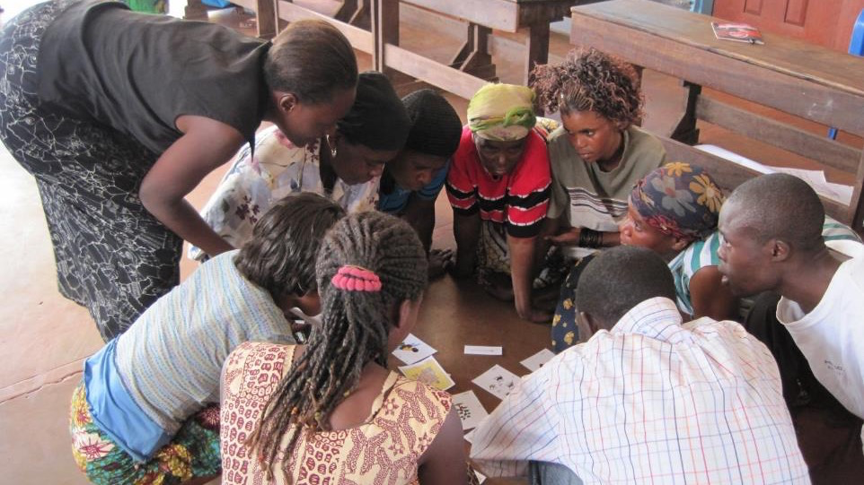
Notes:
As a community they decided that they wanted to do something about the problem. They realized that they needed to learn about why the water was making them sick, so they asked Tikho’s mom, who knows a lot about safe water and germs, for her help. With her assistance, and the help of the organization that she works with, people learned about how germs could make them sick. They also learned about handwashing.

Slide 20
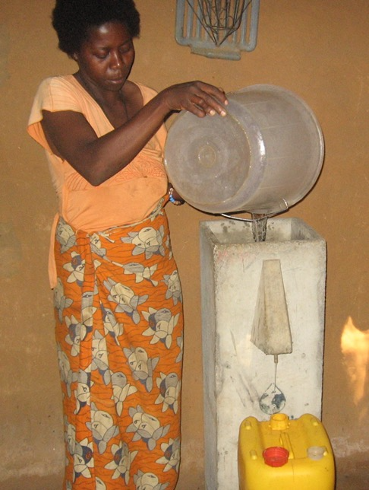
Notes:
After learning about handwashing the community also talked about drinking water. That’s when Tikho’s mom told them about the biosand filter, a low cost technology that they could use to make their water safe.
After learning about the benefits of the filter, many people built their own with the help of the organization where Tikho’s mom works. Now several families in the community have a biosand filter in their house.
Tikho’s mom spends a lot of time visiting people to ensure that they are using their biosand filter correctly. She’s also teaching many of her friends, so that they can help to teach others.

Slide 21
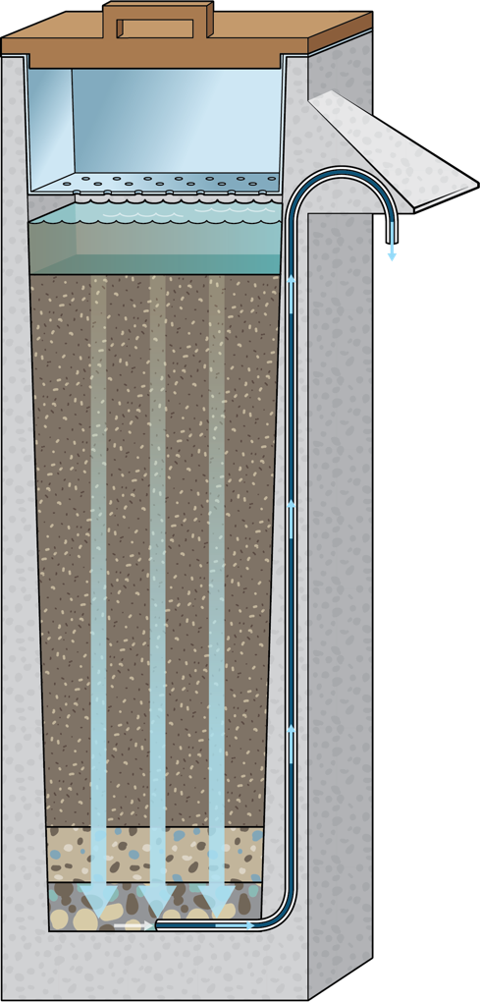
Notes:
This is what a biosand filter looks like on the inside. You take off the lid and pour water into the filter. The water flows through the column of sand. The sand removes the pathogens in the water through a variety of different process. The gravel layers at the bottom of the sand stop the sand from coming out of the filter.

Slide 22
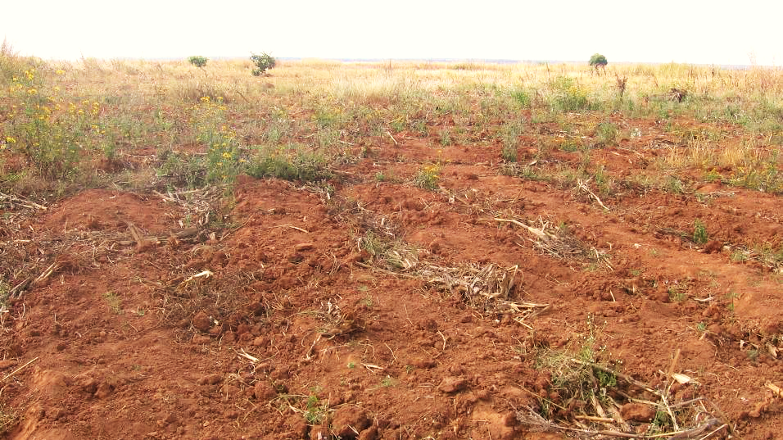
Notes:
Once they learned how to make their water safe, the community wanted to find out how they could stop contaminating the water.
For a long time most people in Tikho’s community went to the bathroom in places like this. Imagine what happens when people poop in the open and around the crops that they are harvesting. When it rains, all of the poop washes into the wells and rivers where they get their drinking water.

Slide 23
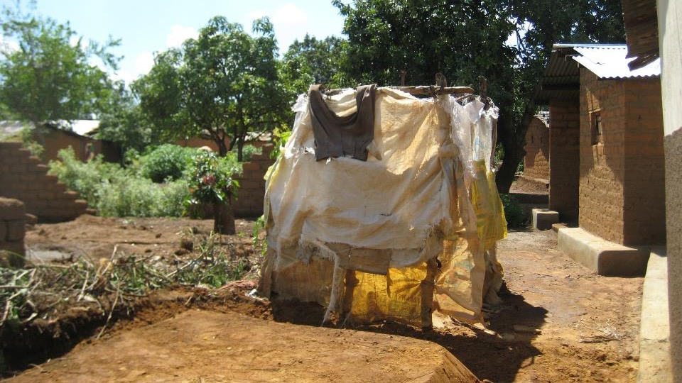
Notes:
To protect their water sources, many people in the community have started to build latrines (outhouses) where they can use the bathroom. This is Tikho’s latrine. It’s starting to fill up so they are building a new latrine beside it.

Slide 24
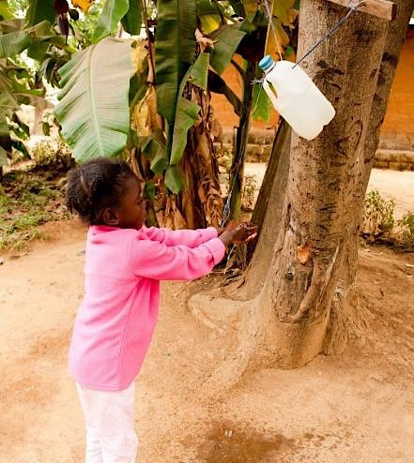
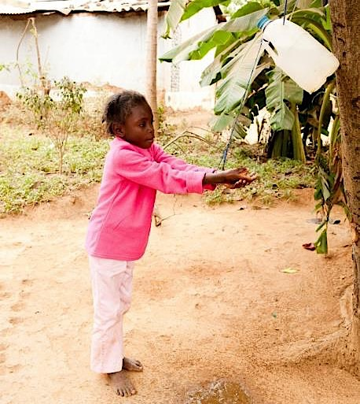
Notes:
At Tikho’s house they have a tippy tap instead of a sink to wash their hands. Its made by stringing an old bottle up on a tree, and poking a hole in the top. You can pull a rope and water comes out to wash your hands. Tikho’s mom is especially strict about having her and her brother and sister wash their hands after they use the washroom and before they eat or prepare food.

Slide 25
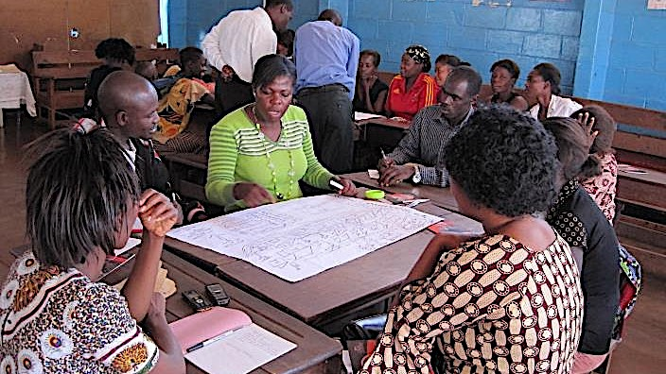
Notes:
Despite the challenges the community has faced, Tikho knows that her community can deal with the issues. The adults are learning about the issues…

Slide 26
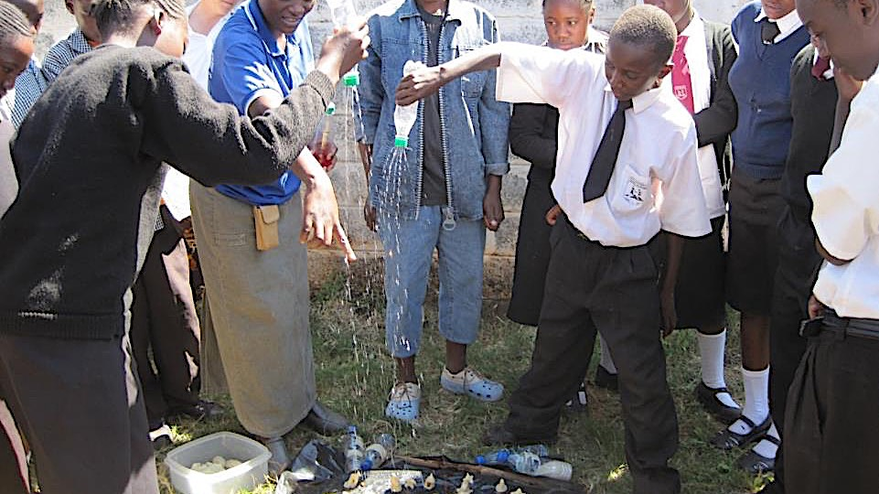
Notes:
…and they are teaching the youth so that they can take action and make a difference in their community. In this picture Tikho’s mom and her co-worker Obi are teaching students how things like garbage and feces can wash into their water source when it rains.
Ask students, to summarize what Tikho’s community has done to improve their access to safe water and sanitation.

Slide 27
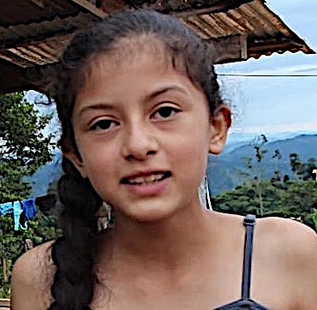
Jenny
Notes:
Jenny lives on the other side of the world, but her community has many similarities to Tikhos, because both are working to overcome challenges with water and sanitation. As you listen Jenny’s story consider what her community has in common with Tikho’s story, and what things are different.

Slide 28
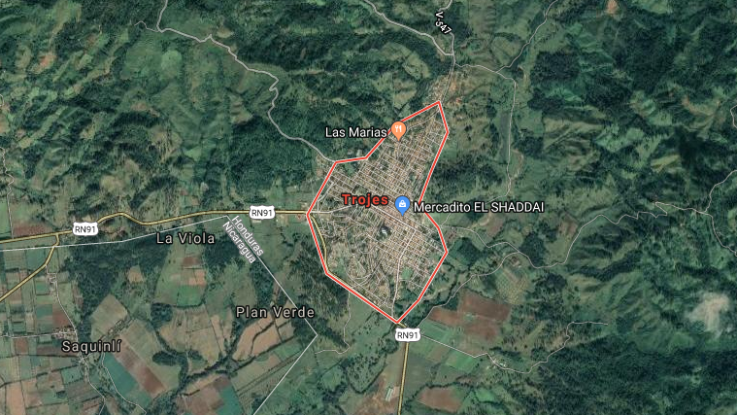
Notes:
Jenny lives in a community called El Paraiso, which is near the larger centre of Trojes in the country of Honduras. Honduras is in Central America.

Slide 29
Notes:
Let’s meet Jenny.

Slide 30
Notes:
Let‘s meet Jenny’s family.

Slide 31
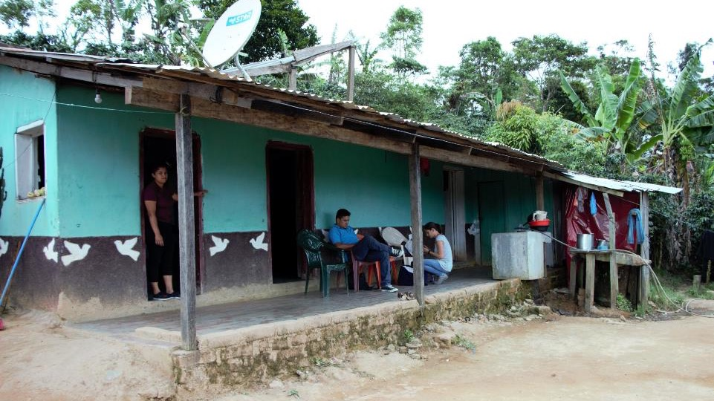
Notes:
This is Jenny’s house.

Slide 32
Notes:
Jenny is going to show us her bedroom. Think about how it is similar and different from Tikho’s room.

Slide 33
Notes:
This is how Jenny washes dishes. You’ll notice the tube beside her. This is bringing water into a basin where she scoops water to wash dishes. In many homes water flows intermittently (not all the time). People store water in the basin so they will have access to it when they need it. However, you’ll notice the basin is open, so the water in it isn’t safe to use as drinking water.

Slide 34
Notes:
Like Tikho, Jenny needs to treat the water that she drinks. She uses a biosand filter, just like Tikho. The difference is that the box the sand sits in is made of plastic, not of concrete.

Slide 35
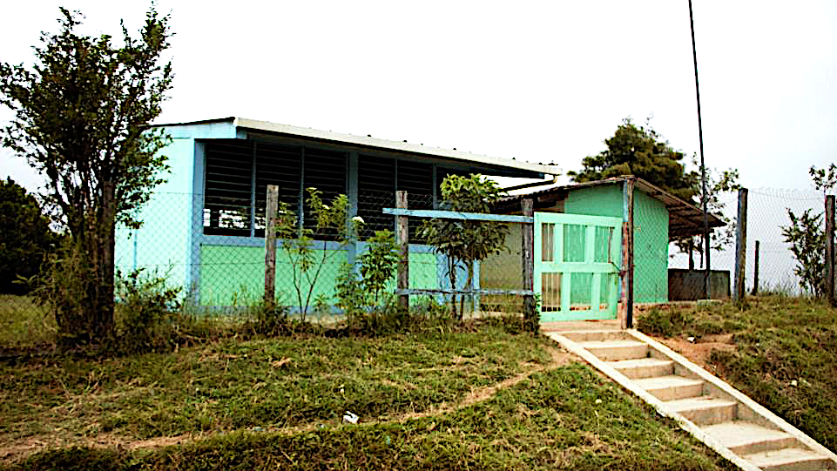
Notes:
This is Jenny’s school. How is it different and similar from Tikho’s school.

Slide 36
Notes:
In Jenny’s school there was originally no access to water. Her and her classmates had to go down to this spring at the bottom of a steep hill to collect the water. This is a strenuous 10 minute walk. We cut down the length of the video to give you an idea of the terrain.

Slide 37
Notes:
Thanks to the efforts of the people in Jenny’s school, and an organization that works with CAWST, pure water for the world, Jenny’s school was able to install a rainwater harvesting tank. They now have access to water at the school. Just like the water at home, Jenny has to treat this water in a biosand filter found at her school.

Slide 38
Notes:
The water from the rainwater harvesting tank goes through a pipe where it is distributed to the bathrooms, to the handwashing station, and to a tap, where Jenny can get water to filter in the schools biosand filter.

Slide 39
Notes:
Pure water for the world also worked with the school to add new toilets. This is what her old latrine looked like.

Slide 40
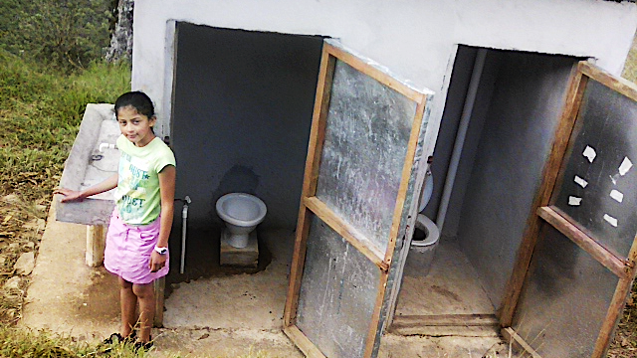
Notes:
And this is what they look like now.

Slide 41
What’s the same/different in Tikho, Jenny, and your lives?
Tikho
Jenny
You
Notes:
Tell students that they are going to compare themselves with Tikho and Jenny.

Slide 42
Water Use Per Person Per Day
251
Litres
Tikho
Jenny
Average Canadian
Notes:
Let’s look at one of the differences and similarities between Tikho, Jenny, and the Average Canadian.
One of the things we have in common is that all of us use water. The difference is how much water we use. In this slide you can see that Tikho and Jenny use far less water than the average Canadian.
Why do you think the Jenny uses more water than Tikho? – Most of the time she has water available in her home, whereas Tikho has to walk to collect water each time she uses.
Why do you think we use so much more water than Tikho and Jenny? –Availability and habit.
How could we reduce our water consumption?

Slide 43
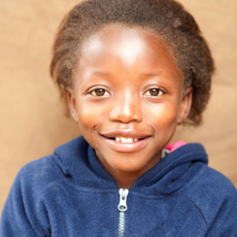
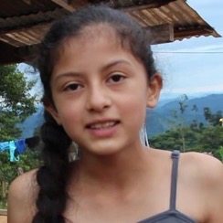
Compare
Notes:
Let’s use the following diagram to learn more about what in our lives is the same and different from Tikho and Jenny.
Follow the instructions in the lesson plan, to create a Venn Diagram with students that compares aspects of their lives with Tikho’s and Jenny’s. Use the cards provided in the lesson plan for students in grades 1 – 3. You the next slide (45) if working with students in grades 4 – 6.

Slide 44
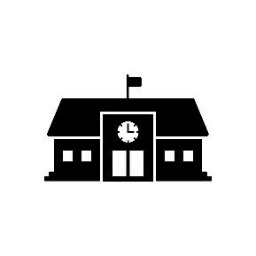
Compare the following:
Water
Use
Source
Treatment
School
Home
Toilet
Actions to improve water and sanitation
Family Life
Notes:
Use this

Slide 45
+ 1 403 243 3285
cawst@cawst.org
cawst.org

