Slide 2
This presentation is used with “Lesson Plan: The Goal of a Latrine Program”
in the
Latrine Program Design Trainer Manual
Available at resources.cawst.org

Slide 3
The Goal of a Latrine Program
Lesson
2018
September

Slide 4
What should be the goal of a latrine program?

Slide 5
Learning Outcomes
Explain what a latrine program goal is
Use a behaviour change model to determine motivators and barriers
Determine the goal of your latrine program

Slide 6
A successful latrine program
requires a clearly defined goal.

Slide 7
Latrine Program Goal = Behaviour Change
Notes:
Correct and Consistent Use of Latrines

Slide 8
The targeted households in the district use an
improved latrine correctly and consistently.

Slide 9

Source: SaniFOAM, 2009

Slide 10
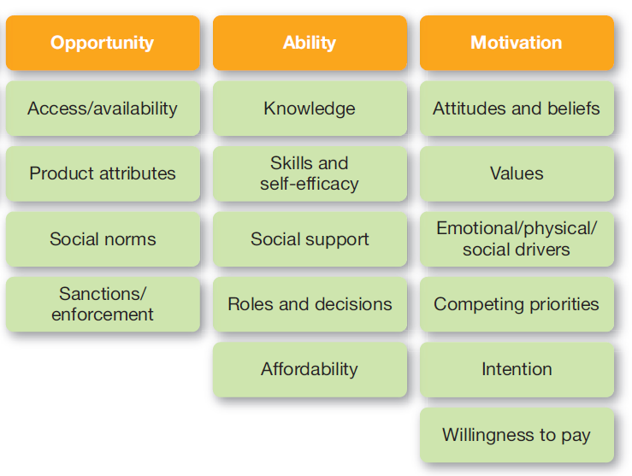
Behavioural Determinants
Internal and external factors that influence an individual’s behaviour
Source: SaniFOAM, 2009

Slide 11

Your Behavioural Determinants

Slide 12
Story Telling

Slide 13

Workbook

Slide 14

Review

Slide 15
Is behaviour change easy?
Notes:
Is behaviour change easy?

