Slide 1
424 Aviation Road NE
Calgary, Alberta, T2E 8H6, Canada
Phone: + 1 (403) 243-3285, Fax: + 1 (403) 243-6199
E-mail: resources@cawst.org, Website: www.cawst.org
CAWST, the Centre for Affordable Water and Sanitation Technology, is a nonprofit organization that provides training and consulting to organizations working directly with populations in developing countries who lack access to clean water and basic sanitation.
One of CAWST’s core strategies is to make knowledge about water common knowledge. This is achieved, in part, by developing and freely distributing education materials with the intent of increasing the availability of information to those who need it most.
This document is open content and licensed under the Creative Commons Attribution Works 3.0 Unported License. To view a copy of this license, visit http://creativecommons.org/licenses/by/3.0 or send a letter to Creative Commons, 171 Second Street, Suite 300, San Francisco, California 94105, USA.
You are free to:
Share – to copy, distribute and transmit this document
Remix – to adapt this document
Under the following conditions:
Attribution. You must give credit to CAWST as the original source of the document. Please include our website: www.cawst.org
CAWST will produce updated versions of this document periodically. For this reason, we do not recommend hosting this document to download from your website.
CAWST and its directors, employees, contractors, and volunteers do not assume any responsibility for and make no warranty with respect to the results that may be obtained from the use of the information provided.
Stay up-to-date and get support:
Latest updates to this document
Other workshop & training related resources
Support on using this document in your work
CAWST provides mentorship and
coaching on the use of its education
and training resources.

Slide 2
This presentation is used with Lesson Plan 20: Emptying Latrines and Transporting Sludge in the Latrine Design and Construction Trainer Manual.
Available at www.cawst.org/resources

Slide 3
Emptying Latrines and Transporting Sludge

Slide 4
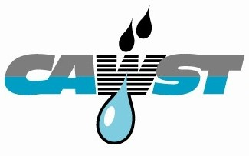
Learning Outcomes
Discuss factors for designing latrines that will be emptied.
Discuss the advantages and limitations of manual and motorized latrine emptying.
Identify health and safety measures to reduce personal and community risk when emptying latrines.

Slide 5
Manual Pit Emptying
Notes:
Latrines and other sanitation facilities are often emptied or cleaned manually

Slide 6
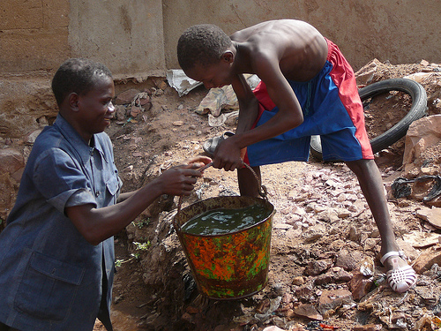
Manual Pit Emptying
(Credit: Hofstetter, 2009)
Notes:
There is often a social stigma attached to manual emptying. People willing to do this kind of work are often the very poor and disadvantaged as a way to earn an income. Manual emptying can be very unpleasant work, and it can pose a number of serious health and safety risks if it is not managed carefully. The tools used for manual emptying are simple – usually no more than a bucket, shovel and rope. Workers often use minimal or no personal protection, like gloves or boots, to prevent direct contact with the sludge. As a result, they report skin rashes and other diseases due to contact with the sludge (Chowdhry and Kone, 2012; Opel, 2012).

Slide 7
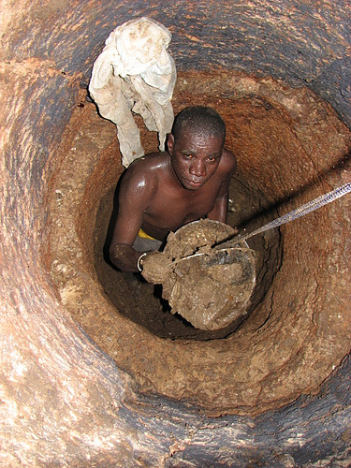
Manual Pit Emptying
(Credit: www.flickriver.com/photos/gtzecosan/tags/ratingz/)
Notes:
Manually emptying sludge (with buckets and shovel) from pits deeper than 1.5 metres is impossible, unless the emptier climbs inside the pit, which is a serious health and safety risk.

Slide 8
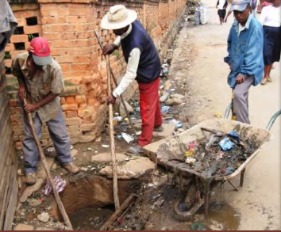
Manual Pit Emptying
“Most of them request a bottle of rum from their client when emptying a pit to be able to bear the unpleasant working conditions.”
(Low Cost Sludge Removal, WashPlus, 2011)
Notes:
Case study in India:
87% of emptiers consume alcohol.
1,000 emptiers die every year in India in various ways including intoxication which increases injury and death rate while at work.

Slide 9
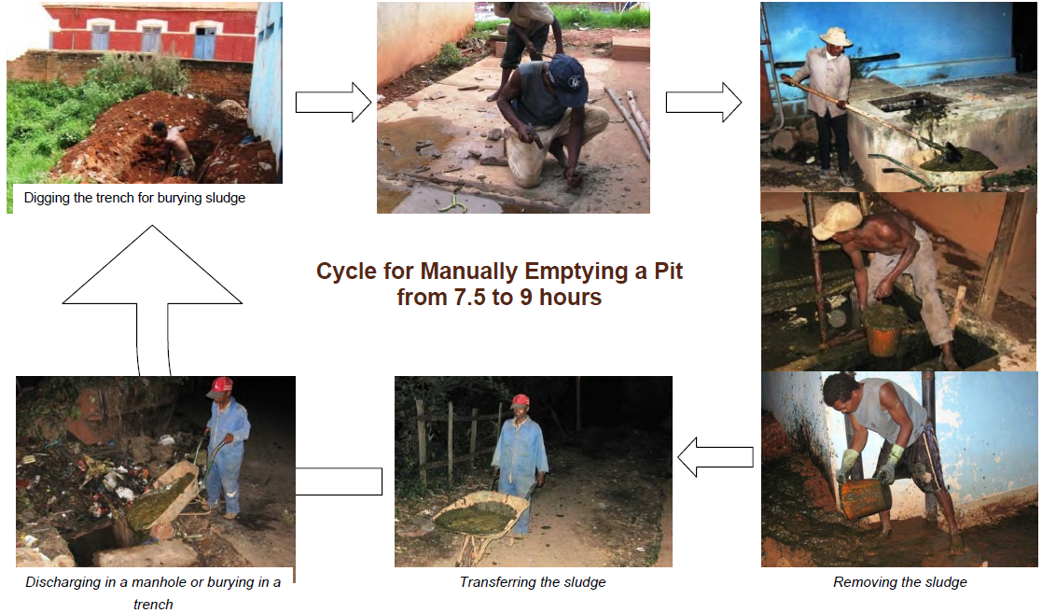
Emptying by Hand
“Most of them request a bottle of rum from their client when emptying a pit to be able to bear the unpleasant working conditions.”
(Credtt: Low Cost Sludge Removal, WashPlus, 2011)

Slide 10
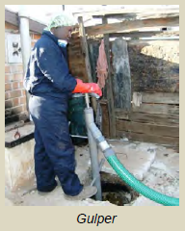
Manually Operated Pumps
Improve the efficiency of manual emptying
Better protect the health and safety of workers
For semi-liquid sludge
Requires a lot of strength to operate the hand pump
(Credit: Low Cost Sludge Removal, WashPlus, 2011)
Notes:
Some portable, manually operated pumps have also been developed to improve the efficiency of manual emptying and better protect the health and safety of workers. Some of these technologies include the:
Manual Desludging Hand Pump (MDHP): Workers push and pull the handle of the hand pump, the sludge is pumped up through the main shaft, and discharged through a spout.
Manual Pit Emptying Technology (MAPET): Hand pump connected to a vacuum tank mounted on a pushcart. When the hand pump is turned, air is sucked out of the vacuum tank and sludge is sucked up into the tank.
Gulper: Works on the same concept as a water pump. When the handle is pumped, the sludge rises up through the bottom of the pump and is forced out of a spout.

Slide 11
Limitations of Manual Pit Emptying
Time consuming: can take several days depending on the size of the pit
Hard and unpleasant work
Increased health risks from exposure to excreta
Increased safety risks from entering pits
Increased environmental risk from spilt excreta
Requires local excreta treatment, use or disposal since transporting excreta more than 0.5 km is impractical
Notes:
Ask the participants “What are the limitations of manual emptying?”
Show the list afterwards.

Slide 12
Advantages of Manual Pit Emptying
Potential for local job and income generation
Hand pumps can be built and repaired with locally available materials
Provides service to difficult to access households
More affordable service for the poor
Notes:
Ask the participants “What are some advantages of manual emptying?”
Show the list afterwards.

Slide 13
Motorized Emptying
(Credit: WEDC)
Notes:
The conventional way to empty latrines is to use a vacuum truck or other vehicle equipped with a motorized pump and storage tank. The pump is connected to a hose which is lowered into the pit, tank or chamber. The excreta is then pumped into the storage tank on the truck. Generally, the storage capacity of a vacuum truck is 3,000-10,000 litres (Tilley et al., 2014).
Motorized emptying is often done with septic tanks.

Slide 14
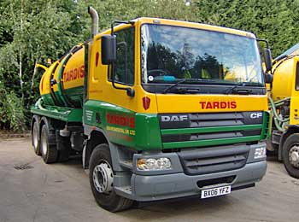
Vacuum Trucks
Notes:
The conventional way to empty latrines is to use a vacuum truck or other vehicle equipped with a motorized pump and storage tank. The pump is connected to a hose which is lowered into the pit, tank or chamber. The excreta is then pumped into the storage tank on the truck. Generally, the storage capacity of a vacuum truck is 3,000-10,000 litres (Tilley et al., 2014).
Motorized emptying is often done with septic tanks.

Slide 15
Advantages of Vacuum Trucks
Fast, and generally efficient
Reduced health, safety and environmental risks
Can be a source of sustainable income
Notes:
Ask the participants “What are the advantages of vacuum trucks?”
Show the list afterwards.

Slide 16
Limitations of Vacuum Trucks
Expensive
Not all households can afford the service
Difficult to access narrow streets and poor roads
Cannot pump thick, dried sludge
Pumps can usually only suck down to a depth of 2–3 metres
Pump must within 30 metres of the latrine
Notes:
Ask the participants “What are the limitations of vacuum trucks?”
Show the list afterwards.

Slide 17
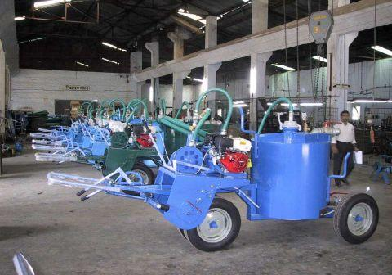
Smaller and More Mobile Motorized Options
Notes:
Smaller, more mobile and inexpensive pumps and vehicles have been developed to help overcome the challenges of using a large vacuum truck. However, none these technologies are yet used at scale.
“Vacutugs” Machines designed by UN Habitat for the emptying of latrines. Vacuum tank, one engine with belts to drive the wheels or the pump. Useful in urban areas where there is no space to dig a new latrine, and no access for large tanker trucks. Essential to have a location and permission to dispose of the latrine contents.
Trialed moderately successfully in Kenya, Mozambique and India.
Essential service but relatively expensive to buy and beyond the reach of entrepreneurs, not yet mass produced. However, affordable, sanitary latrine emptying services could be provided by the private sector; similarly to taxi drivers who don’t own but rent the taxi for the day, latrine emptying equipment could be rented on a daily basis by small scale entrepreneurs.

Slide 18
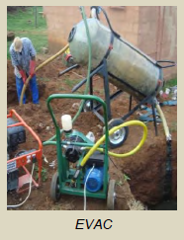
Other Motorized Options
EVAC:
For liquid sludge
Vacuum reservoir system
Motorized
Still under development
(Credit: Low Cost Sludge Removal, WashPlus, 2011)

Slide 19
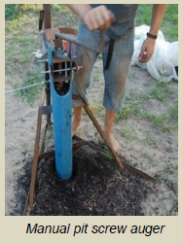
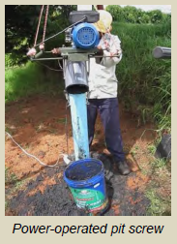
Other Motorized Options
Pit Screw Auger:
For solid sludge
7–25 L /min
Manual or motorized
(Credit: Low Cost Sludge Removal, WashPlus, 2011)

Slide 20
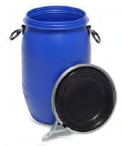
How Do You Transport the Sludge?
Wheelbarrow
Wagon
Cart
Rickshaw
Pick-up Truck
Covered containers!
Notes:
A safe method for transporting the sludge must also be arranged. Vacuum trucks or other large vehicles with storage tanks are generally able to transport sludge directly to the treatment, use or disposal site. Manual workers generally use simple transportation methods that rely on human or animal power.
Manual workers often use open buckets to transport the sludge to the local disposal site. The sludge should be put into covered containers to reduce the risk of spills when it is transported.

Slide 21
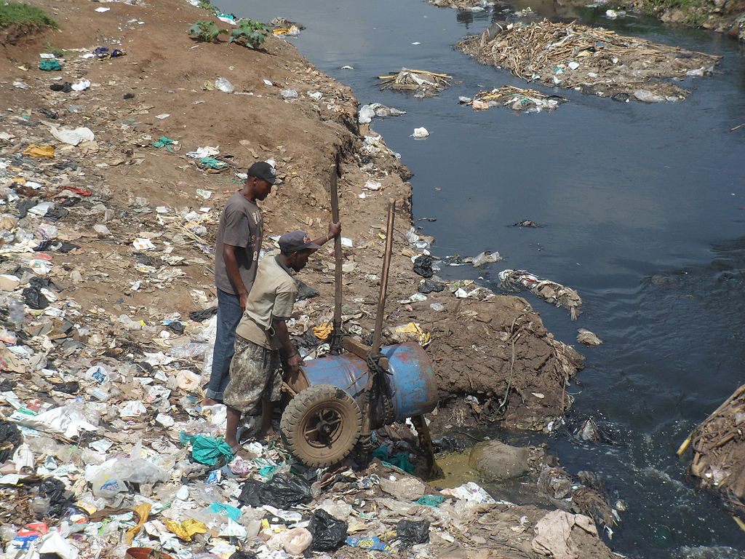
What Is Done With the Sludge?
Dumped near the latrine
Dumped into a canal, river or lake
Disposed in a sewer (not as common)
Other
(Credit: Mbalo, 2012)
Notes:
Explain that due to the challenges of transporting sludge more than 500 metres, a common practice is to dump or bury the sludge near the latrine, in the street or in nearby water sources. However, moving the sludge just a few meters away from where it was collected does not provide a sustainable or hygienic solution for sludge disposal.
Photo shows sludge that has been manually removed from pits being dumped into the local river at Korogocho slum near Nairobi, Kenya.
Explain that sludge treatment, use and disposal options will be discussed later in the workshop.

