Slide 1
2021 | NOVEMBER

Slide 2
Introduction: What is Dilution? (video)
Notes:
Dilution: Adding water to a mixture to decrease the concentration in a sample

Slide 3
LEARNING
OUTCOMES
Discuss the importance of diluting water samples
Calculate a Dilution Factor

Slide 4
GROUP ACTIVITY
When are dilutions needed in drinking water quality testing?
Notes:
Microbiological testing – too many bacteria make plates difficult to count
Physical Testing – turbidity too high (out of range on the meter)
Chemical Testing – chemical concentration too high (out of range)

Slide 5
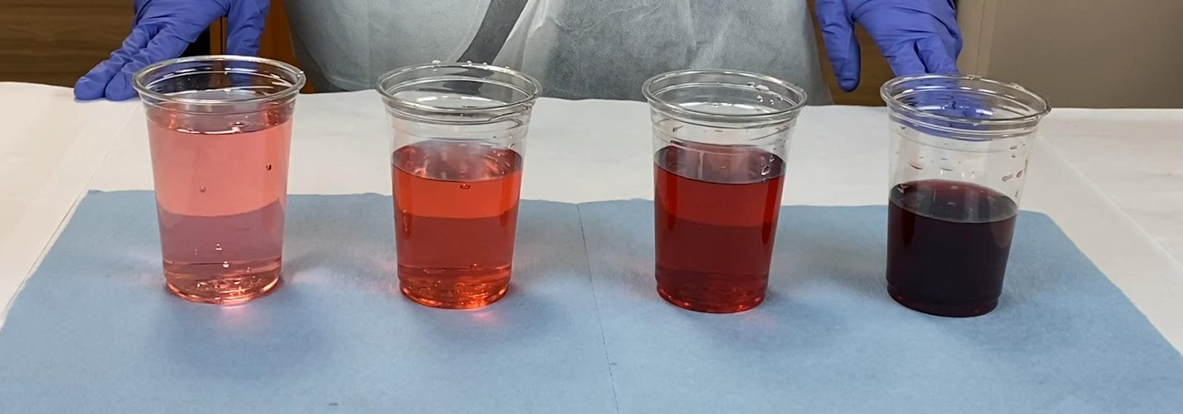
How to Dilute
Add a known volume of dilution water to a known volume of sample.
Example: 99 mL water to 1 mL sample = 100 X dilution
Source: CAWST

Slide 6
Dilution Factors
Step 1: CALCULATE
Total Volume/Sample Volume = Dilution Factor
Notes:
After diluting a sample, you must adjust the test result by multiplying by a dilution factor.

Slide 7
Dilution Factors
Step 2: APPLY
Dilution Factor x Test Result = Final Result
Notes:
After diluting a sample, you must adjust the test result by multiplying by a dilution factor.

Slide 8
Practice
Sample volume = 10 mL
Total volume = 100 mL
Colony count (result) = 15
What are the total Colony Forming Units (CFU) / 100 mL in your sample?

Slide 9
Solution
Step 1: Calculate the dilution factor
100 mL (total volume)/10 mL (sample volume) = 10 (dilution factor)
Step 2: Apply the dilution factor
10 (dilution factor) x 15 (# of colonies) = 150 CFU/100 mL
Notes:
CFU = colony forming units = # colonies on the test plate

Slide 10
GROUP ACTIVITY
Group Work (10-15 minutes)
DILUTION EXERCISE
Notes:
See Trainer Manual for Dilution Exercise instructions.

Slide 11
REVIEW
You are sampling a protected shallow well
What is the likely contamination level and what sample volume would you use?
Note: Use the Dilution Chart Handout to answer this question
Notes:
Answer key:
Contamination level = moderate
Sample volume =50 mL (X 2 dilution factor)

Slide 12
Dilution Chart
Typical Contamination Levels
Contamination Level | Description
Low | Borehole; treated water e.g., directly from a biosand filter or other HWT technology
Moderate | Protected hand dug well or shallow well
Moderate - High | Unprotected hand dug or shallow well
High | Unprotected hand dug or shallow well with evidence of infiltration by runoff
Extreme | Open water source e.g., river, pond or stream
Dilution Chart for Microbiological Testing
Dilution Chart
Contamination Level | Water Sample Volume | Dilution Water Volume | Dilution Factor
Low | 100 mL | 0 mL | X 1 (no dilution)
Moderate | 50 mL | 50 mL | X 2
Moderate – High | 10 mL | 90 mL | X 10
High | 5 mL | 95 mL | X 20
Extreme | 1 mL | 99 mL | X 100
Total Volume = 100 mL
Notes:
Contamination level = moderate
Sample volume =50 mL (X 2 dilution factor)

Slide 13
Thank you!
Calgary . Alberta . Canada
+1 403 243 3285
cawst@cawst.org
cawst.org

