Slide 1




12, 2916 – 5th Avenue
Calgary, Alberta, T2A 6K4, Canada
Phone: + 1 (403) 243-3285, Fax: + 1 (403) 243-6199
E-mail: cawst@cawst.org, Website: www.cawst.org
CAWST, the Centre for Affordable Water and Sanitation Technology, is a nonprofit organization that provides training and consulting to organizations working directly with populations in developing countries who lack access to clean water and basic sanitation.
One of CAWST’s core strategies is to make knowledge about water common knowledge. This is achieved, in part, by developing and freely distributing education materials with the intent of increasing the availability of information to those who need it most.
This document is open content and licensed under the Creative Commons Attribution Works 3.0 Unported License. To view a copy of this license, visit http://creativecommons.org/licenses/by/3.0 or send a letter to Creative Commons, 171 Second Street, Suite 300, San Francisco, California 94105, USA.
You are free to:
        Share – to copy, distribute and transmit this document
        Remix – to adapt this document
Under the following conditions:
        Attribution. You must give credit to CAWST as the original source of the document. Please include our website: www.cawst.org
CAWST will produce updated versions of this document periodically. For this reason, we do not recommend hosting this document to download from your website.
CAWST and its directors, employees, contractors, and volunteers do not assume any responsibility for and make no warranty with respect to the results that may be obtained from the use of the information provided.
Stay up-to-date and get support:
            Latest updates to this document
            Other workshop & training related resources
            Support on using this document in your work
CAWST provides mentorship and
coaching on the use of its education
and training resources.

Slide 2
This presentation is used with Lesson Plan 4: Intro to Drinking Water Quality Testing in the Drinking Water Quality Testing Trainer Manual
Available at www.cawst.org/resources

Slide 3

Introduction to
Drinking Water Quality Testing

Slide 4

Learning Expectations
Discuss the purpose of drinking water quality testing (DWQT).
Explain different options to testing: Observation, portable test kits, mobile laboratory, commercial laboratory, project laboratory.

Slide 5
Why Do We Do
Water Quality Testing?
Ensure safe drinking water
Identify problems
Adopt precautionary measures
Raise awareness
Determine the effectiveness of household water treatment technologies
Select an appropriate water source
Influence government to supply safe water
Notes:
Ask participants for suggestions before showing the answers.

Slide 6
What Are Your Testing Options?
Observation
Portable test kits
Mobile laboratory
Commercial laboratory
Setting up a project laboratory

Slide 7
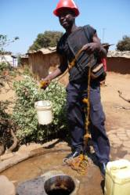
Observation
Advantages:
    Quick, easy and inexpensive
    Does not require specialized equipment
    Does not require highly trained staff
    Gives information about the causes
    of pollution and possible future trends
Limitations:
    Does not confirm the water quality or type of contamination
Notes:
Observation:
Simple observation is a very useful tool to identify potential risks that could affect the current and future quality of drinking water. If contamination is suspected through observing the local environment, then testing is the next step to confirm the water quality.

Slide 8
Portable Test Kits
Advantages:
  Easy to use, portable and self-contained
  Rapid results
  Does not require high level of training
  Less expensive than laboratory testing
Limitations:
  Reduced precision and accuracy
  Reduced level of quality assurance
  More difficult to process a large number of samples
Notes:
Portable Test Kits:
Testing for many physical, chemical, and microbiological parameters can be carried out in the field using specifically designed products that are portable and relatively easy to use. In rural and remote communities, it is more convenient to carry out water testing on-site.

Slide 9
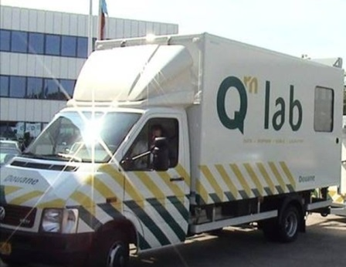
Mobile Laboratory
Advantages:
  Controlled environment
  High level of precision and accuracy
Limitations:
  Relatively expensive
  Requires skilled laboratory technicians
Credit: European Customs Union
Notes:
Mobile Lab:
It is possible to set up a laboratory in a suitable motor vehicle, e.g. truck or van. This is a type of field testing, but a mobile laboratory may provide better facilities than test kits.
Government agencies and research centres responsible for monitoring and water quality testing sometimes use mobile laboratories for periodic water quality testing.
The vehicle is usually the most costly piece of equipment.
Commercial Lab:
Commercial labs use international standards for testing and can provide more consistent, accurate, and precise results.
Using a commercial laboratory can be useful if you are taking a small number of samples and your project is close to a city where a laboratory is present.
The relatively high cost of commercial laboratory testing makes it difficult or impossible to use in many developing countries, especially if many tests are needed.

Slide 10
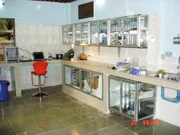
Commercial Laboratory
Advantages:
  Controlled environment
  High level of precision and accuracy
  High level of quality assurance
  More consistent results
  More samples can be processed in a shorter time
Limitations:
  Relatively expensive
  Usually located in urban areas, may require samples to be transported over long distances
  Some laboratories may have limited options of test methods
Credit: Water for Cambodia, Siem Reap
Notes:
Commercial Lab:
Commercial labs use international standards for testing and can provide more consistent, accurate, and precise results.
Using a commercial laboratory can be useful if you are taking a small number of samples and your project is close to a city where a laboratory is present.
The relatively high cost of commercial laboratory testing makes it difficult or impossible to use in many developing countries, especially if many tests are needed.

Slide 11
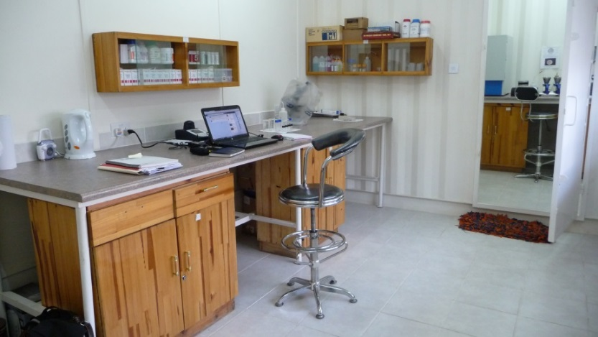
Setting Up a
Project Laboratory
Advantages:
  Control
  Located close to project
  Increased precision and accuracy
  More samples processed
  Source of revenue
Limitations:
  Relatively expensive
  Skilled staff and training required
  Specialized equipment required
  Dedicated facilities required
Credit: Seeds of Hope Water Laboratory
Notes:
Some larger organizations have set up their own water quality testing labs to support their projects. This is usually the case where there are a large number of samples to be taken over a long time frame, and commercial laboratories are not available or too expensive.
The feasibility to establish a project laboratory depends upon the availability of financial resources, physical facilities, skilled technicians, and testing equipment.
Please contact CAWST for further information and consulting support if you wish to establish your own project laboratory.
Advantages:
Organization has control over testing to meet project needs
Can be located close to project area
Precision and accuracy can be similar to a commercial laboratory
More samples can be processed in a shorter time
Can conduct testing for other organizations as a source of revenue
Limitations:
Relatively expensive
Skilled staff and significant training required
Specialized equipment required
Dedicated facilities required

Slide 12
Review
What are the 5 options for drinking water quality testing?
  observation, testing using portable (field) kits, mobile laboratory testing, commercial laboratory testing, and setting up your own project laboratory
Notes:
There are five options for water quality testing: observation, testing using portable (field) kits, mobile laboratory testing, commercial laboratory testing, and setting up your own project laboratory

