Slide 1
Why WASH Matters
2016
July

Slide 2
Country WASH Statistics
What percentage of Country have access to improved water?

Slide 3
Country WASH Statistics
What percentage of Country have access to improved water?
64%

Slide 4
Country WASH Statistics
What percentage of Country have access to improved sanitation?

Slide 5
Kenya WASH Statistics
What percentage of Country have access to improved sanitation?
30%

Slide 6
Kenya WASH Statistics
What percentage of Country households have handwashing stations with soap and water available?

Slide 7
Country WASH Statistics
What percentage of Country households have handwashing stations with soap and water available?
49%

Slide 8
Country WASH Statistics
What was the number of deaths due to Diarrhoeal diseases among children under 5 (in 2015)?

Slide 9
Country WASH Statistics
What was the number of deaths due to Diarrhoeal diseases among children under 5 (in 2015)?
5,442

Slide 10
Country WASH Statistics
What percentage of Country children have stunted growth (2008-2012)?

Slide 11
Country WASH Statistics
What percentage of Country children have stunted growth (2008-2012)?
35%

Slide 12
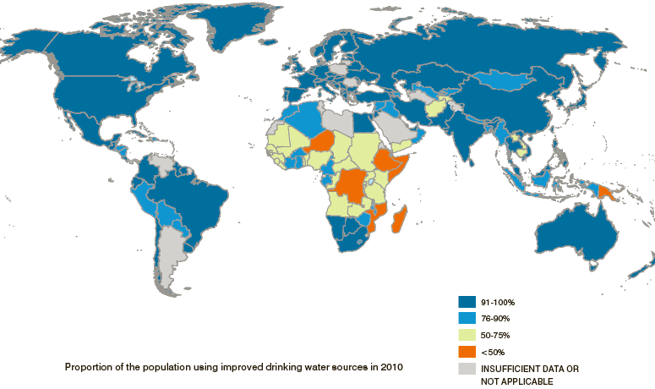
How is the World Doing? – Drinking Water
(Credit: WHO/UNICEF JMP, 2010)
Notes:
Progress as of 2006:
The number of people with access to safe drinking-water rose from 4.1 billion in 1990 to 5.7 billion in 2006.
Available at:
http://www.wssinfo.org/fileadmin/user_upload/resources/JMP-report-2012-en.pdf

Slide 13
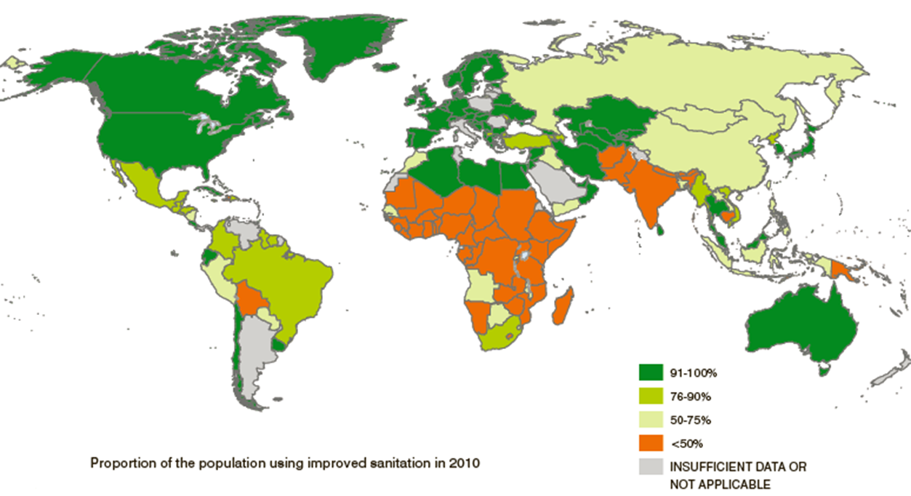
How is the World Doing? – Sanitation
(Credit: UNICEF and WHO, 2014)
Notes:
Title of figure: Proportion of the population using improved sanitation in 2012
There are still 46 countries where less than half the population has access to an improved sanitation facility
Among the world’s regions, Southern Asia and sub-Saharan Africa continue to have the lowest levels of coverage
57% of people in developing regions now use an improved sanitation facility.

Slide 14
Country WASH Statistics
What are the government targets for improved water and sanitation coverage by 2030?

Slide 15
Country WASH Statistics
What are the government targets for improved water and sanitation coverage by 2030?
100%

Slide 16
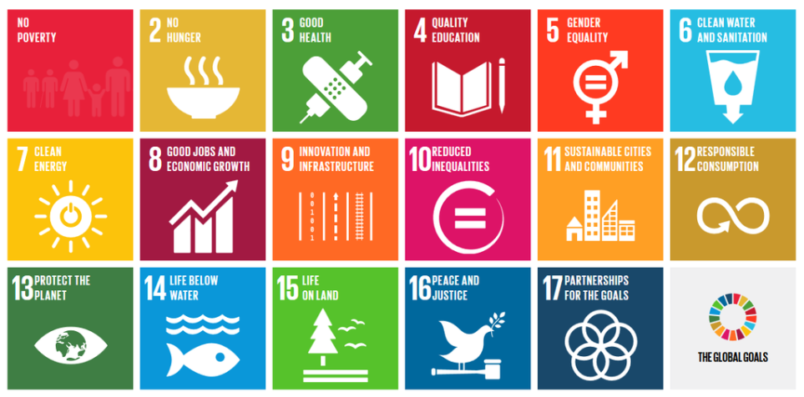
UN Sustainable Development Goals
Notes:
The Sustainable Development Goals (SDGs), Goal 6: Ensure availability and sustainable management of water and sanitation for all. Evolution since the MDGs – we met the MDG for water. Cut by half the proportion of people without access to an improved water source. Improved source does not equal safe – free from pathogens

