Slide 1
Creative Commons
License
This document is open content and licensed under the Creative Commons Attribution Works 4.0 International License. To view a copy of this license, visit http://creativecommons.org/licenses/by/4.0
You are free to: Share – Copy and redistribute the material in any medium or format Remix – Remix, transform, and build upon the material for any purpose, even commercially
Under the following conditions:
Attribution – You must give appropriate credit to CAWST and Eawag-Sandec, provide a link to the license, and indicate if changes were made. You may do so in any reasonable manner, but not in any way that suggests that CAWST and Eawag-Sandec endorses you or your use. Please include our website: www.cawst.org and www.sandec.ch.
CAWST and Eawag-Sandec will produce updated versions of this document periodically. For this reason, we do not recommend hosting this document to download from your website.
CAWST and Eawag-Sandec its directors, employees, contractors, and volunteers do not assume any responsibility for, and make no warranty with respect to, the results that may be obtained from the use of the information provided.

Slide 2
This presentation is used with Lesson Plan Faecal Sludge Quantification and Characterization
in the Introduction to Faecal Sludge Management Trainer Manual
Available at www.cawst.org/resources and www.sandec.ch

Slide 3
Faecal Sludge Quantification and Characterization
2016
MAY

Slide 4
Learning Outcomes
Identify the characteristics of excreta and faecal sludge.
Explain the difference between faecal sludge and wastewater characteristics.
Explain the variability of faecal sludge characteristics.
Discuss the difficulties in reliable faecal sludge quantification and characterization.

Slide 5
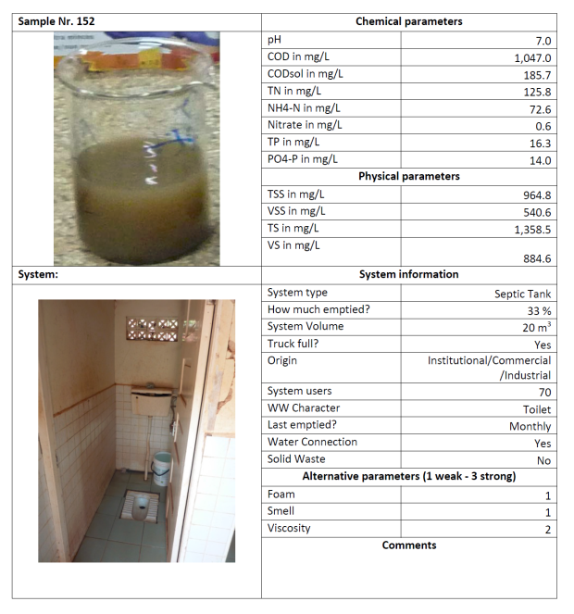
Household Septic Tank
Notes:
These next slides show examples from an Eawag-Sandec study. They collected many faecal sludge samples from various on-site sanitation technologies in Kampala, Uganda. The aim of the research project wasto understand the factors that change faecal sludge characteristics. Some of the data is qualitative (collected through observation and discussions) such as “Last emptied” or “System type”. Some of the data is also qualitative. It was tested in a laboratory, for example “Chemical Oxygen Demand (COD)” or “Total Solids (TS)”. It is very helpful to see the variability in characteristics of faecal sludge. Other qualitative data such as foam and viscosity were useful in predicting the characteristics of faecal sludge.
Eawag-Sandec has published a report that presents the results of 90 samples, in this format. This is available for free at www.sandec.ch.

Slide 6
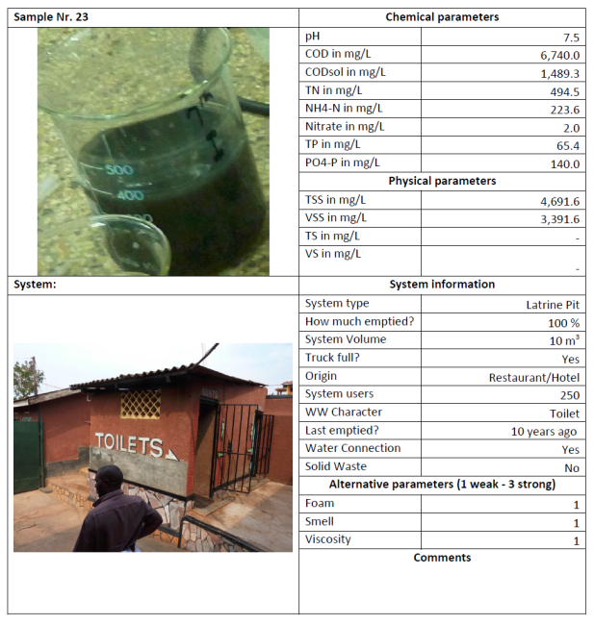
Restaurant Pit Latrine
Notes:
This second example is a pit latrine from a restaurant with approximately 250 users. It was last emptied 10 years ago.

Slide 7
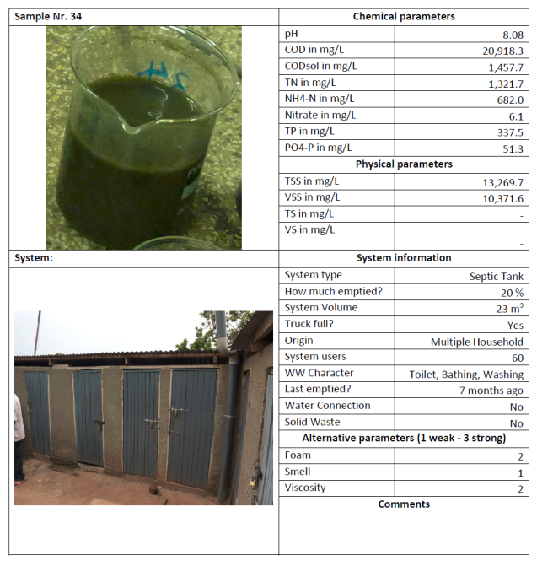
Multiple Household Septic Tank
Notes:
This third example is from a septic tank used by multiple households (60 users). Flushing water, bathing and washing water flow into the septic tank. It was last emptied 7 months ago.
Conclusion: Every sludge is different. It has its own characteristics. It is very time consuming and expensive to collect all this data, particularly the qualitative data. The quantitative data is much easier to collect and can give you a good idea of the sludge characteristics. Eawag-Sandec has published a report on how to characterize faecal sludge based on their experience and this data in particular. It’s available on their website: www.sandec.ch.

Slide 8
How we can support you!
Contact CAWST and Eawag-Sandec for support on using and adapting our education and training resources for your work.
Visit www.cawst.org/resources and www.sandec.ch for:
Latest updates to this document
Other workshop & training related resources
Upper 424 Aviation Rd NE,
Calgary AB T2E 8H6, Canada
+ 1 403 243 3285
support@cawst.org
www.cawst.org
Überlandstrasse 133
CH-8600 Dübendorf, Switzerland
+41 (0)58 765 55 11
info@sandec.ch
www.sandec.ch

