Slide 1
12, 2916 – 5th Avenue
Calgary, Alberta, T2A 6K4, Canada
Phone: + 1 (403) 243-3285, Fax: + 1 (403) 243-6199
E-mail: cawst@cawst.org, Website: www.cawst.org
CAWST, the Centre for Affordable Water and Sanitation Technology, is a nonprofit organization that provides training and consulting to organizations working directly with populations in developing countries who lack access to clean water and basic sanitation.
One of CAWST’s core strategies is to make knowledge about water common knowledge. This is achieved, in part, by developing and freely distributing education materials with the intent of increasing the availability of information to those who need it most.
This document is open content and licensed under the Creative Commons Attribution Works 3.0 Unported License. To view a copy of this license, visit http://creativecommons.org/licenses/by/3.0 or send a letter to Creative Commons, 171 Second Street, Suite 300, San Francisco, California 94105, USA.
You are free to:
Share – to copy, distribute and transmit this document
Remix – to adapt this document
Under the following conditions:
Attribution. You must give credit to CAWST as the original source of the document. Please include our website: www.cawst.org
CAWST will produce updated versions of this document periodically. For this reason, we do not recommend hosting this document to download from your website.
CAWST and its directors, employees, contractors, and volunteers do not assume any responsibility for and make no warranty with respect to the results that may be obtained from the use of the information provided.
Stay up-to-date and get support:
Latest updates to this document
Other workshop & training related resources
Support on using this document in your work
CAWST provides mentorship and
coaching on the use of its education
and training resources.

Slide 2
This presentation is used with Lesson Plan 2: Global and Local Water Issues in the Biosand Filter for Project Implementers Trainer Manual.
Available at www.cawst.org/resources

Slide 3
Global Water and Sanitation Issues

Slide 4
Learning Expectations
Discuss the local and global issues involved with access to safe water and sanitation.
Discuss how unsafe water and poor sanitation is connected to and causes the cycle of poverty.

Slide 5
Think About It
Where have you seen poverty?

Slide 6
Think About It
Why do some regions have so much poverty?

Slide 7
Think About It
What’s being done about it?
Millennium Development Goals (to 2015)
Post-2015 Goals

Slide 8
UN Millennium Development Goals (MDGs)
International agreement
To increase focus and resources on global issues
Focus on reducing global poverty, gender inequality, ill-health and environmental degradation
Developed in 2000
189 states contributed
Notes:
MDGs are good to know about. They have been good to inspire the international community to get behind pressing development issues. You may hear about them while doing international development work. But they don’t have much impact on your work on the ground.
About the MDGs:
In September 2000, 189 heads of state adopted the UN Millennium Declaration and endorsed a framework for development.
The plan was for countries and development partners to work together to increase access to the resources needed to reduce poverty and hunger, and tackle ill-health, gender inequality, lack of education, lack of access to clean water and environmental degradation.
They established eight Millennium Development Goals (MDGs), set targets for 2015, and identified a number of indicators for monitoring progress, several of which relate directly to health.
All goals and their targets are measured in terms of progress since 1990. Reporting on progress towards the MDGs has underscored the importance of working with countries to generate more reliable and timely data. Currently available data show that while some countries have made impressive gains in achieving health-related targets, others are falling behind. Often the countries making the least progress are those affected by high levels of HIV/AIDS, economic hardship or conflict.

Slide 9
8 MDGs to achieve by 2015
Goal 1. Eradicate extreme poverty and hunger
Goal 2. Achieve universal primary education
Goal 3. Promote gender equality and empower women
Goal 4. Reduce child mortality
Goal 5. Improve maternal health
Goal 6. Combat HIV/AIDS, malaria and other diseases
Goal 7. Ensure environmental sustainability
Target 7C: Halve the proportion of people without sustainable access to safe drinking water and basic sanitation
Goal 8. Develop a global partnership for development
*Numbers in targets are relative to 1990 numbers
Notes:
Ironically, safe water and sanitation is necessary for achieving all the other goals, yet it is only mentioned in a target buried in Goal #7 about the Environment!
In 2012, it was announced that the target for drinking water has been met. The target for sanitation is not expected to be met by 2015.
What does “access to” mean? And how is it measured? Who is measuring?

Slide 10
MDGs: Safe Drinking Water

Slide 11
Access to Safe Drinking Water
What is tracked:
The number of people with access to “Improved” versus “Unimproved” Water Sources
Notes:
Note: just because people have access to an improved water source does NOT mean that the water is safe to drink. It may still be contaminated.
The MDG monitoring does NOT track the quality of the water from the improved sources. It also does NOT track whether people consistently use those sources.

Slide 12
What is an “unimproved water source”?
Types of technology and level of services that are less likely to provide safe water, may be unreliable, or environmentally unsustainable
Examples:
Unprotected well
Unprotected spring
Rivers or ponds
Vendor-provided water
Bottled water*
Tanker truck water

Slide 13
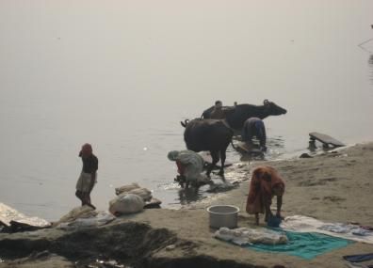
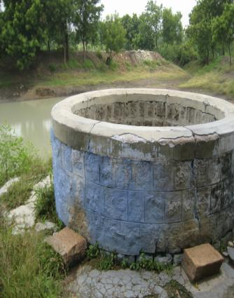
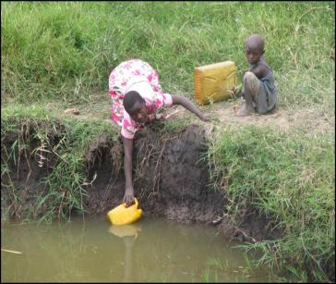
River
Unprotected well
Pond

Slide 14
What is an “improved water source”?
Types of technology and level of services that are more likely to provide safe water
Examples:
Household connection
Public standpipe
Borehole
Protected dug well
Protected spring
Rainwater collection

Slide 15
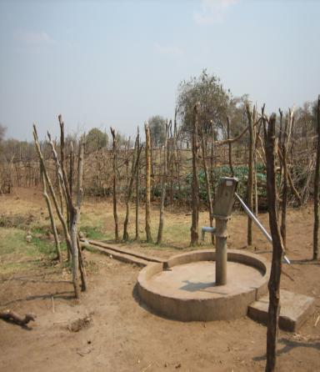
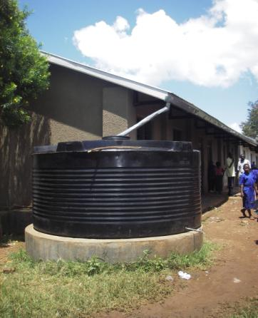
Hand pump
Rainwater collection

Slide 16
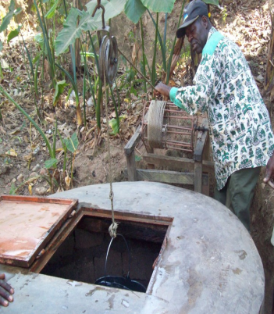
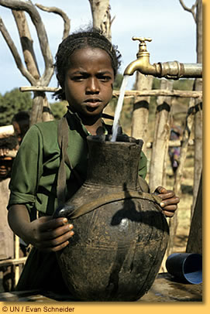
Rainwater collection
Protected well
Stand pipe

Slide 17
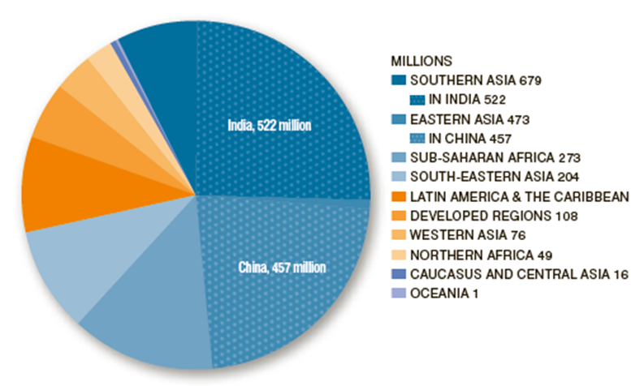
Number of people who gained access to improved drinking water sources from 1990 to 2010 by MDG Region [millions]
As of 2010, the global target for access to improved drinking water has been met.
The proportion of people with access to an improved drinking water source increased from 76% in 1990 to 89% in 2010.
(Credit: WHO/UNICEF JMP, 2012)
Notes:
Based on the proportion of the world population that still uses unimproved water sources, stimulates the inclusion of increasing the access to improved water sources are part of the UN Millennium Development Goals (MDG).
The MDGs have stimulated a global focus on increasing access to safe water and other key issues.
All of these issues are ones that cause the cycle of poverty to continue, which affects billions of people across the globe.

Slide 18
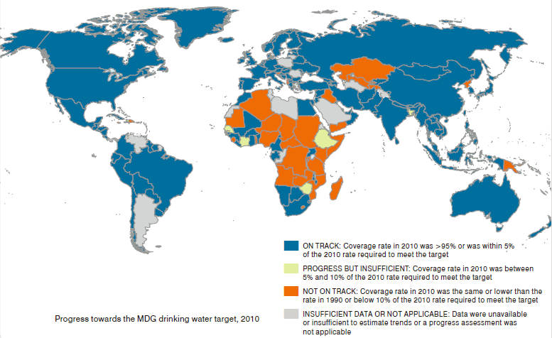
Progress towards the MDG drinking water target, as of 2010
(Credit: WHO/UNICEF JMP, 2012)
Notes:
Progress as of 2006:
The number of people with access to safe drinking-water rose from 4.1 billion in 1990 to 5.7 billion in 2006.
Available at:
http://www.wssinfo.org/fileadmin/user_upload/resources/JMP-report-2012-en.pdf

Slide 19
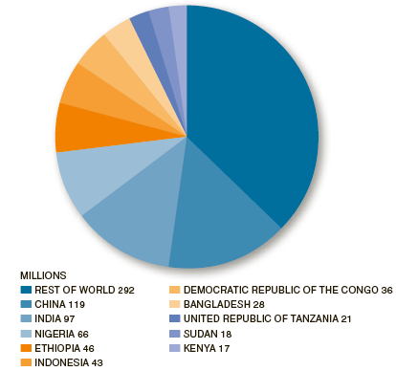
Number of people without access to an improved drinking water source, as of 2010 [millions]
780 million people lack access to an improved drinking water source.
Ten countries are home to two thirds of the global population without an improved drinking water source.
(Credit: WHO/UNICEF JMP, 2012)
Notes:
Based on the proportion of the world population that still uses unimproved water sources, stimulates the inclusion of increasing the access to improved water sources are part of the UN Millennium Development Goals (MDG).
The MDGs have stimulated a global focus on increasing access to safe water and other key issues.
All of these issues are ones that cause the cycle of poverty to continue, which affects billions of people across the globe.

Slide 20
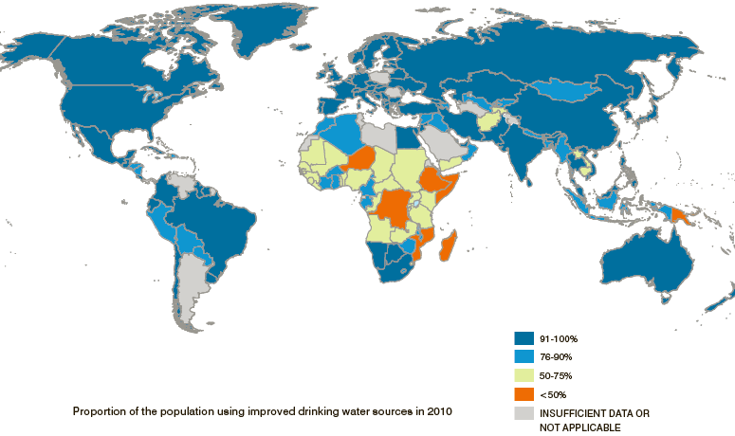
Proportion of people with access to an improved drinking water source, as of 2010
(Credit: WHO/UNICEF JMP, 2012)
Notes:
Progress as of 2006:
The number of people with access to safe drinking-water rose from 4.1 billion in 1990 to 5.7 billion in 2006.
Available at:
http://www.wssinfo.org/fileadmin/user_upload/resources/JMP-report-2012-en.pdf

Slide 21
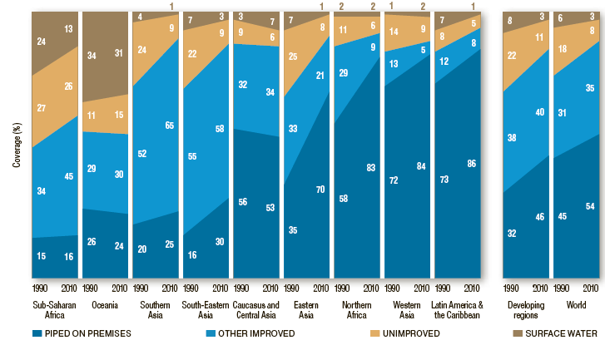
Proportion of People Using Improved and Unimproved Sources, from 1990 to 2010
(Credit: WHO/UNICEF JMP, 2012)
Notes:
Data collected from 1990 to 2006.
Increase in the amount of improved drinking water sources.
Reduction in the amount of unimproved water sources.
The largest concentration of unimproved water sources is in Sub saharan Africa.
A large concentration also in all parts of Asia.

Slide 22
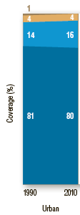
Proportion of people with access to improved and unimproved water sources in urban and rural areas, from 1990 to 2010
(Credit: WHO/UNICEF JMP, 2012)
Notes:
Data collected from 1990 to 2006.
Increase in the amount of improved drinking water sources.
Reduction in the amount of unimproved water sources.
The largest concentration of unimproved water sources is in Sub saharan Africa.
A large concentration also in all parts of Asia.

Slide 23
Think About It
Which areas have the least access to improved water sources?

Slide 24
Global Issue
Large portions of
Africa and Asia
suffer the most from
lack of access to
improved water sources

Slide 25
WHY?
Lack of:
Funding
Resources
Infrastructure
Maintenance
Knowledge
Awareness
Skills
Motivation
Priority

Slide 26
MDGs: Basic Sanitation

Slide 27
Access to Basic Sanitation
What is tracked:
The number of people with access to “Improved” versus “Unimproved” sanitation facilities (latrines)
Notes:
Note: Just because people have access to a safe latrine does NOT mean they will use it.
MDG monitoring does NOT track how many people actually use the facilities.
There is a sliding scale, or ladder, of safe and desirable sanitation facilities. Digging a hole and covering the feces is not considered improved sanitation, but it is better than open defecation.

Slide 28
What is an “unimproved sanitation facility”?
Latrines and practices that are more likely to have contact between humans and excreta; unsafe and unhygienic
Examples:
Open pit latrine (no slab, messy or unsafe)
Bucket latrine
Hanging latrine (drops into water)
Open defecation
Public or shared latrine (- debate)
Notes:
Unimproved sanitation facilities do not ensure a hygienic separation of human excreta from human contact and include:
Pit latrines without slabs or platforms or open pit
Hanging latrines (drop into water)
Bucket latrines
Open defecation in fields, forests, bushes, bodies of water or other open spaces, or disposal of human feces with other forms of solid waste.
Whether shared or public latrines are “unimproved” is under debate. If these facilities are not well maintained (kept clean), they will not be hygienic and therefore not safe. If latrines are shared between a few families who all know each other, it is more likely they will keep the latrine clean.

Slide 29
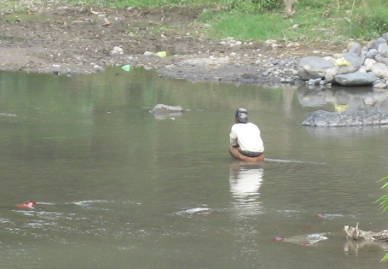
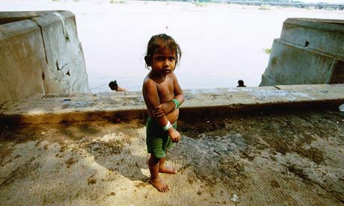
Open defecation
Open toilet area (source:guardian.co.uk/commentisfree/2009/ nov/19/world-toilet-day-sanitation)

Slide 30
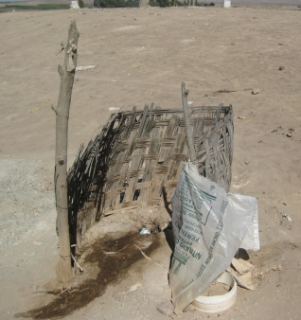
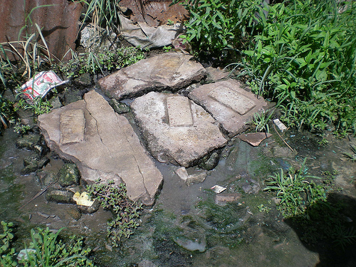
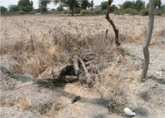
Unimproved pit latrines
(source: defeatdd.org/blog/sustainable-sanitation-peru)
(source: Flickr, photo by K Tayler)
(source: labspace.open.ac.uk)

Slide 31
What is an “improved sanitation facility”?
Latrines and practices that are less likely to results in any contact between humans and excreta; safe and hygienic
Examples:
Connection to a public sewer
Connection to a septic system
Pour-flush latrine
Simple pit latrine
Ventilated improved pit latrine
Notes:
Improved sanitation include sanitation facilities that hygienically separate human excreta from human contact.
Access to basic sanitation is measured against the proxy indicator:
the proportion of people using improved sanitation facilities (such as those with sewer connections, septic system connections, pour-flush latrines, ventilated improved pit latrines and pit latrines with a slab or covered pit)
Shared sanitation facilities are otherwise-acceptable improved sanitation facilities that are shared between two or more households. Shared facilities include public toilets and are not considered improved.

Slide 32
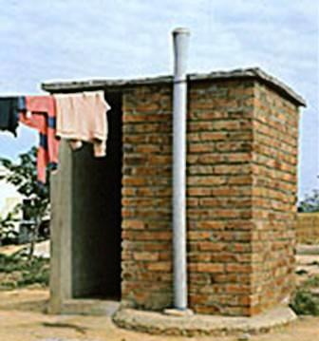
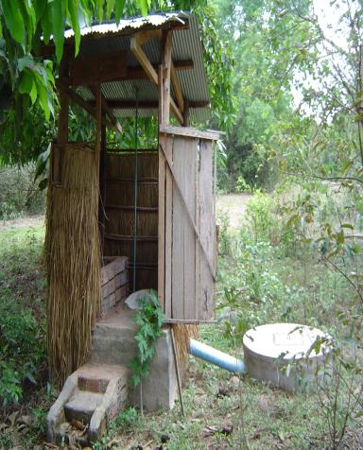
Ventilated Improved Latrine (VIP)
Pour-flush Latrine

Slide 33
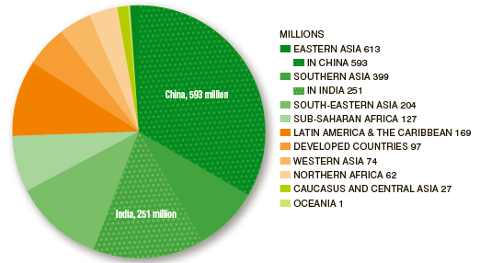
Number of people who gained access to improved sanitation from 1990 to 2010 by MDG Region [millions]
As of 2010, the global target for access to improved sanitation will not be met by 2015.
Sanitation coverage increased from 49% in 1990 to 63% in 2010.
(Credit: WHO/UNICEF JMP, 2012)
Notes:
Based on the proportion of the world population that still uses unimproved sanitation facilities, stimulates the inclusion of increasing the access to improved sanitation facilities are part of the UNDP Millennium Development Goals (MDG).
The MDGs have stimulated a global focus on increasing access to sanitation facilities and other key issues.
All of these issues are ones that cause the cycle of poverty to continue, which affects billions of people across the globe.

Slide 34
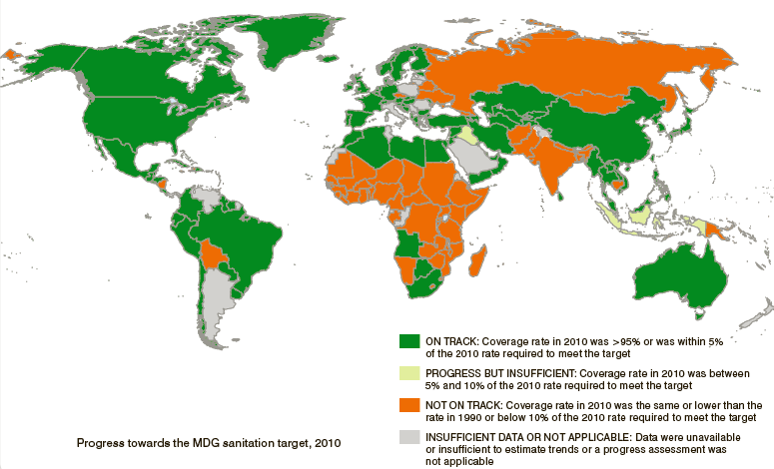
Progress towards the MDG sanitation target, as of 2010
(Credit: WHO/UNICEF JMP, 2012)
The world is not on track to meet the sanitation target.
Notes:
Point out the areas of the globe that are not on track to meet the sanitation targets: Asia and Africa. As well as parts of Europe and South America.
Many more countries that are not on track to improved sanitation facilities than the improved water sources.
Ask: H

Slide 35
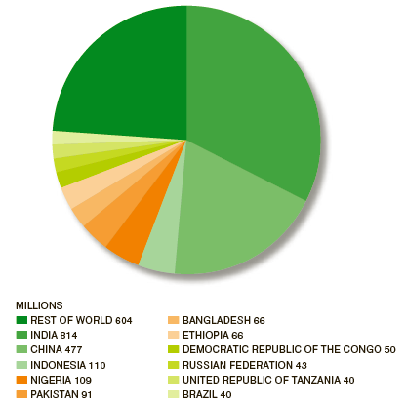
Number of people without access to improved sanitation, as of 2010 [millions]
2.5 billion people do not have access to improved sanitation as of 2010.
(Credit: WHO/UNICEF JMP, 2012)
Notes:
Based on the proportion of the world population that still uses unimproved sanitation facilities, stimulates the inclusion of increasing the access to improved sanitation facilities are part of the UNDP Millennium Development Goals (MDG).
The MDGs have stimulated a global focus on increasing access to sanitation facilities and other key issues.
All of these issues are ones that cause the cycle of poverty to continue, which affects billions of people across the globe.

Slide 36
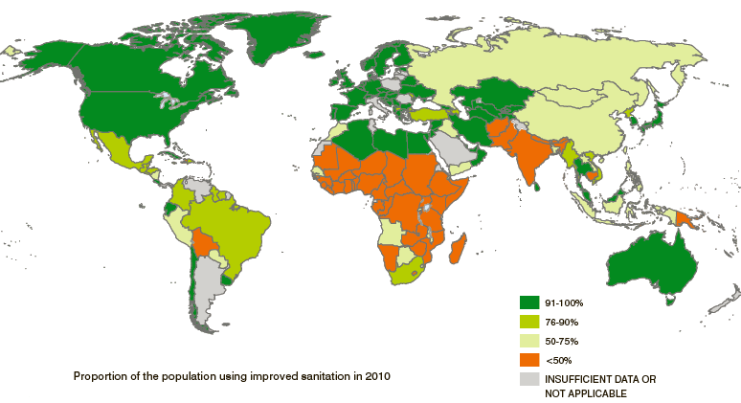
Proportion of people with improved sanitation, as of 2010
(Credit: WHO/UNICEF JMP, 2012)
Notes:
Point out the areas of the globe that are not on track to meet the sanitation targets: Asia and Africa. As well as parts of Europe and South America.
Many more countries that are not on track to improved sanitation facilities than the improved water sources.
Ask: H

Slide 37
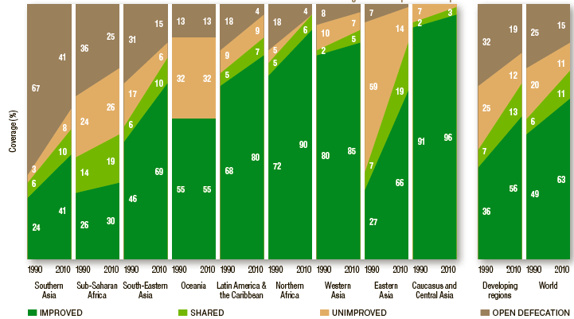
Proportion of people using improved or unimproved sanitation, as of 2010
(Credit: WHO/UNICEF JMP, 2012)

Slide 38
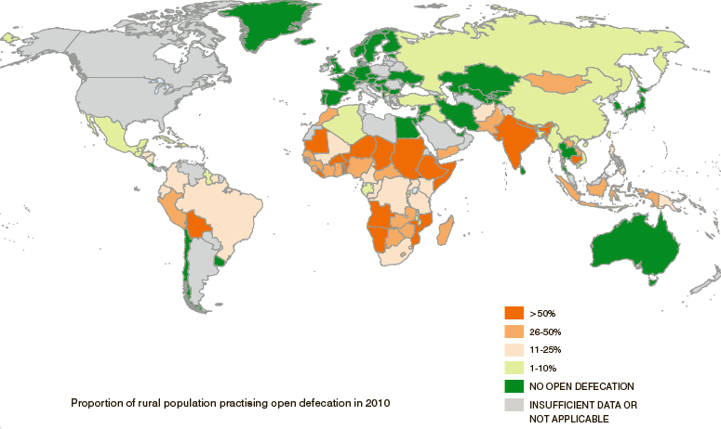
Proportion of people practicing open defecation, as of 2010
(Credit: WHO/UNICEF JMP, 2012)
Notes:
Point out the areas of the globe that are not on track to meet the sanitation targets: Asia and Africa. As well as parts of Europe and South America.
Many more countries that are not on track to improved sanitation facilities than the improved water sources.
Ask: H

Slide 39
Think About It
Which areas have the least access to improved sanitation facilities?
Notes:
Africa and Asia

Slide 40
Global Issue
Large portions of
Africa and Asia
suffer the most from
lack of access to
improved sanitation facilities

Slide 41
WHY?
Lack of:
Funding
Resources
Infrastructure
Maintenance
Knowledge
Awareness
Skills
Motivation
Priority

Slide 42
Consider…
What is the effect on a community if access to safe drinking water is improved but there is still a lack of basic sanitation?
Notes:
Without having improved sanitation facilities the chance of contamination of water is still high.
Even with an improved water source if the efforts aren’t collaborated with improved sanitation, then health could still not improve.
If there is more water provided (quantity), it may create more sanitation problems (drainage, mosquitoes)

Slide 43
What does this mean for me?
The important thing is to get ALL PEOPLE EVERYWHERE:
Safe water that is accessible (not to far) and affordable
Sanitation facilities that stop the transmission of disease and that can be used by everyone
Safe hygiene practices
Notes:
You may hear about the MDGs (in the context of funding/donor priorities, or in international government and NGO-talk)
It is not NGO’s responsibility to report on achieving MDGs – they are monitored by the national governments
The goals for after 2015 are currently being defined (as of 2012).
-Drinking Water: At this point, it looks like they will still have definitions of “improved” and “unimproved” water sources, but will also include considerations of access, affordability, and equity – whether the poorest of the poor and rural populations are gaining access as well as the wealthy and urban populations. There may be a “ladder” approach, acknowledging a basic level of service/access, and a higher, more convenient level of service/access.
-Sanitation: there will be more emphasis on ending open defecation, coverage and use of latrines (whether the whole community has access, whether the poorest of the poor have access, and whether everyone uses the latrines), the sanitation chain (whether latrines are emptied and waste safely disposed of or reused), and having latrines in all schools and health centres.
-There may also be targets for hygiene and equity included.

Slide 44
Cycle of Poverty
Why does unsafe water and poor sanitation cause the cycle of poverty to continue?
Notes:
Disease spreading = ill health = unable to go to school = unable to work = lack of productivity = lack of economic growth = poverty.

Slide 45
Cycle of Poverty
Spreading of Disease
Lack of economic productivity
Ill health
Poverty
Unable to go to school
Lack of productivity
Unable to get a job or work

Slide 46
Review
What can be done to stop the cycle of poverty?
Notes:
Lead the discussion to the context of the workshop.
Improving access to safe drinking water
Basic sanitation facilities.
Hygiene Education

Slide 47
Review
What can be done to improve access to safe drinking water and basic sanitation?
Notes:
This is where you can lead the discussion to:
Household water treatment as opposed to community water treatment – as if there is a lack of sanitation, if the treatment is in the household at the point of use, there is less likelihood of spreading disease
Improved sanitation implementation and practices combined with the implementation of HWTS.
Improved Management of systems
de-centralization of responsibility and ownership
community capacity development
efficient spare parts distribution networks
providing choice of service levels to communities (“technology ladders”)
4. Collect other ideas from the participants.
Review the learning expectations with the entire group. Ask participants whether or not the expectations have been met. If not, give options for participants to find the information they were looking for or identify next steps for follow up.

