Slide 1
12, 2916 – 5th Avenue
Calgary, Alberta, T2A 6K4, Canada
Phone: + 1 (403) 243-3285, Fax: + 1 (403) 243-6199
E-mail: cawst@cawst.org, Website: www.cawst.org
CAWST, the Centre for Affordable Water and Sanitation Technology, is a nonprofit organization that provides training and consulting to organizations working directly with populations in developing countries who lack access to clean water and basic sanitation.
One of CAWST’s core strategies is to make knowledge about water common knowledge. This is achieved, in part, by developing and freely distributing education materials with the intent of increasing the availability of information to those who need it most.
This document is open content and licensed under the Creative Commons Attribution Works 3.0 Unported License. To view a copy of this license, visit http://creativecommons.org/licenses/by/3.0 or send a letter to Creative Commons, 171 Second Street, Suite 300, San Francisco, California 94105, USA.
You are free to:
Share – to copy, distribute and transmit this document
Remix – to adapt this document
Under the following conditions:
Attribution. You must give credit to CAWST as the original source of the document. Please include our website: www.cawst.org
CAWST will produce updated versions of this document periodically. For this reason, we do not recommend hosting this document to download from your website.
CAWST and its directors, employees, contractors, and volunteers do not assume any responsibility for and make no warranty with respect to the results that may be obtained from the use of the information provided.
Stay up-to-date and get support:
Latest updates to this document
Other workshop & training related resources
Support on using this document in your work
CAWST provides mentorship and
coaching on the use of its education
and training resources.

Slide 2
This presentation is used with Lesson Plan 12: Colony Counting in the Drinking Water Quality Testing Trainer Manual.
Available at www.cawst.org/resources

Slide 3
Colony Counting

Slide 4
Learning Expectations
Count bacterial colonies
Discuss error and variation in colony counts

Slide 5
How a Bacterial Colony Forms
Notes:
This slide is optional but is a good visual for how bacteria form colonies
This video is available online at www.youtube.com/watch?v=gEwzDydciWc
Alternatively, if you have access to the off line video, right click on the link in the slide and left click on ‘Edit Hyperlink’, then find the correct link to the file
You will then be able to click on the link in slideshow mode to play the video

Slide 6
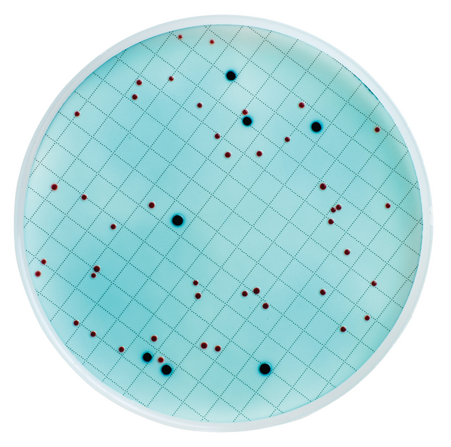
Sample Petri Dish (m-ColiBlue24)
m-ColiBlue24 culture media (blue liquid)
E. coli appear as blue dots
General coliform appear as red dots
Total coliforms = blue + red dots
M-ColiBlue 24 colonies in Petri dish
(Credit: Hach)
Notes:
Total Coliforms include both general coliforms and E. coli (since E. coli is in the coliform family). Therefore, you must count both red and blue colonies to get the total coliform count.
Background appears light blue.

Slide 7
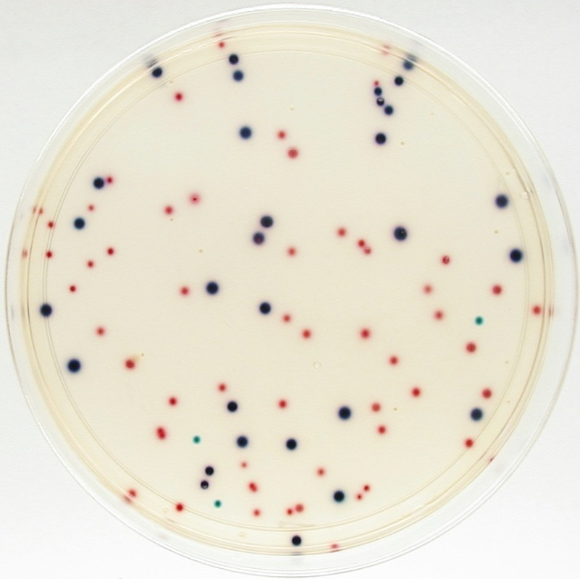
Sample Petri Dish (Coliscan)
Coliscan media (light yellow liquid)
E. coli appear as dark blue to purple dots
General coliforms appear as pink dots
Total coliforms = dark blue/purple + pink dots
Coliscan colonies in Petri dish
(Credit: Micrology Labs)
Notes:
Total Coliforms include both general coliforms and E. coli (since E. coli is in the coliform family) therefore you must count pink, blue and purple colonies to get the total coliform count.
Background is clear.

Slide 8
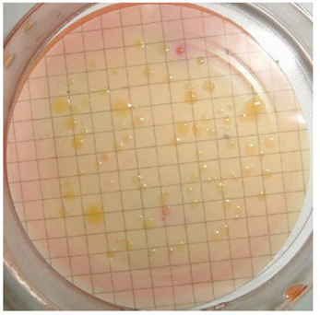
Sample Petri Dish (MLSB)
Membrane Lauryl Sulphate Broth (MLSB) (magenta-red liquid)
E. coli appear as bright yellow dots when incubated at 44°C
General coliforms appear as bright yellow dots when incubated at 37°C
MLSB colonies in Petri dish
(Credit: UK Environment Agency)
Notes:
Background is pink
Only yellow colonies are counted
Limitation: Colonies grown on MLSB must be counted within 15 min of removal from incubator due to colour fading

Slide 9
How Do We Count the Colonies?
Use the horizontal grid lines
Count all colonies of the particular colour you are looking for
Go from top to bottom/left to right until all grid squares are covered

Slide 10
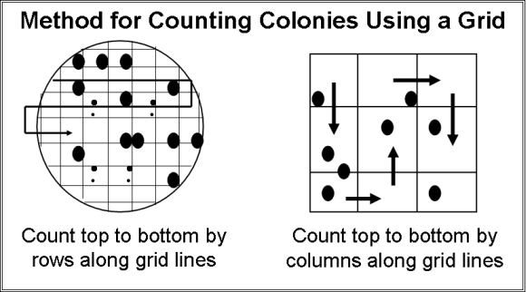
Colony Counting

Slide 11
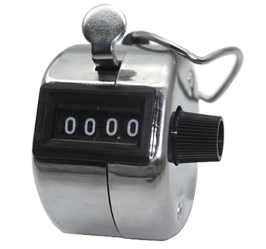
Colony Counter or Hand Tally Counter Clicker
It is helpful to use a hand tally counter clicker for higher colony counts if available
Hand Tally Counter Clicker
Credit: Gadget Plus

Slide 12
Colony Counting
Record results as the number of colony forming units (CFU) per 100 mL
E.g., 55 CFU/100 mL
Prefer plates to have between 20 and 80 colonies
Samples with >200 colonies are considered too numerous to count (TNTC)
Notes:
If plates are TNTC then next time dilute your sample water

Slide 13
Colony Counting Exercise
In pairs, study the Coliscan Colony Counting Guide
Count the E. coli (dark blue/purple), then count the general coliform (pink) colonies
Results will be recorded on the flipchart
Are there any differences in results?
If yes, discuss the differences in results.
Notes:
Divide the participants into pairs and hand out Coliscan Colony Color Guide Sheets.
Ask the partners to count the E. coli (dark blue/purple), then the general coliform (pink) colonies
Record the results on the flipchart under the heading Colony Counting Exercise (save results for Lesson Plan 13: Quality Control).
Discuss the differences in results (variation in counting techniques).
Different colour perception
Subjective colour interpretation
Size of colonies may be difficult to detect
Differences in eyesight
Lighting
The answer to the exercise is : 22 E. coli and 30 general coliforms

Slide 14
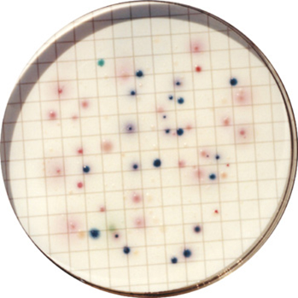
Colony Counting Exercise
Coliscan colonies in Petri dish
(Credit: Micrology Labs)

Slide 15
Colony Counting Exercise
Answer:
22 E. coli
30 general coliforms
Notes:
The answer to the exercise is : 22 E. coli and 30 general coliforms

Slide 16
Review
What colour are fecal coliforms grown on MLSB?
Answer:
Yellow
Notes:
Don’t forget to count colonies within 15 minutes of taking the Petri dishes out of the incubator to avoid colour fading

