Slide 1




424 Aviation Road NE
Calgary, Alberta, T2E 8H6, Canada
Phone: + 1 (403) 243-3285, Fax: + 1 (403) 243-6199
E-mail: resources@cawst.org, Website: www.cawst.org
CAWST, the Centre for Affordable Water and Sanitation Technology, is a nonprofit organization that provides training and consulting to organizations working directly with populations in developing countries who lack access to clean water and basic sanitation.
One of CAWST’s core strategies is to make knowledge about water common knowledge. This is achieved, in part, by developing and freely distributing education materials with the intent of increasing the availability of information to those who need it most.
This document is open content and licensed under the Creative Commons Attribution Works 3.0 Unported License. To view a copy of this license, visit http://creativecommons.org/licenses/by/3.0 or send a letter to Creative Commons, 171 Second Street, Suite 300, San Francisco, California 94105, USA.
You are free to:
        Share – to copy, distribute and transmit this document
        Remix – to adapt this document
Under the following conditions:
        Attribution. You must give credit to CAWST as the original source of the document. Please include our website: www.cawst.org
CAWST will produce updated versions of this document periodically. For this reason, we do not recommend hosting this document to download from your website.
CAWST and its directors, employees, contractors, and volunteers do not assume any responsibility for and make no warranty with respect to the results that may be obtained from the use of the information provided.
Stay up-to-date and get support:
            Latest updates to this document
            Other workshop & training related resources
            Support on using this document in your work
CAWST provides mentorship and
coaching on the use of its education
and training resources.

Slide 2
This presentation is used with Lesson Plan 12: Slab Design in the Latrine Design and Construction Trainer Manual.
Available at www.cawst.org/resources

Slide 3

Slab Design

Slide 4
Learning Outcomes
Describe different slab types and slab materials.
Discuss advantages and limitations of different slab types.

Slide 5
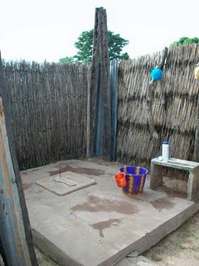
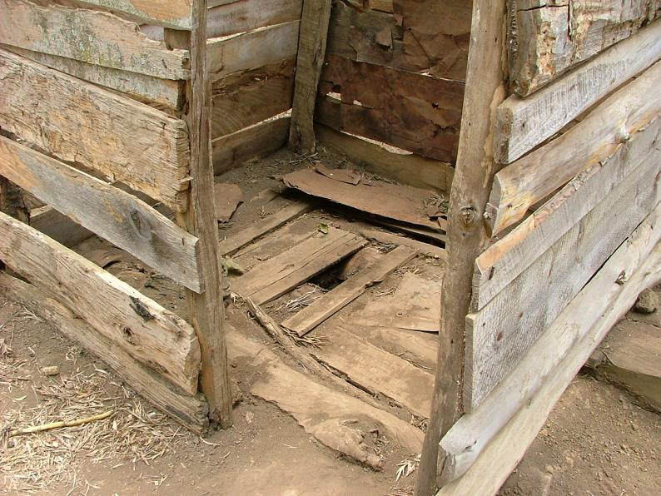
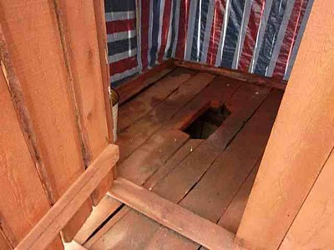
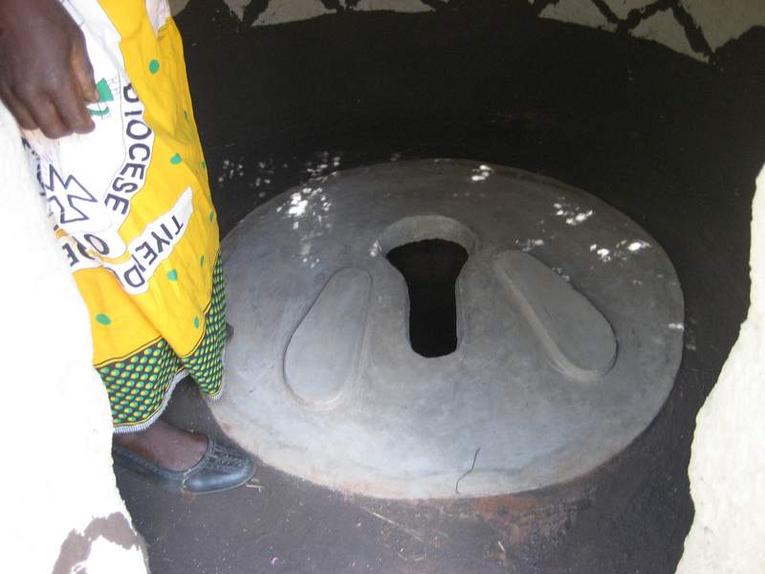
Slabs
Wooden Slab
(Credit: ewbrwanda.wikispaces.com)
Concrete Slab and SanPlat
(Credit: thegambiaorbust.blogspot.com)
Wooden Slab
(Credit: thegreenbackpack.blogspot.com-)
Concrete Dome Slab
(Credit: www.totallandcare.org)
Notes:
Slabs are placed over latrine pits and soakpits. We need them to carry a reasonable amount of weight, more than one person. This extra strength is for safety.
Offset pits allow the majority of loads to be carried by the ground adjacent to the pit. In this case, the slabs don’t need to be as strong.

Slide 6
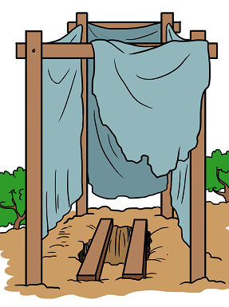
Slabs
Why do we need a latrine slab?
  Defines improved sanitation
  Safety for users
  Keeps excreta away from the users
What characterizes a good slab?
  - Strong, durable, long lasting, smooth, easy to clean, affordable
Notes:
Slabs are placed over latrine pits and soak pits. We need them to carry a reasonable amount of weight, more than one person. This extra strength is for safety.
Record answers to question 2 on flipchart paper, this will be useful for participants later in the lesson to refer to during their discussion about advantages and limitations.

Slide 7
Types of Slabs
Reinforced concrete slab
Dome slab
Wood slab
Pole and earth slab
Plastic slab
To be placed on top of the slab:
Sanitation Platform (SanPlat)

Slide 8
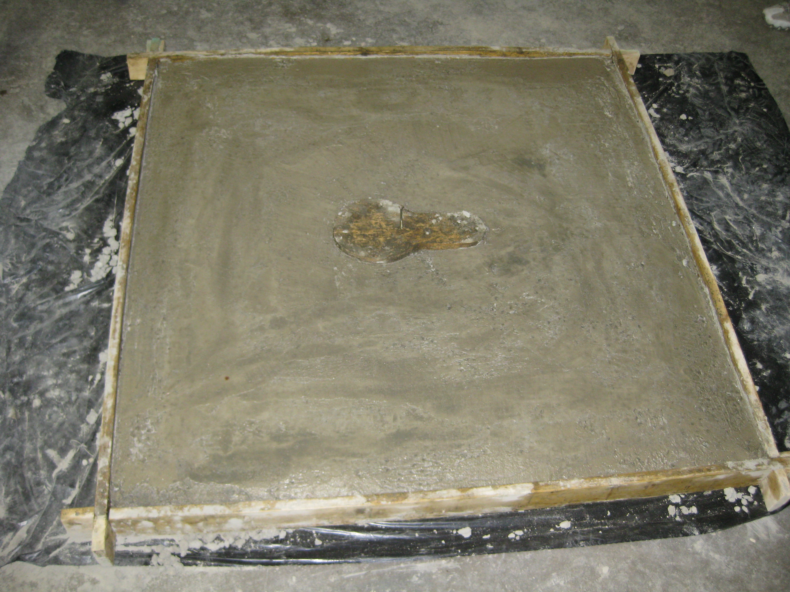
Reinforced Concrete Slab

Slide 9
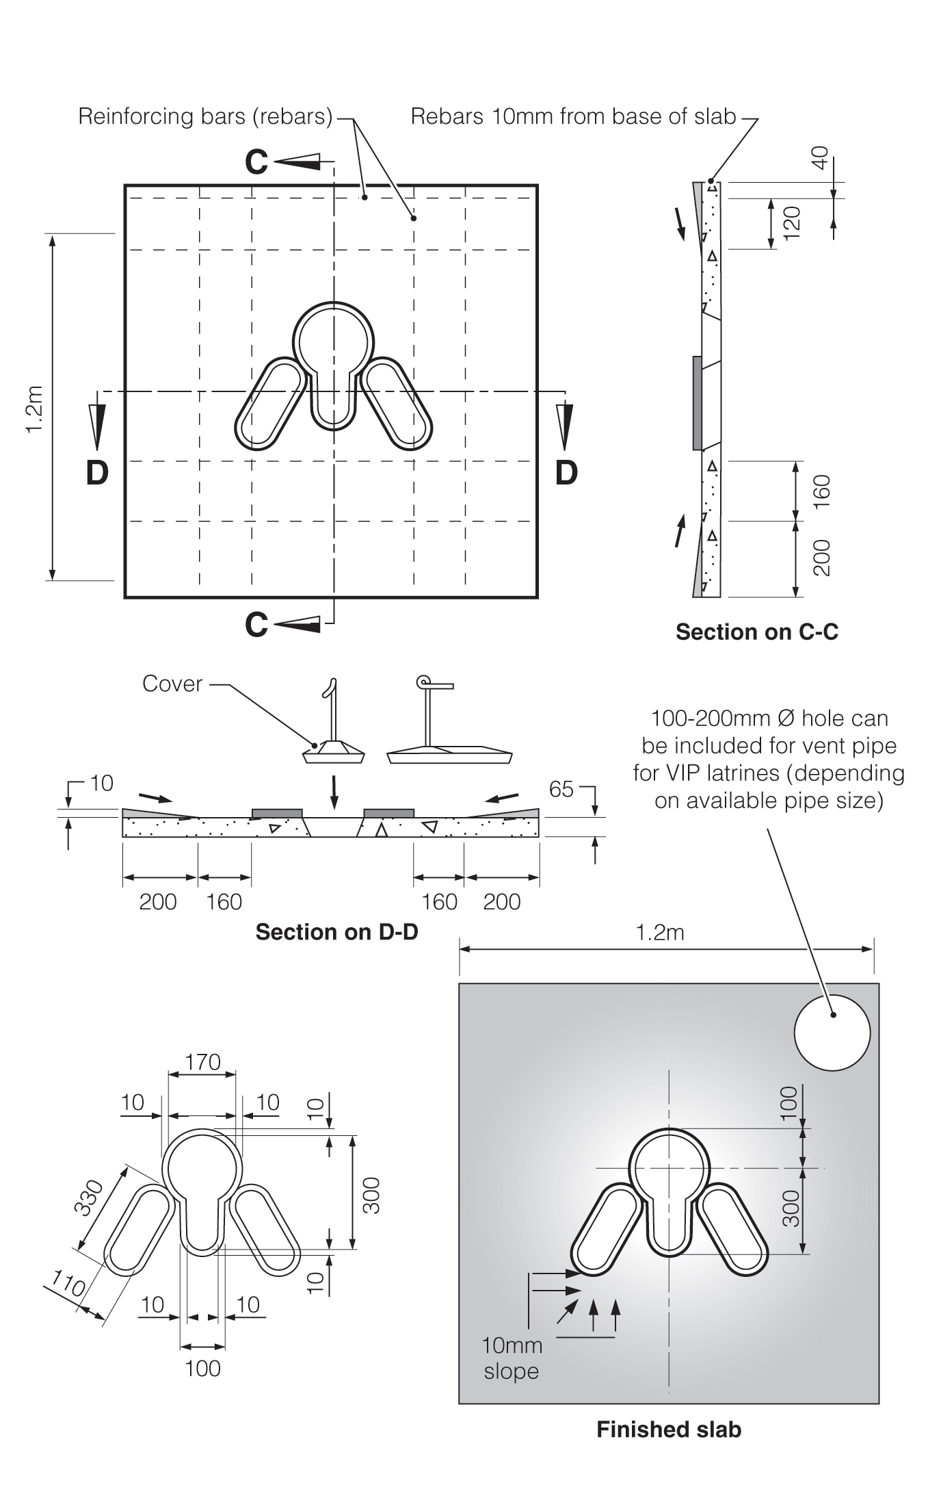
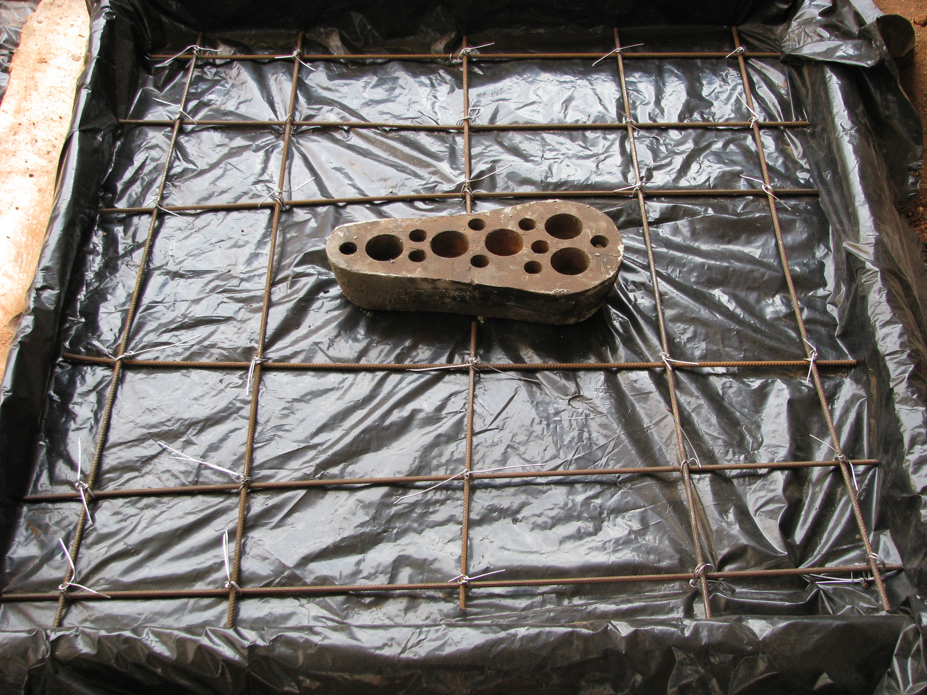
Reinforced Concrete Slabs
Steel Reinforcement Bars
Notes:
This is how reinforcement is placed in a slab. The reinforcement is steel bars.
Can use alternate steel such as fencing wire or barbed wire (would have to re-check calculations to make sure you use enough of it)
Do NOT use anything organic/degradable such as bamboo strips or wood for reinforcement – it will rot!!

Slide 10


Why Reinforce Concrete Slabs?
Activity – Tension and Compression
What is compression?
What is tension?
Notes:
See Latrine Design and Construction Trainer Manual, Lesson Plan 12: Slab Design for activity instructions.

Slide 11
Why Reinforce Concrete Slabs?
Concrete very strong in compression, but weak in tension
Reinforcement makes concrete stronger in tension
Notes:
The bottom of the slab is in tension when a load is placed on top. We normally can’t see it. The forces are pulling it apart and so it cracks.
Steel is really good in tension. It gives strength to the concrete.
Ask participants to show you when concrete is strong using their hands.
Ask participants to show you when steel is strong using their hands.

Slide 12
Why Reinforce a Slab?
Activity – Strength of a Reinforced Slab
What is the difference between an unreinforced slab and a reinforced slab?
Notes:
See Latrine Design and Construction Trainer Manual, Lesson Plan 12: Slab Design for activity instructions

Slide 13
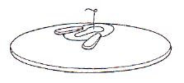
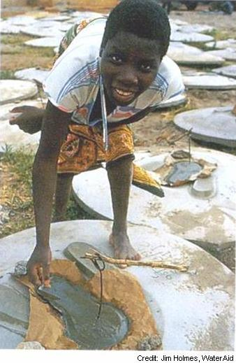
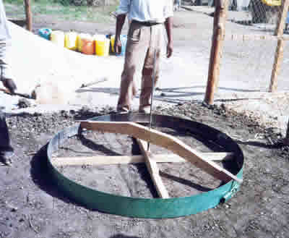
Dome Slabs

Slide 14
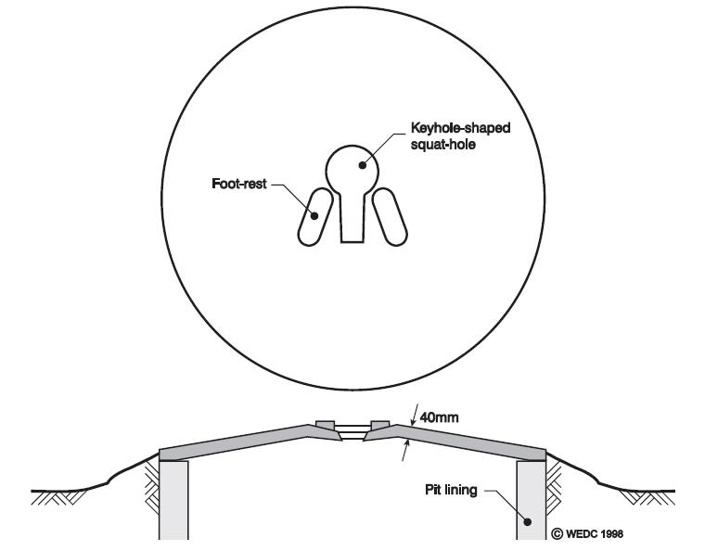
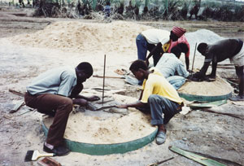
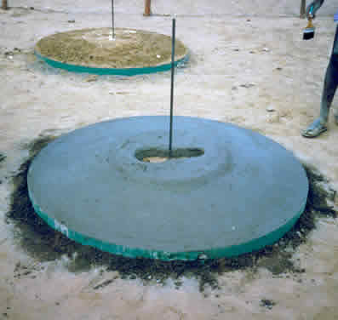
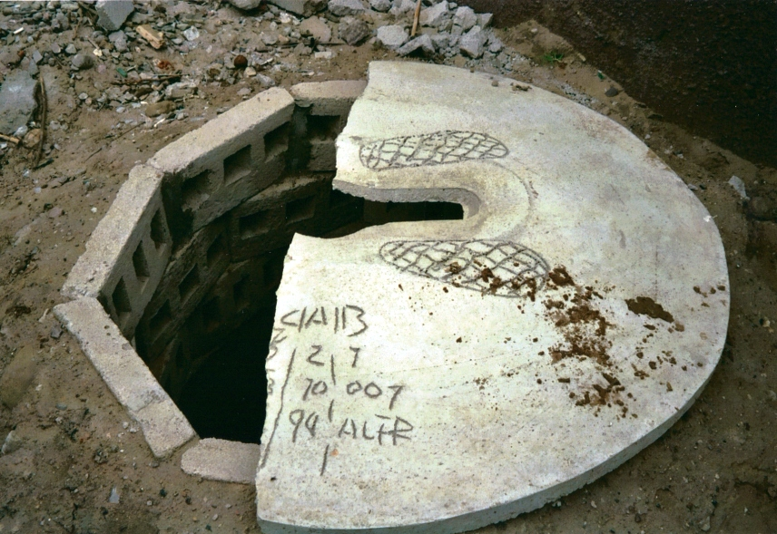
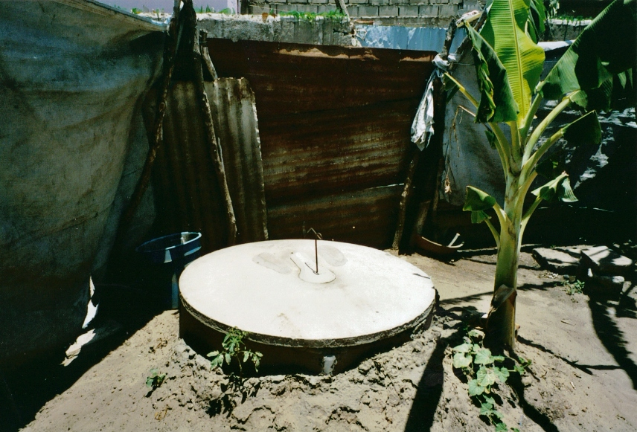
Dome Slabs
Notes:
Right hand pictures: Top – building slab, bottom - finished slab
Bottom pictures: left - Demo showing cross-section of slab and trapezoidal blocks used for pit lining; right – installed slab
Can add one or several rings of fencing/barbed wire around the outside edge for extra reinforcement (optional)

Slide 15
Why is a Dome Strong?
Activity – Strength of a Dome
What is the difference between a flat unreinforced slab and a dome slab?
Notes:
See Latrine Design and Construction Trainer Manual, Lesson Plan 12: Slab Design for activity instructions

Slide 16
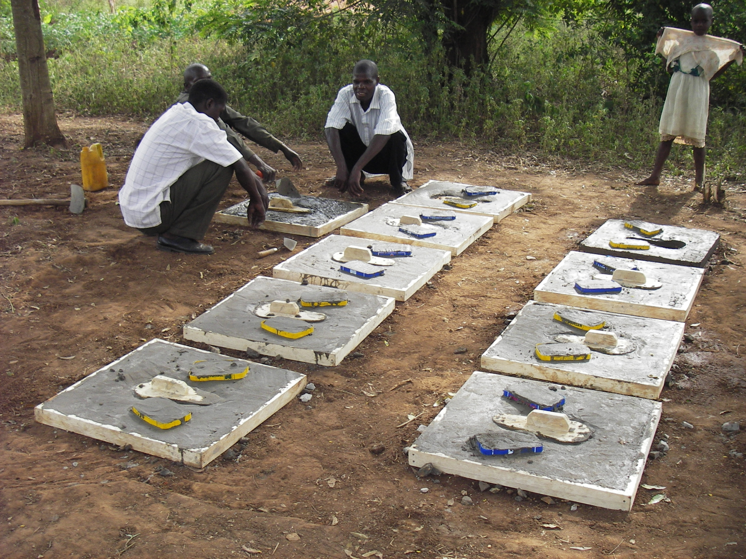
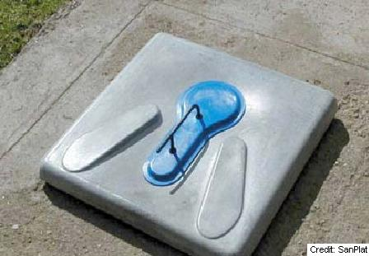
SanPlat ™
Notes:
Is not a slab because it does not span a pit and wouldn’t be able to hold normal loads without support from a slab.
Can be placed on a very simple slab of poles and earth, or planks – slab must be strong enough!!
Drop hole cover in image – commercially available from SanPlat – can be lifted on and off with the foot
Used for new latrines and upgrading of existing latrines
It is optional to place steel reinforcement placed across ends of drop hole to prevent cracking

Slide 17
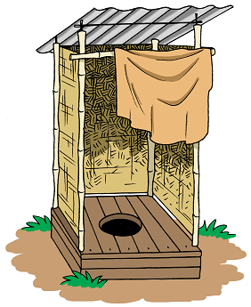
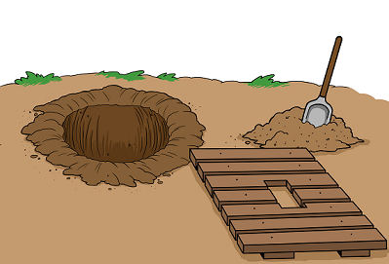
Wood Slabs
Wooden planks span pit
Notes:
Wood may be easily available or expensive locally
If deforestation is a local problem, find an alternate slab material
Must be termite resistant!!!! (or in location with no termites!)
Eventually rots and fails – make it again!

Slide 18

Pole and Earth Slabs
Wooden poles or bamboo span pit
Covered with compacted earth
Can be plastered with traditional materials or with mortar
© WEDC
© WEDC
Notes:
The compacted earth is normally the dirt from the pit excavation
Must be termite resistant!!!!
Traditional plastering materials: Mud + animal dung mix, laterite or clay can be used for plastering earth floor.
Cement mortar is easier to keep clean
Eventually rots and fails – make it again!

Slide 19
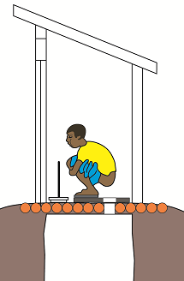
Pole and Earth Slabs
A SanPlat can be used on top of a wood or pole and earth slab to create a smooth and easy to clean squatting surface.
SanPlat placed on a wood slab
(Credit: Shaw/WEDC, 2014)

Slide 20
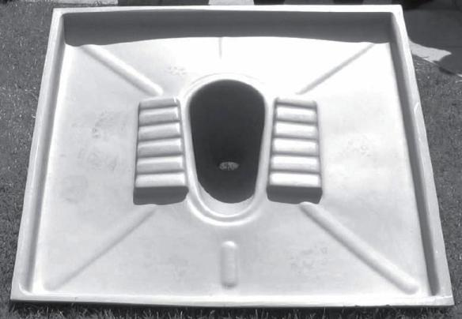
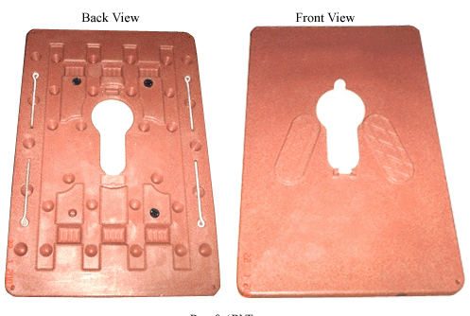
Plastic Slabs
Commonly used in emergencies
Light and easy to transport
Easy to clean
Small models require support structure; large models span the pit
Reusable, can last many years
Not as durable as concrete
Notes:
10s possibly 100s of thousands around the world
Basic drop hole and also pour flush attachments
Often reused after an emergency
People like them – shiny and modern
Self-supporting – will often at least span a trench.
Can be slabs or platforms.
Available in many countries: India, Africa
Gets expensive to span large holes.
Picture in the top right is called a Monoflex. It’s small like a SanPlat. Can be used over a trench latrine or used as platform.

Slide 21
Activity
Illustrate key design criteria for dome slabs, reinforced concrete slabs and SanPlats.

Slide 22
Draw Your Own Diagram
Reinforced Concrete Slab
65 – 80 mm thick
Minimum size 1.1 m by 1.1 m
Steel size and spacing depends on span – refer to table in Latrine Construction Manual
Concrete cover of 25 mm
Concrete mix 1 cement : 2 sand : 4 gravel
Notes:
Get the amount of steel required from standard design tables found in the Latrine Construction Manual.
If any steel is exposed to the air/moisture, it will corrode, and lead to slab failure. That is why a 25 mm concrete cover is recommended.
Concrete mix materials (i.e., sand, gravel) should be no larger than 1/3 of the thickness of the slab.

Slide 23
Draw Your Own Diagram
Dome Slab
40 mm thick
10 cm high in the middle
Size 1.1 m – 1.5 m diameter
Concrete mix 1 cement : 2 sand : 3 gravel
Notes:
You can add steel or chicken wire around the outer edge of the dome.

Slide 24
Draw Your Own Diagram
SanPlat
60 cm by 60 cm
65 mm thick
Concrete mix 1 cement : 2 sand : 3 gravel
Very smooth surface
Notes:
You can add steel rebar at the top and bottom of the keyhole if desired.

Slide 25
Discuss It
In pairs, discuss the advantages and limitations of each type of slab.

Slide 26
Reinforced Concrete Slab
Advantages | Limitations
Can use locally available materials (e.g., cement, sand, gravel) Can be made on-site Very strong Very durable Easy to clean | Relatively expensive because of the steel rebar needed

Slide 27
Concrete Dome Slab
Advantages | Limitations
Less expensive than a reinforced concrete slab for the same width Can use locally available materials Can be made on-site Strong Does not require steel rebar Relatively easy to clean | Dome floor is difficult to keep clean Spills run down the slab away from the drop hole

Slide 28
SanPlat
Advantages | Limitations
Can be created with a very smooth finish so that it is easy to clean Relatively durable People who cannot afford a concrete slab may want to install a SanPlat | Requires a supporting slab

Slide 29
Wood Slab
Advantages | Limitations
Simple to construct Can use locally available materials Can be made on-site Can be upgraded by plastering the floor with clay or earth, or installing a SanPlat Inexpensive | Limited life – wood will eventually rot (wood should be treated to slow down rot and insect attack) Wood floor is difficult to clean
Notes:
It is possible to build a safe and hygienic slab from wood or bamboo. However, these slabs may not be as rigid as concrete slab, may not last as long, or be as easy to clean. But they can be an appropriate choice in circumstances where wood or bamboo is the most affordable and easily available material.
The slab can be built from wood planks, wood poles or bamboo poles that are tied or nailed together. The wood or bamboo can be covered or plastered with earth, mud or clay. To protect it from rot or insect attack, the wood or bamboo should be treated commercially or by painting it with a preservative such as used motor oil, tar oil or house paint. Slabs should be checked frequently to check their condition. Wood or bamboo slabs may last one to two years before becoming unsafe due to rot or insects (Lifewater, 2009 and Cambodian DRHC, 2010).

Slide 30
Pole and Earth Slab
Advantages | Limitations
Simple to construct Can use locally available materials Can be made on-site Can be upgraded by plastering the floor with clay or earth, or installing a SanPlat Inexpensive | Limited life – poles will eventually rot (wood or bamboo should be treated to slow down rot and insect attack) Plastered clay or earth floor is difficult to clean

Slide 31
Plastic Slabs
Advantages | Limitations
Very easy to clean Durable Light and easy transport Good option for emergency situations | Relatively expensive if imported Small sized slabs require supporting slab Easy to steal Not as durable as concrete

Slide 32
Review
How does a slab and toilet work together?
Notes:
Explain to participants that they will now design their slab. Ask participants to turn to the Toilet section in their Sanitation System Design Workbook. Tell them they will have 10 minutes to complete the activity.
Remind participants to think about how their slab and their toilet will work together.
Encourage participants to discuss any questions or challenges with each other or with you.

