Slide 1
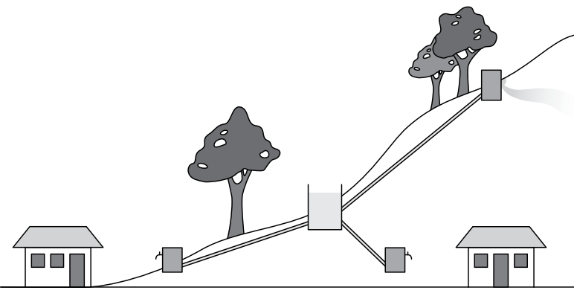
Keeping the water flowing:
Planning for the sustainability of water supply schemes
Image source: http://www.wateraidamerica.org/sites/default/files/attachments/Gravity%20fed%20schemes.pdf

Slide 2
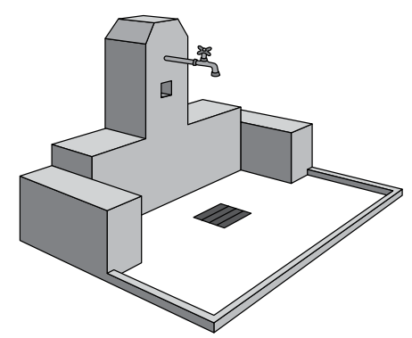
What does it mean to be sustainable?
The service is being used over time
The service functions well
It delivers an acceptable level of quality
It is well-managed
Its operation, maintenance, and replacement costs are covered
It does not affect the environment negatively
Image source: http://www.wateraidamerica.org/sites/default/files/attachments/Gravity%20fed%20schemes.pdf

Slide 3
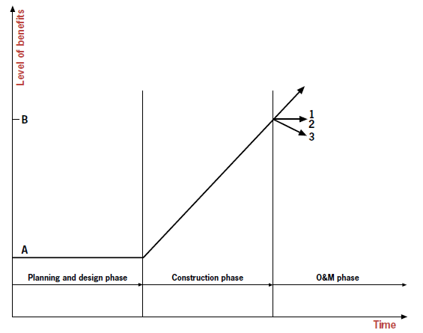
When does sustainability begin?
Source: BRIKKÈ, F. (2000): Operation and Maintenance of rural water supply and sanitation systems. A training package for managers and planners. Malta: IRC

Slide 4
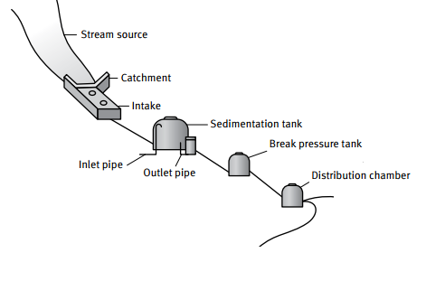
Factors influencing sustainability
Effective operation and maintenance is directly tied to sustainability of the water supply scheme. All O&M activities need to be well-managed to achieve sustainability.
Sustainability planning and activities are not secondary activities and cannot be separated from effective O&M. They are the same.
Source: BRIKKÈ, F. (2000): Operation and Maintenance of rural water supply and sanitation systems. A training package for managers and planners. Malta: IRC

Slide 5
Factors influencing sustainability
Technical factors
Financial factors
Social factors
Managerial factors
+
Environment factors
Source: BRIKKÈ, F. (2000): Operation and Maintenance of rural water supply and sanitation systems. A training package for managers and planners. Malta: IRC

Slide 6
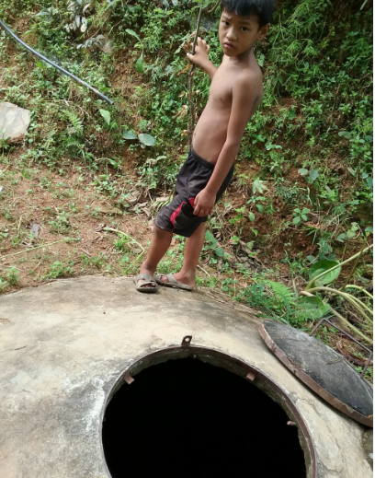
Sustainability Assessment
Assess capacity in these five areas to highlight strengths, weaknesses, and plan for improvement
Environmental factors
Social factors
Technical factors
Financial factors
Managerial factors
Image source http://www.ucc.org/disaster_nepal_quake_water_restoration

Slide 7
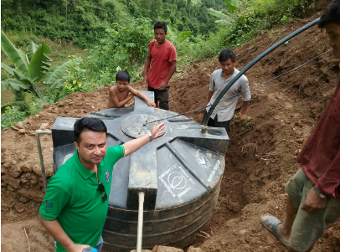
Strengths and Weaknesses
Strengths
Weaknesses
Image source http://www.ucc.org/disaster_nepal_quake_water_restoration

