Slide 2
This presentation is for use with
“Lesson Plan: Water Quality Testing”
in the Household Water Treatment and Safe Storage (HWTS) Trainer Manual
Available at resources.cawst.org

Slide 3
Water Quality Testing
2018
June

Slide 4
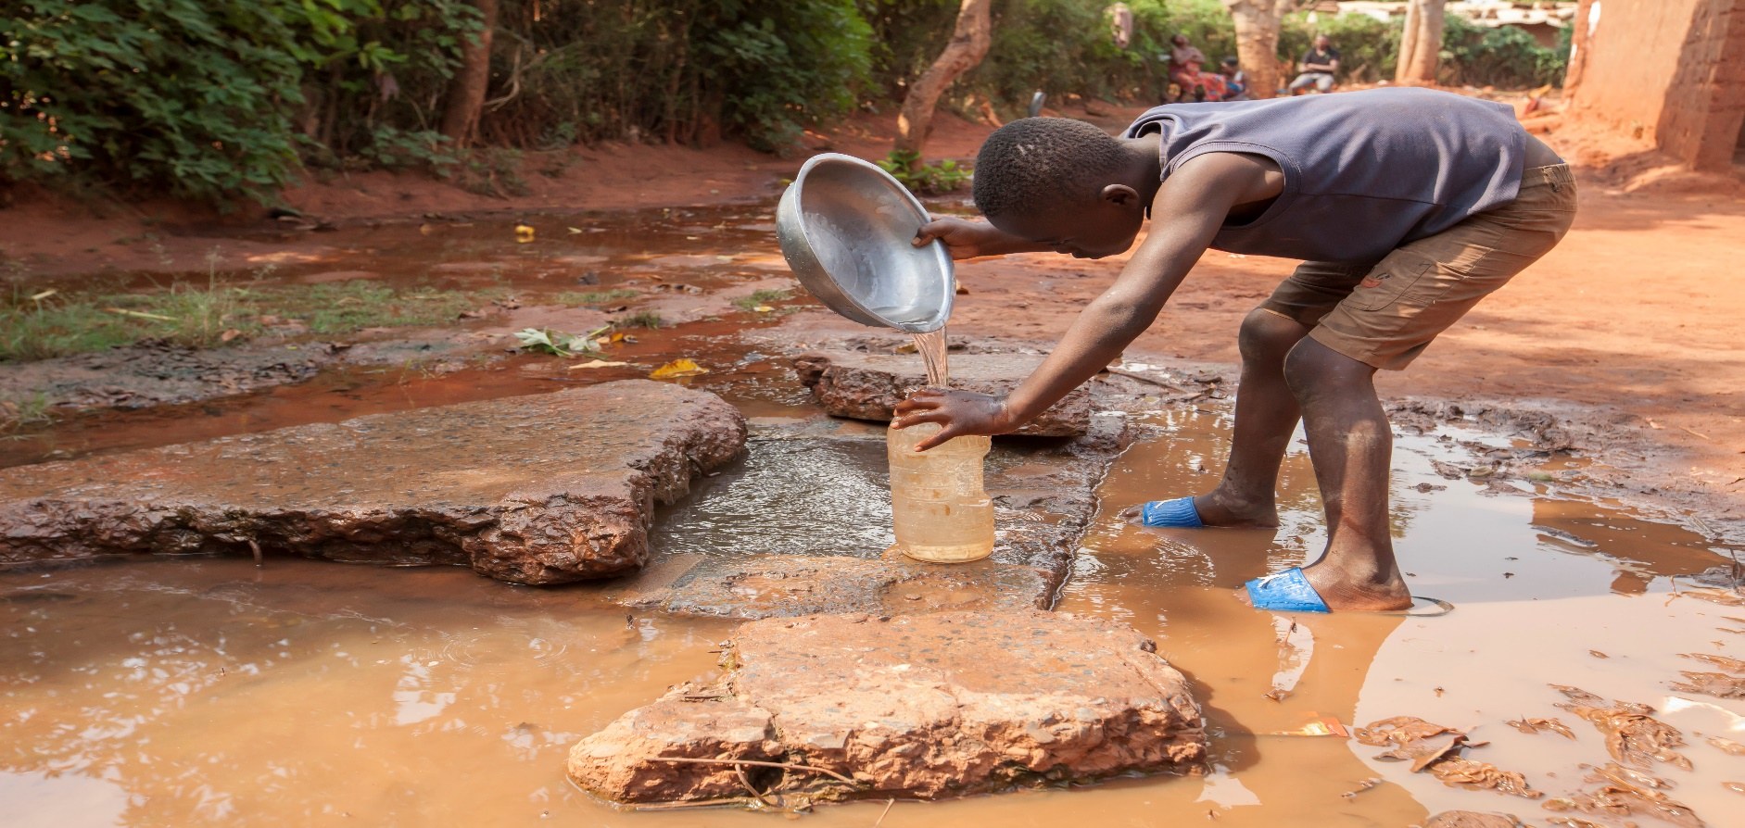
Why include water quality testing in HWTS initiatives?
Image Credit: CAWST

Slide 5
Learning Outcomes
Discuss how water quality testing contributes to successful HWTS implementation
Describe how to test for common water quality parameters
Decide which parameters to prioritize for a given scenario

Slide 6
Aspects of Drinking Water Quality
(World Health Organization, 2017)
Microbiological—Microorganisms in water
Chemical—Natural or human-made elements or compounds in water
Acceptability—Factors that influence the appearance, smell, or taste of water
Radiological—Radioactive substances from natural or human sources

Slide 7
What Is a Parameter?
In water quality, parameters are aspects of drinking water quality that can be measured and that can vary depending on factors such as season and location.
Examples: temperature, E. coli, turbidity, pH

Slide 8
Which Parameters to Test and When
Many considerations: cost, human resources and skills, equipment, risks in the region, standards or guidelines
Data you collect should support:
  Decision-making
  Accountability
  Improvement

Slide 9
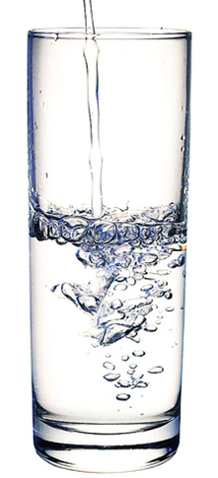
Acceptability Aspects
Affect the appearance, taste, or smell of water
Affect how consumers feel about drinking the water

Slide 10
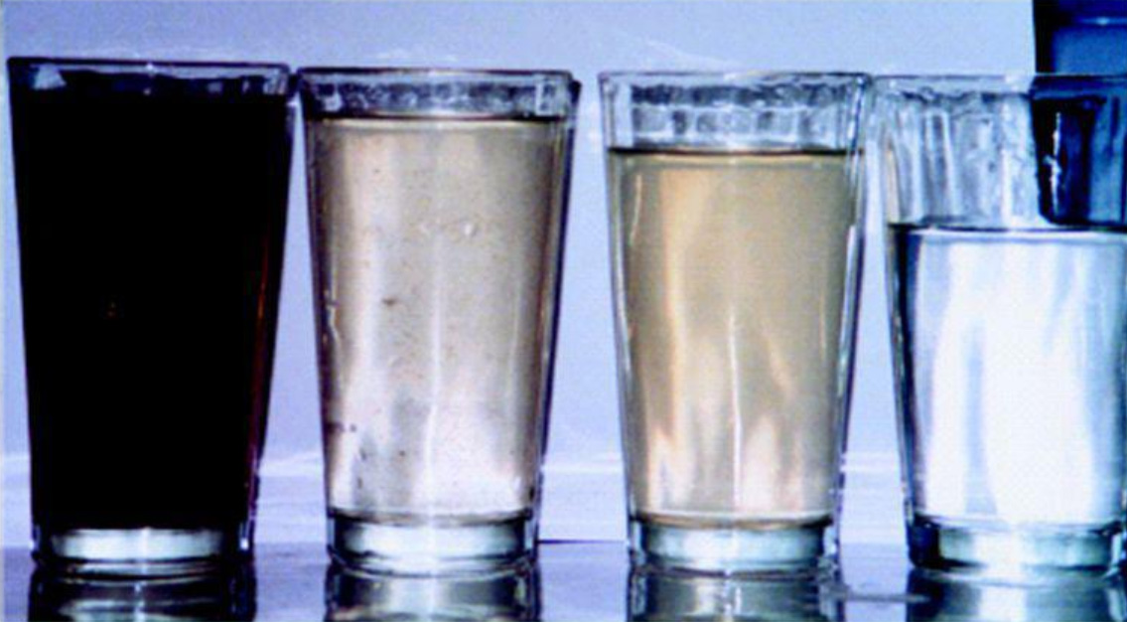
Acceptability: Turbidity
Image Credit: P & G Health Sciences Institute

Slide 11
Important Turbidity Values
Above 5 NTU: visibly cloudy
Below 1 NTU: crystal clear
1 – 5 NTU: target for household filters (WHO, 2017a, WHO 2017b)
Below 0.5 NTU: target for well-functioning municipal systems (WHO, 2017a)
Notes:
NTU = nephelometric turbidity units

Slide 12
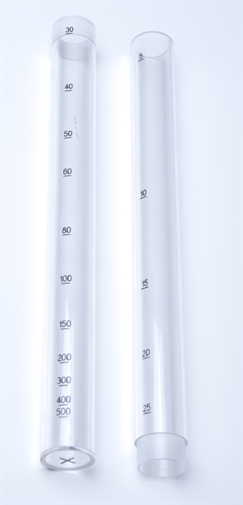
Two Part Turbidity Tube Used in a Portable Kit
Credit: Palintest, International UK
Notes:
A turbidity tube is an easy and inexpensive way to visually estimate NTU.
It is practical for field testing since it is very portable and does not need batteries or replacement parts.
A limitation is that it is harder to read levels less than 10 NTU with a turbidity tube.
How to Use a Turbidity Tube:
1. Slowly pour some water into the tube.
2. Place your head 10 to 20 centimeters directly over the tube so that you can see the disc at the bottom of the tube.
2. Keep adding water until the pattern on the disc at the bottom becomes hard to see when you look down the tube.
3. Stop pouring as soon as the pattern on the disk can no longer be seen.
4. Read the turbidity level in NTUs from the scale on the side of the tube.

Slide 13
Digital Turbidimeter
Notes:
A turbidimeter is operated by a battery or power supply and it gives the digital reading of the turbidity level.
A turbidimeter gives more accurate results, although it is more expensive and vulnerable to damage.

Slide 14
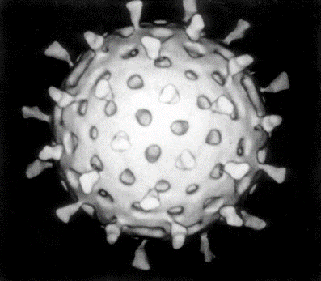
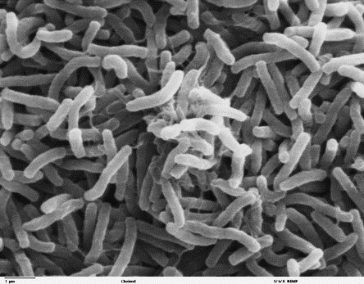
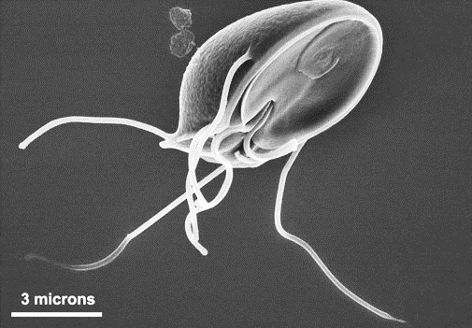
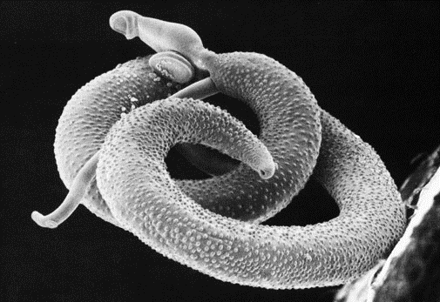
Microbiological Aspects
Virus
Bacteria
Protozoa
Helminth
Image Credit: Graham Beards
Image Credit: public domain
Image Credit: public domain
Image Credit: public domain

Slide 15
Which Microorganisms to Test For
The presence of indicator organisms indicates a likelihood of fecal contamination.
WHO Guidelines: no E. coli or thermotolerant coliforms within a 100 mL sample (WHO, 2017)
Note: No indicator bacteria does not always mean no microbiological contamination.

Slide 16
Microbiological Testing Methods
Presence-Absence (PA)
Most Probable Number (MPN)
Membrane Filtration

Slide 17
Presence-Absence
Negative
Positive for Coliforms
Positive for
E. coli
Black water is a positive result for H₂S bacteria and likely fecal contamination.
Notes:
There are different P-A tests that use total coliform and/or E. coli as the indicators. The general process for these tests is:
A powdered reagent is added to the water sample
The sample is incubated for 24-48 hours at 35ºC
The results are read: Colourless = negative, Colour = total coliforms present, Fluorescent = E. coli present (tested with a UV lamp)
There are different P-A tests using H₂S bacteria that are produced by different manufacturers. For example, in the P-A test manufactured by ENPHO in Nepal, a strip of test paper is added to a water sample. If the test paper turns black within 24 hours, it means that H₂S was produced, which means that bacteria coming from feces are likely present in the water sample.

Slide 18
Most Probable Number (MPN)
# Positive Tubes | MPN Index (CFU/100 mL)
0 | <1.1
1 | 1.1
2 | 2.2
3 | 3.6
4 | 5.1
5 | 6.9
6 | 9.2
7 | 12.0
8 | 16.1
9 | 23.0
10 | >23.0
Multiple wells in a disposable tray
(1 mL each)
Notes:
Estimates the number of indicator bacteria that is most likely to be present in the water sample.
Multiple samples (1-10 mL) of the same water to be tested are added to a culture media in sterile tubes and incubated at a particular temperature for a fixed time (usually 24 hours). Three or five tubes are commonly used, though ten tubes may be used for greater sensitivity.
Becoming more popular to use a disposable tray with multiple small wells instead of multiple tubes since it simplifies the procedure.
By counting the number of tubes or wells showing a positive result, and comparing with a standard table, a statistical estimate of the most probable number of bacteria can be made. The results are reported as MPN per 100 mL.

Slide 19
Membrane Filtration (MF)
Credit: WHO, 2007
Notes:
Most accurate and internationally recognized method
Procedure:
Filter 100 mL water sample
Add culture media to a Petri dish to provide nutrients for indicator organisms to grow
Transfer the membrane filter paper to Petri dish
Incubate for 24-48 hours
Colonies will appear on filter paper and can be counted
Results reported as colony forming units per 100 mL of water sample (CFU/100 mL)
MF has limitations, particularly when testing waters with high turbidity or large numbers of noncoliform (background) bacteria.
Turbidity caused by the presence of algae or suspended particles can clog the membrane or prevent the growth of indicator bacteria on the filter paper. Need to dilute the water sample.

Slide 20
Chemical Parameters
Arsenic
Fluoride
Nitrate and nitrite
Chlorine
Chemical parameters that affect acceptability

Slide 21
Where to Get Information About Chemicals of Concern
Government bodies
WHO
United Nations Environment Programme

Slide 22
How to Test For Chemicals
Test strips
Colour disc comparators
Colorimeters and photometers
Digital meters
Test kits

Slide 23
Test (Reagent) Strips
Designed to react with specific chemicals
Compare colour on strip to colour chart
Notes:
Advantages:
Inexpensive
Easy and simple
Limitations:
Subjective
Low accuracy +/- 10 %

Slide 24
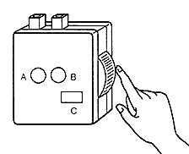
Colour Disc Comparator
Interchangeable colour discs, designed to react with specific chemicals
Notes:
Advantages:
Portable
Better accuracy
Limitations:
Need reagents
More expensive
Subjective

Slide 25
Photometers & Colorimeters
Uses light source to measure chemical concentration
Notes:
Advantages:
More accurate and repeatable results
Limitations:
More expensive
Power source required
Needs calibration
Some training required

Slide 26
Digital Meters
Notes:
Advantages:
Accurate
Portable
Easy to use
Limitations:
More expensive
Power source required
Needs calibration

Slide 27
What to Test?
(Group Work: Scenarios)
Which parameters would you measure for your scenario? When or how often?
Who would you communicate the results to, and how?
What questions or assumptions did you face when deciding?

Slide 28

Quiz

Slide 29
References
World Health Organization. (1997). Guidelines for drinking-water quality: second edition. Volume 3: Surveillance and control of community supplies. Geneva.
World Health Organization. (2017). Guidelines for drinking-water quality: fourth edition incorporating the first addendum. Retrieved from http://apps.who.int/iris/handle/10665/43428

