Slide 1
12, 2916 – 5th Avenue
Calgary, Alberta, T2A 6K4, Canada
Phone: + 1 (403) 243-3285, Fax: + 1 (403) 243-6199
E-mail: cawst@cawst.org, Website: www.cawst.org
CAWST, the Centre for Affordable Water and Sanitation Technology, is a nonprofit organization that provides training and consulting to organizations working directly with populations in developing countries who lack access to clean water and basic sanitation.
One of CAWST’s core strategies is to make knowledge about water common knowledge. This is achieved, in part, by developing and freely distributing education materials with the intent of increasing the availability of information to those who need it most.
This document is open content and licensed under the Creative Commons Attribution Works 3.0 Unported License. To view a copy of this license, visit http://creativecommons.org/licenses/by/3.0 or send a letter to Creative Commons, 171 Second Street, Suite 300, San Francisco, California 94105, USA.
You are free to:
Share – to copy, distribute and transmit this document
Remix – to adapt this document
Under the following conditions:
Attribution. You must give credit to CAWST as the original source of the document. Please include our website: www.cawst.org
CAWST will produce updated versions of this document periodically. For this reason, we do not recommend hosting this document to download from your website.
CAWST and its directors, employees, contractors, and volunteers do not assume any responsibility for and make no warranty with respect to the results that may be obtained from the use of the information provided.
Stay up-to-date and get support:
Latest updates to this document
Other workshop & training related resources
Support on using this document in your work
CAWST provides mentorship and
coaching on the use of its education
and training resources.

Slide 2
This presentation is used with Lesson Plan 13: Quality Control in the Drinking Water Quality Testing Trainer Manual.
Available at www.cawst.org/resources

Slide 3
Importance of Quality Control

Slide 4
Learning Expectations
1. Explain the importance of quality control in drinking water quality testing.
2. Describe aseptic practices, secondary contamination, and sterilization.
3. Discuss the importance of health and safety in drinking water quality testing.

Slide 5
Why Do We Need Quality Control?
Minimize errors
Ensure reliable and consistent test results

Slide 6
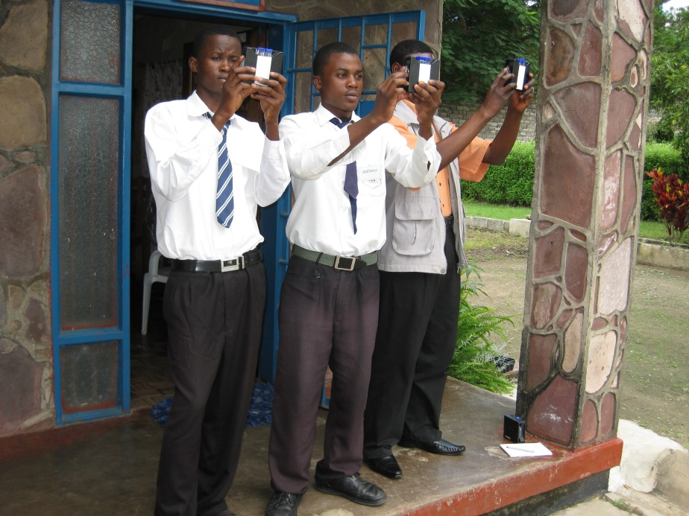
Differences in Test Results
Differences in measurement
Changes in environmental conditions (e.g., light, temperature, power supply)
Human error (e.g., doing tests while tired)
Interpretation (e.g., colour perception)
Differences in chemical quality and equipment calibration
Poor training leading to technical errors
Credit: CAWST
Notes:
Rare for the same person to get the exact same result for a repeated test.
Ask participants for reasons why we get differences in test results before showing the answers.

Slide 7
What Should be Included in a Quality Control System?
Management - staff organization, job descriptions, responsibilities
Documented standard operating procedures (SOPs)
Staff training - sampling and testing
Equipment calibration and maintenance
Checking quality of reagents and culture media
Validating test methods
Record keeping
Double checking and reporting results

Slide 8
Quality Control in Microbiological Testing
What is secondary contamination?
Contamination of a sample or equipment with bacteria from skin, hair, environment, air, etc.
Contamination from one sample to another (also called cross contamination)
Notes:
Ask participants to define secondary contamination before showing the answer.

Slide 9
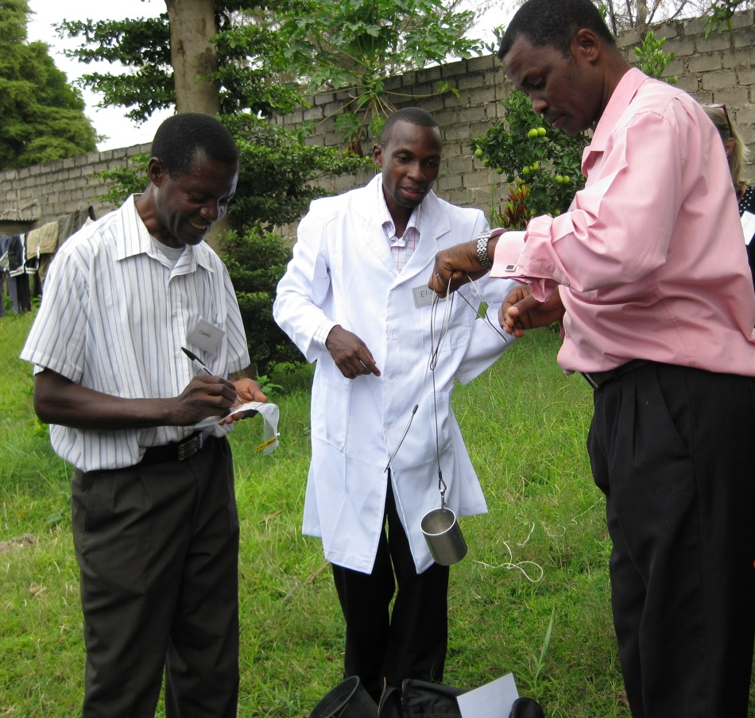
How Do We Minimize Contamination?
Use aseptic practices to:
Prevent contact with microorganisms and reduce secondary contamination
Protect the environment and people doing the testing
Credit: CAWST
Notes:
Using Aseptic techniques helps ensure valid test results, and can save time and resources by not having to repeat tests

Slide 10
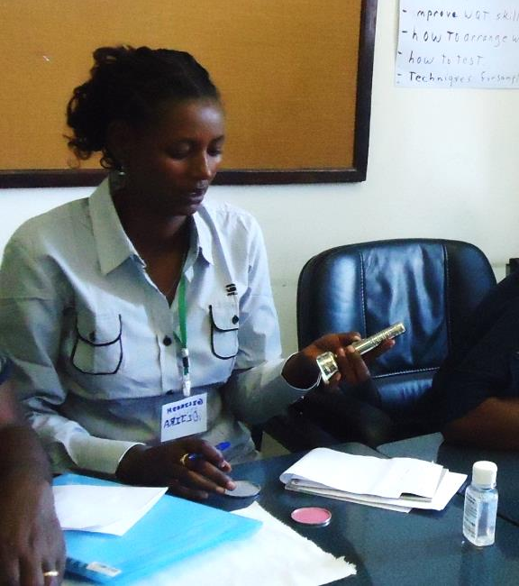
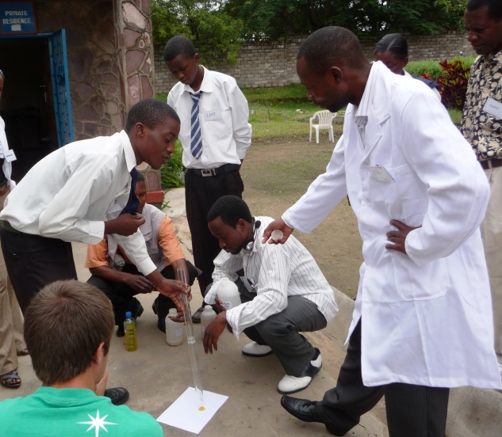
Effective Aseptic Practices
Never touch the inside of equipment
Sample containers, Petri dishes, measuring containers
Wash hands with soap and water and/or hand sanitizer
Cover cuts with waterproof plasters (band aids)
Secure loose clothing and jewelry
Wear personal protective equipment
Lab coat and eye protection
Credit: CAWST
Credit: CAWST
Notes:
Refer to Aseptic Practices handout for a complete list.
Additional Personal Preparation:
Tie back long hair
Wear rubber (latex) gloves
Remove ties, flowing sleeves, long necklaces
Roll down sleeves and button up lab coat to protect normal clothes from accidental spills
Roll down sleeves and button up lab coat to protect normal clothes from accidental spills

Slide 11
Quality Control for Microbiological Testing
If testing more than one type of sample, test least contaminated first
Filtered water (usually best quality)
Stored water
Transport water
Source water (usually worst quality)
Shake the water sample before plating
Run a blank sample using sterile water for each 10-20 test samples
Notes:
Bacteria like to clump together and stick to the sides of a sample container, shaking the sample for 10 seconds distributes them more evenly
Running blank samples verifies that culture media is sterile (also dilution/rinse water and other secondary contamination sources)

Slide 12
Sterilization
Very important for microbiological testing!
Sterilize ALL equipment between uses
Conventional oven: Heat at 180°C for 30 minutes
Boiling: Boil for 10 minutes
Autoclave: Heat at 121°C for 20 minutes
Pressure cooker: Heat for at least 30 minutes
Use a flame from a lighter to disinfect tweezers or Petri dishes
Use methanol to disinfect membrane filtration apparatus

Slide 13
Importance of Health and Safety
Project implementer responsible to provide safety equipment and training
Fire extinguishers, safety glasses, gloves, ﬁrst-aid kits, water safety and first aid training
Technician responsible to use equipment and products properly
Read safety information of chemical reagents (e.g., arsenic, methanol)
Safely dispose of samples and waste
Notes:
Safety equipment should be routinely checked and all staff should be trained in their use.
It is also important to make sure that everyone knows who to call in an emergency.
During water sampling, a basic first-aid kit should be carried at all times, and should not be left in the transport vehicle if staff need to move far away from it.
Samples and any waste generated during testing may contain pathogens or chemicals that may be harmful to health and must be properly and safely disposed

