Slide 1




424 Aviation Road NE
Calgary, Alberta, T2E 8H6, Canada
Phone: + 1 (403) 243-3285, Fax: + 1 (403) 243-6199
E-mail: resources@cawst.org, Website: www.cawst.org
CAWST, the Centre for Affordable Water and Sanitation Technology, is a nonprofit organization that provides training and consulting to organizations working directly with populations in developing countries who lack access to clean water and basic sanitation.
One of CAWST’s core strategies is to make knowledge about water common knowledge. This is achieved, in part, by developing and freely distributing education materials with the intent of increasing the availability of information to those who need it most.
This document is open content and licensed under the Creative Commons Attribution Works 3.0 Unported License. To view a copy of this license, visit http://creativecommons.org/licenses/by/3.0 or send a letter to Creative Commons, 171 Second Street, Suite 300, San Francisco, California 94105, USA.
You are free to:
        Share – to copy, distribute and transmit this document
        Remix – to adapt this document
Under the following conditions:
        Attribution. You must give credit to CAWST as the original source of the document. Please include our website: www.cawst.org
CAWST will produce updated versions of this document periodically. For this reason, we do not recommend hosting this document to download from your website.
CAWST and its directors, employees, contractors, and volunteers do not assume any responsibility for and make no warranty with respect to the results that may be obtained from the use of the information provided.
Stay up-to-date and get support:
            Latest updates to this document
            Other workshop & training related resources
            Support on using this document in your work
CAWST provides mentorship and
coaching on the use of its education
and training resources.

Slide 2

This presentation is used with Lesson Plan 15: Domestic Wastewater in the Introduction to Environmental Sanitation Trainer Manual.
Available at www.cawst.org/resources

Slide 3

Domestic Wastewater Management

Slide 4
Learning Outcomes
List the three components of domestic wastewater: blackwater, greywater and overflow water.
Discuss the importance of properly managing greywater and overflow water.
Identify management options for greywater.
Identify management options for overflow water.

Slide 5
Why is it Important?
Notes:
Managing greywater and overflow water is essential to protect public health and prevent environmental contamination. However, greywater and overflow water have traditionally received little attention. Pathogens can spread quickly through the environment when greywater and overflow water are poorly managed. For instance, standing water can:
• Spread pathogens that cause disease (like schistosomiasis)
• Breed disease vectors (like mosquitos that transmit dengue fever, Japanese encephalitis, West Nile fever and malaria)
• Enter a water point, like a well or tap stand, and contaminate the water source
• Become stagnant and cause bad smells that make the local environmental unpleasant for those living in the area
Poor drainage can also cause more frequent and severe flooding, spreading contamination. In some places, waterborne disease outbreaks can be reduced through better domestic wastewater management.

Slide 6
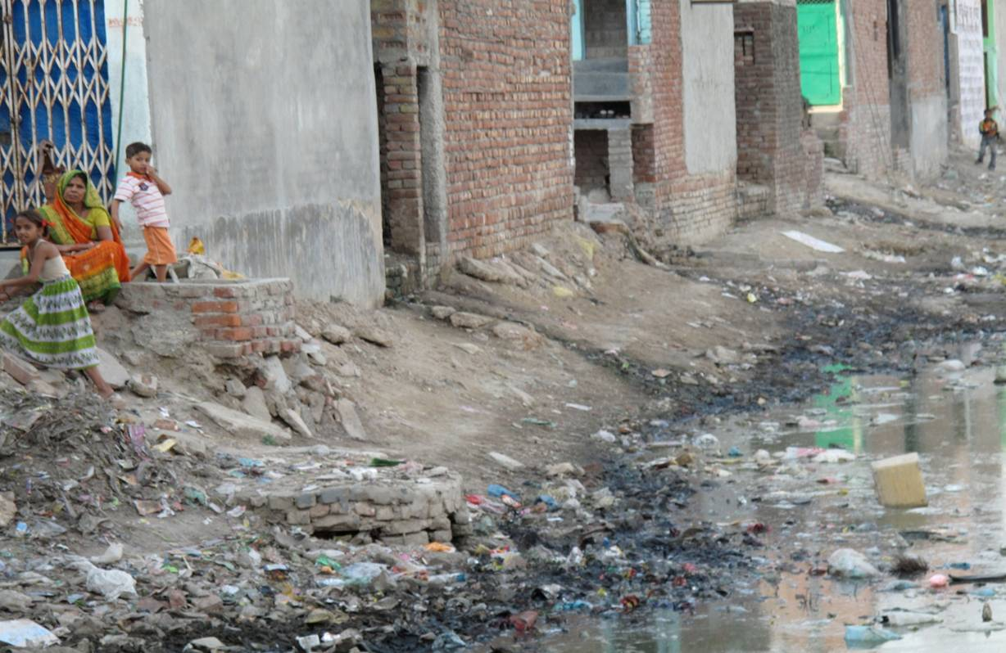
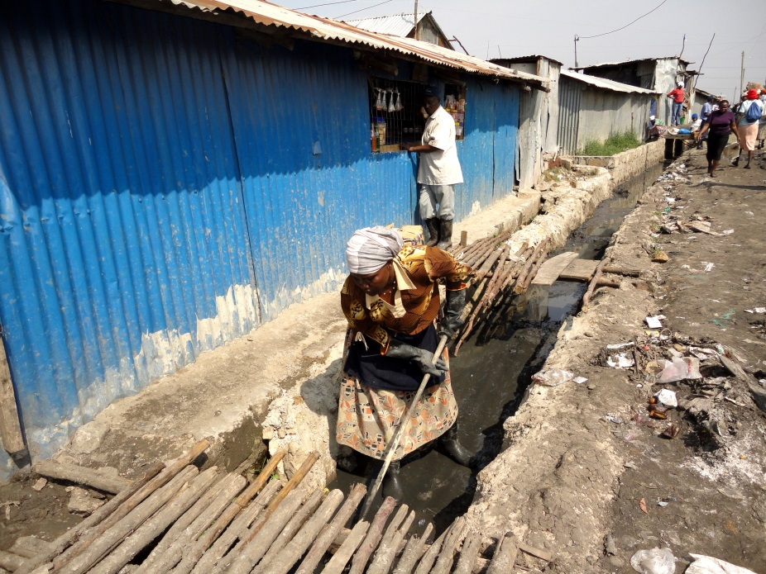
Discharge to a Drainage System
Notes:
In urban and peri-urban areas of low and middle-income countries, greywater is most often discharged untreated into drains or sewers (provided they exist). This water then flows into surface water body, like a lake, river or ocean. This can lead to oxygen depletion, increased turbidity, and microbiological and chemical contamination of surface water.
But in many places, drainage channels become dumps for household waste. Channels must be kept clean of waste to prevent them from blocking water flow and causing additional flooding. See CAWST’s Technical Brief: Solid Waste Management for further information on how to properly dispose of solid waste.

Slide 7
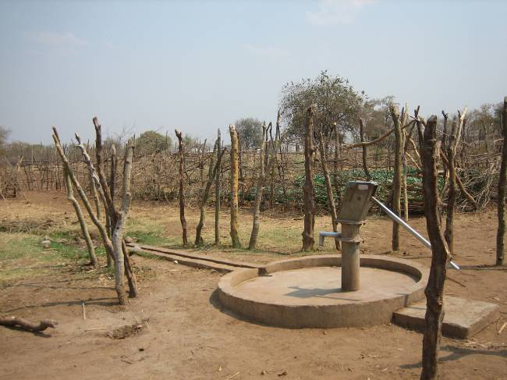
Water for Irrigation
Notes:
Overflow water and greywater can be used for irrigation.
Overflow water from a pump or tapstand can go directly to irrigation.
Greywater should be first treated. As a minimum, pass through a grease trap to get rid of pathogens, soap, oils and other residues that might harm plants before being used for irrigation. Needs to meet WHO Guidelines for Greywater Use in Agriculture (2006).
The image shows: Drainage from hand pump to a garden, Zambia, and a small irrigation channel for a field

Slide 8
Grease Trap
Legend
Removable cover(s).
Watertight casing.
Inlet elbow, 90°.
Outlet tee.
Floating fats and scum
Settled solids
Notes:
A grease trap acts like a small septic tank. Greywater flows into the trap where oils, fats and soap scum float to the surface and gravity settles heavier suspended solids to the bottom. Relatively clean water then flows out of the grease trap.
It is important to install a grease trap before infiltrating greywater into the ground, reusing it in agriculture, or discharging it to drainage channels. This lowers the risk of clogging the soak pit or infiltration trench and reduces the potential amount of contamination entering the drainage systems.
Can be made from local materials:
-concrete
-plastered brick
-plastered concrete blocks
-reused oil drums
Requires regular cleaning to remove accumulated materials at the inlet and settled solids at the bottom. This will help prevent bad smells. Solid waste should be properly disposed.
Cleaning grease traps can be an unpleasant job. Encourage people to use gloves and to wash their hands with soap afterwards.

Slide 9
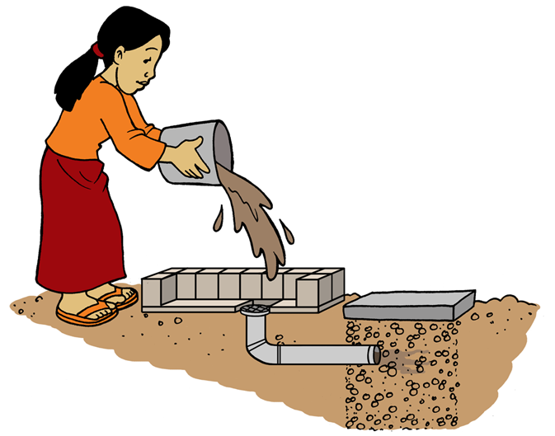
Soak Pit for Disposal
Accessible
Grease Trap
Notes:
A soak pit is a dug pit that allows wastewater to be safely infiltrated into the ground.

Slide 10
Soak Pit
Notes:
Pits must be lined or filled with rocks to prevent erosion and to prevent the walls from collapsing.
The simplest and quickest way to build a soak pit is to dig a pit and fill it with rocks. However, the rocks reduce the volume of wastewater that the pit can hold and finding enough rock may be difficult in some places.
The size of the soak pit is based on the amount of wastewater entering the pit and whether the water is clean or dirty. Infiltration only happens through the side walls of the soak pit. Almost no infiltration occurs through the base of the pit because it quickly clogs with solids. It is important to design the size of the soak pit to handle peak flows of wastewater, especially if the infiltration capacity of the surrounding soil is low.

Slide 11
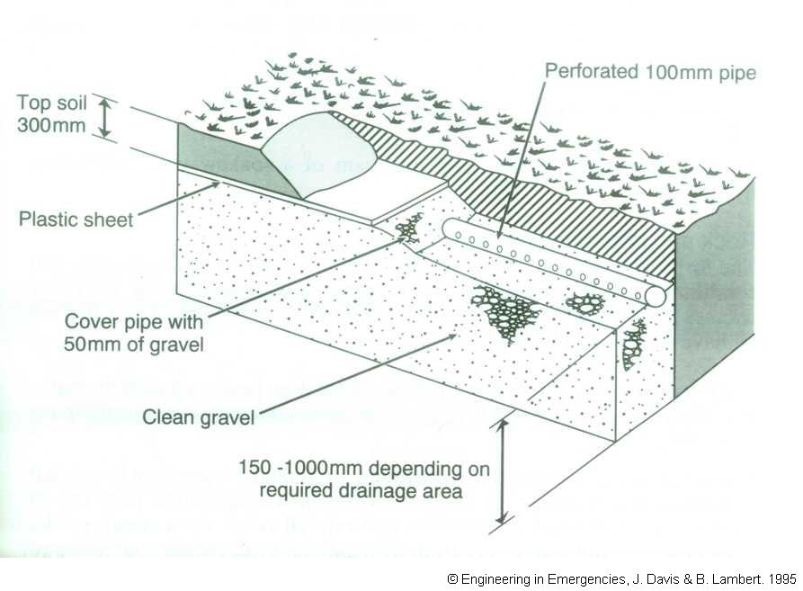
Infiltration Trench
Notes:
Trenches can be used in situations where a soak pit is unable to infiltrate the total amount of wastewater. This can be either because of low soil infiltration capacity, large amounts of wastewater or a combination of the two.
Infiltration trenches are long shallow pits. They require more planning, space and materials than a soak pit, but create a much greater surface area for infiltration into the soil. Infiltration trenches are often used in conjunction with septic tanks.

Slide 12
Review
A tell B: What is blackwater and where does it come from?
B tell A: What is greywater and where does it come from?
A tell B: What is overflow water and where does it come from?
A tell B: What are options to manage greywater?
B tell A: What are options to manage overflow water?
Notes:
Use Tool: A Tell B for the review activity.

