Slide 1
424 Aviation Road NE
Calgary, Alberta, T2E 8H6, Canada
Phone: + 1 (403) 243-3285, Fax: + 1 (403) 243-6199
E-mail: resources@cawst.org, Website: www.cawst.org
CAWST, the Centre for Affordable Water and Sanitation Technology, is a nonprofit organization that provides training and consulting to organizations working directly with populations in developing countries who lack access to clean water and basic sanitation.
One of CAWST’s core strategies is to make knowledge about water common knowledge. This is achieved, in part, by developing and freely distributing education materials with the intent of increasing the availability of information to those who need it most.
This document is open content and licensed under the Creative Commons Attribution Works 3.0 Unported License. To view a copy of this license, visit http://creativecommons.org/licenses/by/3.0 or send a letter to Creative Commons, 171 Second Street, Suite 300, San Francisco, California 94105, USA.
You are free to:
Share – to copy, distribute and transmit this document
Remix – to adapt this document
Under the following conditions:
Attribution. You must give credit to CAWST as the original source of the document. Please include our website: www.cawst.org
CAWST will produce updated versions of this document periodically. For this reason, we do not recommend hosting this document to download from your website.
CAWST and its directors, employees, contractors, and volunteers do not assume any responsibility for and make no warranty with respect to the results that may be obtained from the use of the information provided.
Stay up-to-date and get support:
Latest updates to this document
Other workshop & training related resources
Support on using this document in your work
CAWST provides mentorship and
coaching on the use of its education
and training resources.

Slide 2
This presentation is used with Lesson Plan 22: Treatment, Use and Disposal in the Latrine Design and Construction Trainer Manual.
Available at www.cawst.org/resources

Slide 3
Excreta Treatment, Use and Disposal

Slide 4
Learning Outcomes
Discuss the value of using treated excreta in agriculture.
Discuss the importance of treating excreta before using it.
Identify latrine technologies that can treat excreta.
Discuss the social acceptance of using human excreta.
Identify how to safely dispose of excreta not intended for use.

Slide 5
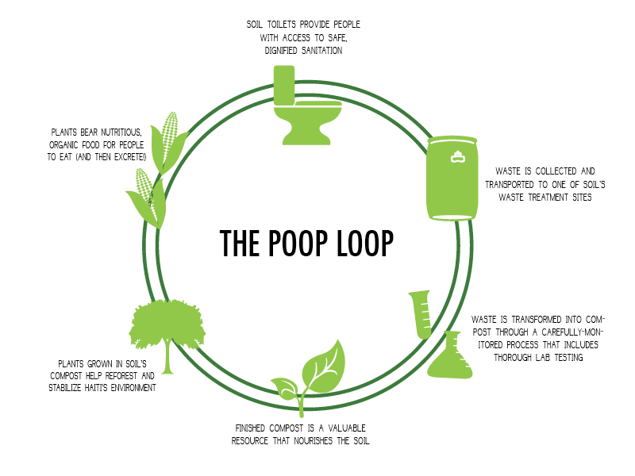
SOIL – Haiti
(Credit: SOIL)
Notes:
Since 2006, SOIL has been transforming waste into resources in Haiti where over 75% of the population lacks access to safe sanitation. There are numerous challenges for building latrines in Haiti, such as extensive soil erosion and deforestation which cause periodic and severe flooding during heavy rains; densely populated communities with little space to dig pit latrines; and a catastrophic earthquake in 2010 which severely damaged or destroyed many communities.
SOIL has been working to create a social business model for providing access to safe, dignified sanitation. Customers pay about US$5 per month for a locally-made toilet with a removable container in their home. The toilet is serviced by SOIL each week. The service includes removing the full waste container and replacing it with an empty sanitized one, as well as replenishing a supply of cover material (helps reduce smells, flies, and improves the sludge properties for composting later).
After collecting the full containers, SOIL transports the waste to their compost sites. Through a carefully monitored process, the waste is transformed into nutrient-rich compost. SOIL then sells the compost for use in agriculture and reforestation projects, providing an environmentally-friendly alternative to chemical fertilizers while generating revenue to support the provision of sanitation services.

Slide 6
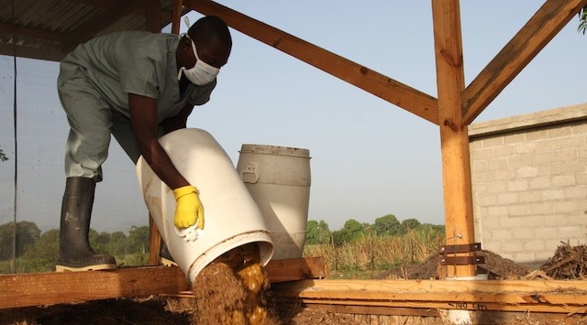
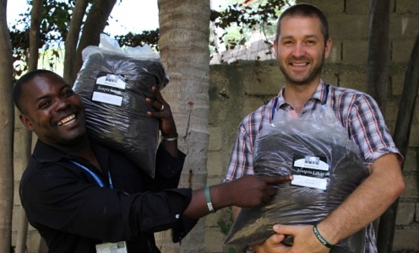
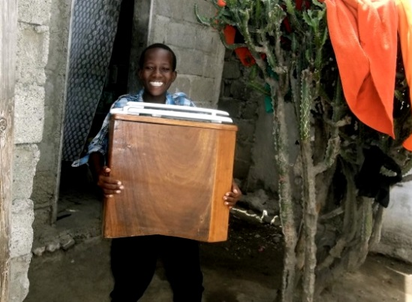
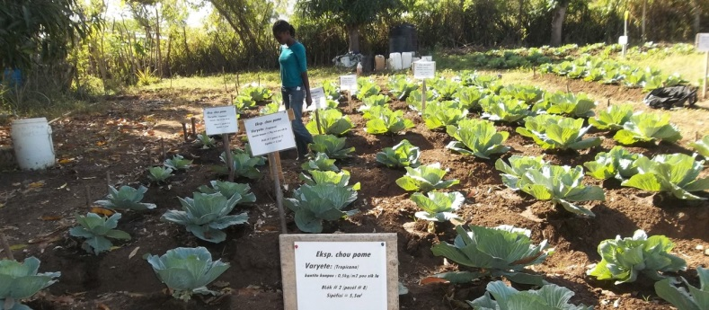
SOIL – Haiti
Dignified Sanitation
Waste Transformation
Agricultural Growth
Notes:
+ 3,500 people accessing SOIL EcoSan toilets through SOIL's growing EkoLakay social business pilot + 240,000 gallons of waste treated each year + 75,000 gallons of compost sold for agricultural and reforestation efforts around Haiti + 10,000 people benefiting from SOIL’s education programs and resources each year

Slide 7
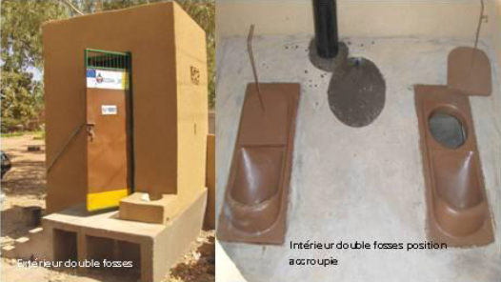
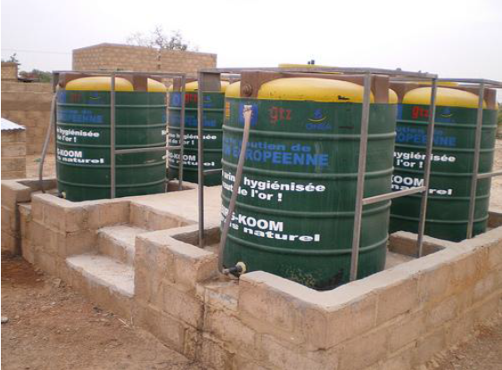
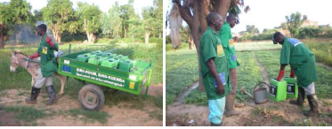
Urine Diversion – Burkina Faso
(Credit: www.flickr.com/photos/gtzecosan/)
Notes:
German Technical Cooperation (GTZ), West African Centre for Low Cost Water Supply and Sanitation (CREPA) and National Office for Water Supply and Sanitation (ONEA)
1000 Dehydrating latrines were built
5 “eco-stations” were built ran by a separate association
National Water Laboratory analyzed samples to make sure the products were safe to apply
To increase acceptance they gave sanitized urine as “liquid fertilizer” and dried feces as “solid fertilizer”
Having witnessed the crop yields using natural fertilizer, farmers are willing to pay for these products.

Slide 8
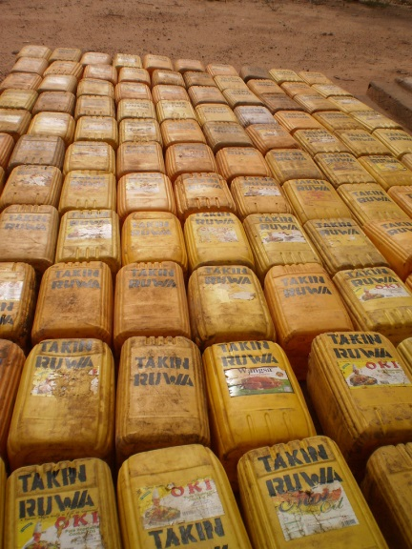
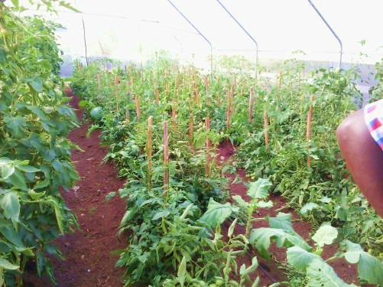
Other Global Examples
Commercial tomato growing - Uganda
Aguie Project - Niger
(Credit: www.flickr.com/photos/gtzecosan/)

Slide 9
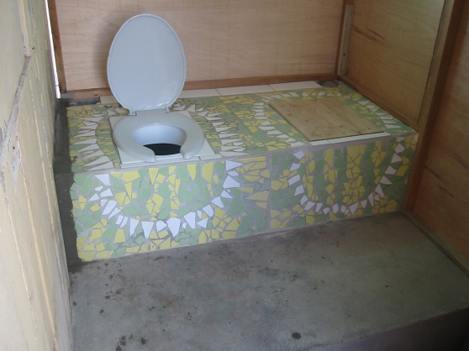
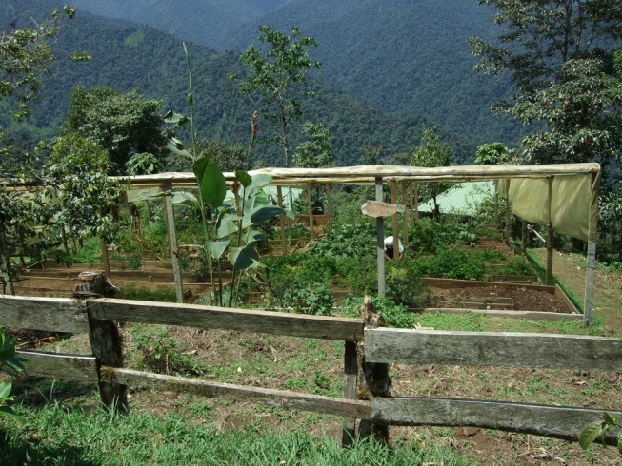
Other Global Examples
Urine diverting dehydrating toilet - Peru
Organic Farm - Ecuador
(Credit: www.flickr.com/photos/gtzecosan/)

Slide 10
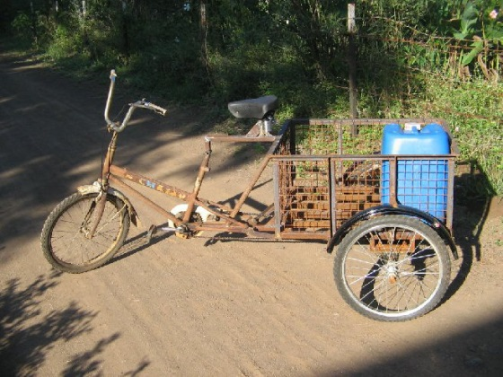
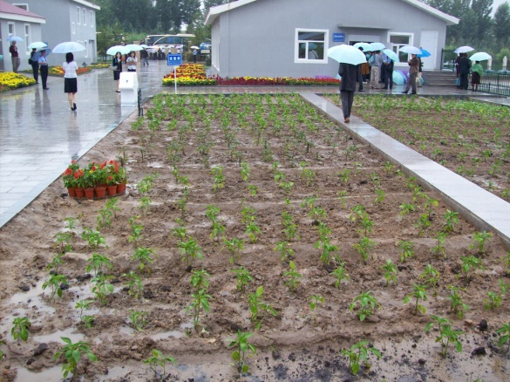
Other Global Examples
Urine Tricycle - India
Urban agriculture in Ecotown - China
(Credit: www.flickr.com/photos/gtzecosan/)

