Slide 1

12, 2916 – 5th Avenue
Calgary, Alberta, T2A 6K4, Canada
Phone: + 1 (403) 243-3285, Fax: + 1 (403) 243-6199
E-mail: cawst@cawst.org, Website: www.cawst.org
CAWST is a Canadian non-profit organization focused on the principle that clean water changes lives. Safe water and basic sanitation are fundamentals necessary to empower the world’s poorest people and break the cycle of poverty. CAWST believes that the place to start is to teach people the skills they need to have safe water in their homes.
CAWST transfers knowledge and skills to organizations and individuals in developing countries through education, training and consulting services. This ever expanding network can motivate individual households to take action to meet their own water and sanitation needs.
One of CAWST’s core strategies is to make knowledge about water common knowledge. This is achieved, in part, by developing and freely distributing education materials with the intent of increasing its availability to those who need it most. You should feel free to copy and distribute this document in any form, printed or electronic. If you wish to use any parts of this document in the creation of your own materials, please ensure that CAWST is properly acknowledged. Please include our website address: www.cawst.org.
Feel free to include a link from your website to the CAWST website. Please do not host this document to download from your website as we will have updated versions from time to time. Please email us if you have any questions or feedback.
This document is open content and licensed under the Creative Commons Attribution Works 3.0 Unported License. To view a copy of this license, visit: http://creativecommons.org/licenses/by/3.0
You are free to:
Share – to copy, distribute and transmit this document
Remix – to adapt this document
Under the following conditions:
Attribution. You must give credit to CAWST as the original source of the document
CAWST and its directors, employees, contractors, and volunteers do not assume any responsibility for and make no warranty with respect to the results that may be obtained from the use of the information provided.

Slide 2

Household Water Treatment for Vulnerable Populations

Slide 3

Learning Expectations
Impact of diarrheal diseases on vulnerable populations
The importance of safe water for vulnerable populations
The importance of the multi-barrier approach for vulnerable populations

Slide 4
Learning Expectations #1
Impact of diarrheal diseases on vulnerable populations
  Elderly
  Infants and Children
  Sick (e.g. people living with HIV/AIDS)

Slide 5
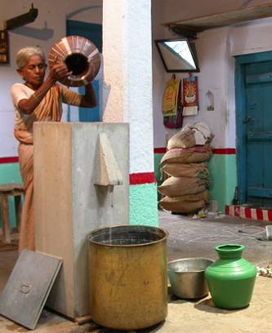
Elderly

Slide 6
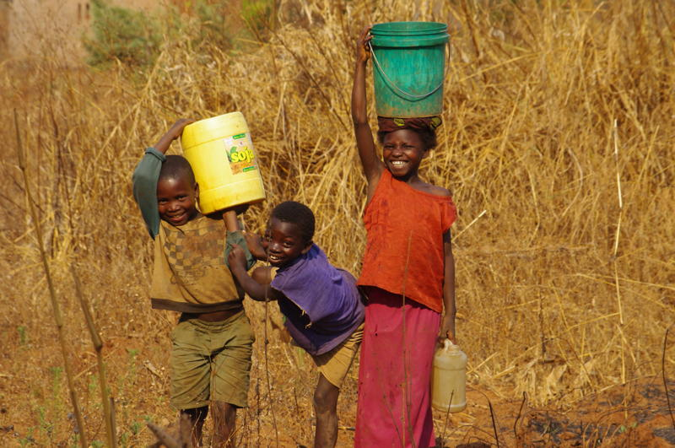
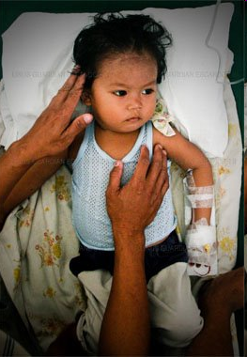
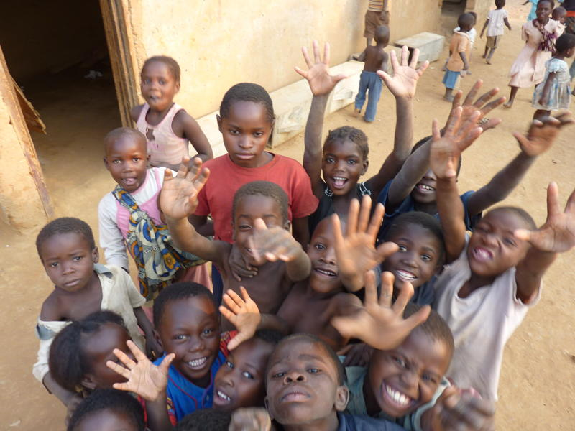
Infants and Children
Greg Hamer –
SHIP volunteer
mtxtremist.blogspot.com
Heidi Fuller - CAWST

Slide 7
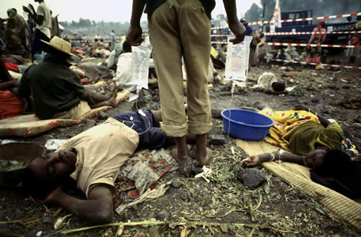
Sick
Connect.in.com

Slide 8
Elderly and Children
Ability to fight disease or strength of immune system
Elderly – reduced = more vulnerable
Children – under-developed = more vulnerable
Notes:
Elderly: Reduced ability to fight infection and disease so are more vulnerable when exposed. This is due to a reduction in T cell response to infection and disease. (CD4 cells are one type of T cell)
“Much of the decrease in immunoresponsiveness seen in elderly populations is associated with changes in T cell responses…. The loss of effective immune activity is largely due to alterations within the T cell compartment ”
Source: The immune system in the elderly: II. Specific cellular immunity. Ginaldi, L. et al.
Found at: http://www.ncbi.nlm.nih.gov/pubmed/10580636
Children: Under-developed ability to fight infection and disease so are more vulnerable when exposed.
“The growth and development of the lymphocytes, a type of white blood cell vital to the immune system [are not complete in children]…This system protects the body against microorganisms and germs. Children's immune systems aren't fully developed until the age of 14.”
Source: About Children's Immune Systems | eHow.com http://www.ehow.com/about_4597764_childrens-immune-systems.html#ixzz16P6tk2ZQ

Slide 9
People Living with HIV/AIDS
For HIV virus, CD4 cells are the host for the virus replicate and invade
Decrease in CD4 count in the blood = more vulnerable
Notes:
CD4 cells are one type of cell in the body that is available to fight disease. In the case of HIV, CD4 cells are the host cell for the virus to replicate and invade the body. Over time the CD4 count in the body decreases as the virus continues to infect the cells. This reduces the strength of the infected person’s immune system. The infected person becomes increasingly sick and more vulnerable to other diseases.
Source: http://aids.about.com/od/newlydiagnosed/qt/cd4.htm

Slide 10
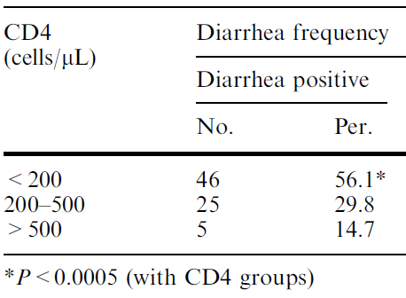
(Sadraei et al., 2005. CD4+ Cell Counts and Opportunistic Protozoa in Indian HIV-Infected Patients. Parasitol Res 97: 270–273)
Notes:
A healthy immune system has 600-1200 CD4 cells per microliter (cells/μL).
If an individual is HIV+, a CD4 count of 350-600 is still okay.
From 200-350, the individual is at risk for infection and disease.
Less than 200, the individual is at a much greater risk for infection and disease.
Source: http://aids.about.com/od/newlydiagnosed/qt/cd4.htm
The study above shows that:
From 500 count to 500-200 count the percentage of people with diarrhea doubles.
From 200-500 count to 200 count, the number of people with diarrhea doubles again.
Conclusion: Individuals with low CD4 counts or weak immune systems, like the sick, elderly and children, are more vulnerable to diarrheal diseases

Slide 11
Death Rates 20,000 HIV+ Adults Uganda
Notes:
Of 20,000 deaths of due to HIV/AIDS, 7 in 10 people had diarrhea.

Slide 12
Review
Discuss why diarrheal diseases have a significant impact on vulnerable populations

Slide 13
Learning Expectation #2
The importance of safe water for vulnerable populations

Slide 14
Pictures kids holding glass of water

Slide 15
Safe Water and PLWHA
“HIV-positive patients without access to clean water are at risk for a variety of common and opportunistic pathogens. “
(Partners in Health, 2006. PIH Guide to the Community-Based Treatment of HIV in Resource-Poor Settings, Second Edition)

Slide 16
Safe Water & Anti-Retrovirals
“Access to safe water is essential for PLWHA, as this allows patients to take their drugs and avoid diarrheal diseases that reduce drug absorption.”
(WHO, 2008. Essential Prevention and Care Interventions for Adults and Adolescents Living with HIV in Resource-limited Settings)

Slide 17
Diarrhea and ARV Absorption
Level of ARV Drug in Blood
(Brantley et al., 2003. British Journal of Infectious Diseases
Notes:
Anti-retroviral drugs (ARV) prevent HIV replication, strengthens immunity, and decreases vulnerability to other diseases
Anti-retroviral drugs (ARV) are better absorbed if patients use safe drinking water

Slide 18
Review
Discuss the importance of safe water for vulnerable populations

Slide 19
Learning Expectation #3
The importance of the multi-barrier approach for vulnerable populations

Slide 20
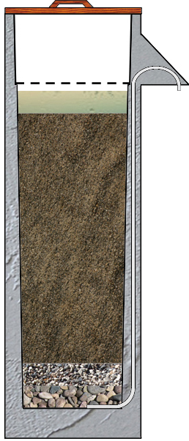
Multi-Barrier Approach to Safe Water
Household Water Treatment
Source Protection
Sedimentation
Filtration
Disinfection
Safe Storage
Each step provides an incremental reduction in the risk to health.
Notes:
Using the multi-barrier approach is the best way to reduce the risk of drinking unsafe water.
Each step in the process, from source protection, to water treatment and safe storage, provides an incremental health risk reduction.

Slide 21
Pathogen Resistance to Chlorine
Most bacteria
Viruses
Mycobacteria
Protozoa
  Giardia
  Cryptosporidium
Least
Most
(Adapted from Sobsey, UNC)

Slide 22
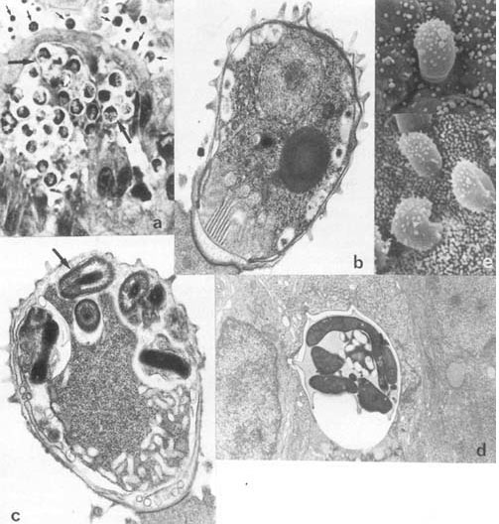
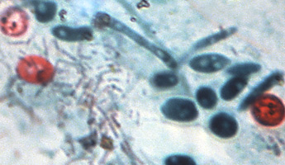
Cryptosporidium
ecdc.europa.eu
examiner.com

Slide 23
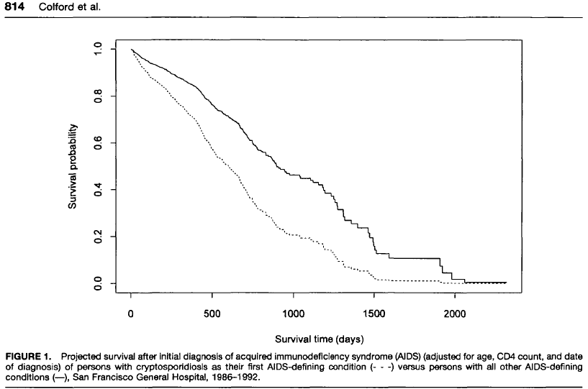
% Survival of AIDS Patients and Cryptosporidium
Without Cryptosporidiosis
With Cryptosporidiosis
(Colford et al.)
Notes:
Survival rates of AIDS patients with and without the disease caused by Cryptosporidium.
Cryptosporidium is one of the pathogens resistant to chlorine.

Slide 24
Review
Discuss why the multi-barrier approach to safe water is so important for vulnerable populations
Notes:
Using all barriers reduces the chance that treatment resistant pathogens are removed from the water.

Slide 25
Learning Expectations
Impact of diarrheal diseases on vulnerable populations
The importance of safe water for vulnerable populations
The importance of the multi-barrier approach for vulnerable populations

Slide 26
Any Questions?

