Slide 1
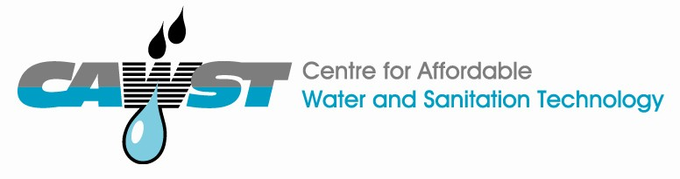



12, 2916 – 5th Avenue
Calgary, Alberta, T2A 6K4, Canada
Phone: + 1 (403) 243-3285, Fax: + 1 (403) 243-6199
E-mail: cawst@cawst.org, Website: www.cawst.org
CAWST, the Centre for Affordable Water and Sanitation Technology, is a nonprofit organization that provides training and consulting to organizations working directly with populations in developing countries who lack access to clean water and basic sanitation.
One of CAWST’s core strategies is to make knowledge about water common knowledge. This is achieved, in part, by developing and freely distributing education materials with the intent of increasing the availability of information to those who need it most.
This document is open content and licensed under the Creative Commons Attribution Works 3.0 Unported License. To view a copy of this license, visit http://creativecommons.org/licenses/by/3.0 or send a letter to Creative Commons, 171 Second Street, Suite 300, San Francisco, California 94105, USA.
You are free to:
        Share – to copy, distribute and transmit this document
        Remix – to adapt this document
Under the following conditions:
        Attribution. You must give credit to CAWST as the original source of the document. Please include our website: www.cawst.org
CAWST will produce updated versions of this document periodically. For this reason, we do not recommend hosting this document to download from your website.
CAWST and its directors, employees, contractors, and volunteers do not assume any responsibility for and make no warranty with respect to the results that may be obtained from the use of the information provided.
Stay up-to-date and get support:
            Latest updates to this document
            Other workshop & training related resources
            Support on using this document in your work
CAWST provides mentorship and
coaching on the use of its education
and training resources.

Slide 2

This presentation is used with Lesson Plan 6: Multi-Barrier Approach in the Biosand Filter for Project Implementers Trainer Manual.
Available at www.cawst.org/resources

Slide 3

The Multi-Barrier Approach to Safe Drinking Water

Slide 4
Learning Expectations
List and describe the five steps in the multi-barrier approach to safe drinking water.

Slide 5
The Multi-Barrier Approach to Safe Drinking Water
There are 5 steps to get safe drinking water. The 5 steps are called the Multi-Barrier Approach to Safe Drinking Water.
Doing 1 step will make your water safer to drink. But doing all 5 steps will get the safest water.

Slide 6
The Multi-Barrier Approach to Safe Drinking Water
The 5 steps are:
1. Protect your source water
2. Sediment your water
3. Filter your water
4. Disinfect your water
5. Store your water safely

Slide 7
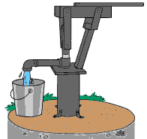
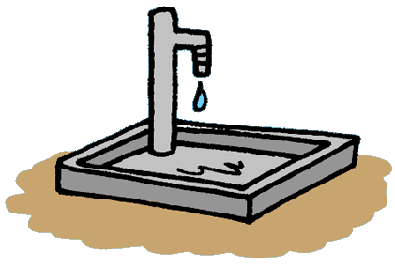
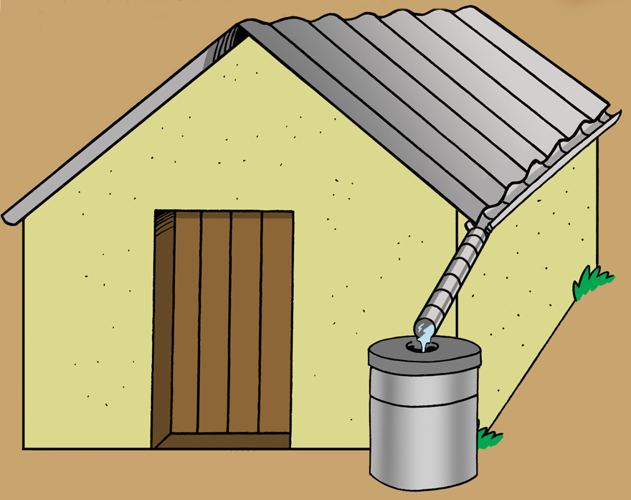
The Multi-Barrier Approach to Safe Drinking Water
1. Protect your source water
Keep it clean.
Keep surface flow, runoff and waste water out.
Keep human and animal waste out.

Slide 8


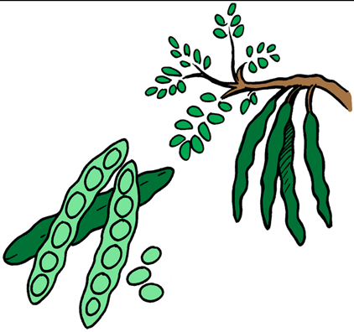
The Multi-Barrier Approach to Safe Drinking Water
2. Sediment your water
Let the dirt and large particles in the water fall to the bottom.
You can use alum, moringa seeds or prickly pear cactus to help the dirt settle.

Slide 9
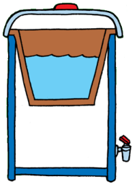
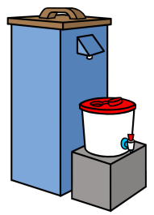
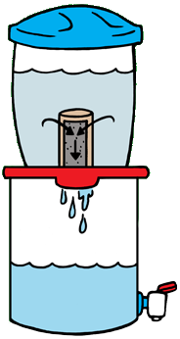
The Multi-Barrier Approach to Safe Drinking Water
3. Filter your water
Filter out the remaining dirt and large pathogens
Use a biosand filter, a ceramic pot or a ceramic candle filter.

Slide 10
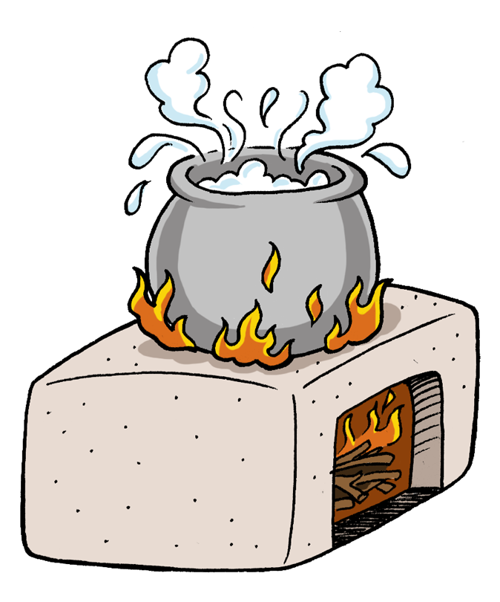

The Multi-Barrier Approach to Safe Drinking Water
4. Disinfect your water
Disinfecting the water will get rid of even the smallest pathogens that are still in the water.
You can use chlorine, boiling, or SODIS.

Slide 11
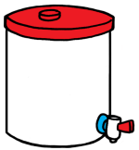
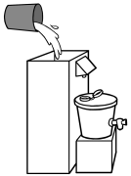
The Multi-Barrier Approach to Safe Drinking Water
5. Store your water safely
Use a safe storage container to store your drinking water.
Use a different bucket for collecting water from the source and for storing treated water.

Slide 12
The Multi-Barrier Approach to Safe Drinking Water
5. Store your water safely
Clean your safe water storage containers regularly.
Use a tap to get the water out, or pour it out.

Slide 13
Review
What are the five steps to safe drinking water?
Protect your source water
Sediment your water
Filter your water
Disinfect your water
Store your water safely

