Slide 1
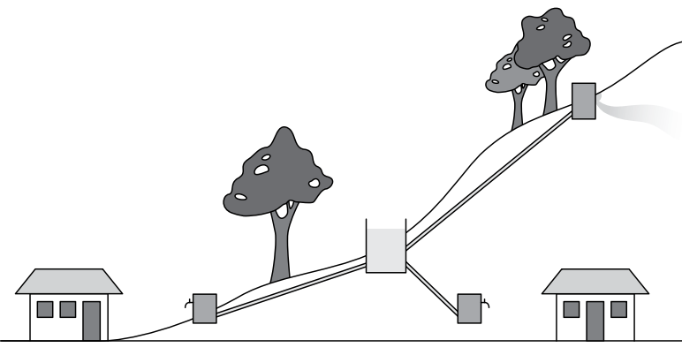
Keeping the water flowing:
Identifying Maintenance Problems
Image source: http://www.wateraidamerica.org/sites/default/files/attachments/Gravity%20fed%20schemes.pdf

