Slide 1




12, 2916 – 5th Avenue
Calgary, Alberta, T2A 6K4, Canada
Phone: + 1 (403) 243-3285, Fax: + 1 (403) 243-6199
E-mail: cawst@cawst.org, Website: www.cawst.org
CAWST, the Centre for Affordable Water and Sanitation Technology, is a nonprofit organization that provides training and consulting to organizations working directly with populations in developing countries who lack access to clean water and basic sanitation.
One of CAWST’s core strategies is to make knowledge about water common knowledge. This is achieved, in part, by developing and freely distributing education materials with the intent of increasing the availability of information to those who need it most.
This document is open content and licensed under the Creative Commons Attribution Works 3.0 Unported License. To view a copy of this license, visit http://creativecommons.org/licenses/by/3.0 or send a letter to Creative Commons, 171 Second Street, Suite 300, San Francisco, California 94105, USA.
You are free to:
        Share – to copy, distribute and transmit this document
        Remix – to adapt this document
Under the following conditions:
        Attribution. You must give credit to CAWST as the original source of the document. Please include our website: www.cawst.org
CAWST will produce updated versions of this document periodically. For this reason, we do not recommend hosting this document to download from your website.
CAWST and its directors, employees, contractors, and volunteers do not assume any responsibility for and make no warranty with respect to the results that may be obtained from the use of the information provided.
Stay up-to-date and get support:
            Latest updates to this document
            Other workshop & training related resources
            Support on using this document in your work
CAWST provides mentorship and
coaching on the use of its education
and training resources.

Slide 2

Biosand Filter
Mold Versions

Slide 3
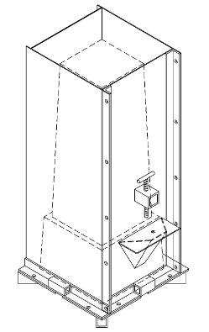
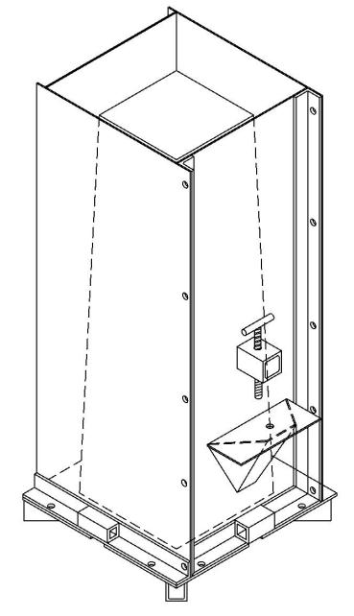

Biosand Filter Molds
Version 10
(No Ledge)
Mold
Version 10
(With Ledge)
Mold
Version 9 (With Ledge)
Mold

