Slide 1
Training Opening
Resource Person

Slide 2
Training Introduction
Covers detailed topics related to Gender and Social Inclusion in Sanitation
Target audiences:
Municipal sanitation officials
Officials from development partners
Sanitation professionals & researchers
This training is participatory with different types of group activities.
The training will be an informal event

Slide 3
Objectives
General
To introduce gender perspective in the practical implementation of urban sanitation projects or programs along with key interventions
Specific Objectives
To introduce the basic knowledge on Gender, Gender Equality and Social Inclusion (GEDSI), and interlink between gender and urban sanitation
To identify the necessity of mainstreaming gender in the project
To familiarize with the gender perspective in urban sanitation
To incorporate and implement gender in existing and new project cycle
Notes:
Present the objectives of the training.

Slide 4
Presentation Outline
Introduction of host, trainers
Approach of training
Introduction of participants
Learning Expectation
Pre-test

Slide 5
Approach of Training and Learning
Approach of training and learning
Experiential, hands-on and learning by doing
Individual and group activities
Case studies and learning from others’ experience
Powerpoint presentations
Open discussion, questions and answers
Develop a sense of community and network within the group

Slide 6
Building Layout
Toilet
Emergency exit
Driniking water
First aid

Slide 7
Training Structure
1
2
3
6
7
4
5
Training Opening
Gender: Concept and its terminologies
Gender Mainstreaming
Laws and Policies for gender mainstreaming
Gender Perspective in WASH
Mainstreaming Gender in Project Cycle
Training
Closing
Notes:
This training includes

Slide 8
Icebreaker
Introduce themselves with their
Name
Address
Enrolled organization
Roles and responsibilities in organization
Roles in household works
But, there is twist
Pretend as you were born with opposite sex than you are now,
What would be your name?
What would be your roles in household and organization
Notes:
Trainer Note: conclusion of the activity?

Slide 9
Learning Expectation
One expectation from a participant in meta card
Read and paste
Expectation

Slide 10
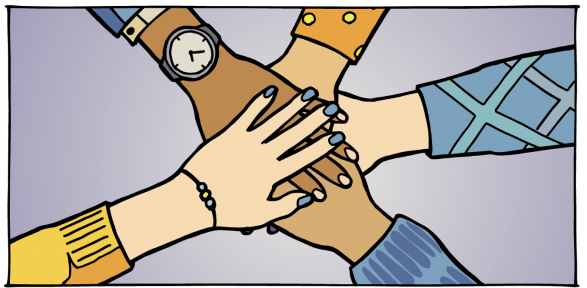
Group Agreement
Attentive in the training session
Keeping mobile in silent mode
Give respect and take respect
Taking turns to put the ideas one by one
Avoiding side talks
Respect time

Slide 11
Group Agreement
Attentive in the training session
Keeping mobile in silent mode
Give respect and take respect
Taking turns to put the ideas one by one
Avoiding side talks
Respect time

Slide 12
Pre-test
Scan the QR code
Or,
Click the link: https://forms.office.com/r/euEqSVAW9S
Notes:
Replace this link and QR code for each new training session

