Slide 1
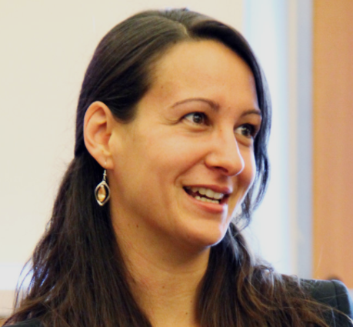
Rainwater Harvesting - Building From the Existing
Emilie Sanmartin
International Technical Advisor
Notes:
Emilie Sanmartin has been volunteering with CAWST since 2008 and joined CAWST staff in 2010 as an International Technical Advisor. Emilie holds a Master of Science in Water Management in Community Water Supply from Cranfield University, UK. Before joining CAWST she gained over three years' professional experience in the humanitarian sector working in Ethiopia, Congo, Sudan, Paraguay and Haiti with Oxfam and other international NGOs. She has worked with CAWST in Cameroon, Haiti, Peru and Guatemala. She is now responsible for CAWST's service provision in North America and supports the Global Services team.

Slide 2
Learning Outcomes
During this session we will learn different ways to access the existing potentials to start or re-start a RWH project.

Slide 3
Overview
1. What is the Current RWH Situation?
2. RWH as a System: catchment → transport → storage
3. Low Hanging Fruit and Ladder Approach to RWH
4. Behaviour Change and RWH

Slide 4
What is the Current RWH Situation?
Is RWH already happening in the community?
Culturally
From a previous project
Start with the existing systems and methods in place
Notes:
Observe what is already happening in the community, ask.
Anything from a bucket collecting water in the ground to a tank connected to a roof.
Don’t bring something brand new and non achievable/affordable, start from what is in place either it is functional or not.
Let’s have a look at a few examples…

Slide 5
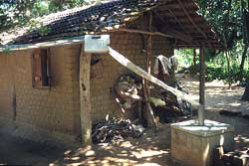
Small Scale – Household Catchment, Southeast Asia
(ITGD South Asia)

Slide 6
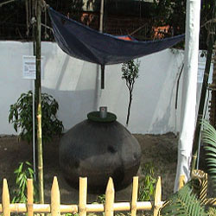
Small Scale – Sari Rainwater Harvesting, Bangladesh

Slide 7
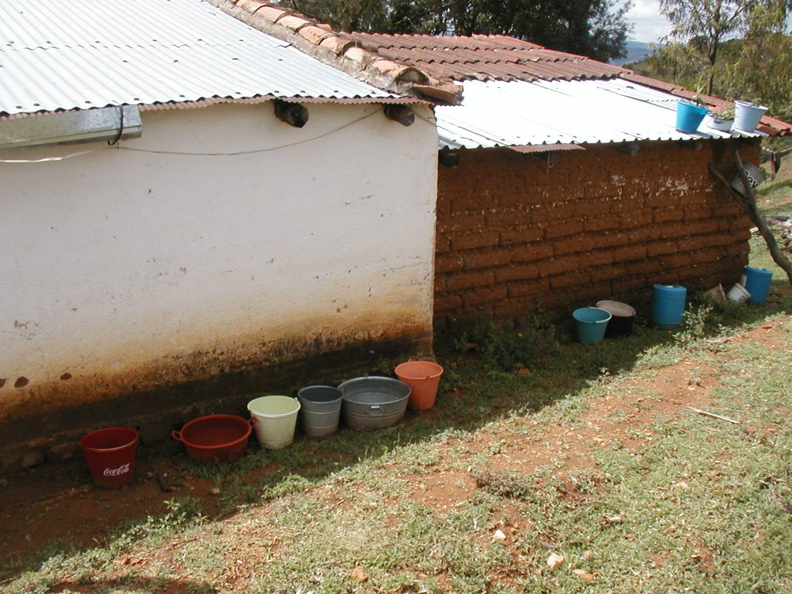
Even Smaller Scale – Bucket Harvesting, Mexico

Slide 8
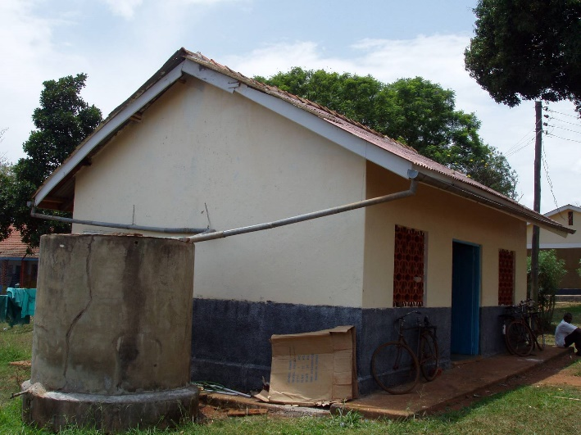
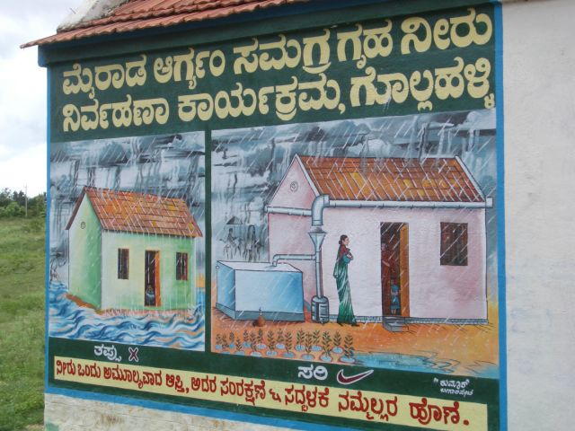
Rainwater Harvesting as a System
Catchment
Storage
Transport
Empower the user by explaining the all system and its importance
Notes:
Catchment → transport/delivery → storage
As engineers we tend to focus on the storage, not the best place to start.
Insure that user understands the integrality of the system and not just the storage

Slide 9
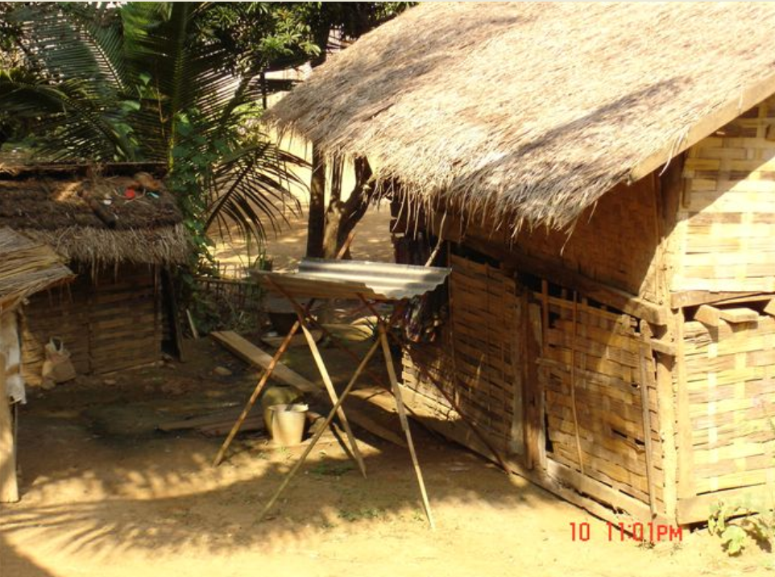
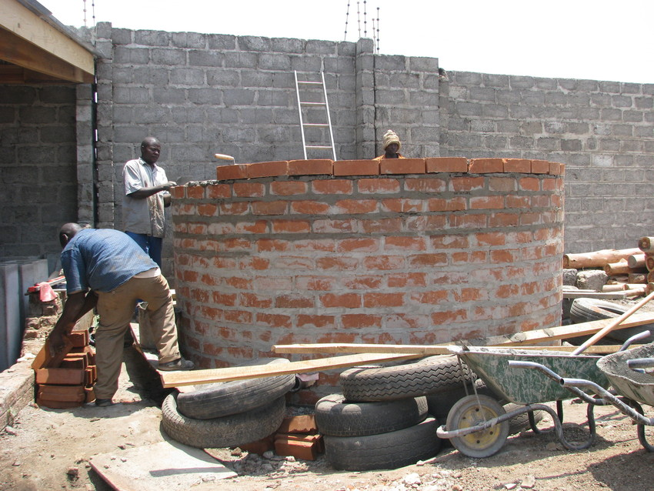
Low Hanging Fruit and Ladder Approach
Scale-up from the existing
Affordable solution that can be “upgraded”
Notes:
Example of size of tank in the literature Vs the real need of a tank with a wide base to start → can we expanded
Building a RWH tank cost is high (more than latrine) – ferrociment tank

Slide 10
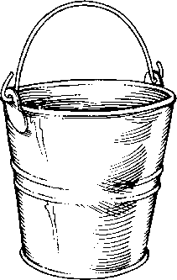
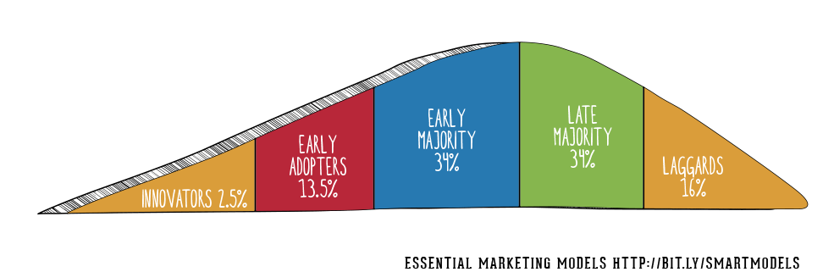
Behaviour Change and RWH
Work with innovators and early adopters

Slide 11
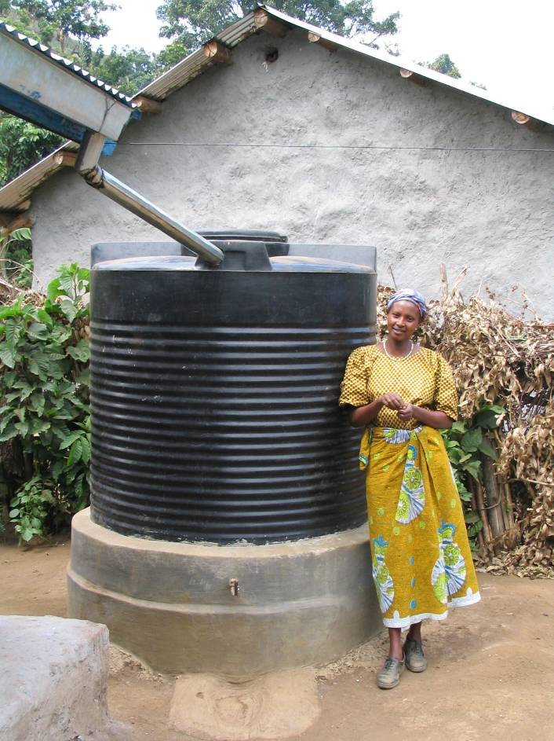
Questions

Slide 12
Resources
https://resources.cawst.org
Thank you!

