Slide 1
COVID-19 - Impact and Response Strategies
2020
APR 28
Notes:
Animated gif

Slide 3
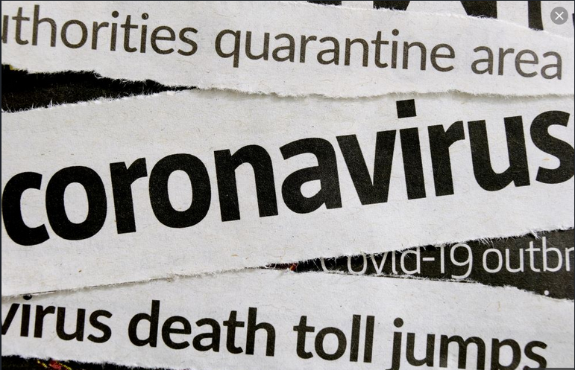
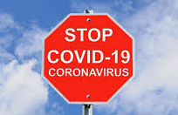
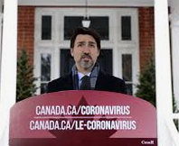
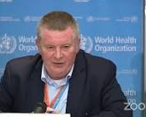
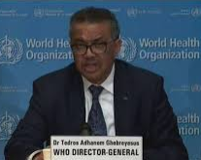
Notes:
Delete and replace images of people more relevant to your audience.
COVID-19 is reported continuously in the news and on social media.
Stories can be solid and reliable based on facts and verified reporting.
Stories can also be inaccurate or misleading, based on conjecture, catastrophizing and overly sensationalised.
Navigating the flood of information and knowing what to trust and what to question is not easy.
In this presentation we have tried to collect and share reliable information that CAWST has gathered, and answer some of the questions that we have been hearing from staff and clients.
This is a dynamic and fluid situation, and official guidance and information are evolving as knowledge and understanding of COVID-19 grow.
Familiar faces- Images from Internet
Tedros Adhanom, Director-General of the World Health Organization
Dr. Deena Hinshaw, Chief Medical Officer of Health, Alberta
Dr Mike Ryan, Executive Director, WHO Health Emergencies Programme
Justin Trudeau, Prime Minister of Canada

Slide 4
Outline
What is COVID-19?
What’s the global impact?
How to prevent transmission and respond to COVID-19?
How can we all work safely and support our clients?
Notes:
Learning Outcomes
Describe the basic microbiology of the novel coronavirus [SARS CoV2].
Describe the global impact of COVID-19 to date.
Describe the distribution and risk factors of COVID-19 spread.
Describe methods to reduce transmission of COVID-19.
Discuss strategies to support clients with programming to reduce the impact of COVID-19.

Slide 5
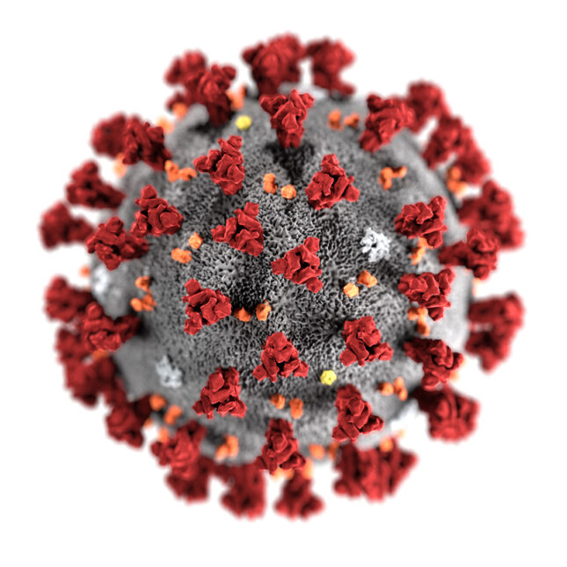
Coronaviruses
Coronaviruses are a family of viruses that cause infections in mammals and birds.
The coronavirus gets its name from the distinctive corona or 'crown' of sugary-proteins that project from the particle.
Coronaviruses can cause colds or other mild respiratory illnesses, around 30% of cases of the common cold are due to coronaviruses.
Coronaviruses also cause more serious diseases, including Severe Acute Respiratory Syndrome (SARS), Middle East Respiratory Syndrome (MERS), and COVID-19.
Source: CDC Public Health Image Library. Alissa Eckert, MS; Dan Higgins, MAMS
Notes:
What Is a Coronavirus?
Coronaviruses are a family of viruses known for containing strains that cause potentially deadly diseases in mammals and birds.
In humans they're typically spread via droplets of fluid produced by infected individuals.
Some rare but notable strains, including SARS-CoV-2 (responsible for COVID-19), and those responsible for severe acute respiratory syndrome (SARS) and Middle East respiratory syndrome (MERS), can cause death in humans.
First described in detail in the 1960s, the coronavirus gets its name from a distinctive corona or 'crown' of sugary-proteins that projects from the envelope surrounding the particle. Encoding the virus's make-up is the longest genome of any RNA-based virus – a single strand of nucleic acid roughly 26,000 to 32,000 bases long.
There are four known genuses in the family, named Alphacoronavirus, Betacoronavirus, Gammacoronavirus, and Deltacoronavirus. The first two only infect mammals, including bats, pigs, cats, and humans. Gammacoronavirus mostly infects birds such as poultry, while Deltacoronavirus can infect both birds and mammals.
Sources
www.sciencealert.com/coronavirus

Slide 6
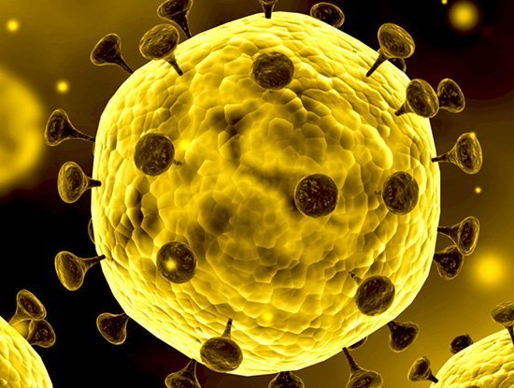
Coronavirus Terminology
The virus:
SARS-CoV-2
Severe Acute Respiratory Syndrome - Corona Virus - 2
SARS was number 1
nCoV
novel Corona Virus
The disease:
COVID-19
Corona Virus Disease - 19
19 = identified in the year 2019
Source: www.sciencealert.com/coronavirus
Notes:
Clarify:
SARS-CoV2 is the name given to the virus
COVID-19 is the disease caused by the virus
Novel coronavirus (nCoV) is a provisional name given to a new strain that has not been previously identified in humans, before a name is decided on.

Slide 7
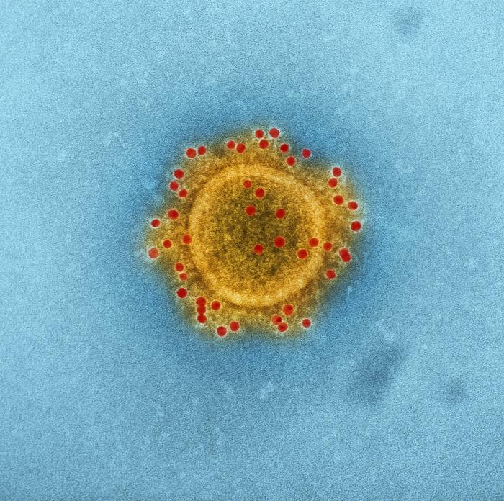
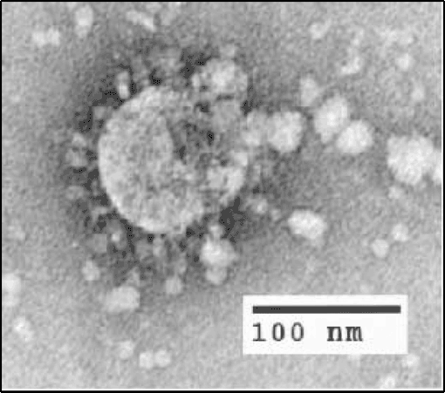
Comparison of MERS, SARS and COVID-19
 | Number of days for first 1000 people to be infected | Number of people that died for every 100 infected | Total number of cases and deaths
Middle East Respiratory Syndrome (MERS) 2012 | 903 | 34 | 2,494 cases 858 deaths
Severe Acute Respiratory Syndrome (SARS) 2003 | 130 | 10 | 8,437 cases 813 deaths
Coronavirus Disease 2019 (COVID-19) | 48 | 2 (0.1-15) | >3 million cases >200,000 deaths
Source: National Institute of Allergy and Infectious Diseases (NIAID)
Source: C.S. Goldsmith, CDC
Based on Information from ISOS Webinar 26 March, and WHO 28 April
Source: CDC Public Health Image Library. Alissa Eckert, MS; Dan Higgins, MAMS
Notes:
This slide compares what is known about the recent Coronavirus outbreaks. It also illustrates how our understanding has grown about COVID-19.
Information from ISOS presentation on 26 March, for every 100 people infected, the virus has killed 2 people.
1 month later (April 22), numbers of infected are more than 2.6 million with a global mortality rate of closer to 7% on average. (0.1% - 15%)
MERS - 2494 cases, 858 deaths
SARS - 8437 cases, 813 deaths
COVID-19
more easily transmitted than SARS or MERS
lower case fatality rate
total number of deaths will far exceed SARS and MERS due to widespread infections and larger number of cases
COVID-19 (SARS-CoV-2)
SARS-CoV-2 was first identified in the Chinese city of Wuhan in December 2019. It has now spread around the globe.
At the time of writing (April 22), numbers of infected are more than 2.6 million with a global mortality rate of closer to 7% on average. Coronavirus COVID-19 (2019-nCoV)
As of April 2020, the search for the animal origin of COVID-19 is ongoing, however more evidence suggests pangolins may have passed Coronavirus from bats to humans. Pangolins acted as the intermediary host.
Severe acute respiratory syndrome (SARS-CoV)
SARS was first recognised as a distinct strain of coronavirus in 2003. The source of the virus has never been clear, though the first human infections can be traced back to the Chinese province of Guangdong in 2002. The virus then became a pandemic, causing more than 8,000 infections of an influenza-like disease in 26 countries with close to 800 deaths.
Middle East respiratory syndrome (MERS-CoV)
MERS was first identified in Saudi Arabia in 2012 in people displaying symptoms of fever, cough, shortness of breath and occasionally gastrointestinal problems such as diarrhoea. An animal source for the virus has never been officially confirmed, though evidence points to dromedary camels as a potential reservoir of infection. The World Health Organisation has identified around 2,500 cases of infection in 27 countries since initial outbreaks, resulting in nearly 860 deaths.

Slide 8
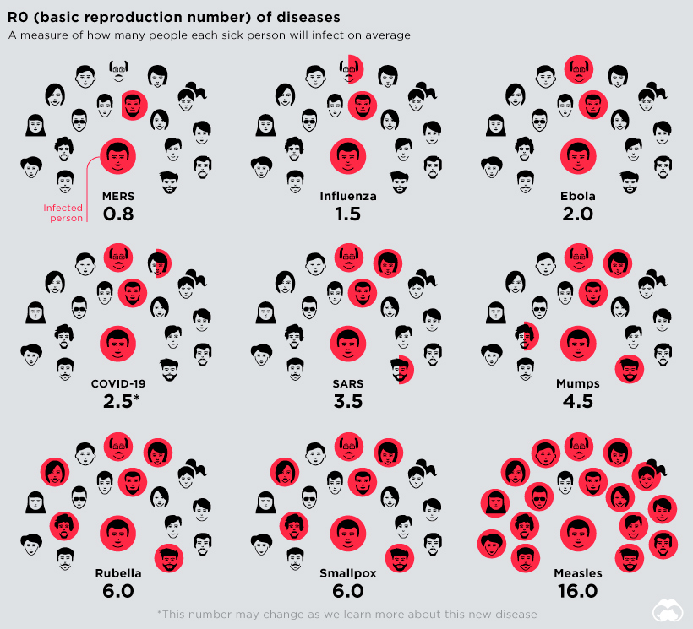
Comparison of Reproduction (R0) Numbers
R0 estimates how many people each sick person will infect.
Generally, the larger the R0, the harder it is to control the epidemic.
Source: History of Pandemics, visualcapitalist.com
Notes:
Reproduction number is an estimate of how many people each sick person will infect. R0 is pronounced “R-zero” or “R-naught”
Assumes all population is susceptible, i.e. nobody is immune, nobody is vaccinated, no preventive measures in place.
The 2.5 R0 number for COVID-19 is an estimate based on available epidemiological information. The R0 number can vary by population and location. Recent modeling suggests that at the start of the outbreak in Wuhan, the Reproduction Number was 5.7 (95% CI 3.8–8.95). https://wwwnc.cdc.gov/eid/article/26/7/20-0282_article
It remains to be seen what the R0 will be for other parts of the world.
Public health interventions aim to stop the spread of a disease and reduce the R0 number to <1, such as physical distancing, infection control, isolation, vaccination
When the R0 is less than 1, the epidemic will eventually die out.
https://www.cebm.net/covid-19/when-will-it-be-over-an-introduction-to-viral-reproduction-numbers-r0-and-re/

Slide 9
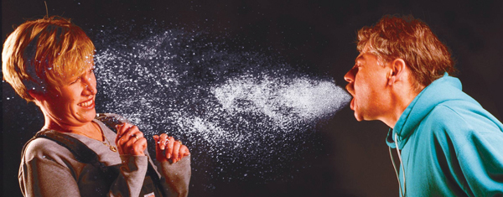
Transmission
A person becomes infected when the COVID-19 virus enters the body through the mouth, nose, or eyes.
COVID-19 virus is primarily transmitted between people directly through respiratory droplets, and transfer from contaminated surfaces, objects, and hands.
Survival of the virus on surfaces (fomites)
plastic ~72 hours, stainless steel ~48 hours, cardboard ~24 hours
Aerosols are a possible route of transmission
Virus can be present in feces. No reports of fecal−oral transmission of the COVID-19 virus to date.
Source: biosafety.utk.edu/biosafety-program/biosafety-manual/3-biosafety-practices-and-procedures/
lockwoodasia.com
alibaba.com
rona.ca
Notes:
The virus enters a person's body by large respiratory droplets containing the virus that adhere to mucous membranes of a person's eyes, nose or mouth, or by touching a surface or an object contaminated with the virus and then proceeding to touching one's eyes, nose and mouth. https://www.canada.ca/en/public-health/services/diseases/2019-novel-coronavirus-infection/health-professionals/assumptions.html
Mucous membranes are susceptible areas for virus transmission.
Survival on surfaces varies, seems to survive best on hard, impermeable materials. New England Journal of Medicine: https://www.nejm.org/doi/full/10.1056/NEJMc2004973
Study did not determine time period when the virus present on the surfaces was infective, only the time until the virus was no longer detectable.
Aerosols are being studied as a possible route of transmission
Aerosols are very fine droplets that can be emitted when a person coughs or sneezes.
They can remain suspended in the air for longer periods of time.
In an analysis of 75,465 COVID-19 cases in China, airborne transmission was not reported. Ong SW, Tan YK, Chia PY, Lee TH, Ng OT, Wong MS, et al. Air, surface environmental, and personal protective equipment contamination by severe acute respiratory syndrome coronavirus 2 (SARS-CoV-2) from a symptomatic patient. JAMA. 2020 Mar 4 [Epub ahead of print].
Airborne transmission is different from droplet transmission as it refers to the presence of microbes within droplet nuclei, which are generally considered to be particles <5μm in diameter, can remain in the air for long periods of time and be transmitted to others over distances greater than 1 m. Like measles.
The potential of transmission via feces is concerning. The SARS-CoV-1 virus was shown to have spread via aerosolization of fecal matter contaminated with the virus. https://www.nejm.org/doi/10.1056/NEJMoa032867
There is some evidence that COVID-19 infection may lead to intestinal infection and be present in feces. However, to date only one study has cultured the SARS-CoV-2 virus from a single stool specimen.⁹ There have been no reports of fecal−oral transmission of the COVID-19 virus to date. https://doi.org/10.1053/j.gastro.2020.02.055 https://doi.org/10.1053/j.gastro.2020.02.054
Cruise ships: https://www.cdc.gov/mmwr/volumes/69/wr/mm6912e3.htm?s_cid=mm6912e3_w
Transmission: https://www.who.int/news-room/commentaries/detail/modes-of-transmission-of-virus-causing-covid-19-implications-for-ipc-precaution-recommendations

Slide 10
Asymptomatic Infections & Transmission
Asymptomatic: People are infected but do not develop any symptoms and do not feel unwell.
Pre-symptomatic: People are infected but do not display symptoms until later in the illness ~2 days (or more).
Pre-symptomatic and asymptomatic infections appear to be common.
Evidence is growing that transmission occurs in these cases, and that this might be an important pathway of transmission.
Highlights the need for rigorous hygiene practices including physical distancing, handwashing, and respiratory hygiene.
guardian.com
Notes:
WHO and other health authorities are assessing ongoing research on this subject and the implications for the control of the pandemic.
Symptomatic cases of COVID-19 are causing the majority of transmission^{Footnote 1}; however many people with COVID-19 have only mild symptoms, especially at the early stage of the disease, and can still transmit to other people.
Asymptomatic and presymptomatic transmission of COVID-19 is occurring; however, it remains unclear if it is a major driver of transmission.
https://www.canada.ca/en/public-health/services/diseases/2019-novel-coronavirus-infection/health-professionals/assumptions.html
Pre- / Asymptomatic transmission example
Choir in Washington State. 60 people attended a choir rehearsal. Precautions were taken, no physical contact, hand hygiene, some spacing of people (distance unclear ~1m). Nobody had any obvious symptoms, 45 from the 60 people at rehearsal became ill. Singing creates and expels a lot of droplets - could be aerosols?
https://www.latimes.com/world-nation/story/2020-03-29/coronavirus-choir-outbreak
Presymptomatic Transmission of SARS-CoV-2 — Singapore, January 23–March 16, 2020 https://www.cdc.gov/mmwr/volumes/69/wr/mm6914e1.htm?s_cid=mm6914e1_w
Summary: 2 tourists with no symptoms visited a church in Singapore, they developed symptoms 3 and 5 days later. 3 other people attended the church later that day and became ill. CCTV showed that they occupied the same seats or were nearby. Virus present on surfaces? Virus aerosols suspended in air?
Cluster A. A woman aged 55 years (patient A1) and a man aged 56 years (patient A2) were tourists from Wuhan, China, who arrived in Singapore on January 19. They visited a local church the same day and had symptom onset on January 22 (patient A1) and January 24 (patient A2). Three other persons, a man aged 53 years (patient A3), a woman aged 39 years (patient A4), and a woman aged 52 years (patient A5) attended the same church that day and subsequently developed symptoms on January 23, January 30, and February 3, respectively. Patient A5 occupied the same seat in the church that patients A1 and A2 had occupied earlier that day (captured by closed-circuit camera) (5). Investigations of other attendees did not reveal any other symptomatic persons who attended the church that day.
CDC Diamond Princess study: demonstrated a high proportion (46.5%) of pre and asymptomatic infections at the time of testing.
https://www.cdc.gov/mmwr/volumes/69/wr/mm6912e3.htm?s_cid=mm6912e3_w
Italy: 44% of confirmed cases studied were asymptomatic
Japan: 0.06% were asymptomatic
China: up to 75% of initially asymptomatic cases progress to clinical disease; up to 12.6% of transmissions could have occurred before symptom onset.
Singapore: Presymptomatic transmission caused seven clusters of cases
These proportions based on nationally notified cases likely reflect laboratory testing algorithms rather than true estimates of asymptomatic infections.
https://www.ecdc.europa.eu/sites/default/files/documents/RRA-sixth-update-Outbreak-of-novel-coronavirus-disease-2019-COVID-19.pdf
European Centre for Disease Prevention and Control. Novel coronavirus disease 2019 (COVID-19) pandemic:
increased transmission in the EU/EEA and the UK – sixth update – 12 March 2020. Stockholm: ECDC; 2020.

Slide 11
Symptoms and Severity of Illness
Common symptoms include:
cough
fever
shortness of breath
runny nose
sore throat
Symptom of serious illness:
difficulty breathing
pneumonia
Other symptoms include:
fatigue
muscle pain (aches)
chills
sudden loss of taste or smell
nausea and diarrhea
headache
Most people (about 80%) recover from this disease without needing special treatment.
Those who are older, and those with other medical problems are more likely to develop serious illness.
Notes:
COVID-19 symptoms are similar to influenza and other respiratory illnesses
Absence of a particular “common” symptom does not indicate absence of the disease!
https://www.albertahealthservices.ca/topics/Page16997.aspx
Covid toes or hands - Some are calling the phenomenon “COVID toes” or “COVID hands,” according to Dr. Kerri Purdy, president of the Canadian Dermatology Association.
“They’re these painful red and purple bumps that tend to occur at the tips of the toes or on the tops of the feet, or on the tops of the fingers or tips of the fingers,” she said.
Seems to occur more frequently in younger people, sometimes the only “symptom”.
Digestive Symptoms
https://journals.lww.com/ajg/Documents/COVID19_Han_et_al_AJG_Preproof.pdf
https://journals.lww.com/ajg/Documents/COVID_Digestive_Symptoms_AJG_Preproof.pdf
Centers for Disease Control & Prevention, USA Symptoms of Coronavirus
https://www.cdc.gov/coronavirus/2019-ncov/symptoms-testing/symptoms.html

Slide 12
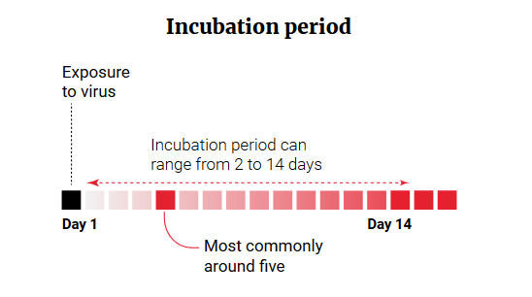
Incubation & Duration of Illness
Incubation Period
median 5.1 days
commonly 3 - 11.5 days
wide range in observed incubation periods
Duration of illness:
Mild cases 1-2 weeks
Severe cases 3-6 weeks or longer
Source: South China Morning Post - SCMP Graphics
Notes:
Incubation - possible range 1-14 days
Critical to understand this to inform isolation guidance and for modeling outbreak progression
https://www.ecdc.europa.eu/en/covid-19/questions-answers
When people talk about mild or moderate cases this can still be very unpleasant.
Severe cases require hospitalisation and sometimes intensive care.
https://www.healthline.com/health-news/what-its-like-to-survive-covid-19
https://www.webmd.com/lung/covid-recovery-overview#1
Severe and critical cases
Require breathing and rehydration support - many require intensive care.
In a review by the WHO-China Joint Mission of 55 924 laboratory-confirmed cases in China.
6·1% were classified as critical (respiratory failure, shock, and multiple organ dysfunction or failure)
13·8% as severe (dyspnoea, respiratory rate ≥30 breaths per min, oxygen saturation ≤93%, partial pressure of arterial oxygen to fraction of inspired oxygen [PaO₂/FiO₂] ratio <300 mm Hg, and increase in lung infiltrates >50% within 24–48 h)
https://www.thelancet.com/journals/lanres/article/PIIS2213-2600(20)30161-2/fulltext

Slide 13
Treatment and Recovery
Treatment
No specific treatment or cure for COVID-19 at present time
Several treatments under investigation.
Symptomatic therapies for mild cases
Breathing and rehydration support for more severe cases
Recovery
Can be lengthy convalescence
Concern that there may be long term health impacts
Notes:
Treatment
Therapies that are under investigation include drugs that have been used to treat malaria and autoimmune diseases; antiviral drugs developed for other viruses, and antibodies from people who have recovered from COVID-19. www.health.harvard.edu/diseases-and-conditions/treatments-for-covid-19 www.who.int
Symptomatic therapies for mild cases
Rest and hydration
Medications to relieve fever, aches and muscle pains (paracetamol / acetaminophen and ibuprofen)
Breathing support for more severe cases - may require intensive care setting and other therapies
Nasal canula - provides additional oxygen, patient breathing independently
Ventilator and mask - breathing is assisted with ventilator, patient may be sedated
Ventilator and intubation - tube inserted into airway breathing is controlled by ventilator, patient may be sedated
https://www.ctvnews.ca/health/coronavirus/why-ventilators-are-so-crucial-in-treating-covid-19-patients-1.4877810
Intensive care management of coronavirus disease 2019 (COVID-19): challenges and recommendations
Intensive care units cater to patients with severe or life-threatening illnesses and injuries, which require constant care, close supervision from life support equipment and medication in order to ensure normal bodily functions. They are staffed by highly trained physicians, nurses and respiratory therapists who specialize in caring for critically ill patients. ICUs are also distinguished from general hospital wards by a higher staff-to-patient ratio and access to advanced medical resources and equipment that is not routinely available elsewhere. Common conditions that are treated within ICUs include acute (or adult) respiratory distress syndrome, hypertension, metastases and other life-threatening conditions. https://en.wikipedia.org/wiki/Intensive_care_unit
Recovery
Fatigue and breathing problems can last weeks or months depending on severity https://www.theguardian.com/world/2020/apr/07/the-road-to-recovery-for-covid-19-patients
Long term effects
Patients with COVID-19 who developed acute respiratory distress syndrome (ARDS) could have a greater risk of long-term health issues.
Additionally, people requiring intensive care are at increased risk for mental health issues like post-traumatic stress disorder (PTSD), anxiety, and depression.
Impaired lung function from SARS-CoV-2 infection can negatively affect other organs like the heart, kidneys, and brain, with significant health impacts that may last after getting over the infection.
https://www.healthline.com/health-news/what-we-know-about-the-long-term-effects-of-covid-19

Slide 14
Questions?
Source: CDC Public Health Image Library. Alissa Eckert, MS; Dan Higgins, MAMS

Slide 15
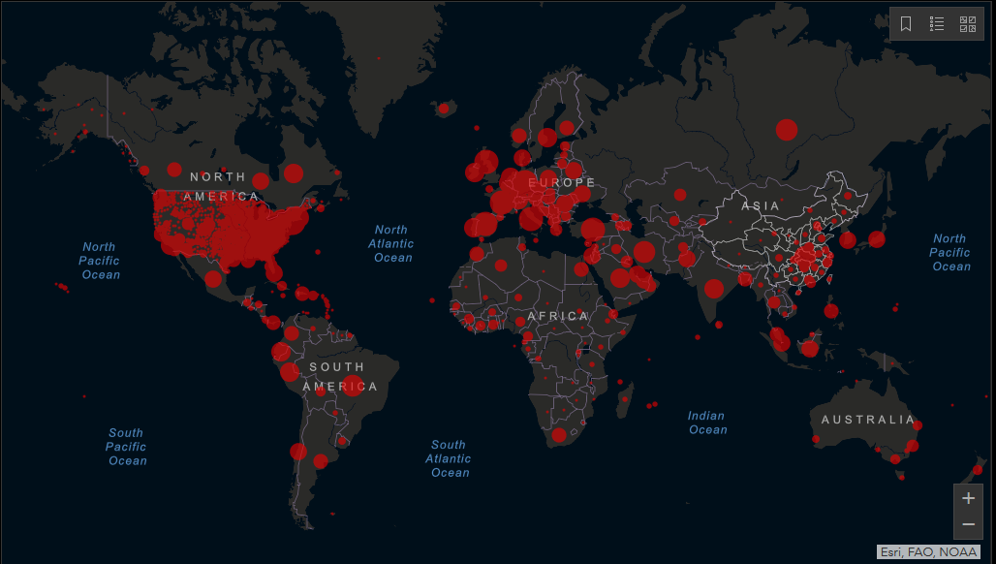
COVID-19 Cumulative Confirmed Cases
28 April, 2020
Confirmed cases = 3,062,557
Deaths = 212,221
Recovered = 906,022
Source: Johns Hopkins University https://coronavirus.jhu.edu/map.html
Notes:
Update slide!
Visit webpage, https://coronavirus.jhu.edu/map.html
Copy map using “snipping tool”, paste into slide.
Update figures for confirmed cases, deaths, recovered.
Majority of confirmed cases appear to be in China, Europe and USA.
This likely reflects a combination of actual COVID-19 cases and the availability of testing and surveillance services.
Numbers of cases in other parts of the world may be higher but are not reported due to limited access to testing.
Case Fatality Rate 181235/2611182 = ~7% but varies widely from 0.1% to 14.6%
Differences in mortality numbers can be caused by:
Differences in the number of people tested: With more testing, more people with milder cases are identified. This lowers the case-fatality ratio.
Demographics: For example, mortality tends to be higher in older populations.
Characteristics of the healthcare system: For example, mortality may rise as hospitals become overwhelmed and have fewer resources.
Other factors, many of which remain unknown.

Slide 16
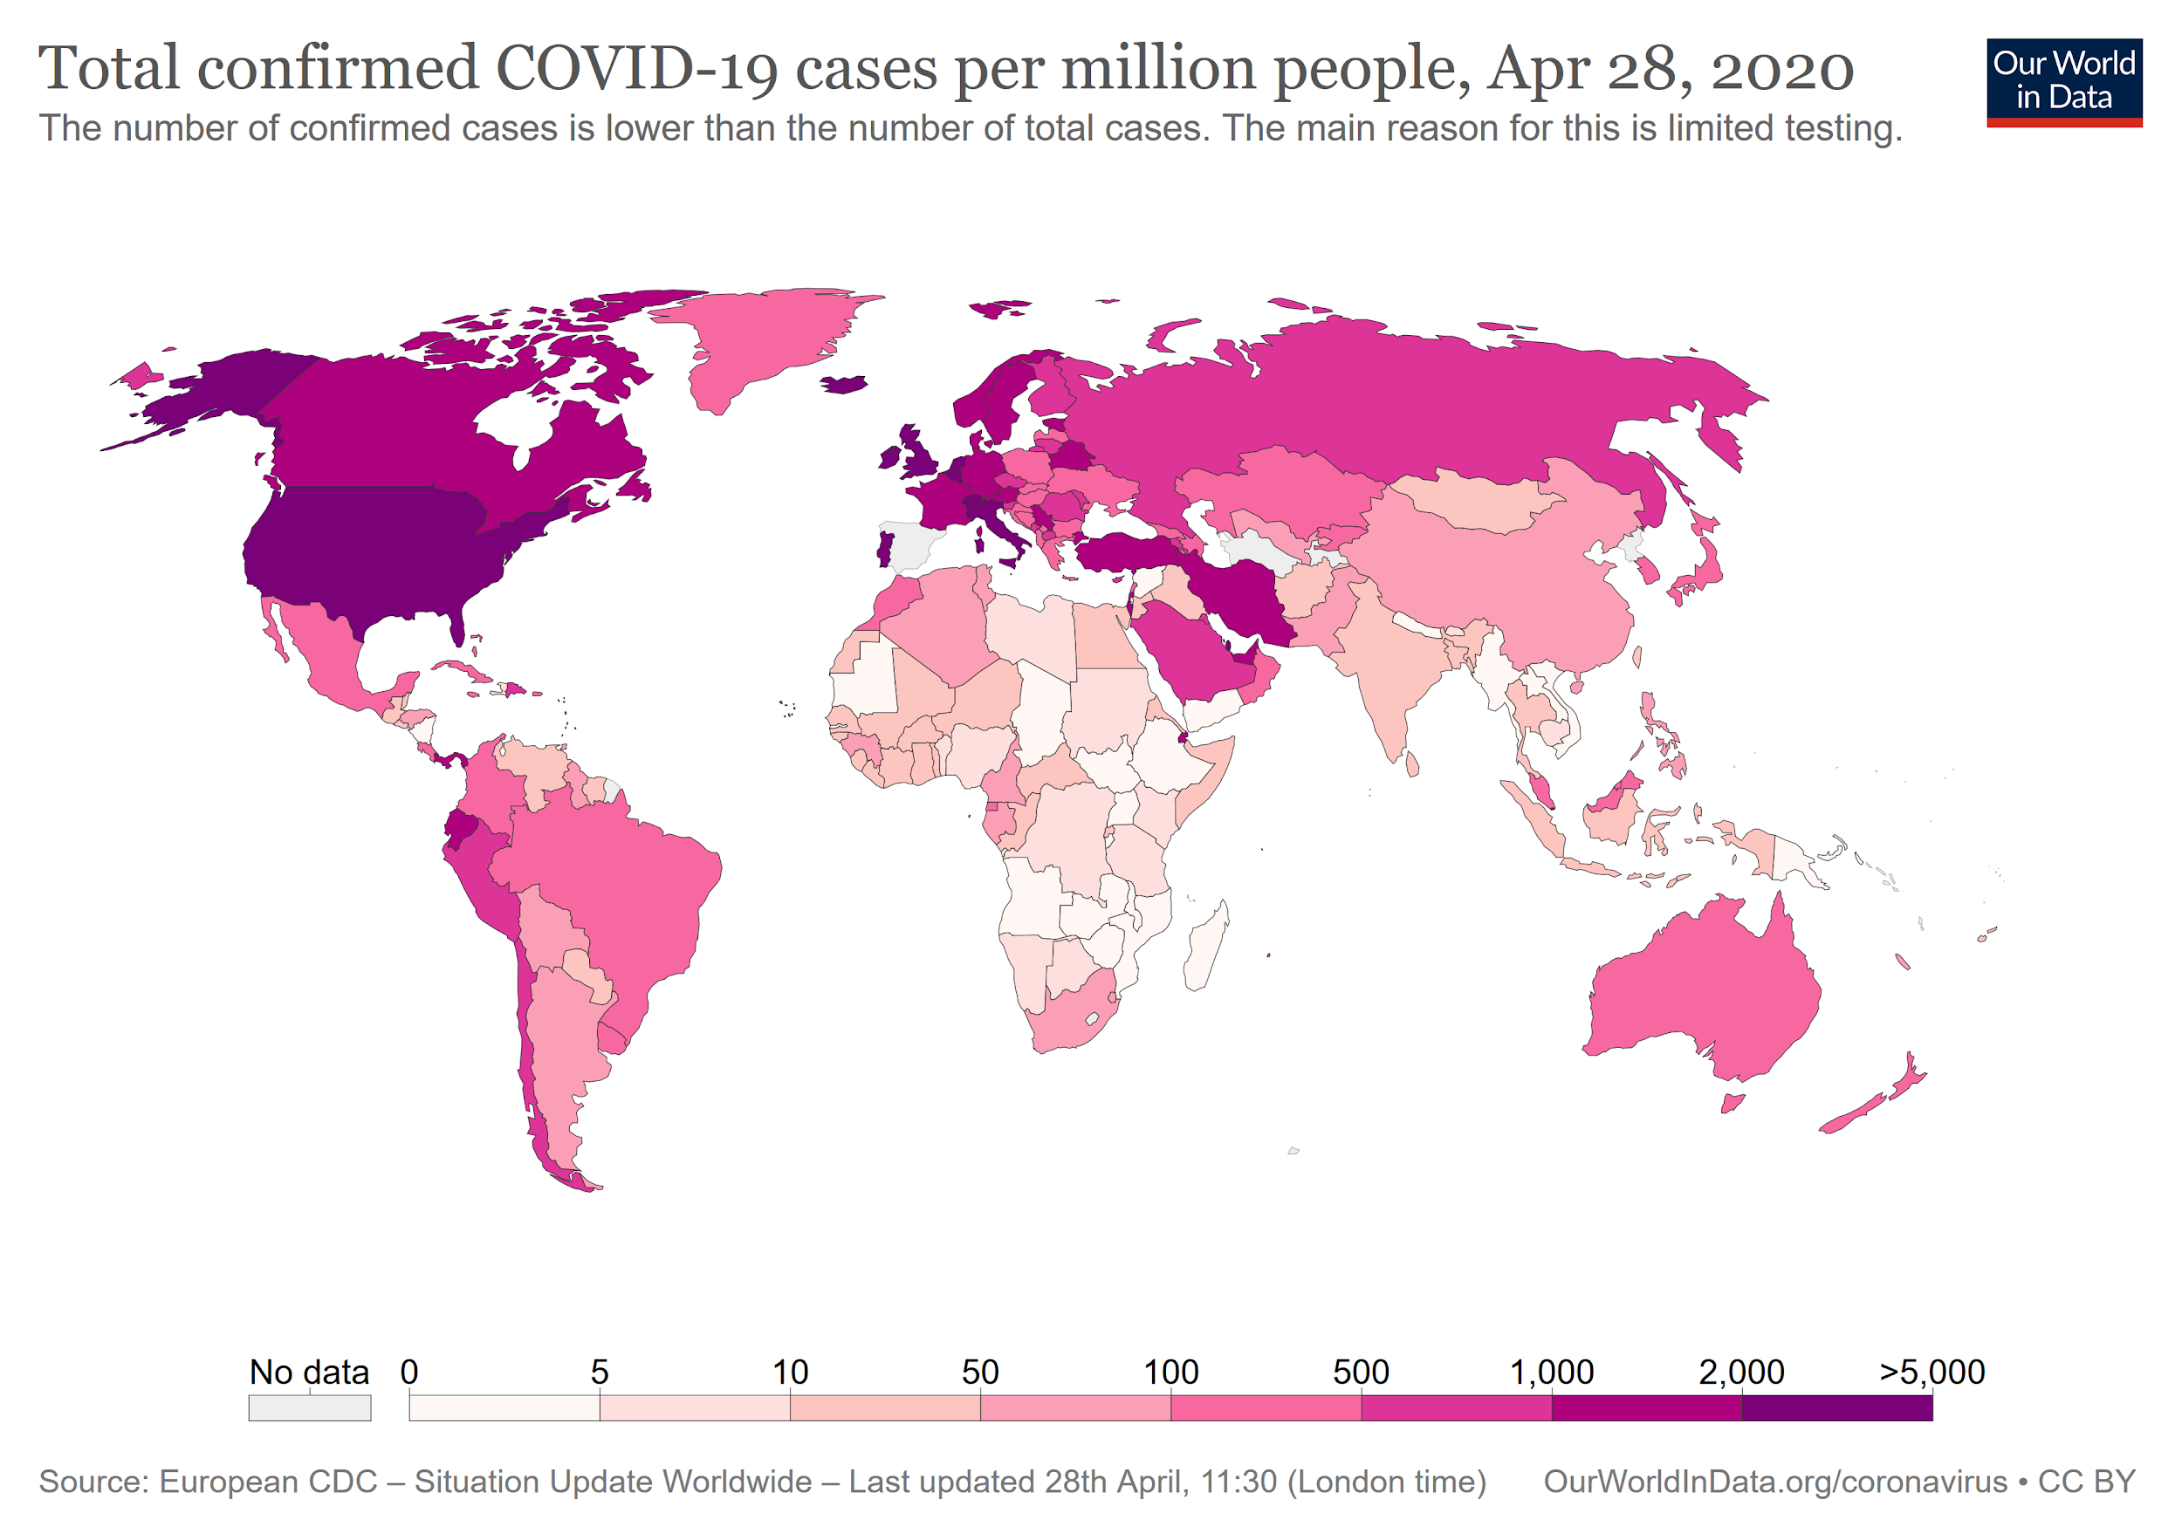
Animation
Notes:
Update slide!
Visit webpage https://ourworldindata.org/grapher/total-confirmed-cases-of-covid-19-per-million-people?time=0..65
Download image as png file (button at bottom right of map), and insert into slide.
Or copy map using “snipping tool”, paste into slide.
Many factors play into the differences in the number of cases including: testing availability, control measures put in place, speed of reaction, how people live, etc.
Play animation (link in slide)
Until Feb 21 only really China affected
February 27th - Italy starts turning
End of March - Europe and N. America
Today April 22 - US, Spain, Italy, Holland with highest rates of confirmed cases
It took 8 weeks for this virus to spread across the globe.
https://ourworldindata.org/grapher/total-confirmed-cases-of-covid-19-per-million-people?time=0..65

Slide 17
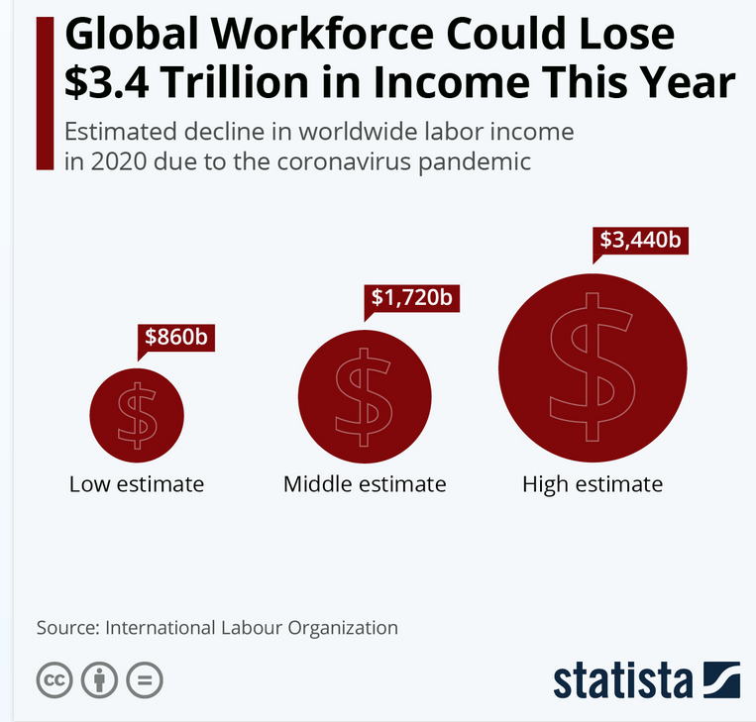
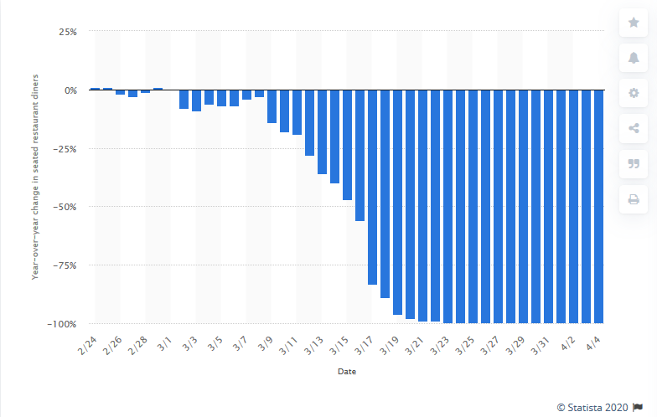
Impact on Economies
Year-over-year daily change in seated restaurant diners due to the coronavirus (COVID-19)
Source www.statista.com
According to a preliminary assessment by the International Labour Organization (ILO), the COVID-19 pandemic will have a significant effect on labor markets around the world, with unemployment rising by up to 24.7 million people
The pandemic is causing increasing damage to the global restaurant industry. Due to measures of social distancing and general caution in public places, consumers have been dining out less and less.
Notes:
Which sectors have been hit hardest
“Worst affected sectors”
retail and wholesale (482 million);
manufacturing (463 million)
business services and administration (157 million); and
food and accommodation (144 million workers),
https://news.un.org/en/story/2020/04/1061322
/www.statista.com/chart/21235/change-in-global-labor-income-due-to-covid-19/
While it’s still impossible to predict the economic fallout of the coronavirus pandemic and the measures currently taken to contain it, it’s becoming increasingly clear that the toll on the world economy will be heavy, possibly heavier than what we’ve seen during the financial crisis of 2007-2009.
According to a preliminary assessment by the International Labour Organization (ILO), the COVID-19 pandemic will have a significant effect on labor markets around the world, with unemployment rising by up to 24.7 million people compared to a baseline scenario, depending on how badly global economic activity is impacted. Assuming a 2 percent decline in global GDP for 2020, the ILO expects global unemployment to increase by 5.3 million, while a 4 percent drop in GDP would result in 13 million additional jobless people. The worst-case scenario sees global economic activity disrupted heavily, global GDP dropping by 8 percent and an increase in global unemployment of 24.7 million.
While these numbers are alarming on their own, it’s important to consider the implications of such a steep increase in unemployment around the world. When people lose their job, they lose their primary income, which translates into lower consumption of goods and services and thus exacerbates economic weakness.
According to the ILO’s estimates, workers could lose between $860 billion and $3.4 trillion in labor income this year alone, which will likely prolong the negative effects of current lockdowns and make recovery from this crisis even harder.

Slide 18
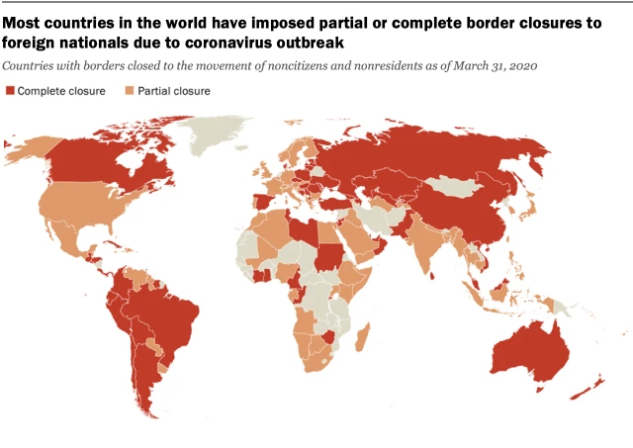
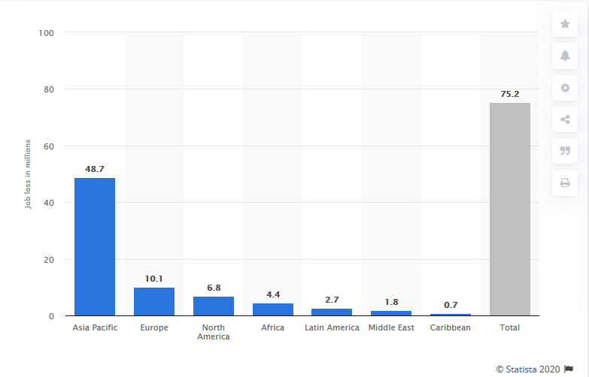
Impact on Global Travel
Predicted employment loss in the travel and tourism industry
(millions)
Pew Research Centre, March 31
www.statista.com
Current estimates predict between US$2 trillion to $3.4 trillion of income loss and 25 million job cuts. For one sector, the impact is particularly catastrophic: Tourism. Isabelle Durant, UNCTAD Deputy Secretary-General. UN Conference on Trade and Development unctad.org
Notes:
Travel and tourism have been hard hit by the pandemic and the measures put in place to stop the spread.
Every country in the world has put in place travel controls at borders, and implemented closures to foriegn nationals, and/or strict quarantine measures for arrivals. https://pandemic.internationalsos.com/2019-ncov/ncov-travel-restrictions-flight-operations-and-screening
Some low and middle income countries rely on travel and tourism as important parts of their economies, and this has been increasing in recent years..
Thailand $65billion
China $40billion
India $30billion
https://data.worldbank.org/indicator/st.int.rcpt.cd
Recovery will take several years, 5 years has been suggested based on previous experiences, including 9/11, the 2008 financial crisis. https://skift.com/2020/04/12/what-shape-would-the-travel-industry-recovery-look-like/
Re-employment of all the people who have lost their jobs in the industry will be similar.

Slide 19
Country Risk Factors
Healthcare system
Population density
Conflict
Displacement
International exposure
Age of populations
Climate - hot, humid
Source: uihere.com Niviane Viana
Notes:
Risk Factors apply everywhere, low, middle and high income countries.
https://africacenter.org/spotlight/mapping-risk-factors-spread-covid-19-africa/
World Economic Forum, 30 Mar 2020
There are many factors that contribute to the spread or control of outbreaks.
Healthcare system
The strength or weaknesses of health care systems: ability to identify cases, manage surges of infected patients, testing, ramp up supply of PPE, etc.
Access to the health system: insurance, affordability, equitable access to care, rural vs urban, etc.
Healthcare system already strained due to malnutrition and disease.
Many countries have history and experience of dealing with regular infectious disease outbreaks
Population density
Higher densities are more likely to enable transmission
Housing style, how people live together, etc.
Physical distancing may be harder to implement
Conflict - affects all functions in society, coupled with disease outbreaks, even more of a disaster
Displacement
IDPs and refugees are vulnerable, higher densities and overcrowding in camps, limited access to health care, and to food, cash, and other needs.
Conversely, in well managed camps, there could be better healthcare than in surrounding communities, food supplies centrally managed.
International exposure
The virus was carried around the world by travelers: tourists, business, people, migrant workers, etc.
Countries that have less international travel into and out of the country may fare better, at least in the beginning of the outbreak.
Initially probably introduced to urban centres. Migrant workers, if not quarantined upon return, could potentially carry the virus to rural populations.
Age of populations
younger populations might be better off, potentially fewer severe cases and more mild to moderate. The median age of the 1.3 billion population in Africa is 19.7 years, China-38.4, Europe-43.1 years
older tend to be hit worse, more likely to overwhelm the health system with more severe cases
Climate - hot, humid.
Still to be seen, but hot weather and humid conditions tend to inactivate coronaviruses
Coronaviruses appear to survive better in cooler, dryer conditions
United Nations University Institute for Water, Environment and Health
Collateral Damage: Mass vaccination campaigns being suspended. Global Polio Eradication Initiative suspended - resources being shifted to COVID-19 fight
COVID-19 is one more disease crisis layered on top of other WASH related diseases, whether malaria, cholera, shigella, trachoma, etc..
These have not gone away, and may become worse as scarce resources are dedicated to dealing with COVID-19.
malnutrition, anemia, malaria, HIV/AIDs, and tuberculosis
ICU very limited. The capacity for most African countries to provide critical care is the lowest in the world.
Ability to do physical distancing: many people rely on daily incomes, importance of cultural and social gatherings: church, mosque, celebrations, etc.
Third, social cohesion and social gatherings are of great importance in Africa. For example, weekly attendance of a religious service is highest in Africa with rates as high as 82% in Uganda and Ethiopia. As a result, measures to impose social and physical distancing may prove to be more challenging, as demonstrated by the protests that broke out on 20 March 2020 in Senegal after public gatherings, including gatherings at mosques were banned as cases of COVID-19 rose. Earlier this week, Tanzania came under scrutiny when it was announced that the country will not close places of worship.
Migrant workers being laid off and returning to unaffected rural areas.
For aggressive preventive measures to work, we will need the full support of populations. Full support of populations can only be achieved with community engagement and strong health leadership.
On March 23, Tanzanian President John Magufuli was widely criticized for encouraging the public to continue to attend places of worship, rather than imposing stringent restrictions to mitigate the spread of the COVID-19 outbreak. Explaining his decision, the president stated, “We are not closing places of worship. That’s where there is true healing. Corona is the devil and it cannot survive in the body of Jesus.”

Slide 20
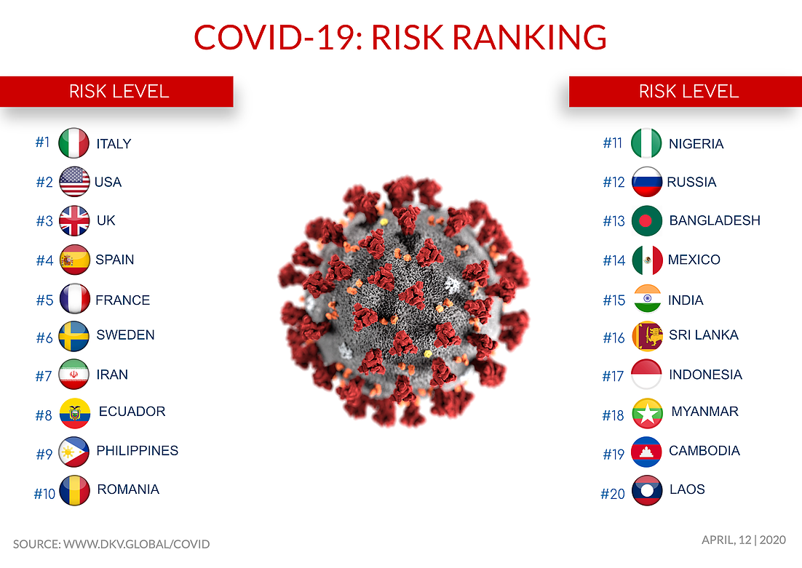
Other Regions - Europe, Americas, Asia
Notes:
Deep Knowledge Group https://www.dkv.global/covid
The COVID-19 Risk Ranking Framework conducts benchmarking of countries according to their levels of risk according to a variety of medical and non-medical factors, including risk of infection, hospitalization, death and lasting health conditions, as well as the country’s risk of negative economic, quality-of-life and geopolitical issues resulting from the pandemic. The framework is used to provide information on which countries where citizens will have the greatest likelihood of positive outcomes during the global COVID-19 pandemic, across the full-scope of factors impacting general safety, wellness and quality of life. It utilizes 24 specific parameters grouped into 4 distinct categories: Infection Spread Risk, Government Management, Healthcare Efficiency and Regional Specific Risks.
The framework features 24 parameters grouped into 4 major categories:
Infection Spread Risk
Government Management
Healthcare Efficiency
Regional Specific Risks

Slide 21
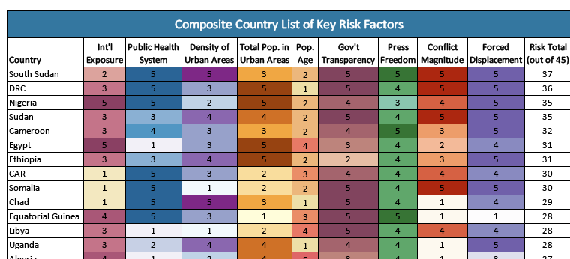
Countries at Highest Risk in Africa
Africa Center for Strategic Studies, April 3, 2020
Notes:
Africa specific, you can choose to delete and/or replace with context/regional specific info.
https://africacenter.org/spotlight/mapping-risk-factors-spread-covid-19-africa/#composite
What’s missing on this list?
Chronic and infectious diseases - health and wellbeing
WASH
Experience responding to outbreaks
Migrant workers returning home, often from urban to rural areas.
The median age of the 1.3 billion population in Africa is 19.7 years, China-38.4, Europe-43.1 years
Many countries in Africa have history of dealing with infectious disease outbreaks

Slide 22
Poor hand hygiene services
WHO / UNICEF Joint Monitoring Programme, https://washdata.org
Notes:
https://washdata.org/
It doesn’t look good!
Physical distancing, respiratory hygiene, and hand hygiene are the three most important ways to control COVID-19.
Half of schools don’t have soap and water.
40% of homes and health facilities don’t have soap and water or hand sanitizer.
Schools in many countries are closed, but reopening of schools requires attention to hand hygiene and other prevention measures.
Urgent action is required NOW to address hand hygiene in health facilities, for all people using the facilities - medical and support staff, in-patients, out-patients, attendants, and visitors

Slide 23
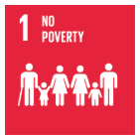
Inequalities
Gender
Wealth
Vulnerable people
Notes:
https://globalhandwashing.org/putting-equality-inclusion-and-rights-at-the-centre-of-a-covid-19-water-sanitation-and-hygiene-response/
https://www.thelancet.com/journals/lancet/article/PIIS0140-6736(20)30526-2/fulltext
Outcomes and risks will be different based on different individual factors
Women are responsible for water collection and caregiving
Front-line workers are disproportionately women ~70%
Increase risk of violence against women
One in 10 women in Canada is very or extremely concerned about the possibility of violence in the home (Stats Canada Poll)
https://www150.statcan.gc.ca/n1/daily-quotidien/200408/dq200408c-eng.htm
Men may be more likely to die of COVID-19
Men tend to smoke more
Estrogen may be protective
https://www.latimes.com/science/story/2020-03-21/why-is-the-coronavirus-more-deadly-for-men-than-for-women
Wealth - particularly those reliant on a daily wage - more likely to work and increase possible exposure
Vulnerable people / disadvantaged groups / marginalized groups
People with chronic health issues
People living with disabilities
People reliant on a daily wage
People living in informal settlements, refugee and IDP camps

Slide 24
It is really important that we remember that now – the psychological impact of the pandemic is going to be huge. Some of it will be fear of repression, police violence and domestic abuse, others will be less obvious – fear of contact with strangers (perhaps leading to ‘othering’ of marginalized groups), fear of physical contact and intimacy. There will be love and care too of course, but both are bound to shape how people go about framing claims to things like public services and engaging in public politics.
Duncan Green, Oxfam, From Poverty to Power
Notes:
https://oxfamblogs.org/fp2p/how-is-covid-playing-out-in-fragile-and-conflict-affected-settings/?utm_source=feedburner&utm_medium=feed&utm_campaign=Feed%3A+FromPovertyToPower+%28From+Poverty+to+Power+%3A+Duncan+Green%29
We can work to reduce the potential negative impacts to people’s mental health and wellbeing.

Slide 25
Questions?
Source: wikipedia.org/wiki/GIF

Slide 26
Preventing Transmission of COVID-19
Government Actions
Individual Actions
Workplace Actions
Programmatic Responses

Slide 27
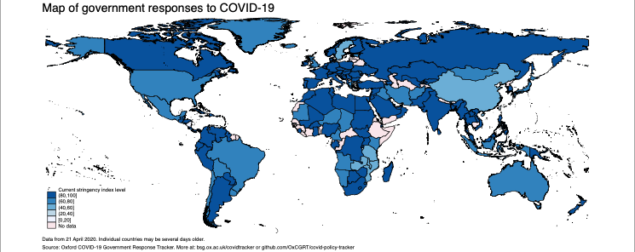
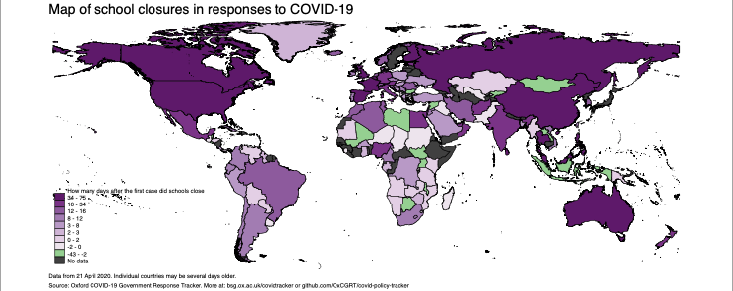
Government Actions
Test, isolate cases, and contact tracing
Physical and social distancing
Lockdown
Cancellation of public events
Self-isolation / quarantine
School closures
https://www.bsg.ox.ac.uk/research/research-projects/coronavirus-government-response-tracker
Notes:
Most governments around the world have responded to the pandemic and implemented closures, restrictions, public health orders, and other measures to try to control the spread of the disease.
Public health actions including testing, isolation of cases, and contact tracing are critical to slow down and control transmission. Testing and contact tracing are key to understand how the disease is spreading in the community in order to prioritize and allocate resources efficiently and effectively. https://www.npr.org/sections/health-shots/2020/03/10/814129534/how-the-painstaking-work-of-contact-tracing-can-slow-the-spread-of-an-outbreak
All of these measures come at a price. https://news.un.org/en/story/2020/04/1061322
There are concerns that some governments will use the pandemic to drive through unpopular reforms, curtail their citizens rights, and further marginalize some groups. https://www.hrw.org/news/2020/03/19/human-rights-dimensions-covid-19-response
Government responses
https://www.bsg.ox.ac.uk/research/research-projects/coronavirus-government-response-tracker
Blue map - Government Responses to COVID-19 shows how severe or stringent the measures are that have been put in place. Darker blue color is more stringent (indicators used are below).
Purple map - School Closures in response to COVID-19 shows how quickly a country put in place school closures after 1st case identified. Lighter colors show more rapid response. Green means closures were done before first case.
Stringency Indicators
S1_School closing,
S2_Workplace closing,
S3_Cancel public events
S4_Close public transport
S5_Public information campaigns
S6_Restrictions on internal movement
S7_International travel controls
S8_Fiscal measures
S9_Monetary measures
S10_Emergency investment in health care
S11_Investment in Vaccines
S12_Testing framework
S13_Contact tracing

Slide 28
Government Actions - 1918 Flu Pandemic
Kelowna Capital News
Notes:
1919 Flu Pandemic, also known as Spanish Flu.
January 1918 to December 1920 (3 years!)
Notice from 1918 in the Kelowna Capital newspaper, Kelowna, BC, Canada
Public Health restrictions put in place - very similar today.
Social and physical distancing are tried and tested measures.

Slide 29
Individual Actions
Wash your hands frequently with soap
Maintain social and physical distancing
Avoid touching eyes, nose and mouth
Practice respiratory hygiene
Clean “high touch” surfaces regularly
Stay at home if you feel unwell, even with mild symptoms
If you have fever, cough and difficulty breathing, seek medical care early
Stay informed and follow advice given by your healthcare provider
unocha.org
Notes:
https://www.who.int/emergencies/diseases/novel-coronavirus-2019/advice-for-public
Wash your hands frequently
Regularly and thoroughly clean your hands with an alcohol-based hand rub or wash them with soap and water.
Why? Washing your hands with soap and water or using alcohol-based hand rub kills viruses that may be on your hands.
Maintain social distancing
Maintain at least 1 metre (3 feet) distance between yourself and anyone who is coughing or sneezing. (2m or 6 feet is better)
Why? When someone coughs or sneezes they spray small liquid droplets from their nose or mouth which may contain virus. If you are too close, you can breathe in the droplets, including the COVID-19 virus if the person coughing has the disease.
Avoid touching eyes, nose and mouth
Why? Hands can transfer the virus to your eyes, nose or mouth. From there, the virus can enter your body and can make you sick.
Practice respiratory hygiene
Make sure you, and the people around you, follow good respiratory hygiene. This means covering your mouth and nose with your bent elbow or tissue when you cough or sneeze. Then dispose of the used tissue immediately.
Why? Droplets spread virus. By following good respiratory hygiene you protect the people around you from viruses such as cold, flu and COVID-19.
If you have fever, cough and difficulty breathing, seek medical care early
Stay home if you feel unwell. If you have a fever, cough and difficulty breathing, seek medical attention and call in advance. Follow the directions of your local health authority.
Why? National and local authorities will have the most up to date information on the situation in your area. Calling in advance will allow your health care provider to quickly direct you to the right health facility. This will also protect you and help prevent spread of viruses and other infections.
&amp;amp;nbsp;
Stay informed and follow advice given by your healthcare provider
Stay informed on the latest developments about COVID-19. Follow advice given by your healthcare provider, your national and local public health authority or your employer on how to protect yourself and others from COVID-19.
Why? National and local authorities will have the most up to date information on whether COVID-19 is spreading in your area. They are best placed to advise on what people in your area should be doing to protect themselves.

Slide 30
Non-Medical Masks / Face Coverings
Several governments and Health Agencies are recommending use of face coverings or non-medical masks by the general public.
Wearing a mask or face covering:
may be helpful in protecting others
can prevent your respiratory droplets from contaminating other people or surfaces
may stop you from touching your nose and mouth
(Photo: Columbus (Ohio) Dispatch)
“Wearing a non-medical face mask does not replace physical distancing & self-isolation. It also doesn't protect the person wearing it but it might help prevent spreading the virus to other people.”
Dr. Deena Hinshaw, Chief Medical Officer of Health, Alberta
Notes:
WHO does not recommend the use of masks by the general public, but does provide guidance to those who are considering this.
“There is limited evidence that wearing a medical mask by healthy individuals in the households or among contacts of a sick patient, or among attendees of mass gatherings may be beneficial as a preventive measure. However, there is currently no evidence that wearing a mask (whether medical or other types) by healthy persons in the wider community setting, including universal community masking, can prevent them from infection with respiratory viruses, including COVID-19. Advice on the use of masks in the context of COVID-19
However, WHO has said, “We can certainly see circumstances in which the use of masks, both home-made and cloth masks, at the community level may help with an overall comprehensive response to this disease,” Dr. Michael Ryan, executive director of the WHO’s health emergencies program.
A major concern is that medical masks are diverted from health care workers who need them to do their job and stay safe.
Wearing a mask or face covering may be helpful in protecting others.
Masks are a way to cover your mouth and nose to prevent respiratory droplets from contaminating other people or surfaces.
Wearing a mask may stop you from touching your nose and mouth.
BUT Wearing a mask can be uncomfortable and can actually increase touching of the face.
Masks can be useful when physical distancing is difficult to fully achieve e.g. shopping, public transport, work place

Slide 31
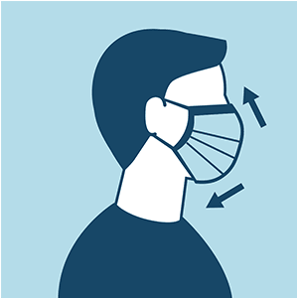
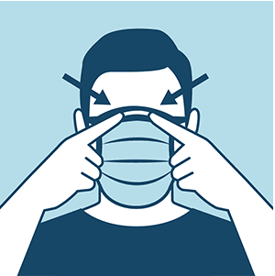
Mask DOs and DON’Ts
Face mask DOs:
Make sure it fits well and doesn't gape at the sides
Wash your hands before putting it on and after taking it off
Wear masks for a short time
Carry a bag with clean masks and a plastic bag that can be used store used masks until they can be washed at home
Face mask DON'TS:
Don't re-use masks or share them with others
Don't wear a mask that is damp or soiled
Don't touch your face while wearing the mask
Don't move or adjust the mask while it is on your face
https://thespinoff.co.nz/wp-content/uploads/2020/04/Covid-19-Masks-working-04.gif
Images: CDC
Notes:
Dos and don’ts sourced from Dr. Deena Hinshaw’s Twitter.

Slide 32
Self-Isolation and Quarantine
Always follow national guidelines and mandatory requirements on testing and isolation protocols.
If you have been instructed to self-isolate or self-quarantine by your health authority, follow the instructions that they provide.
General guide to self-isolation
Stay at home
Avoid contact with others and keep your distance
Wash your hands
Cover your coughs and sneezes
Wear a mask over your nose and mouth
Notes:
Isolation and quarantine are public health practices used to protect the public by preventing exposure to people who have or may have a contagious disease.
It can be confusing to understand the difference, because “isolation” and “quarantine” are often used interchangeably. These are the definitions from the U.S. Department of Health & Human Services.
Isolation separates sick people with a contagious disease from people who are not sick.
Quarantine is a measure that separates and restricts the movement of people who were exposed to a contagious disease to see if they become sick. These people may have been exposed to a disease and do not know it, or they may have the disease, but do not show symptoms.
Isolation and quarantine can be voluntary or mandatory. Mandatory isolation or quarantine is when a health authority or government issues an order requiring people to isolate or quarantine themselves for a period of time. Voluntary or Self-Isolation / Quarantine is when a person has not been ordered into quarantine but, out of caution, chooses to do so at home.
Self Isolation
Stay home
• Do not use public transportation, taxis or rideshares.
• Do not go to work, school or other public places.
Avoid contact with others
• No visitors unless essential (e.g. care providers)
• Stay away from seniors and people with chronic medical conditions (e.g. diabetes, lung problems, immune deficiency).
• As much as possible, stay in a separate room away from other people in your home and use a separate bathroom if you have one.
• Make sure that shared rooms have good airflow (e.g. open windows).
• If these steps are not possible, keep a distance of at least two metres from others at all times.
Keep your distance
• If you are in a room with other people, keep a distance of at least two metres and wear a mask that covers your nose and mouth.
• If you cannot wear a mask, people should wear a mask when they are in the same room as you.
Wash your hands
• Wash your hands often with soap and water.
• Dry your hands with a paper towel or with cloth towel that no one else will share.
• Use an alcohol-based hand sanitizer if soap and water are not available.
Cover your coughs and sneezes
• Cover your mouth and nose with a tissue when you cough or sneeze.
• Cough or sneeze into your upper sleeve or elbow, not your hand.
• Throw used tissues in a lined wastebasket, and wash your hands. Lining the wastebasket with a plastic bag makes waste disposal safer.
• Clean your hands after emptying the wastebasket.
Wear a mask over your nose and mouth
• Wear a mask if you must leave your house to see a health care provider.
• Wear a mask when you are within two metres of other people, or stay in a separate room.
How to Self-Isolate: Public Health Ontario. https://www.google.com/url?sa=t&rct=j&q=&esrc=s&source=web&cd=1&ved=2ahUKEwi_gJrTvtfoAhUOo54KHcvGCUwQFjAAegQIARAB&url=https%3A%2F%2Fwww.publichealthontario.ca%2F-%2Fmedia%2Fdocuments%2Fncov%2Ffactsheet-covid-19-how-to-self-isolate.pdf%3Fla%3Den&usg=AOvVaw2yPcN_W83Vv8hcXxs1p3y1

Slide 33
Preventing Transmission in the Workplace
Employers should start doing these things now, even if COVID-19 has not arrived in the communities where they operate.
Make sure your workplaces are clean and hygienic
Promote regular and thorough handwashing
Display posters promoting handwashing, respiratory hygiene, and to stay home if sick
Modify procedures to enable physical distancing and other measures
Limit number and size of face-to-face meetings
Follow local guidelines and limitations on gatherings
Notes:
Getting your workplace ready for COVID-19, WHO https://www.who.int/docs/default-source/coronaviruse/advice-for-workplace-clean-19-03-2020.pdf
Make sure your workplaces are clean and hygienic:
regularly disinfect surfaces and frequently handled objects
pay attention to desks, tables, door handles, keyboards, etc.
Promote regular and thorough hand-washing:
provide hand sanitiser, or water and soap to allow hand washing.
make it easy for people to wash their hands anywhere in the workspace,( not just in the toilets).
Display posters promoting hand-washing, respiratory hygiene, and to stay home if sick:
ask your local health authority for these or consult www.WHO.int
Modify procedures to enable physical distancing and other measures
Assess everything that you do
Identify the risk points, implement changes that reduce risks
Limit number and size of face-to-face meetings.
Are they necessary?
If so, organize the meetings and logistics so that all preventive measures can be done
Follow local guidelines and limitations on gatherings.
If it is not allowed, don’t do it.

Slide 34
Preventing Transmission in the Workplace
Develop a plan for what to do in case COVID-19 arrives in your community.
Plan for what to do if someone becomes ill with suspected COVID-19 at your workplace
Seek input from your local public health authority.
Adjust operations and work plans, reschedule, cancel, or reorganize activities to reduce potential exposure
Where possible, promote regular teleworking across your organization.
Now is the time to prepare for COVID-19.
Simple precautions and planning can make a big difference.
Action now will help protect your employees and your business.
Notes:
Getting your workplace ready for COVID-19, WHO https://www.who.int/docs/default-source/coronaviruse/advice-for-workplace-clean-19-03-2020.pdf
Plan for what to do if someone becomes ill with suspected COVID-19 at your workplace
Identify and prepare a room or area that can be used to accommodate and isolate the staff member until they can be moved to their home or to a health facility
Identify who to call. Doctor? Health authority? Hospital? Relative?
Plan for how you will clean and sanitize the space afterwards
With planning and foresight, many activities can be adjusted to be made safe, and reduce risk of transmission.
When planning, assume that anybody can be asymptomatic and spread the disease unknowingly.
What do you do to prevent that?

Slide 35
Supporting continuation of operations and services
“The world will likely change in a number of ways after the pandemic is gone, but these old water development problems will continue knocking at the door.” Vladimir Smakhtin, Director of UNU-INWEH
Follow national directives and restrictions placed on work, travel, and gatherings
Work with the organization to:
Determine what parts of their operations are essential / critical to continue.
Determine if they can shift focus to COVID-19 mitigation, and what and how they might do that.
Analyse activities
Can they be done in a way that reduces risk to an acceptable level?
Can activities be modified so as to respect physical distancing and hygiene measures?
In person training or consulting? WASH promotion activities?
Construction activities?
Delivery and installation of products?
Put equality, inclusion and rights at the centre of a COVID-19 water, sanitation and hygiene response, and do no harm! (WaterAid, 2020)
Notes:
Employers should consider their business continuity plans and how COVID-19 could impact their workplace. To prepare, make plans to:
protect employees
limit spread in workplaces
ensure continuity of critical services if staff are ill or self-isolating
explore alternate working arrangements, such as:
working from home or remotely
doing work that doesn't require contact with other people
https://www.alberta.ca/assets/documents/covid-19-workplace-guidance-for-business-owners.pdf
https://www.ccohs.ca/oshanswers/hsprograms/planning_pandemic.html
WaterAid: https://washmatters.wateraid.org/blog/putting-equality-inclusion-and-rights-at-centre-of-covid-19-water-sanitation-and-hygiene-response

Slide 36
Considerations when Supporting Clients
Putting equality, inclusion and rights at the centre of a COVID-19 water, sanitation and hygiene response
Support governments and other WASH actors to deliver the human right to water and sanitation as a central part of response efforts, provided in a way that is non-discriminatory and accessible to all.
Develop crisis responses alongside the affected communities rather than for them, to ensure solutions meet cultural, social and religious challenges. Disability rights, women’s rights and indigenous rights groups, to name a few, are best placed to help us shape our response in a way that is empowering, does no harm and responds to real requirements.
Tackle and confront any discrimination and stigmatisation in response efforts, related to factors such as age, gender, race, ethnicity, socio-economic status, livelihood type and caste. We must closely monitor our messaging, images and approaches to ensure they are not inadvertently fuelling discrimination.
Promote collection of water, cleanliness of water and sanitation facilities and practising of hygiene as the responsibility of all – not just women.
Recognise the obligations and responsibility of government and sector actors to respond; do not make this an issue of individual action or responsibility.
Ensure we are collecting and disaggregating data to understand differing impacts on all parts of the population. At minimum age, disability, gender and location disaggregation is needed.
Source: WaterAid
Notes:
https://globalhandwashing.org/putting-equality-inclusion-and-rights-at-the-centre-of-a-covid-19-water-sanitation-and-hygiene-response/
WaterAid Policy piece
Support governments and other WASH actors to deliver the human right to water and sanitation as a central part of response efforts, provided in a way that is non-discriminatory and accessible to all.
Develop crisis responses alongside the affected communities rather than for them, to ensure solutions meet cultural, social and religious challenges. Disability rights, women’s rights and indigenous rights groups, to name a few, are best placed to help us shape our response in a way that is empowering, does no harm and responds to real requirements.
Tackle and confront any discrimination and stigmatisation in response efforts, related to factors such as age, gender, race, ethnicity, socio-economic status, livelihood type and caste. We must closely monitor our messaging, images and approaches to ensure they are not inadvertently fuelling discrimination.
Promote collection of water, cleanliness of water and sanitation facilities and practising of hygiene as the responsibility of all – not just women.
Recognise the obligations and responsibility of government and sector actors to respond; do not make this an issue of individual action or responsibility.
Ensure we are collecting and disaggregating data to understand differing impacts on all parts of the population. At minimum age, disability, gender and location disaggregation is needed.

Slide 37
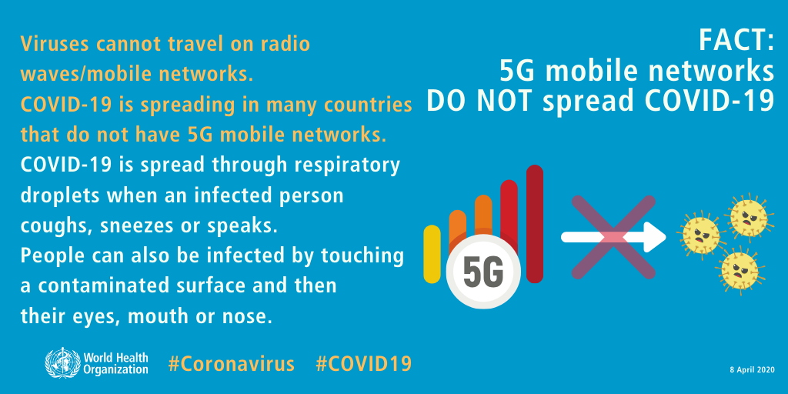
Questions?
Notes:
There is no such thing as a silly question.
There is a lot of confusing information out there. If there is something you have heard that you are not sure about, please ask.
Raise hands
Write in the chat box
what if health authorities are not saying anything/much yet we know there is a high risk
How to clean your mask
Chronic disease list - immunocompromised HIV/AIDS

Slide 38
+ 1 403 243 3285
support@cawst.org
cawst.org

Slide 39
Thanks!
Questions?

