Slide 1
12, 2916 – 5th Avenue
Calgary, Alberta, T2A 6K4, Canada
Phone: + 1 (403) 243-3285, Fax: + 1 (403) 243-6199
E-mail: cawst@cawst.org, Website: www.cawst.org
CAWST, the Centre for Affordable Water and Sanitation Technology, is a nonprofit organization that provides training and consulting to organizations working directly with populations in developing countries who lack access to clean water and basic sanitation.
One of CAWST’s core strategies is to make knowledge about water common knowledge. This is achieved, in part, by developing and freely distributing education materials with the intent of increasing the availability of information to those who need it most.
This document is open content and licensed under the Creative Commons Attribution Works 3.0 Unported License. To view a copy of this license, visit http://creativecommons.org/licenses/by/3.0 or send a letter to Creative Commons, 171 Second Street, Suite 300, San Francisco, California 94105, USA.
You are free to:
Share – to copy, distribute and transmit this document
Remix – to adapt this document
Under the following conditions:
Attribution. You must give credit to CAWST as the original source of the document. Please include our website: www.cawst.org
CAWST will produce updated versions of this document periodically. For this reason, we do not recommend hosting this document to download from your website.
CAWST and its directors, employees, contractors, and volunteers do not assume any responsibility for and make no warranty with respect to the results that may be obtained from the use of the information provided.
Stay up-to-date and get support:
Latest updates to this document
Other workshop & training related resources
Support on using this document in your work
CAWST provides mentorship and
coaching on the use of its education
and training resources.

Slide 2
This presentation is used with Lesson Plan 11: How the Biosand Filter Works in the Biosand Filter for Project Implementers Trainer Manual.
Available at www.cawst.org/resources

Slide 3
Pathogen Removal in the Biosand Filter

Slide 4
Learning Expectations
Describe the 4 ways that pathogens are removed from the water inside a filter.

Slide 5
Function of the BSF
What does a biosand filter do?
Makes dirty water safer to drink

Slide 6
Function of the BSF
How does the BSF make water safe to drink?
The BSF removes almost all pathogens and dirt from water.

Slide 7
Function of the BSF
How does the BSF remove pathogens from the water?
Pathogens are removed from the water in 4 ways:
Trapping (they are too big to get through)
Absorption (they stick to sand grains)
Predation (they get eaten)
Natural Death (they die from suffocation, starvation or old age)

Slide 8
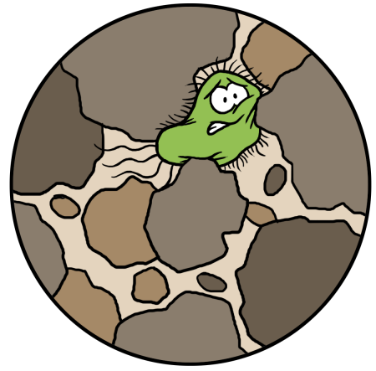
Trapping
Dirt and large pathogens get trapped between sand grains. They are too big to get through.
Notes:
The primary mechanism for removing pathogens in the biosand filter is through mechanical trapping of material as the contaminated water passes through the filter.
The sand grain sizes are usually 0.1 to 1 mm.
The pore (or spaces between the sand grains**) is usually less than this.
Large materials such as bits of grass or leaves, silt, clay particles and mud are trapped in the spaces between the sand grains.
Large pathogens such as parasites, helminthes, and worms are also trapped between the sand grains. It there are smaller pathogens (bacteria or viruses) attached to the larger particles, these are also trapped in the sand grains.
If this was the only mechanism at work, the filter could remove approximately 60 – 90 % of the pathogens that would be in the water. This is typical for a conventional rapid sand filters. For the larger pathogens (helminthes and protozoa), the trapping can remove 99.9 % or more.
Occasionally there might be a source of water that has very fine silt or clay particles in the water that are much smaller than the pore spaces between the sand. They may also be electrically charged such that they are repelled from the sand grains. In this instance, the fine silt/clay particles may go right through the filter. (This happened in a test filter set up in Oklahoma and in some of the DHAN project filters in India.) If this happens, the best solution is to add a coagulant (natural or chemical) that will change the charge on the particles and allow them to settle or be trapped in the filter.
** You may wish to illustrate the concept of the pore spaces by using large (1 “) stones in a clear plastic or glass container. It is very easy to see that there are spaces between the stones. The same thing applies when the sand grains are small - there are still spaces between the grains of sand.
To visualize the size of bacteria and viruses, you might want to use the animation at this web site. http://www.cellsalive.com/howbig.htm

Slide 9
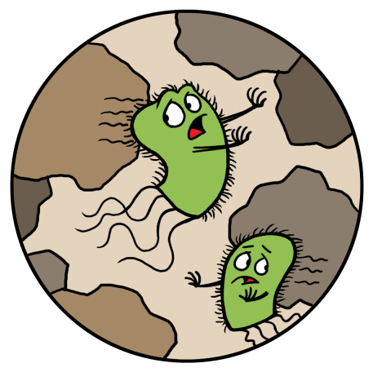
Adsorption
Some pathogens will stick to the sand and dirt inside the filter.
Notes:
The second mechanism that is at work in the filter is called “adsorption” or a better word for it might be “attraction”. Small particles are attracted to each other due to forces such as electrical (positive and negative charges), adhesion (like glue) or other forces I don’t really know about.
Pathogens can be attracted to larger particles that are floating in the water and then they may in turned be trapped in the sand pores or they may stick to the sides of a sand grain.
As a biofilm (illustrated by the green line around the sand grain) starts to build up, it can become sticky and attract other particles to it. Each grain has a biofilm around it and when you put them all together in the filter, it creates a biolayer (or schmutzedeche) within the filter.
The thickest and most active layer is at the top surface of the sand. This still continues down into the filter but becomes less active. I refer to this as a biological zone. After about 10-15 cms there is very little biological activity due to the lack of nutrients and oxygen.

Slide 10
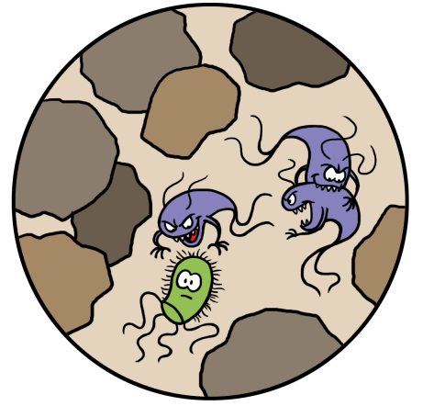
Predation
Microbes in the biolayer eat some pathogens.
Notes:
Pathogens on the surface area of the sand grains grow and thrive very much like a pond or wetland ecosystem. The growing micro – organisms need nutrients such as nitrogen and carbon to live. The source for the nitrogen and carbon are other micro- organisms as well as nutrients in the water (organic material, nitrates). Oxygen is also required for the organisms to live. This comes from the oxygen that is dissolved in the water. If the water is too deep above the sand layer, the oxygen can not diffuse enough to get to the organisms.
Large micro–organisms consume smaller ones. Stronger ones consume weaker ones. Living ones consume dying ones. It can also be describes as the cycle of life or survival of the fittest. I have heard someone refer to it as coyotes and gophers; or foxes and rabbits. The coyotes eat the gophers; the gophers eat seeds and grass; the grass gets it’s nutrients from the soil water and sun - It’s just the way the cycle of life works. (be cautious about using the coyotes and gophers comparison if the audience doesn’t know what coyotes and gophers are - or if they are animal lovers!)

Slide 11
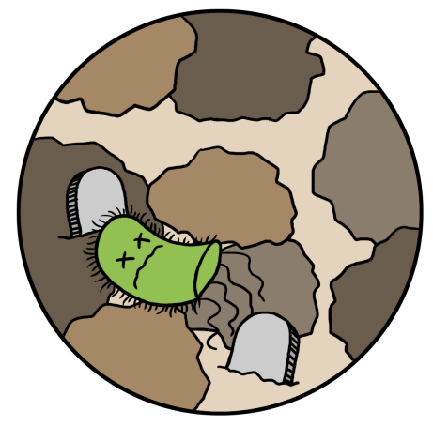
Natural Death
Some pathogens die naturally inside the filter. They may die because they do not have enough oxygen or food, or from old age.
Notes:
This mechanism is very similar to the previous one. The main difference is that this refers to the “natural” die-off rate or life expectance of the micro-organism. If they are trapped long enough within the filter, they will die-off before they can exit the filter with the water stream. If the “pause” period is long enough, the organism will also die-off.
The dead micro-organisms are illustrated as the dark or black particles within the biofilm around each grain of sand.
The life cycle of some organisms is very short (a few hours) so if they can be stopped within the filter, they will die-off.
The other reason for a natural die-off will be due to the lack of oxygen. If the organism is trapped deep within the filter where oxygen can not reach it, it will die-off.

Slide 12
Review
What are the 4 ways pathogens are removed from the water inside a filter?
Trapping (they are too big to get through)
Adsorption (they get stuck to sand)
Predation (they get eaten)
Natural Death (they die from suffocation, starvation or old age)

Slide 13
Review
Create an action for each of the ways the filter removes pathogens:
Pathogens get trapped in the sand
Pathogens stick to sand grains
Microbes eat pathogens
Pathogens die naturally

