Slide 1
2020 | JULY

Slide 2
Introduction
What are the 4 Aspects of Drinking Water Quality?
Notes:
Ask the question to the group.

Slide 3
Aspects of Drinking Water Quality
Microbiological
Microorganisms in water
Chemical
Natural or human-made elements or compounds in water
Acceptability
Factors that influence the appearance, smell, or taste of water
Radiological
Radioactive substances from natural or human sources
Usually very small risk; not considered in this training

Slide 4
LEARNING
OUTCOMES
List the four aspects of drinking water quality
Identify different types of pathogens
Describe microbiological indicator organisms
Examine impacts of priority chemicals on drinking water
Discuss factors that affect the acceptability of drinking water

Slide 5
Microbiological Aspects

Slide 6
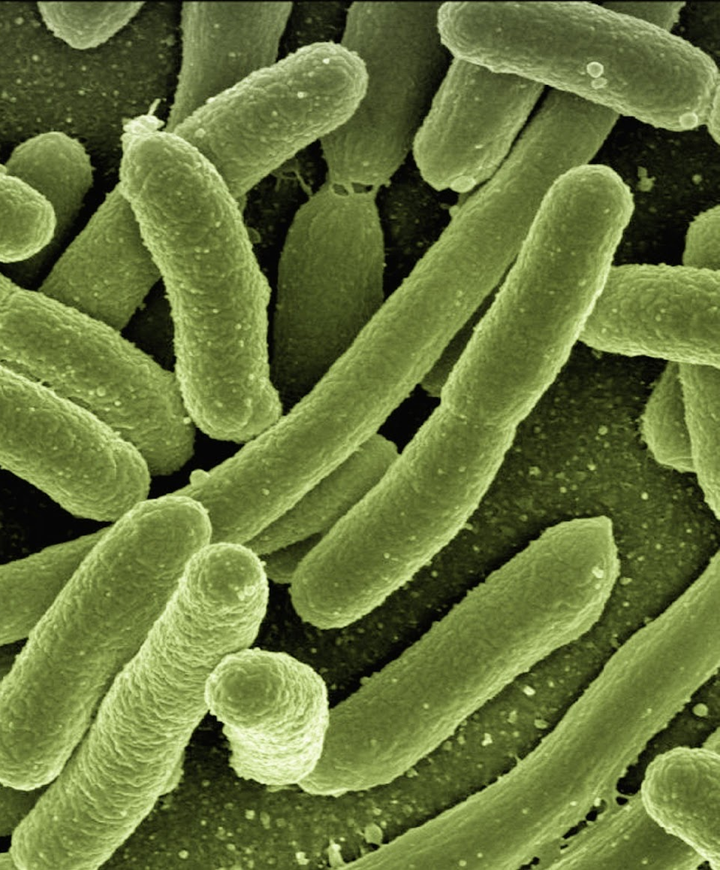
What is a Pathogen?
A microorganism that causes disease (not all microorganisms are pathogens)
Source: Articulate Content Library

Slide 7
4 Types of Microorganisms
Viruses 0.03 - 0.2 microns
Bacteria 0.2 – 10 microns
Protozoa 2– 50 microns
Helminths 40 – 100+ microns

Slide 8
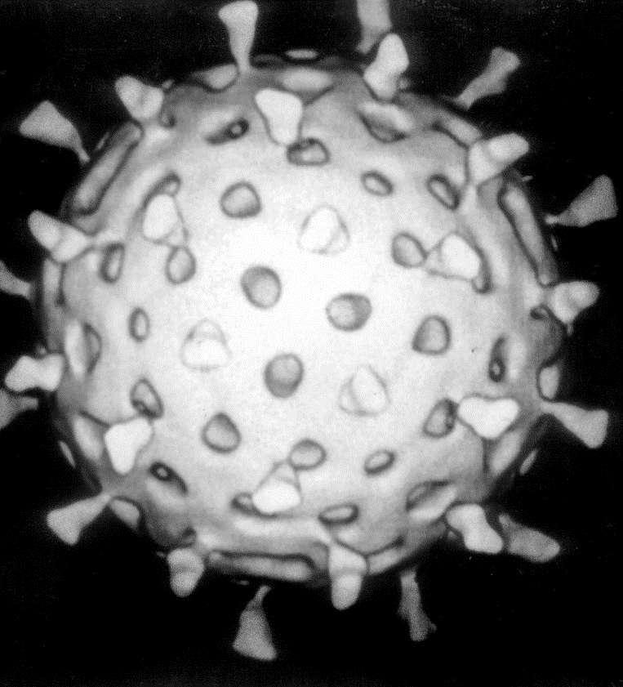
Viruses
Unable to reproduce by themselves
Invade host cells
Water-borne examples: Hepatitis A & E, rotavirus
Mosquito-borne examples: Dengue virus, West Nile virus
Computer-assisted image of a rotavirus particle (70 nm in diameter).
Image Credit: Graham Beards.
Notes:
Viruses - Invade other living cells to reproduce

Slide 9
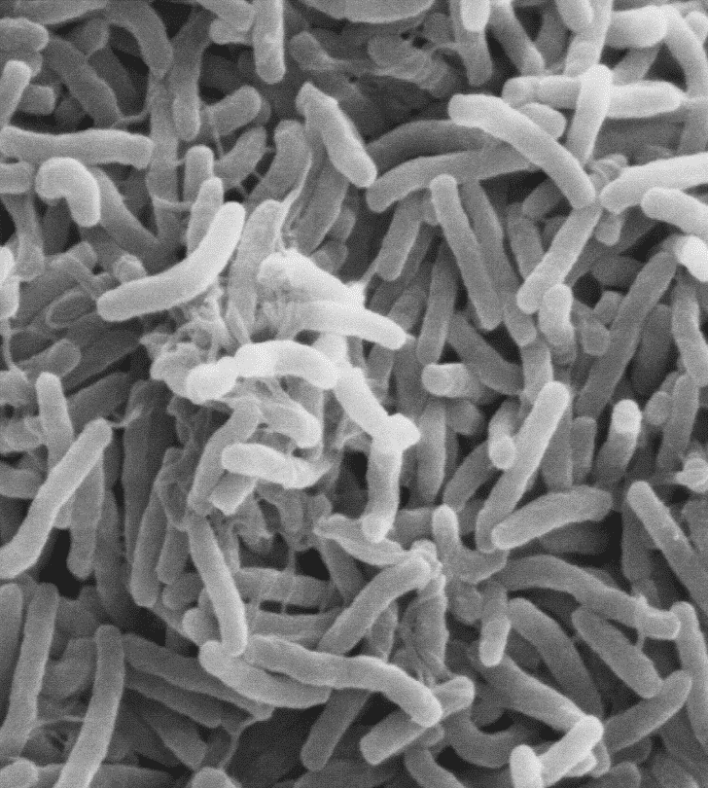
Bacteria
Very common in feces
Escherichia coli (E. coli) bacteria mainly found in feces
Waterborne disease examples: cholera, shigellosis, typhoid
Scanning electron micrograph of Vibrio cholerae bacteria (public domain).
Each bacterium is around 0.5 μm wide by 2 μm long.
Notes:
Bacteria - Tiny, single-celled organisms. Common in feces.

Slide 10
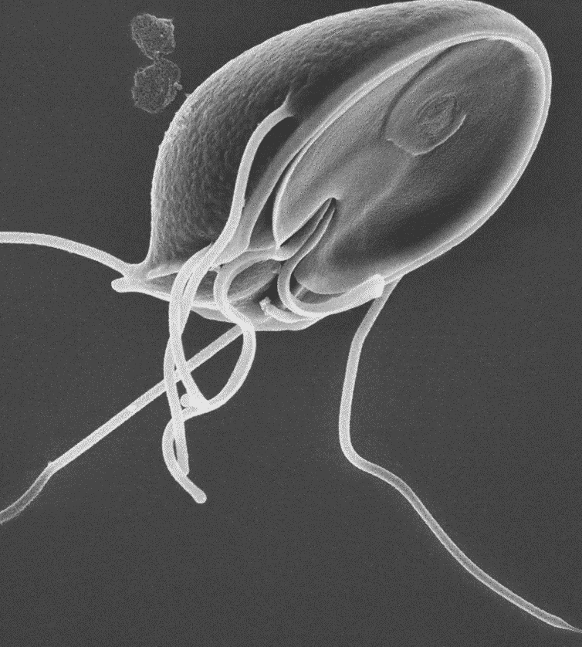
Protozoa
Some need a host to survive
Some can form cysts
Waterborne examples: Amoeba, cryptosporidium, giardia
Mosquito-borne example (breeds in standing water): Malaria
Micrograph of a Giardia parasite (approximately 12 μm long).
Image credit: CDC / Dr. Stan Erlandsen (public domain).
Notes:
Protozoa - Diverse group of single-celled organisms. Some form cysts.

Slide 11
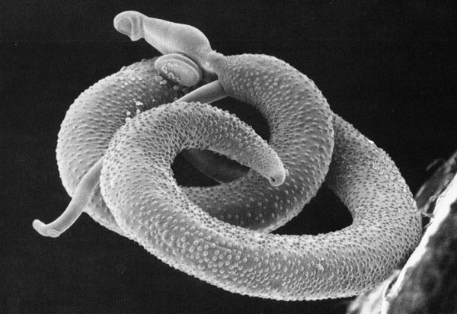
Helminths (worms)
Need a host to survive
Many are passed in feces
Water-related examples: pin worms, hook worms, schistosomes, guinea worms
Scanning electron micrograph of a pair of Schistosoma
mansoni (public domain). Adults can grow to over 1 cm long.
Scanning electron micrograph of a pair of Schistosoma
mansoni (public domain). Adults can grow to over 1 cm long.
Notes:
Helminths - Parasitic worms.

Slide 12
How many different kinds of pathogens are found in water?
What organisms would be tested in water from local water sources?

Slide 13
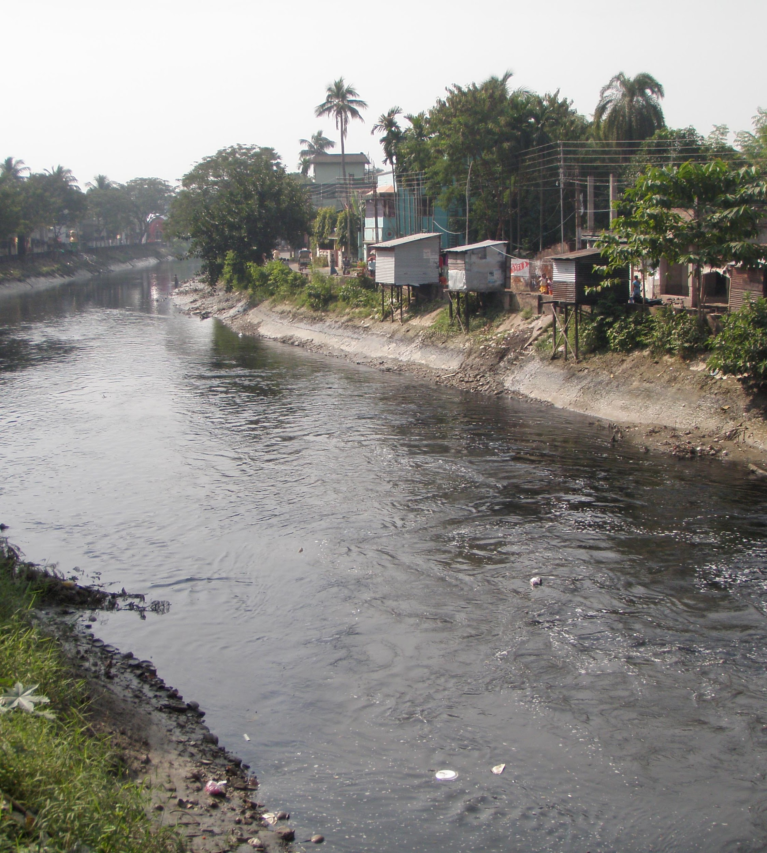
Test all Pathogens?
Time consuming
Complicated
Expensive
Most pathogens come from feces
Test for signs of feces!
Source: Biswarup Ganguly, via Wikimedia. Hanskhali drainage canal, passes contaminated water direct to the Ganges at Howrah, West Bengal

Slide 14
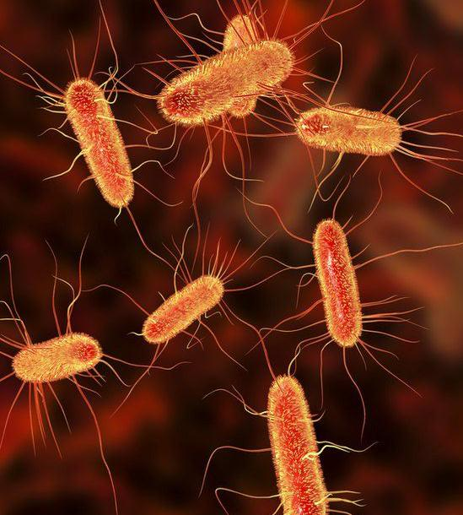
How to test for feces?
Indicator Bacteria: Indicate the presence of feces
E. coli (standard)
Thermotolerant (fecal) coliforms
Source: E. coli, via Wikimedia Commons

Slide 15
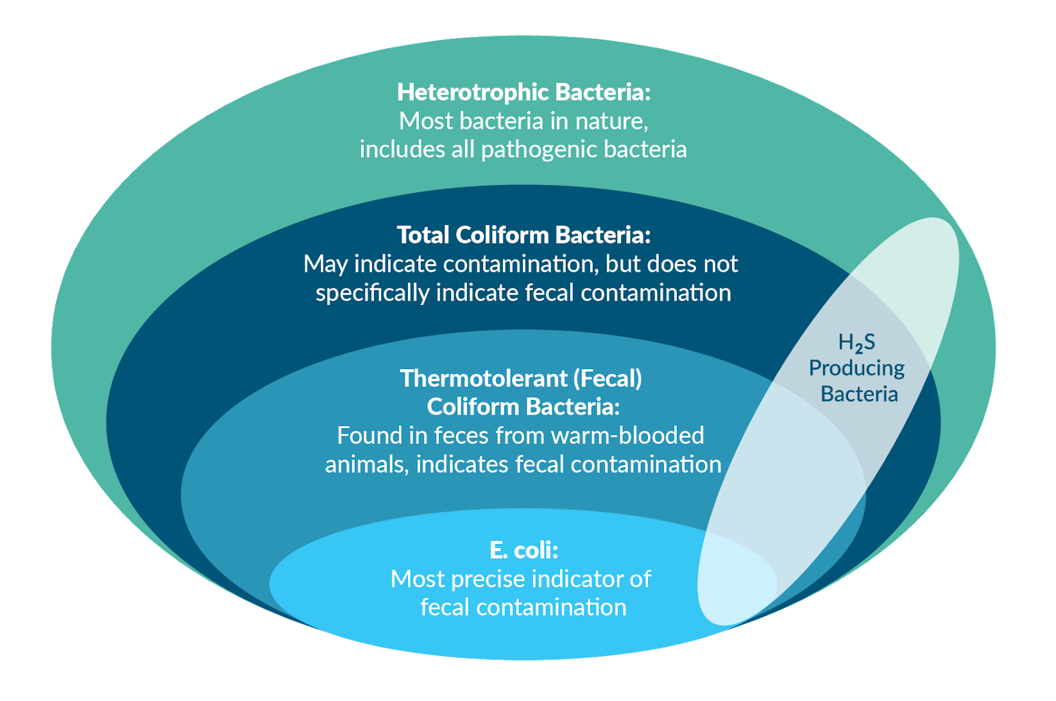
Bacteria Subgroups
Note: A large number of bacteria can produce hydrogen sulfide (H2S). Most come from feces but not all, therefore they are not as specific as E. coli or thermotolerant coliforms to detect fecal contamination.
Notes:
There are several types of indicators, each with certain characteristics. E. coli and thermotolerant (TTC) coliforms (also known as fecal coliforms) are the two main bacterial indicators used for water quality testing.
As shown in the above diagram, E. coli is a type (or subgroup) of thermotolerant coliform, and thermotolerant coliforms are a type (or subgroup) of total coliforms.
Bacterial indicators, such as E. coli and thermotolerant coliforms, are not intended to be absolute indicators for the presence of pathogens in drinking water. Rather the presence of these bacterial indicators in a water sample means that the water was likely contaminated with feces and at a higher risk for causing disease.

Slide 16
WHO Guideline for Drinking Water
Zero fecal contamination in any 100mL Sample
Notes:
The WHO recognizes that zero fecal contamination can be difficult to achieve, especially in developing countries where many people rely on household and small community drinking water systems. It is recommended that, in these settings, the guideline values should be seen as goals for the future, rather than an immediate requirement (WHO, 2011).

Slide 17
Risk for Fecal Contamination in Drinking Water
E. coli level (CFU/100 mL sample) | Risk¹ | Recommended Action²
<1 | Conforms | No health risk
<10 | Low | Water may be consumed as it is
10-99 | Intermediate | Treat if possible, but may be consumed as it is
100-999 | High | Must be treated
> 1,000 | Very High | Rejected or treated very thoroughly
Source: (¹ Médecins Sans Frontières, 2010; ² Harvey, 2007)
Notes:
Many relief agencies use these values to determine when water treatment is required in emergency situations (adapted from Médecins Sans Frontières, 2010 and Harvey, 2007).

Slide 18
Stretch
Break!

Slide 19
Chemical Aspects

Slide 20
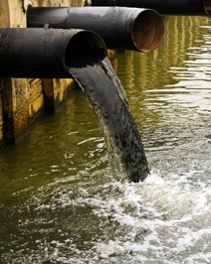
Chemical Aspects
Natural or human-made elements or compounds
Health effects are often more gradual and long-term (compared to microbiological)
Source: EPA

Slide 21
Information Treasure Hunt
Use Chemical Parameter Clues handout
Read posted chemical facts
Identify the correct chemical parameters
Notes:
Explain that participants should work in pairs or small groups to identify and record the correct chemical parameters by following the clues on the handout. Read the posted chemical fact sheets to identify and record the correct chemical parameters on the handouts.
Give 10 minutes to complete this activity and review the answers with the group.

Slide 22
Priority Chemicals
Arsenic
Fluoride
Nitrate

Slide 23
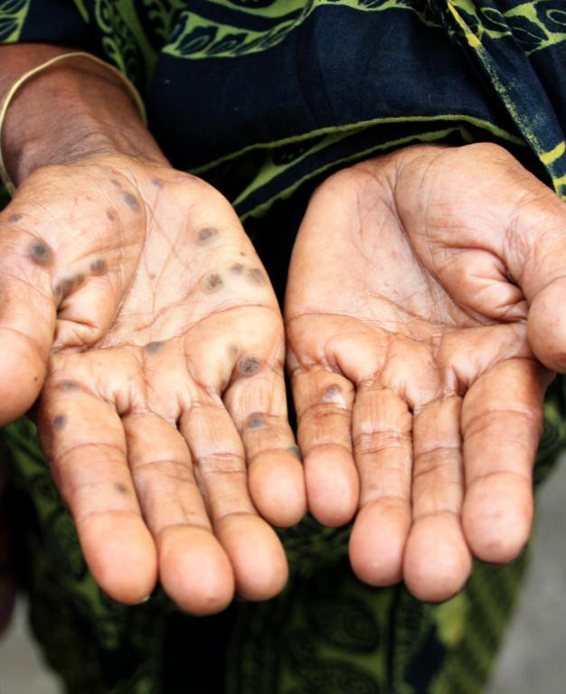
Arsenic
Potential long term health effects:
Keratosis; hard patches on palms and feet
Source: Arsenic Poisoning, Anita Ghosh, REACH
via Wikimedia Commons

Slide 24
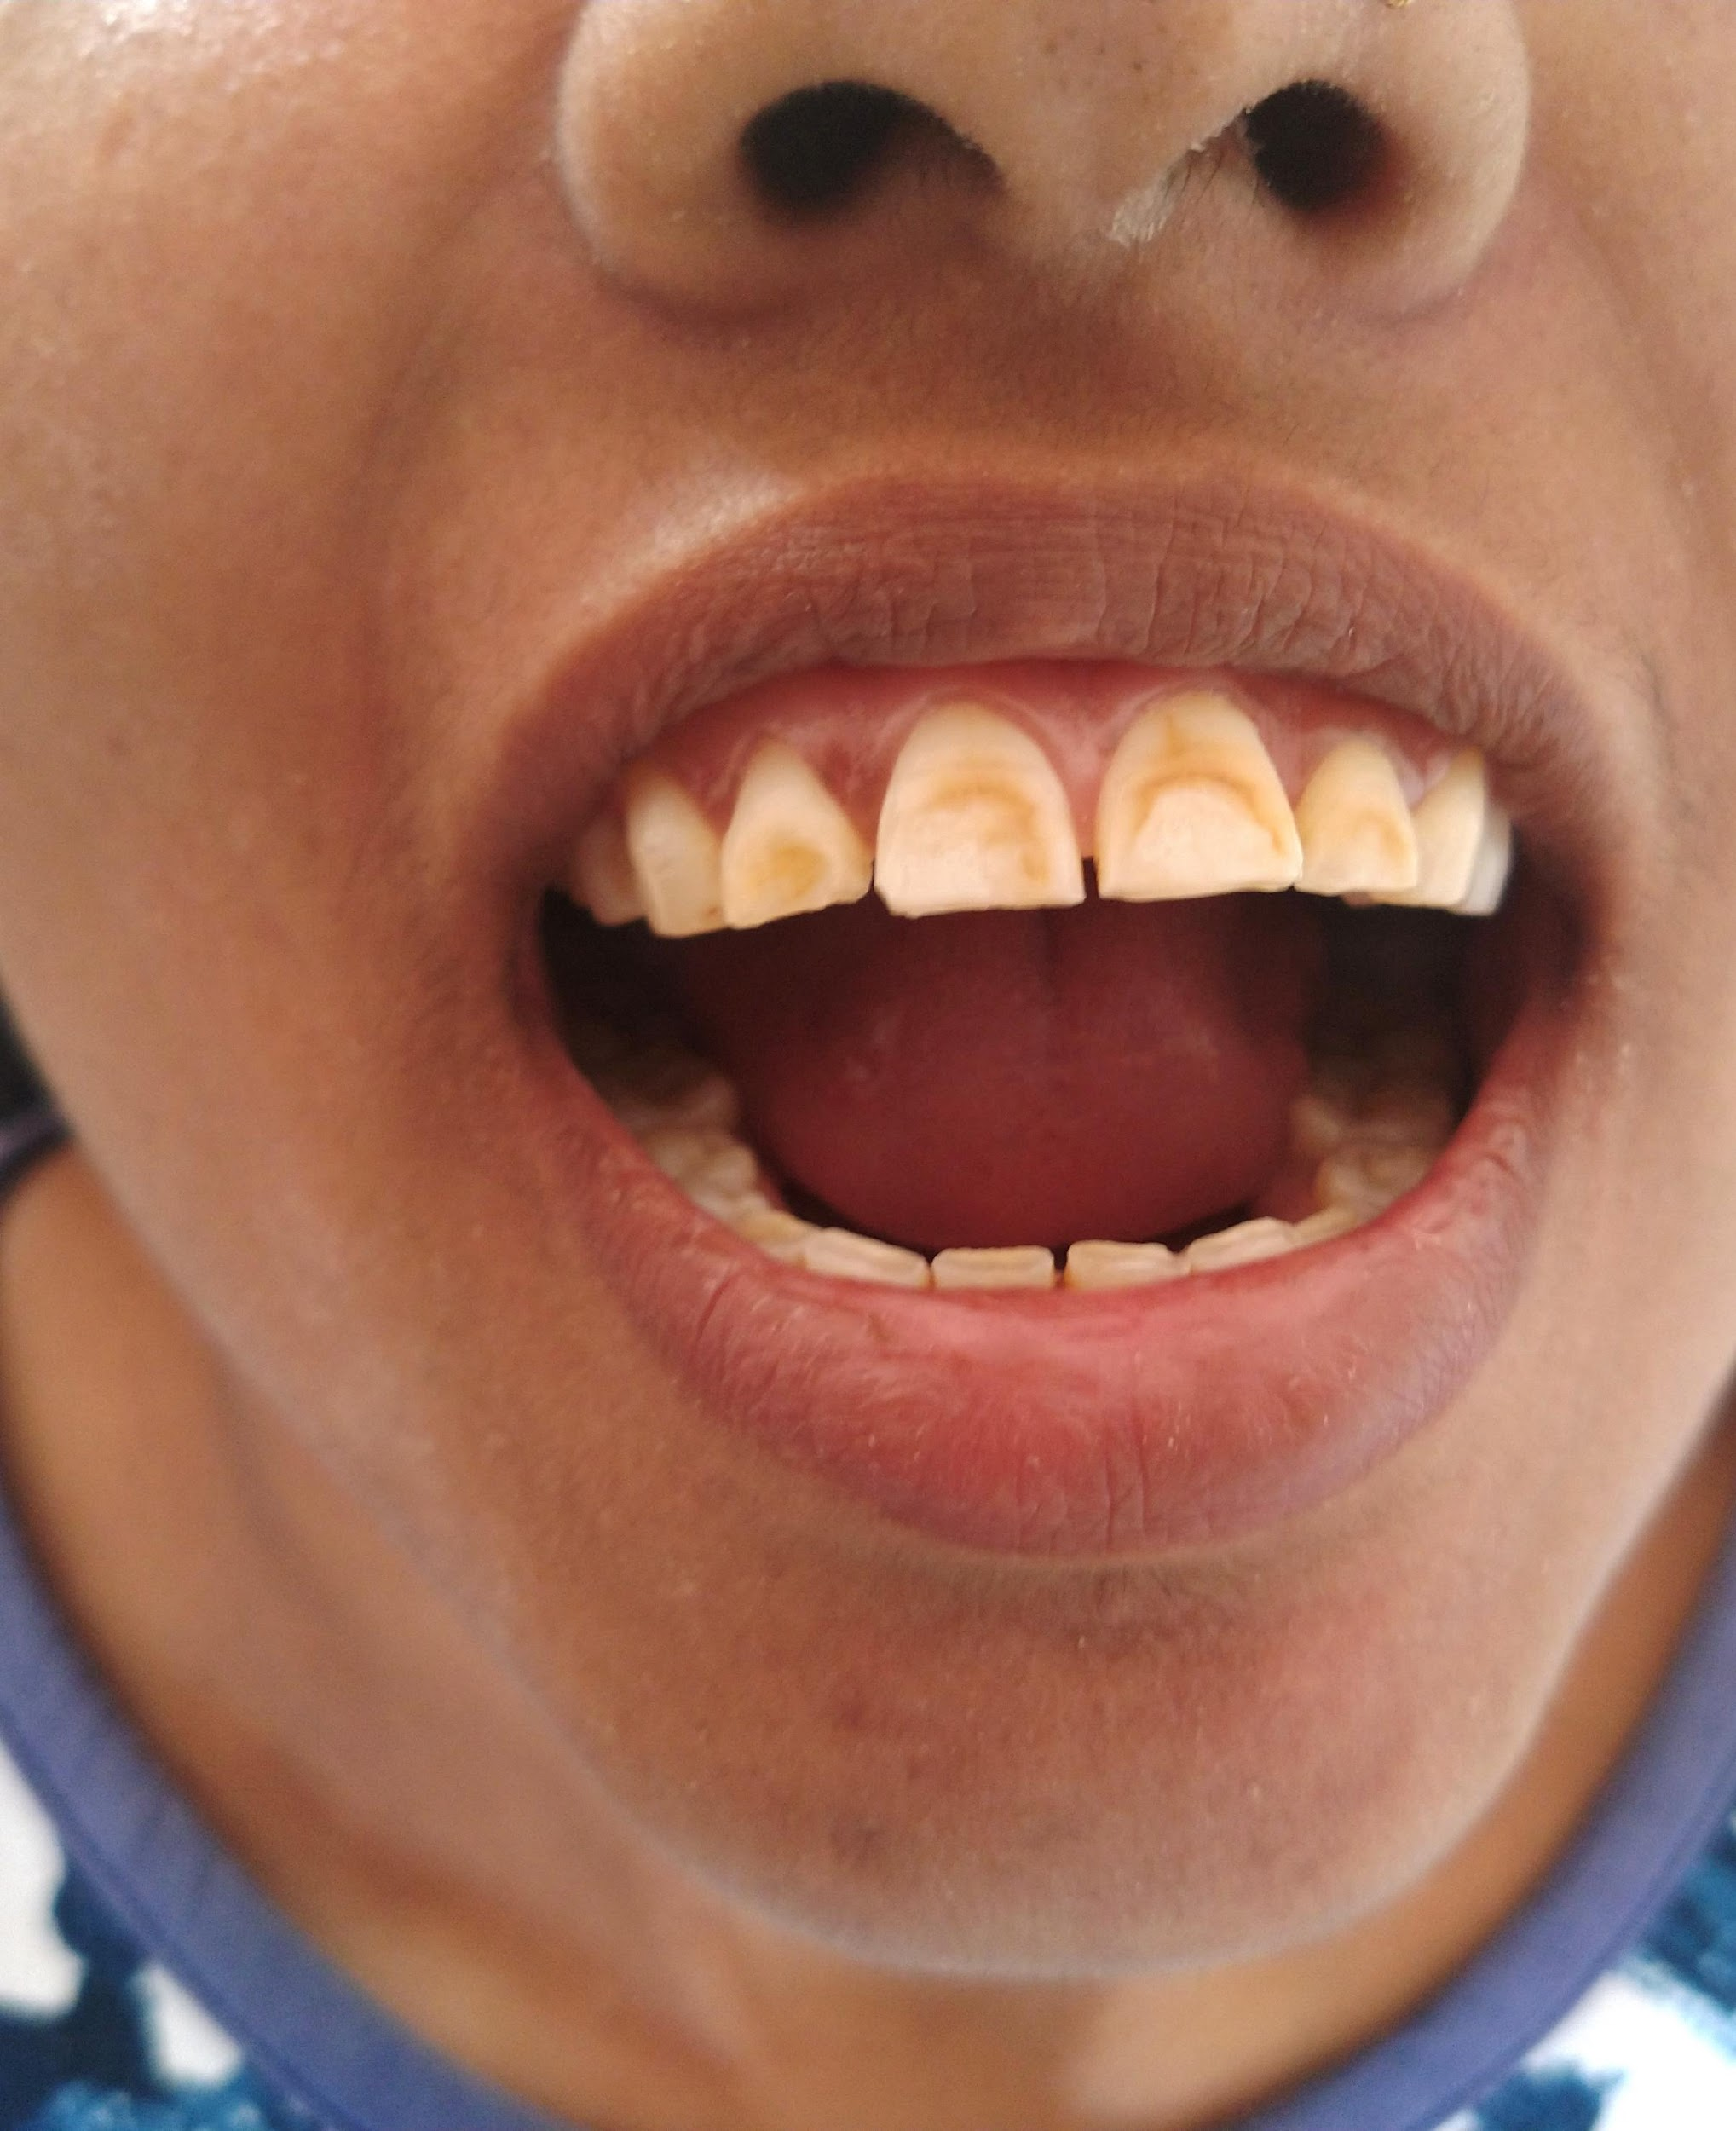
Flouride
Potential long term health effects:
Dental and skeletal fluorosis
Source: Dental_Flurosis, Nizil Shah
via Wikimedia Commons

Slide 25
Nitrate and Nitrite
Potential health effect:
Blue baby syndrome or cyanosis
Source: Articulate Library
Notes:
High nitrate and nitrite levels may cause blue baby syndrome when baby formula is prepared with contaminated water; causes difficulty breathing and skin turns blue from lack of oxygen (cyanosis)

Slide 26
Acceptability Aspects

Slide 27
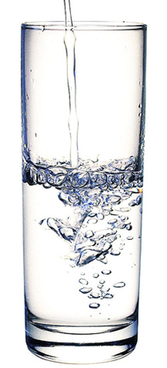
Acceptability Aspects
Affect the appearance, taste, or smell of water
Affect how consumers feel about drinking the water
Source: Envato Elements

Slide 28
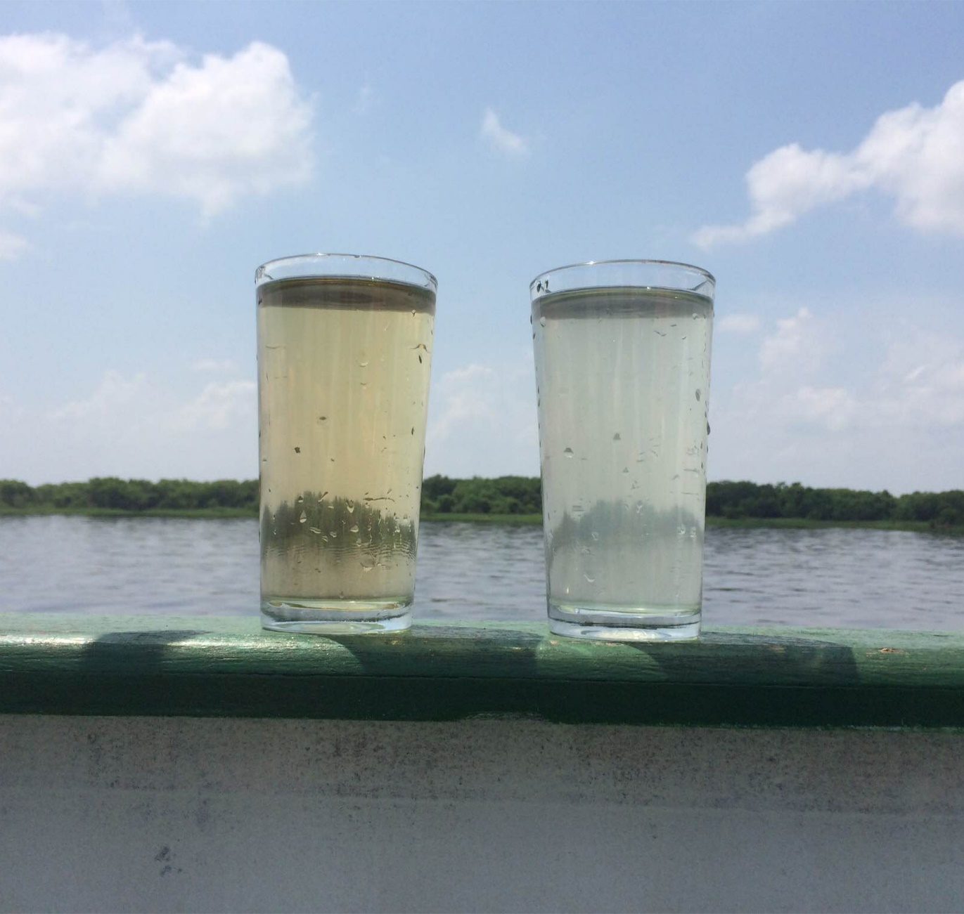
Acceptability Aspects
Colour
Taste and Smell
Temperature
Notes:
Acceptability aspects may point to other issues and affect how people feel about drinking the water.
The acceptability aspects of drinking water are usually things that we can measure with our senses: colour, taste, odour and temperature and turbidity.
In general, we judge drinking water to have good acceptability qualities if it is clear, tastes good, has no smell and is cool.

Slide 29
Acceptability: Colour
Examples:
Organic material: brown/yellow
Iron: red/orange
Manganese: black
Algae: green
Bacterial growth: black (or other colours)
Notes:
May cause people to look for other sources.

Slide 30
Acceptability: Taste and Smell
Examples:
Algae and some bacteria: unpleasant taste and smell
Sulphate: bitter taste, rotten egg smell
Iron: metallic taste
Mineral concentration: may taste salty
Chlorine: chemical taste and smell
Notes:
May indicate contamination or may make people find another source.
Taste and odour are perhaps the most important characteristics of drinking water from the point of view of the user.
It is next to impossible to convince people that water is safe to drink if it tastes or smells bad.

Slide 31
Acceptability: Temperature
Examples:
Cool water is generally more pleasant than warm water to drink
The aesthetic objective for water temperature is 15°C (Guidelines for Canadian Drinking Water Quality, 2019)
Warmer water promotes microbial growth which can lead to unpleasant odour/taste/colour
Notes:
May indicate contamination or may make people find another source.

Slide 32
Acceptability: Turbidity
Examples:
The turbidity of drinking water for small community water systems and household water treatment methods should be less than 5 NTU Nephelometric Turbidity Unit = NTU
The WHO recommends that turbidity should be no more than 1 NTU (WHO, 2011)
Notes:
Suspended particles of silt or clay that make water cloudy.
Particles are not dangerous on their own, but pathogens attach to them.

Slide 33
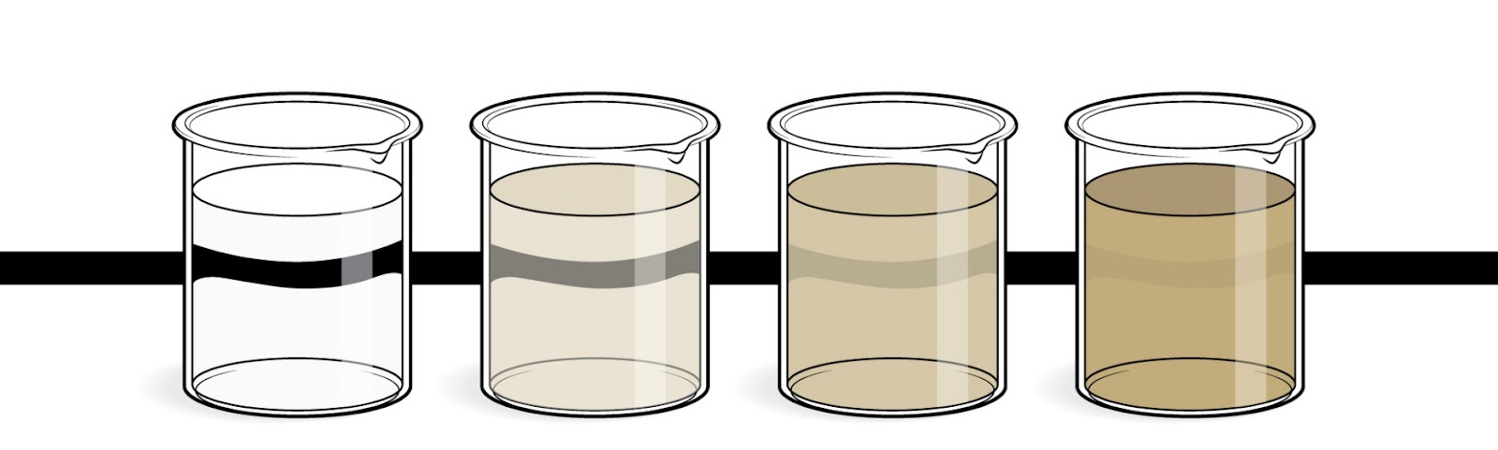
Example of turbidity levels
< 5 NTU 5-20 NTU 20-100 NTU > 100 NTU
Source: CAWST, 2021
Notes:
Suspended particles of silt or clay that make water cloudy.
Particles are not dangerous on their own, but pathogens attach to them.

Slide 34
Why do we care about
Acceptability?
Notes:
For long-term behaviour change and use of HWTS, people must like the taste, smell, and appearance of their water.
Some acceptability aspects (such as turbidity) may indicate microbiological contamination.

Slide 35
Radiological Aspects
Radioactive substances from natural or human sources
Generally very small and not covered in this training
Notes:
Generally, the amount of radiation people consume in their water is very small compared to radiation exposure from other sources (for example, the sun).

Slide 36
DISCUSSION
For most water supply systems, which aspects of water quality are most important to monitor and treat?
Notes:
See trainer manual for summary of key points. Aspects of DWQT.

Slide 37
REVIEW
Paper Cabbage review activity
or
Word Search review activity in the Workbook

Slide 38
Thank you!
Calgary . Alberta . Canada
+1 403 243 3285
cawst@cawst.org
cawst.org

