Slide 1




424 Aviation Road NE
Calgary, Alberta, T2E 8H6, Canada
Phone: + 1 (403) 243-3285, Fax: + 1 (403) 243-6199
E-mail: resources@cawst.org, Website: www.cawst.org
CAWST, the Centre for Affordable Water and Sanitation Technology, is a nonprofit organization that provides training and consulting to organizations working directly with populations in developing countries who lack access to clean water and basic sanitation.
One of CAWST’s core strategies is to make knowledge about water common knowledge. This is achieved, in part, by developing and freely distributing education materials with the intent of increasing the availability of information to those who need it most.
This document is open content and licensed under the Creative Commons Attribution Works 3.0 Unported License. To view a copy of this license, visit http://creativecommons.org/licenses/by/3.0 or send a letter to Creative Commons, 171 Second Street, Suite 300, San Francisco, California 94105, USA.
You are free to:
        Share – to copy, distribute and transmit this document
        Remix – to adapt this document
Under the following conditions:
        Attribution. You must give credit to CAWST as the original source of the document. Please include our website: www.cawst.org
CAWST will produce updated versions of this document periodically. For this reason, we do not recommend hosting this document to download from your website.
CAWST and its directors, employees, contractors, and volunteers do not assume any responsibility for and make no warranty with respect to the results that may be obtained from the use of the information provided.
Stay up-to-date and get support:
            Latest updates to this document
            Other workshop & training related resources
            Support on using this document in your work
CAWST provides mentorship and
coaching on the use of its education
and training resources.

Slide 2

This presentation is used with Lesson Plan 4: Local and Global Issues in the Introduction to Environmental Sanitation Trainer Manual.
Available at www.cawst.org/resources

Slide 3
Local and Global
Sanitation Issues

Slide 4

Learning Outcomes
Discuss the local and global issues involved with access to basic sanitation.
Discuss how poor sanitation is connected to and causes the cycle of poverty to continue.

Slide 5
Think About It
What’s being done to meet the needs of the world’s poorest?
UN Millennium Development Goals to
  Reduce poverty and hunger
  Tackle ill-health
  Address gender inequality
  Improve education
  Provide safe water and adequate sanitation
Notes:
About the MDGs…
In September 2000, 189 heads of state adopted the UN Millennium Declaration and endorsed a framework for development.
The plan was for countries and development partners to work together to increase access to the resources needed to reduce poverty and hunger, and tackle ill-health, gender inequality, lack of education, lack of access to clean water and environmental degradation.
They established eight Millennium Development Goals (MDGs), set targets for 2015, and identified a number of indicators for monitoring progress, several of which relate directly to health.
All goals and their targets are measured in terms of progress since 1990. Reporting on progress towards the MDGs has underscored the importance of working with countries to generate more reliable and timely data. Currently available data show that while some countries have made impressive gains in achieving health-related targets, others are falling behind. Often the countries making the least progress are those affected by high levels of HIV/AIDS, economic hardship or conflict.

Slide 6
8 MDGs by 2015
Goal 1. Eradicate extreme poverty and hunger
Goal 2. Achieve universal primary education
Goal 3. Promote gender equality and empower women
Goal 4. Reduce child mortality
Goal 5. Improve maternal health
Goal 6. Combat HIV/AIDS, malaria and other diseases
Goal 7. Ensure environmental sustainability
  Halve the proportion of people without sustainable access to safe drinking water and basic sanitation
Goal 8. Develop a global partnership for development
Notes:
Millennium Development Goals (MDGs) are a United Nations led initiative to promote development through reduction of poverty, achievement of universal primary education, increasing access to water and sanitation, etc.
There are eight goals to be achieved by 2015. They will be replaced by the Sustainable Development Goals in 2016.

Slide 7
Access to Basic Sanitation
What does this mean?
Improved sanitation hygienically separates human excreta from human contact
  Connection to a public sewer or septic system
  Pit latrine with slab
  Pour flush latrine
  Ventilated improved pit (VIP) latrine
  Composting latrine
Notes:
Access to basic sanitation is measured against the proxy indicator: the proportion of people using improved sanitation facilities.
Improved sanitation hygienically separates human excreta from human contact.
This term was developed by the UNICEF and World Health Organization (WHO) Joint Monitoring Programme (JMP) for Water Supply and Sanitation. It is used to measure progress towards achieving the Millennium Development Goal (MDG) of halving by 2015 the proportion of people without sustainable access to basic sanitation (UNICEF and WHO, 2013).

Slide 8
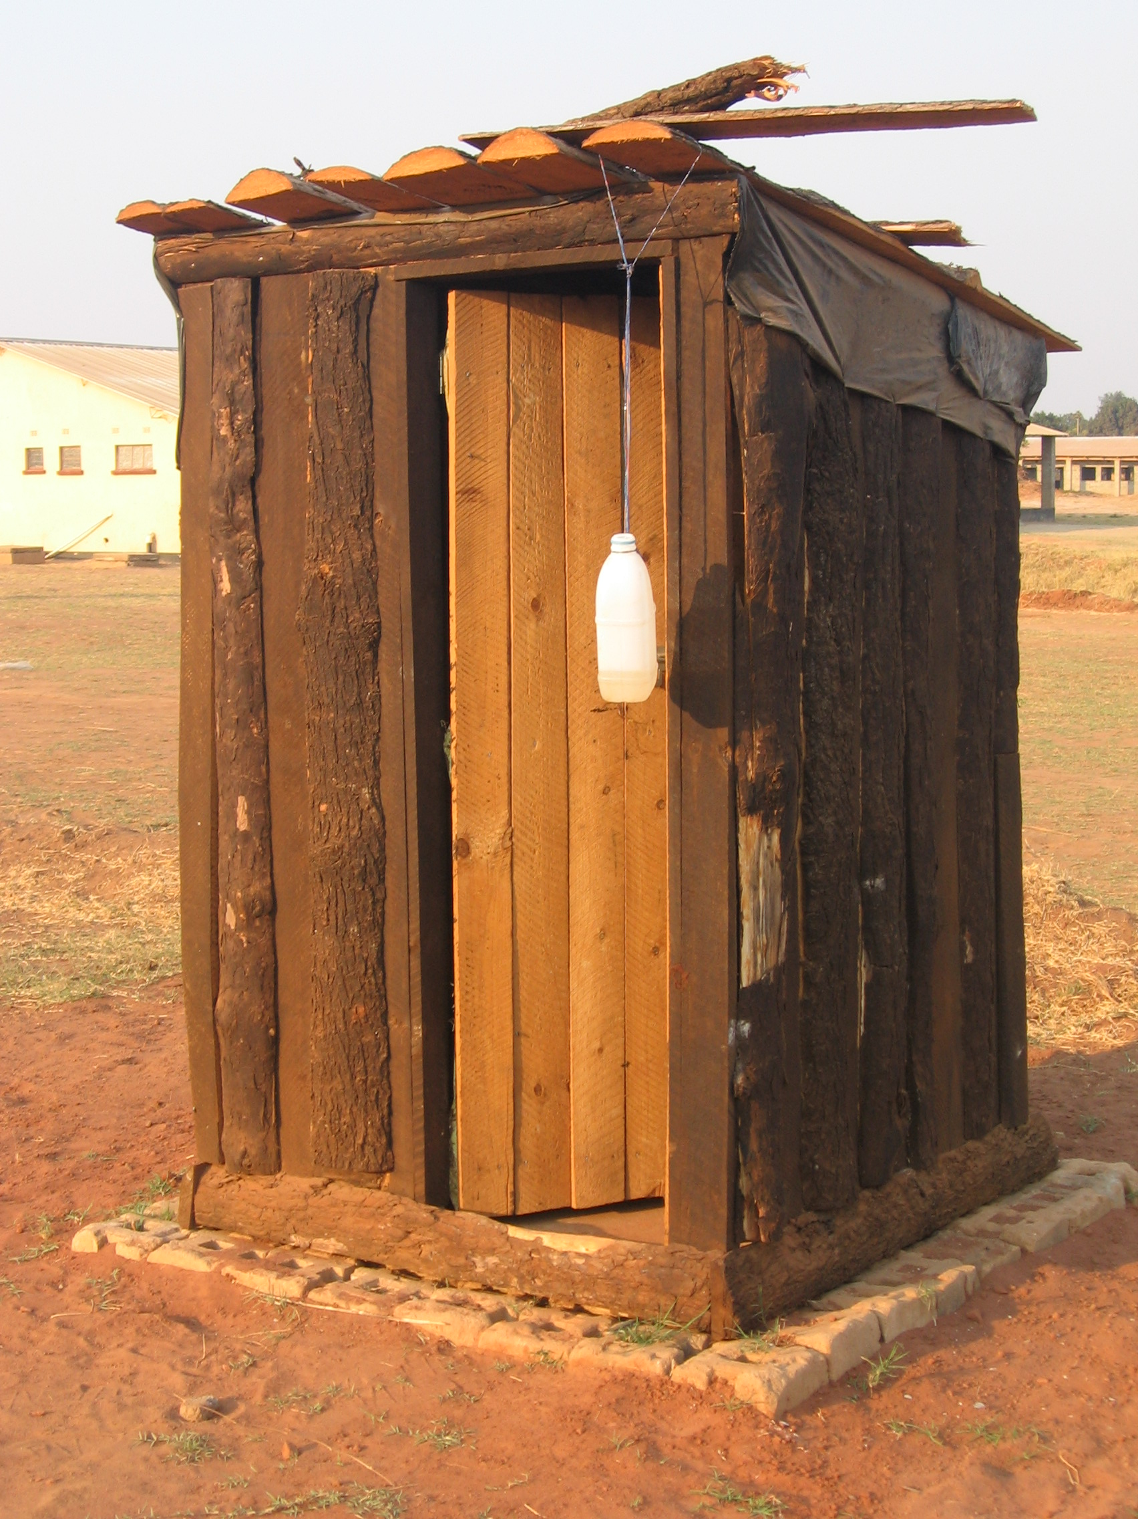
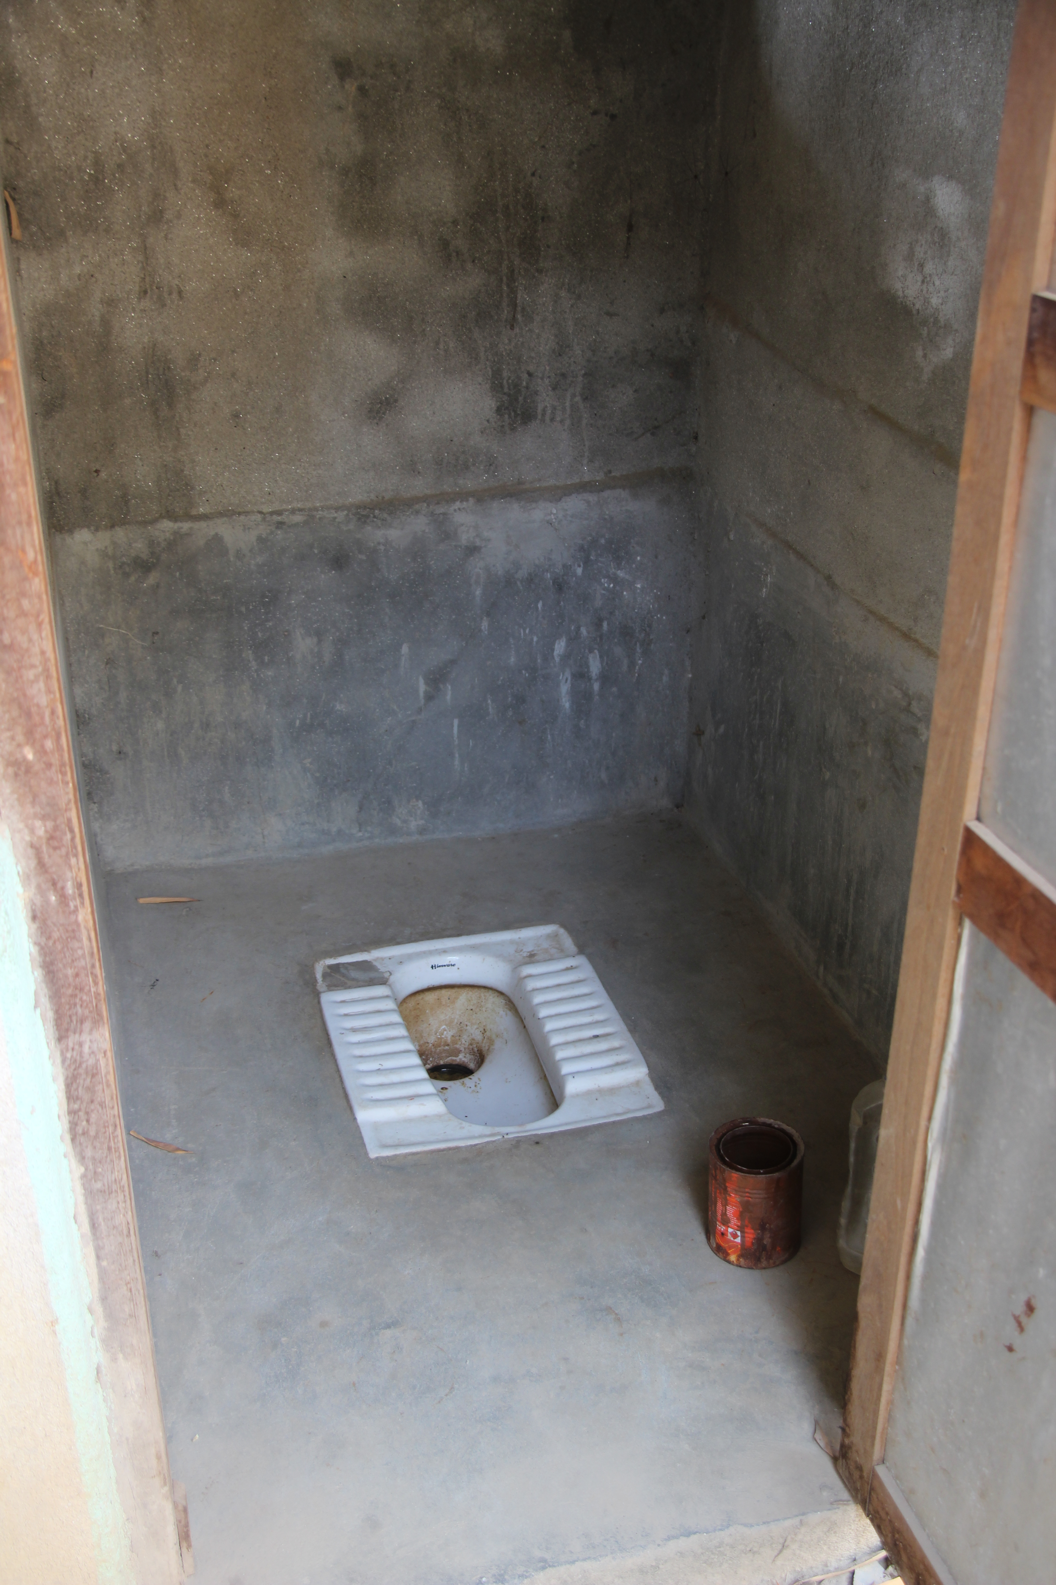
Improved Sanitation
Pit latrine, Zambia
Pour Flush Latrine, Nepal

Slide 9
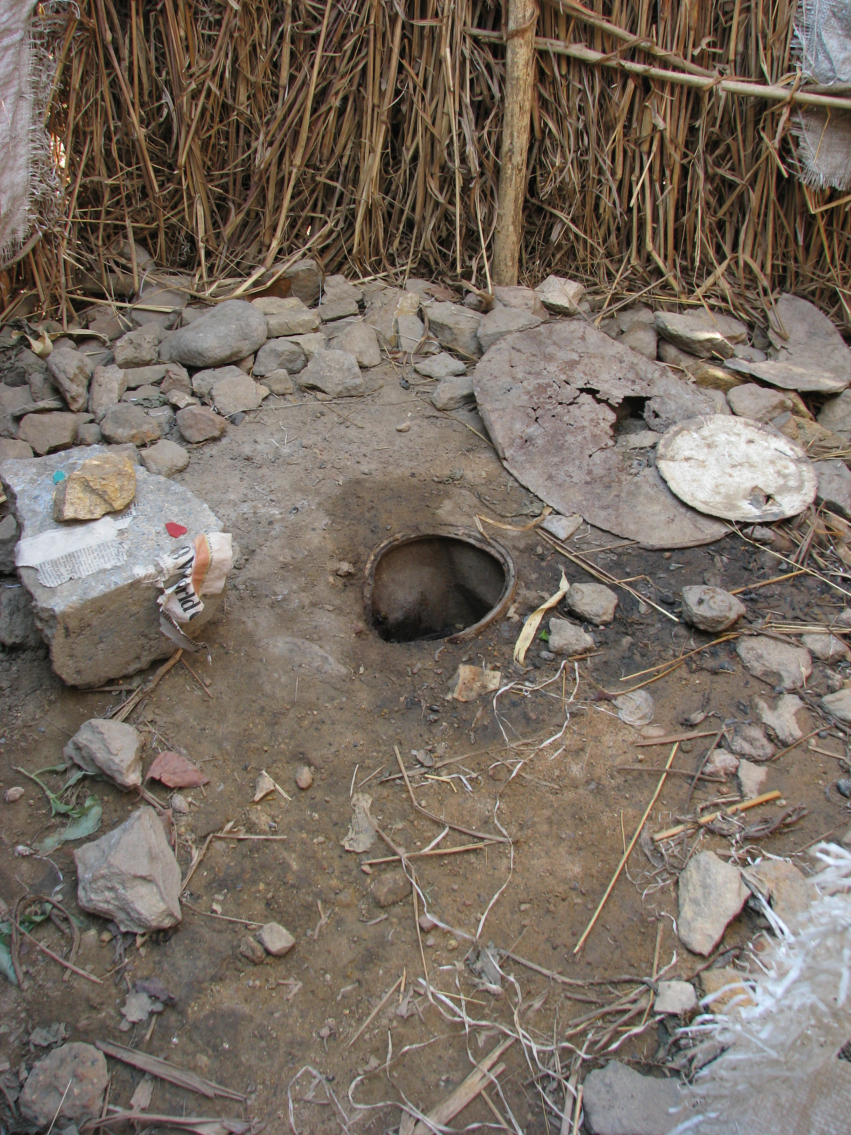
Unimproved
Sanitation Facilities
Pit latrine without slab, or open pit
Bucket
Hanging latrine
Flush or pour flush latrine discharging to elsewhere
Shared facilities of any type
Open defecation
Pit latrine without slab, Zambia
Notes:
Unimproved sanitation facilities do not ensure a hygienic separation of human excreta from human contact.

Slide 10
45 Countries with
Less than 50% Coverage
(Credit: UNICEF and WHO, 2014)
Notes:
As of 2012, around 2.5 billion people lack access to adequate sanitation (UNICEF and WHO, 2014)
784 million people use public or shared sanitation facilities
732 million use unimproved sanitation facilities that do not hygienically separate human excreta from human contact
The group most in need of improved sanitation is the rural poor

Slide 11
Open Defecation
(Credit: UNICEF and WHO, 2014)
Notes:
1 billion (14% of the world population) defecate in the open
The majority (70%) of those without sanitation live in rural areas, where 90% of all open defecation takes place

Slide 12
Access + Use = Benefits
Access alone is not enough!
Many people achieved access to sanitation, but many latrines were not used
Notes:
• Since 1990, almost 2 billion people have gained access to an improved sanitation facility, and open defecation declined from 24% to 14% of the world population.

Slide 13
What About Locally?
% urban population using improved sanitation
% rural population using improved sanitation
% total population using improved sanitation
% total population practicing open defecation
Notes:
Add country or regional information about access to improved sanitation.
Country and regional information is available at:
UNICEF and World Health Organization (2015). Progress on Sanitation and Drinking Water: 2015 Update and MDG Assessment. WHO/UNICEF Joint Monitoring Programme for Water Supply and Sanitation. UNICEF, New York, USA and WHO, Geneva, Switzerland. Available at: www.wssinfo.org/fileadmin/user_upload/resources/JMP-Update-report-2015_English.pdf

Slide 14
Cycle of Poverty
How is poor sanitation connected to and causes the cycle of poverty to continue?
Notes:
Disease spreading = ill health = unable to go to school = unable to work = lack of productivity = lack of economic growth = poverty.

Slide 15
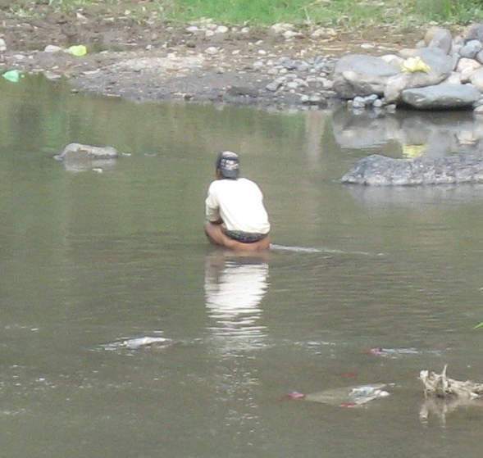
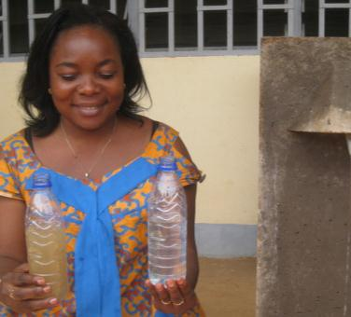
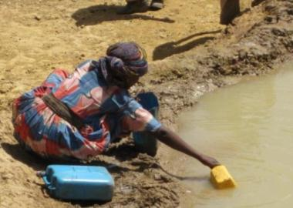
Cycle of Poverty
Family Sick
Healthy Family
$$ Spent on Health Care
School & Education
Poverty
Weak & Vulnerable Society
Strong & Safe Society
Job & Income
Loss of Dignity
& Depression
Opportunities
Notes:
Open defecation contaminates drinking water and causes illness
Children under five are highly vulnerable to waterborne diseases
Sick children unable to attend school
Uneducated adults: Life of poverty & illness

Slide 16
Review
What are some of the local and global issues related to poor sanitation?
How is poor sanitation connected to and causes the cycle of poverty to continue?
Notes:
Ask the participants to stand in two lines facing each other in pairs. Name one line A and the other B.
Ask line A to briefly discuss some of the local and global sanitation issues. After 1 minute, ask line A to move one person to the right. Line B will then discuss the same topic with a new partner for 1 minute.
Ask line A to briefly discuss poor sanitation is connected to and causes the cycle of poverty to continue. After 1 minute, ask line A to move one person to the right. Line B will then discuss the same topic with a new partner for 1 minute.

