Slide 1



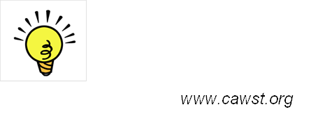
12, 2916 – 5th Avenue
Calgary, Alberta, T2A 6K4, Canada
Phone: + 1 (403) 243-3285, Fax: + 1 (403) 243-6199
E-mail: cawst@cawst.org, Website: www.cawst.org
CAWST, the Centre for Affordable Water and Sanitation Technology, is a nonprofit organization that provides training and consulting to organizations working directly with populations in developing countries who lack access to clean water and basic sanitation.
One of CAWST’s core strategies is to make knowledge about water common knowledge. This is achieved, in part, by developing and freely distributing education materials with the intent of increasing the availability of information to those who need it most.
This document is open content and licensed under the Creative Commons Attribution Works 3.0 Unported License. To view a copy of this license, visit http://creativecommons.org/licenses/by/3.0 or send a letter to Creative Commons, 171 Second Street, Suite 300, San Francisco, California 94105, USA.
You are free to:
        Share – to copy, distribute and transmit this document
        Remix – to adapt this document
Under the following conditions:
        Attribution. You must give credit to CAWST as the original source of the document. Please include our website: www.cawst.org
CAWST will produce updated versions of this document periodically. For this reason, we do not recommend hosting this document to download from your website.
CAWST and its directors, employees, contractors, and volunteers do not assume any responsibility for and make no warranty with respect to the results that may be obtained from the use of the information provided.
Stay up-to-date and get support:
            Latest updates to this document
            Other workshop & training related resources
            Support on using this document in your work
CAWST provides mentorship and
coaching on the use of its education
and training resources.

Slide 2

Safe Water Storage

Slide 3
Learning Expectations
Explain why it is important to store water in safe storage container.
Describe the characteristics for a safe water storage container and their importance.
Demonstrate how to clean a safe water storage container.
Describe safe water handling practices.

Slide 4
Reason for Safe Water Storage
Safe or treated water is often contaminated in the storage container before it gets used.
People may still be drinking contaminated water, even though the water was treated!

Slide 5
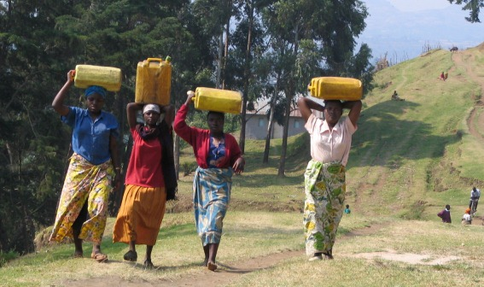
Reason for Promoting Safe Water Storage
Preventing water contamination during transport and storage
Improving hygiene practices (safe water handling)
Preventing mosquito breeding (water storage containers are covered)

Slide 6
Risk of Water Recontamination
Sources: Duke and et al (2006) http://rrh.deakin.edu.au

Slide 7
Biosand Filter Effectiveness and Recontamination
Sources: Duke and et al (2006) http://rrh.deakin.edu.au

Slide 8
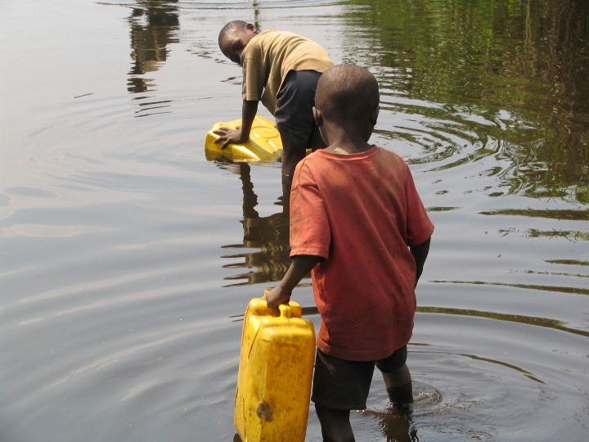
Safe Water Storage
Use one container to collect water to pour into the filter and a different container to collect the filtered water. The container used to collect filtered water should be a safe water storage container.

Slide 9
Criteria for a Good Container
  Small opening for filling and pouring
  Spout / tap / spigot for pouring water
  Lid or cap for opening to clean – tight fitting, attached to container
  Easy to clean – no hidden corners, lid is removable
  Lightweight
  Comfortable handles (easy to carry)
  Durable, UV resistant plastic
  Dark colour so sunlight cannot get through (preventing algae)
  Sticker telling users how to clean it

Slide 10
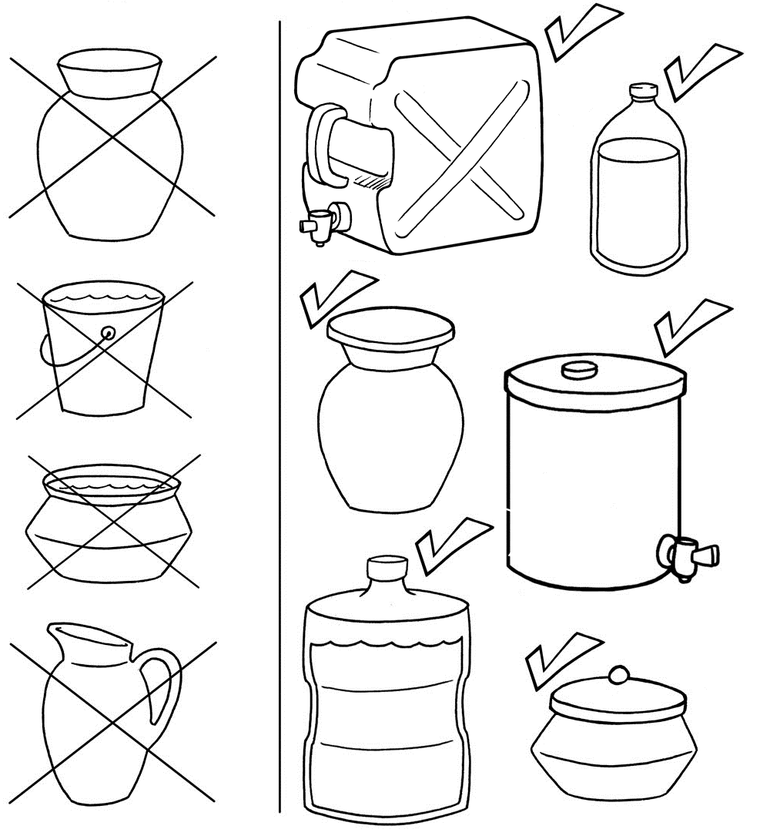
Criteria for a Good Container

Slide 11
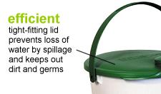
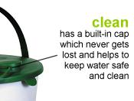


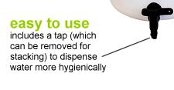
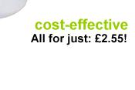
Oxfam Bucket
*robustness??
http://www.oxfam.org.uk/emergencies/oxbucket.htm
Notes:
Discuss the good points and bad points of what participants see in this picture.

Slide 12
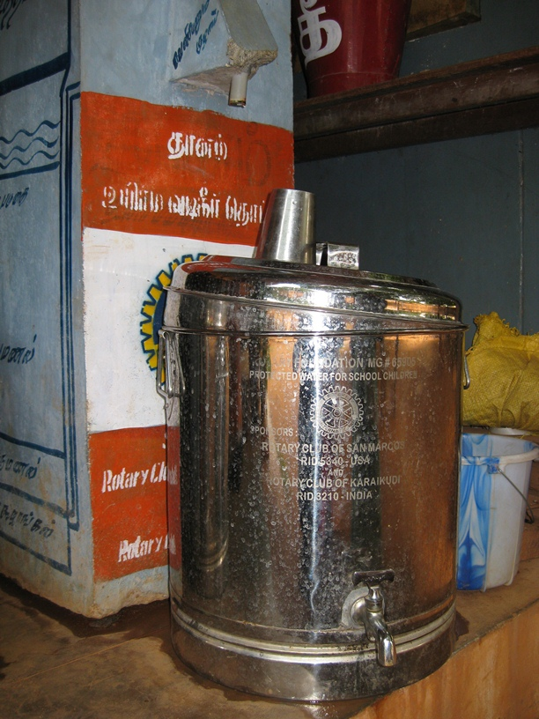
Locally Made Container
India
Notes:
Discuss the good points and bad points of what participants see in this picture.

Slide 13
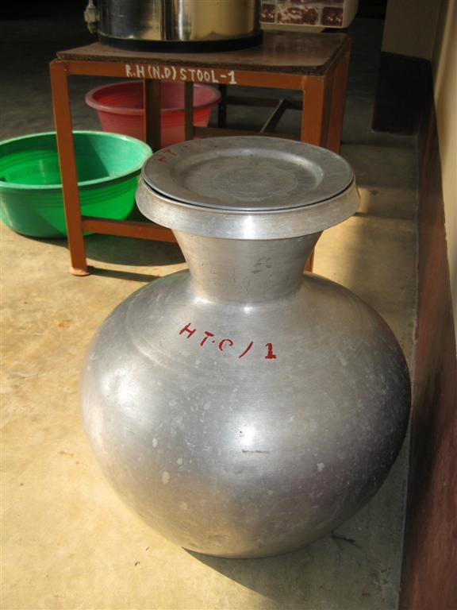
Kolshi with Lid
South Asia
Notes:
Discuss the good points and bad points of what participants see in this picture.

Slide 14
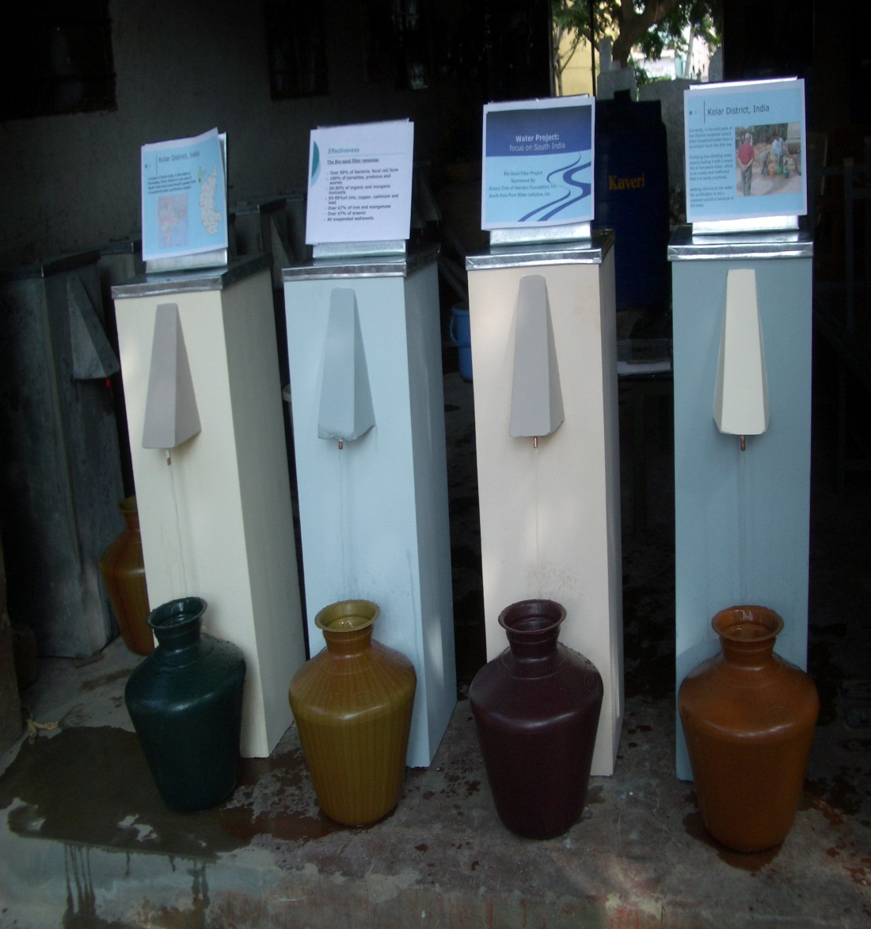
Filters with traditional containers
India
Notes:
Discuss the good points and bad points of what participants see in this picture.

Slide 15
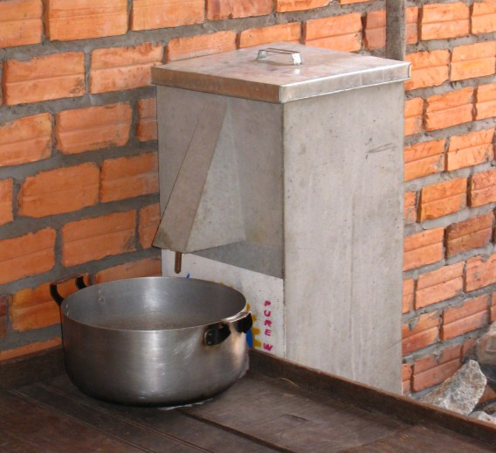
Common Water Collection
Notes:
Discuss the good points and bad points of what participants see in this picture.

Slide 16
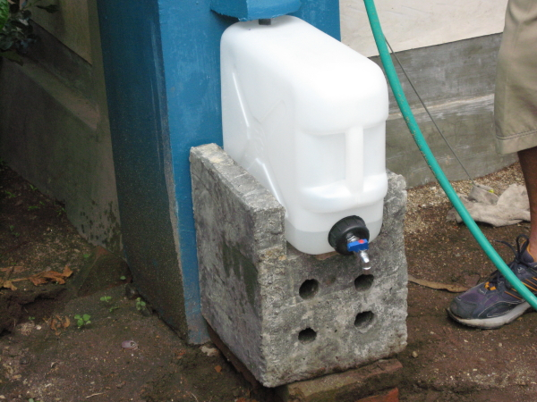
Filtered water storage
Small opening
Handle
Tap
*transparent → algae growth??
Indonesia
Notes:
Discuss the good points and bad points of what participants see in this picture.

Slide 17
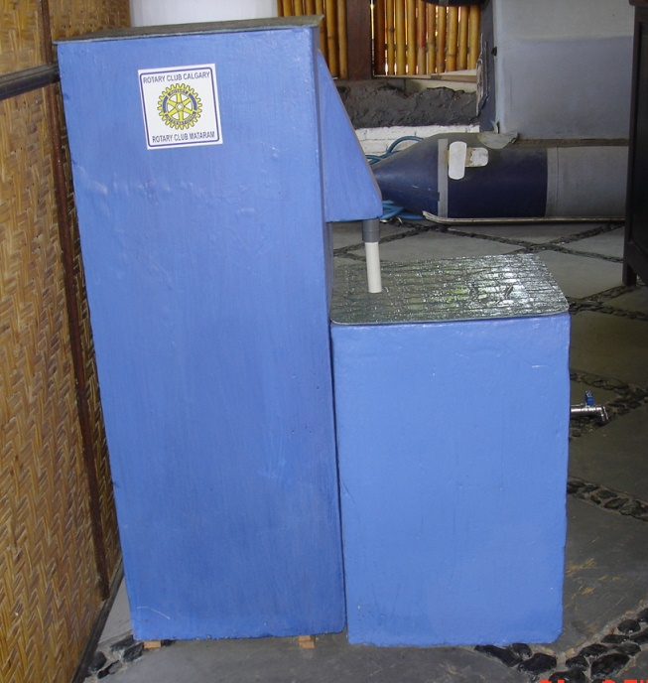
Concrete container
Indonesia
Notes:
Discuss the good points and bad points of what participants see in this picture.

Slide 18
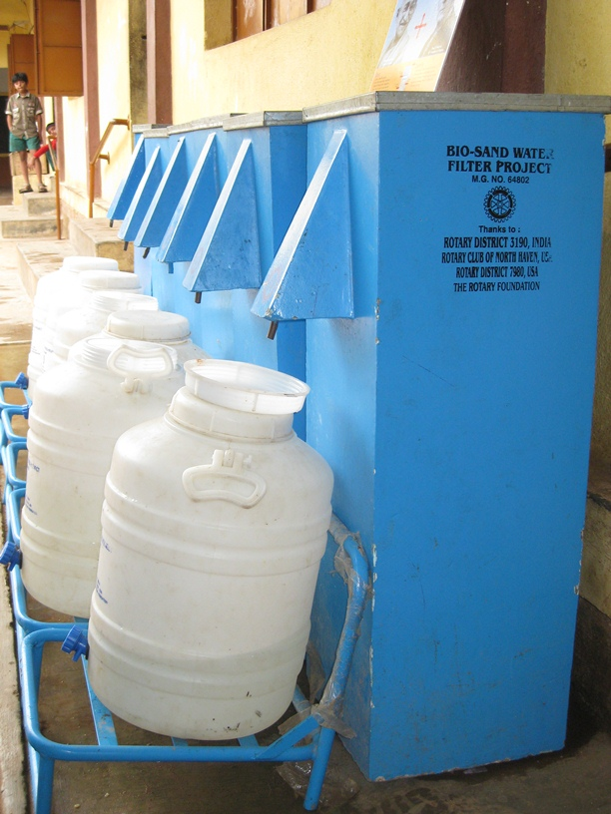
Filtered water storage
India
Notes:
Discuss the good points and bad points of what participants see in this picture.

Slide 19
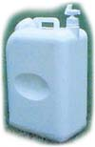
CDC Safe Water System
$4 - 8 US
www.cdc.gov/safewater
Notes:
Discuss the good points and bad points of what participants see in this picture.

Slide 20
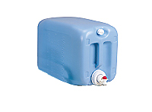
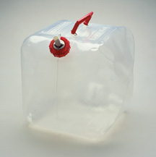
Plastic Containers
Collapsible
Notes:
Discuss the good points and bad points of what participants see in this picture.
*robustness?
*algae growth?

Slide 21
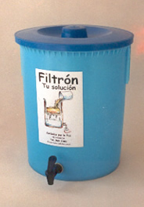
This container also holds a ceramic filter
- Good lid
- Tap
Notes:
Discuss the good points and bad points of what participants see in this picture.

Slide 22
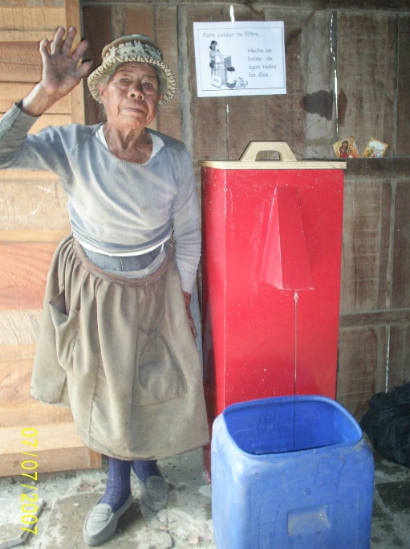
Filtered water storage
Peru
Notes:
Discuss the good points and bad points of what participants see in this picture.
Is there a lid?
A smaller opening would be better to keep out dust, insects, animals, and other things that could fall into the water and contaminate it.

Slide 23
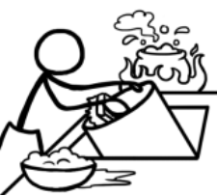
Safe Water Handling
Using different containers for getting untreated water and colleting treated water
Store water off the ground in a shady place in the home
Store water away from small children and animals
Clean the safe storage container often
Notes:
Other safe water handling practices include:
Using a container to collect and store untreated water and using it only for untreated water
Using a different container to store treated water - never use this container for untreated water
Frequently cleaning out the storage container with soap or chlorine
Storing treated water off the ground in a shady place in the home
Storing treated water away from small children and animals
Pouring treated water from the container instead of scooping the water out of it
Drinking treated water as soon as possible, preferably the same day

Slide 24
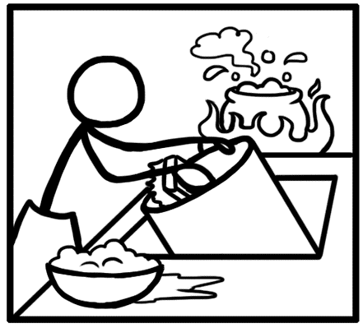
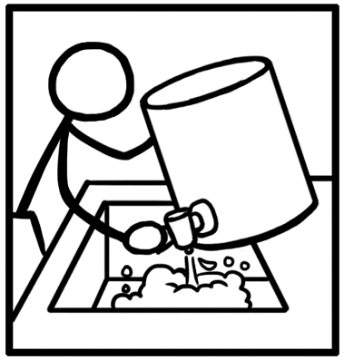
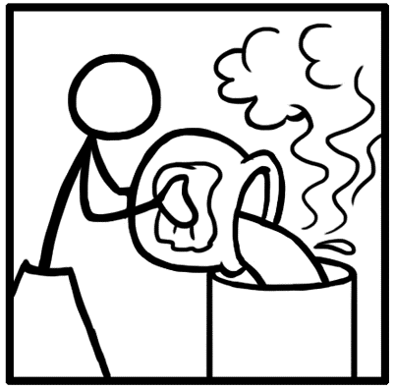
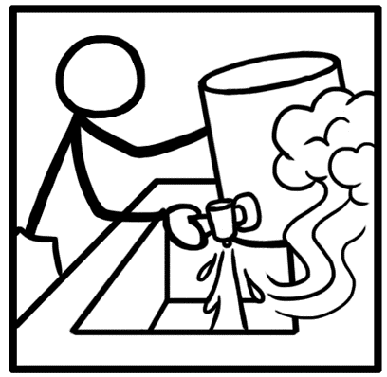
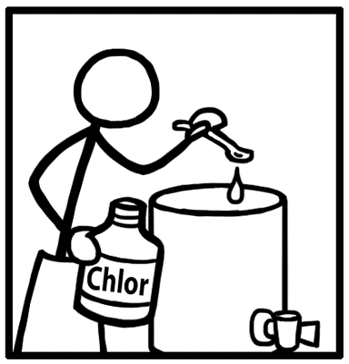
Clean the Safe Storage Container
Use safe water, soap, and a clean cloth or scrub brush to clean the inside and outside of the container and the lid.
Rinse the container thoroughly with safe water.
Allow the container and lid to air dry on a clean surface, or dry with a clean cloth.
Fill the container with filtered water to drink.
If available, add some chlorine to the container of filtered water. Let the chlorinated water sit in the container for 30 minutes. After 30 minutes, you may drink the water or pour the water out and re-fill the container with fresh filtered water.
Notes:
Other safe water handling practices include:
Using a container to collect and store untreated water and using it only for untreated water
Using a different container to store treated water - never use this container for untreated water
Frequently cleaning out the storage container with soap or chlorine
Storing treated water off the ground in a shady place in the home
Storing treated water away from small children and animals
Pouring treated water from the container instead of scooping the water out of it
Drinking treated water as soon as possible, preferably the same day

Slide 25
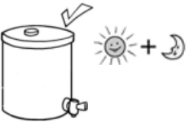
Safe Water Handling
Pour water from the container instead of scooping or dipping
Drink treated water as soon as possible, preferably the same day
Notes:
Other safe water handling practices include:
Using a container to collect and store untreated water and using it only for untreated water
Using a different container to store treated water - never use this container for untreated water
Frequently cleaning out the storage container with soap or chlorine
Storing treated water off the ground in a shady place in the home
Storing treated water away from small children and animals
Pouring treated water from the container instead of scooping the water out of it
Drinking treated water as soon as possible, preferably the same day

Slide 26

Review
Draw a picture of a water container that is locally available.

Slide 27
Review
Hold up your picture.
What is the most common water storage container used locally?
Is it a safe storage container?
If it is not “safe”, how could you make it safe? Are there other local options?

