Slide 1
Creative Commons
License
This document is open content and licensed under the Creative Commons Attribution Works 4.0 International License. To view a copy of this license, visit http://creativecommons.org/licenses/by/4.0
You are free to: Share – Copy and redistribute the material in any medium or format Remix – Remix, transform, and build upon the material for any purpose, even commercially
Under the following conditions:
Attribution – You must give appropriate credit to CAWST and Eawag-Sandec, provide a link to the license, and indicate if changes were made. You may do so in any reasonable manner, but not in any way that suggests that CAWST and Eawag-Sandec endorses you or your use. Please include our website: www.cawst.org and www.sandec.ch.
CAWST and Eawag-Sandec will produce updated versions of this document periodically. For this reason, we do not recommend hosting this document to download from your website.
CAWST and Eawag-Sandec its directors, employees, contractors, and volunteers do not assume any responsibility for, and make no warranty with respect to, the results that may be obtained from the use of the information provided.

Slide 2
This presentation is used with Lesson Plan Operation and Maintenance in the Introduction to Faecal Sludge Management Trainer Manual
Available at www.cawst.org/resources and www.sandec.ch

Slide 3
Operation and Maintenance of Faecal Sludge Treatment Facilities
2016
JULY

Slide 4
Learning Outcomes
Identify common operational challenges of faecal sludge treatment facilities.
Discuss the importance of a monitoring plan to ensure a faecal sludge treatment facility is operating as designed.
Discuss methods of ensuring that industrial sludge is not discharged at faecal sludge treatment facilities.

Slide 5
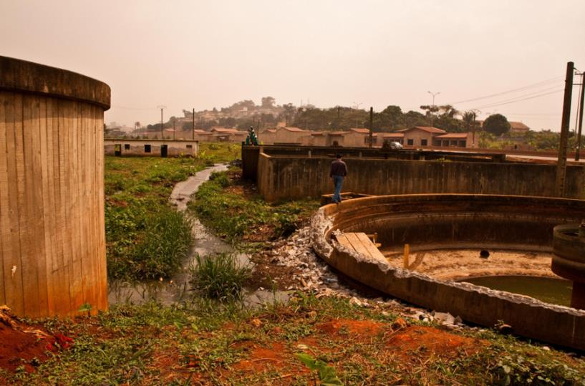
Treatment Failures
Yaoundé, Cameroon
(Credit: Eawag-Sandec)
Notes:
This pictures shows a treatment facility in Yaoundé, Cameroon where the wastewater is by-passing the treatment facility instead of going through the treatment technologies. This is an obvious failure.

Slide 6
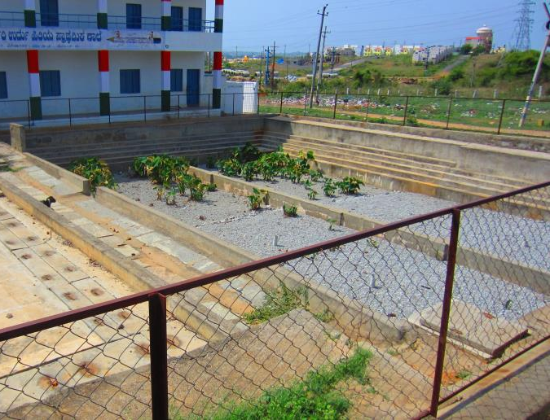
Treatment Failures
Bangalore, India
(Credit: Eawag-Sandec)
Notes:
However, treatment failures can also look more subtle. For example in this photo, facilities are mismanaged on a constructed wetland in Bangalore, India. The constructed wetland has almost no plants because they were eaten by goats (you may see a goat somewhere on the picture). A treatment facility worker did not close the door of the facility or the fence was broken. This influences the performance of a constructed wetland. It is not dysfunctional, but the wetland relies on plants to treat the faecal sludge.

Slide 7
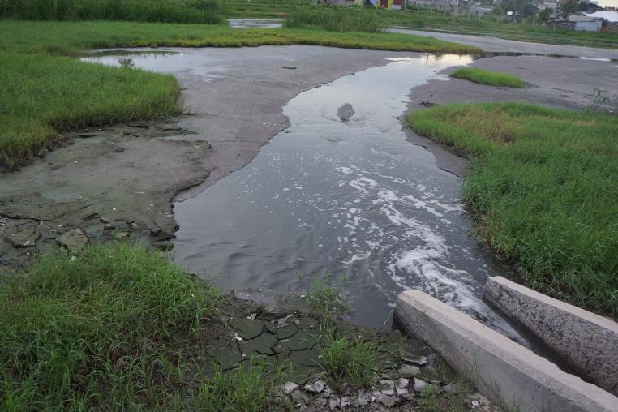
Treatment Failures
Dar es Salaam, Tanzania
(Credit: Eawag-Sandec)
Notes:
Or this sedimentation pond in Dar es Salaam, Tanzania which has not been emptied.

Slide 8
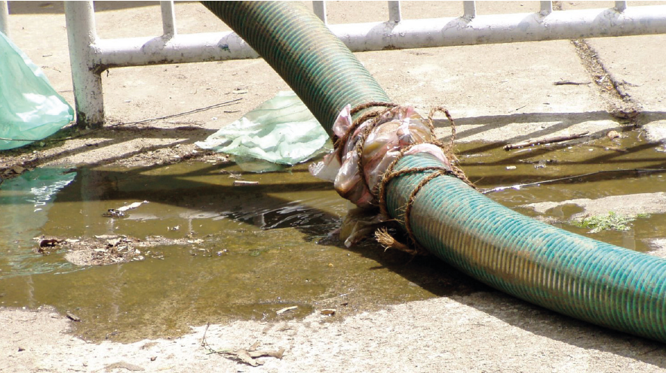
Collection and Transport Failures
(Credit: David M. Robbins)
Notes:
Failures are obviously also an issue for faecal sludge collection and transport which will not be specifically covered in this workshop. However, a lot of the discussed will also apply for them. For example, this picture shows a leaky hose. Leaky hoses not only mean that faecal sludge enters the environment, but that the pump of the vacuum trucks are not working efficiently.

Slide 9
Terminology
Operation: All the activities that are required to ensure that a faecal sludge treatment facility delivers treatment services as designed.
Maintenance: All the activities that ensure long-term operation of equipment and infrastructure.

Slide 10
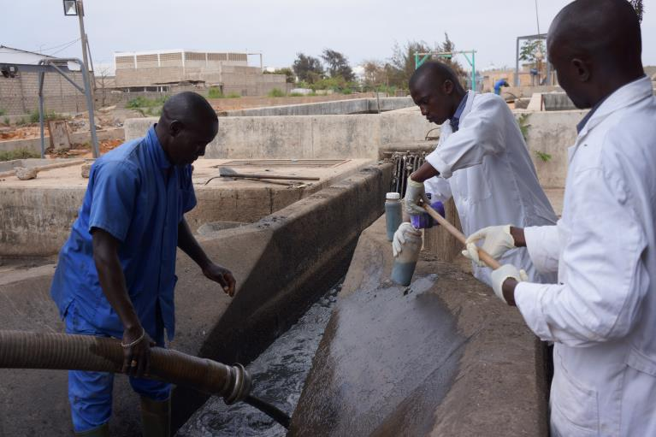
Monitoring Program
Dakar, Senegal
(Credit: Eawag-Sandec)
Notes:
Physical-chemical and microbiological parameters are required to operate a treatment facility.
To operate a treatment facility, a treatment operator needs to know, for example, how much faecal sludge at one time can go into treatment, how often sludge should be removed from a treatment technology, or if the treatment facility is operating as designed. This picture shows treatment operators collecting faecal sludge at the inflow of a settling-thickening tank in Dakar, Senegal. They are sampling to determine the properties of the faecal sludge entering the facility.

Slide 11
Key Treatment Parameters to Monitor
Dewatering: Moisture and solids content
Stabilization: Biological and chemical oxygen demand
Nutrient management: Nutrient content
Pathogen inactivation: Pathogen content (e.g., helminth eggs)
Credit: CAWST
Credit: CAWST
Notes:
The parameters most commonly analysed are linked to treatment objectives. Do you remember these two illustrations from the lessons on faecal sludge treatment objectives? Monitoring of faecal sludge treatment tells you whether or not your treatment objectives are being met.
The moisture and solids content for example important to determine the quality of treatment products after dewatering.
The biological and chemical oxygen demand is an important design parameter for treatment facilities. It is usually included in legal standards prescribing the required quality of the treatment effluent to protect water sources. It informs faecal sludge stabilization.
The nutrient content for examples of nitrogen and phosphorus influences the resource potential of products and is included in legal effluent standards to protect water sources. It informs nutrient management.
And the pathogen content, for example E. coli and helminth eggs, are important to quantify the quality of treatment products. It informs pathogen inactivation. This is to protect public health if products are used, for example in agriculture.

Slide 12
How we can support you!
Contact CAWST and Eawag-Sandec for support on using and adapting our education and training resources for your work.
Visit www.cawst.org/resources and www.sandec.ch for:
Latest updates to this document
Other workshop & training related resources
Upper 424 Aviation Rd NE,
Calgary AB T2E 8H6, Canada
+ 1 403 243 3285
support@cawst.org
www.cawst.org
Überlandstrasse 133
CH-8600 Dübendorf, Switzerland
+41 (0)58 765 55 11
info@sandec.ch
www.sandec.ch

