Slide 1
12, 2916 – 5th Avenue
Calgary, Alberta, T2A 6K4, Canada
Phone: + 1 (403) 243-3285, Fax: + 1 (403) 243-6199
E-mail: cawst@cawst.org, Website: www.cawst.org
CAWST is a Canadian non-profit organization focused on the principle that clean water changes lives. Safe water and basic sanitation are fundamentals necessary to empower the world’s poorest people and break the cycle of poverty. CAWST believes that the place to start is to teach people the skills they need to have safe water in their homes.
CAWST transfers knowledge and skills to organizations and individuals in developing countries through education, training and consulting services. This ever expanding network can motivate individual households to take action to meet their own water and sanitation needs.
One of CAWST’s core strategies is to make knowledge about water common knowledge. This is achieved, in part, by developing and freely distributing education materials with the intent of increasing its availability to those who need it most. You should feel free to copy and distribute this document in any form, printed or electronic. If you wish to use any parts of this document in the creation of your own materials, please ensure that CAWST is properly acknowledged. Please include our website address: www.cawst.org.
Feel free to include a link from your website to the CAWST website. Please do not host this document to download from your website as we will have updated versions from time to time. Please email us if you have any questions or feedback.
This document is open content and licensed under the Creative Commons Attribution Works 3.0 Unported License. To view a copy of this license, visit: http://creativecommons.org/licenses/by/3.0
You are free to:
Share – to copy, distribute and transmit this document
Remix – to adapt this document
Under the following conditions:
Attribution. You must give credit to CAWST as the original source of the document
CAWST and its directors, employees, contractors, and volunteers do not assume any responsibility for and make no warranty with respect to the results that may be obtained from the use of the information provided.

Slide 2
This presentation is used with Lesson Plan 5: Rainwater Harvesting Technology in the Rainwater Harvesting Trainer Manual.
Available at www.cawst.org/resources

Slide 3
Rainwater Harvesting Technology

Slide 4
Learning Expectation
Identify the scale of different rainwater harvesting systems.
Compare the two types of rainwater catchment systems.
Describe the three main components of any rainwater catchment system.

Slide 5
Learning Expectation 1
Identify the scale of different rainwater harvesting systems.

Slide 6
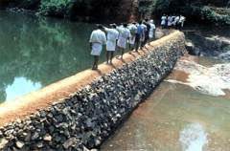
Large Scale - Check Dam Yethadka, India
(India Together, 2006)
Notes:
Known locally as Kattas
Made from locally available material
Temporary structure (removed before monsoon season)
A traditional system which is making a comeback where bore wells do not supply enough water

Slide 7
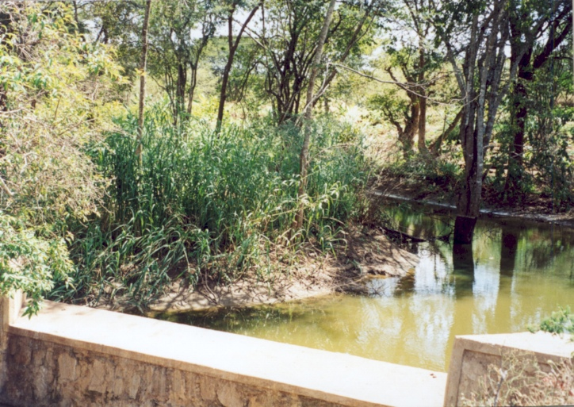
Large Scale -Kitui Sand Dam, Kenya
(WOCAT)
Notes:
A dam that stores water in the sand which accumulates above it
Sand reduces evaporation
Minimal maintenance for a well constructed dam
For more information: http://www.fao.org/ag/agl/agll/wocat/wqtsum.asp?questid=KEN20

Slide 8
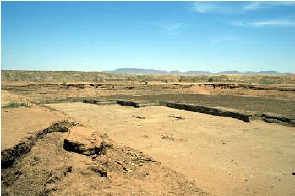
Large Scale - The Azagarfa hafir, Darfur, Sudan
(Practical Action, n.d.) www.practicalaction.org
Notes:
Used where rainfall is annual but for short periods
Water is used for many purposes including domestic drinking water
Water can be stored for up to 5 months
For more information on water harvesting in Sudan: www.practicalaction.org

Slide 9
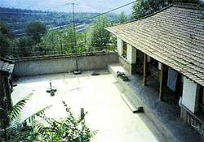
Medium Scale – Courtyard System, China
(Rainwater Toolkit, 2005)
Notes:
Water is stored under the couryard and raise using a handpump
For more information: www.rainwater-toolkit.net

Slide 10
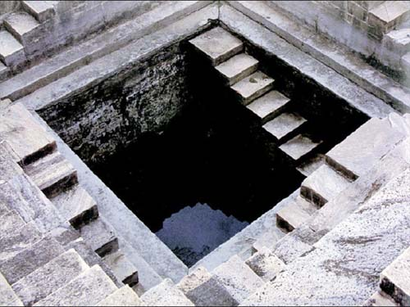
Medium Scale – Traditional Rainwater Harvesting, India
(Global Rainwater Harvesting Collective, n.d.)

Slide 11
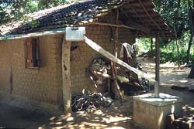
Small Scale – Household Catchment, Southeast Asia
(ITGD South Asia)

Slide 12
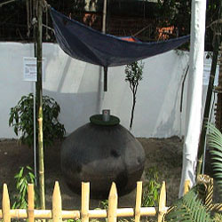
Small Scale – Sari Rainwater Harvesting, Bangladesh

Slide 13
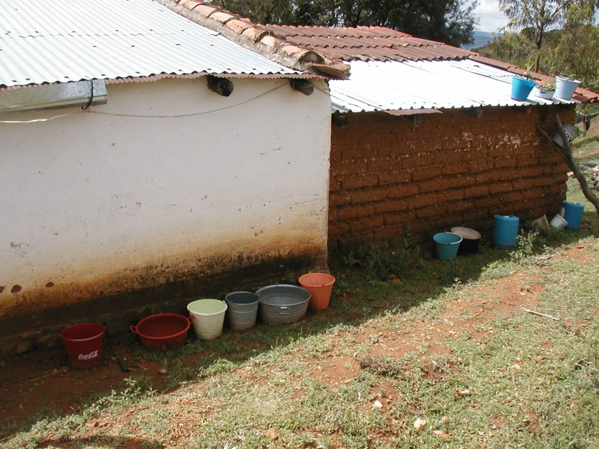
Even Smaller Scale – Bucket Harvesting, Mexico

Slide 14
Quick Chat
With a partner, discuss the rainwater harvesting technology you found most interesting.

Slide 15
Learning Expectation 2
Compare the two types of rainwater catchment systems.

Slide 16
Catchment Systems
2 Types of catchment system
Roof Catchment
Ground Catchment
Notes:
Note to trainer: Rock catchments are a subset of ground catchments and are only usually used in a large scale.

Slide 17
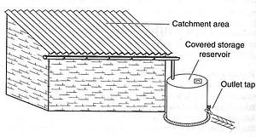
Roof Catchment
Notes:
Roofs yield high rainfall runoff
Good quality water
Direct water supply
Low construction costs
Limited catchment area

Slide 18
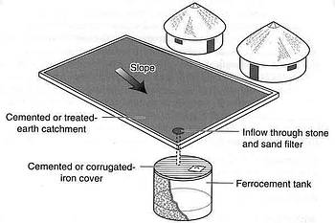
Ground Catchment
Notes:
- Poorer quality water
- Less efficient
- Inconvenient to withdraw water
Used when a suitable roof is not available
bigger catchment area

Slide 19
Quick Chat
What do the two systems have in common?
Notes:
Household use
Catchment area
A way to get water to the tank
Storage tank

Slide 20
Learning Expectation 3
Describe the three main components of any rainwater catchment system.
What do you think they are?

Slide 21
3 Catchment Components
Catchment Area
Delivery System
Storage Reservoir

