Slide 1
Creative Commons
License
This document is open content and licensed under the Creative Commons Attribution Works 4.0 International License. To view a copy of this license, visit http://creativecommons.org/licenses/by/4.0
You are free to: Share – Copy and redistribute the material in any medium or format Remix – Remix, transform, and build upon the material for any purpose, even commercially
Under the following conditions:
Attribution – You must give appropriate credit to CAWST and Eawag-Sandec, provide a link to the license, and indicate if changes were made. You may do so in any reasonable manner, but not in any way that suggests that CAWST and Eawag-Sandec endorses you or your use. Please include our website: www.cawst.org and www.sandec.ch.
CAWST and Eawag-Sandec will produce updated versions of this document periodically. For this reason, we do not recommend hosting this document to download from your website.
CAWST and Eawag-Sandec its directors, employees, contractors, and volunteers do not assume any responsibility for, and make no warranty with respect to, the results that may be obtained from the use of the information provided.

Slide 2
This presentation is used with Lesson Plan Collection and Transport in the Introduction to Faecal Sludge Management Trainer Manual
Available at www.cawst.org/resources and www.sandec.ch

Slide 3
Collection and Transport
2016
JULY

Slide 4
Learning Outcomes
Describe faecal sludge collection and transport process from a household to a treatment facility.
Identify suitable faecal sludge collection and transport methods for the local context.
Identify challenges and solutions for improving faecal sludge collection and transport.

Slide 5
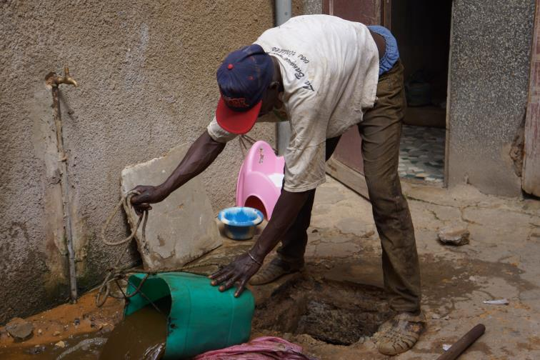
Manual Collection
Dakar, Senegal
(Credit: Eawag-Sandec)
Notes:
Unfortunately, manual faecal sludge collection without adequate health protection is a common form of faecal sludge collection. This picture shows a worker in Dakar, Senegal emptying a pit latrine with a bucket. In Dakar, the collected faecal sludge is being disposed in hole dug in front of the house. Moving the sludge just a few meters away from where it was collected does not provide a sustainable or hygienic solution.
Manual emptying is typically done in areas that are inaccessible by mechanical equipment and trucks – usually unplanned and informal communities. A recent survey of 30 cities in Africa and Asia found that about one-third of households manually empty their latrines. While family members sometimes do this job themselves, a manual emptier is hired almost 90% of the time (Chowdhry & Kone, 2012).
As well, some on-site sanitation systems can only be emptied manually. For example, composting latrines and dehydrating latrines must be emptied with a shovel because the material is solid and cannot be removed with a vacuum or a pump.

Slide 6
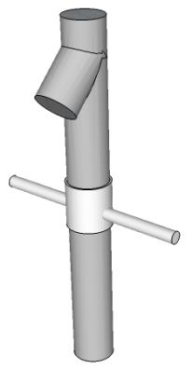
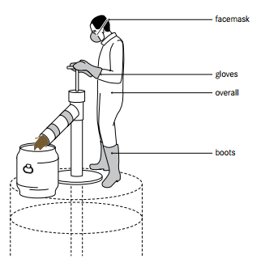
Manual Collection Technologies
Sanihub
The Gulper
Sanihub
Rising pipe
Sanihub
(Credit: Tilley et al., 2014)
Bottom valve
Plunger
Notes:
Some portable, manually operated pumps have also been developed to improve the efficiency of manual collection and better protect the health and safety of workers. Some of these technologies include the Manual Diaphragm Pump, Manual Pit Emptying Technology (MAPET), and the Gulper.
These illustrations on the left sludge shows faecal sludge collection with the Gulper technology. The Gulper consists of a rising pipe, plunger and bottom valve illustrated on the right of the slide.
As the handle is moved up and down, the bottom valve and the plunger valve open and close in series and sludge is lifted up the riser pipe to exit the Gulper via a downward angled spout. A strainer is fitted to the bottom of the rise piper to prevent solid waste from the entering and blocking the Gulper.
Advantages of the Gulper is a simple design which can be built with locally available materials and skills generally available in low-income countries. This has been key for the replication of the Gulper in many countries worldwide (especially East and South Africa).

Slide 7
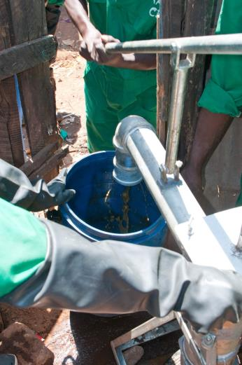
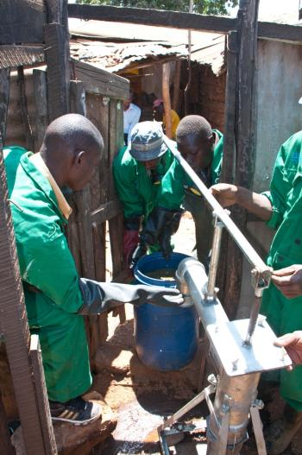
Manual Collection Technologies
Kenya
(Credit: Eawag-Sandec)
(Crediit: Eawag-Sandec)
Notes:
Of all the manual emptying technologies, the Gulper has been gaining use and becoming more widespreadf, in Asia and Africa. This is mainly due to strong interventions from external organizations, like nongovernmental organizations, that provided funding, training and technical support. These pictures show a manual collection with a gulper in Kenya. The faecal sludge is being pumped in a barrel for transport.

Slide 8
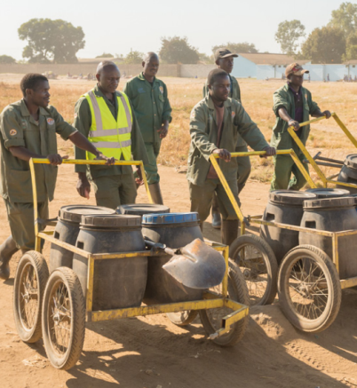
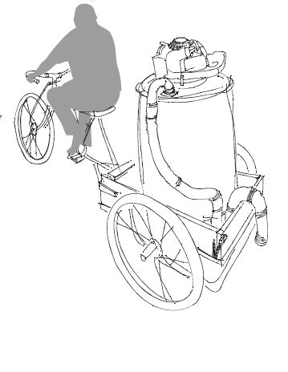
Manual Transport
Lusaka, Zambia
(Credit: Research Triangle Institute)
(Credit: WSUP (2014): Faecal Sludge Management services in Lusaka: moving up the excreta management ladder)
Notes:
The collected faecal sludge can be transported using manual or motorized vehicles. The picture on the left shows entrepreneurs transporting faecal sludge manually on push carts for treatment in Lusaka, Zambia. The picture on the right shows a schematic of a potential manually operated tricycle for faecal sludge transport. Manually operated transport limits the distance the faecal sludge can be transported.

Slide 9
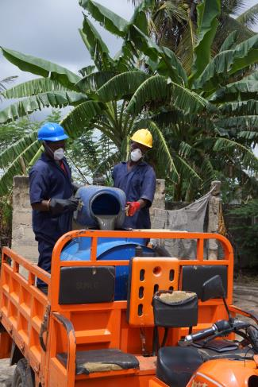
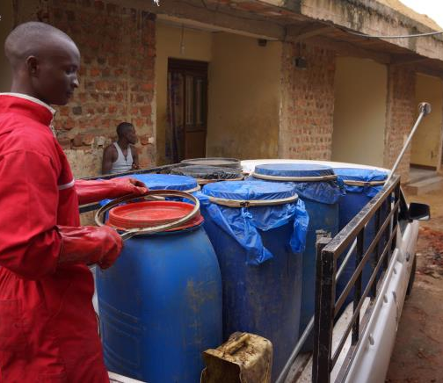
Motorized Transport
Dar es Salaam, Tanzania
(Credit: Eawag-Sandec)
(Credit: Eawag-Sandec)
Notes:
Motorized transport allows for more sludge being transported over longer distances. The picture on the left shows entrepreneurs loading faecal sludge on a motorized tricycle in Dar es Salaam, Tanzania. On the right, an entrepreneur is loading a pickup with faecal sludge for transport to treatment.

Slide 10
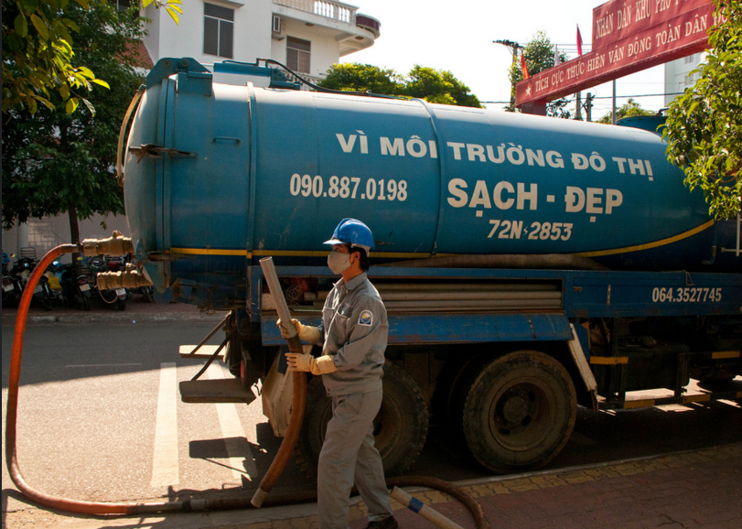
Motorized Collection and Transport
Vietnam
(Credit: Eawag-Sandec)
Notes:
Vacuum trucks are the most efficient way of faecal sludge collection and transport. Faecal sludge is sucked with a pump through a hose into the tank. As both the pump and the tank are mounted to the truck, vacuum trucks allow transport of large quantities of faecal sludge over longer distances. This pictures shows a vacuum truck collecting faecal sludge in Vietnam.

Slide 11
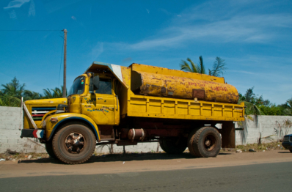
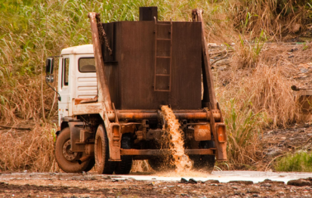
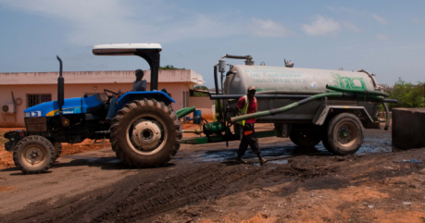
Motorized Collection and Transport
Senegal and Cameroon
(Credit: Eawag-Sandec)
(Credit: Eawag-Sandec)
(Credit: Eawag-Sandec)
Notes:
For example, trucks from Senegal and Cameroon. Most commonly trucks have a storage capacity of 200 to 16,000 litres, and can hold as much as 55,000 litres.

Slide 12
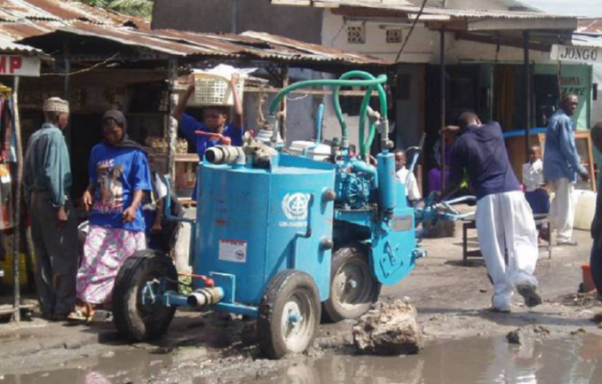
Motorized Collection and Transport
Bangladesh
(Credit: Eawag-Sandec)
Notes:
Disadvantages of vacuum trucks is that they cannot access urban areas with limited road access. Vacuum trucks are also designed for emptying water-based latrines, such as pour flush latrines, septic tanks and aqua privies. Depending on the on-site sanitation technology, the sludge can become too thick and cannot easily be pumped. In this case, it is necessary to dilute the sludge with water so that it can flow more easily, but this is inefficient and potentially costly. (By adding water to the pit the top portion of the sludge in the pit is easier to empty. Other challenges of using vacuum trucks include:
• Most conventional vacuum trucks are manufactured in North America, Japan or Europe so they are expensive to import and buy locally
• It is difficult to locate spare parts and a local mechanic to repair broken pumps and trucks
• Poor households often cannot afford the services of a conventional vacuum truck
Smaller, more mobile and inexpensive pumps and vehicles have been developed to help overcome the challenges of using vacuum trucks. For example, this pictures shows the Vacutug navigating in Bangladesh. UN-HABITAT started the Vacutug project in 1995. It commissioned a motorized system that could be manufactured locally, is affordable, easily serviceable, able to operate in narrow streets, and capable of pumping out dense sludge from latrines. It has been tested by the UN and various nongovernmental organizations in some African and Asian countries; however, large-scale production and distribution of the Vacutug on a global scale has yet to start.

Slide 13
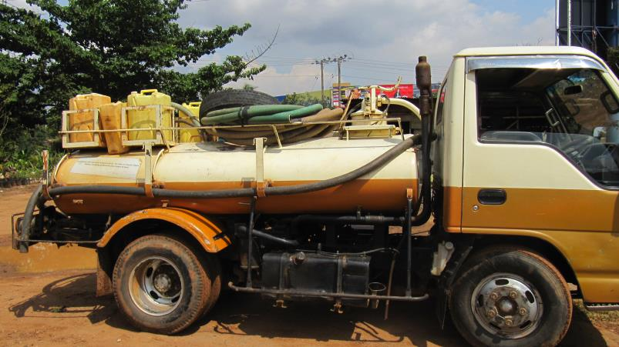
Collection and Transport Tasks
(Credit: Eawag-Sandec)
Notes:
Go to the household. Bring all required equipment.
Finding and accessing the household is the first task of faecal sludge collection. Access to the on-site sanitation technology can be limited, especially in urban environments. As shown in the picture, faecal sludge collection requires equipment such as hoses, safety equipment, (e.g. gum boots) or jerry cans with water to dilute thick sludge before collection.
Meet the customer to arrange logistics and inform them of the service
As the customer is king and the service provider always requires information before faecal sludge collection, meeting the customer is an important task.
Tell them the fee or negotiate with the customer
Faecal sludge collection is only one of many expenses for a household. Especially in poor areas it can contribute a high percentage of the annual spending. Therefore, the fee is negotiated before the service.

Slide 14
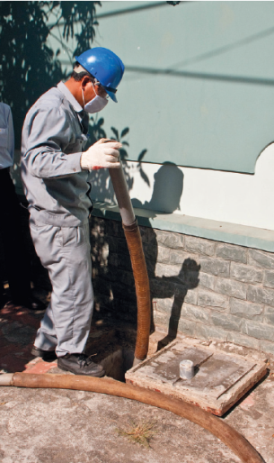
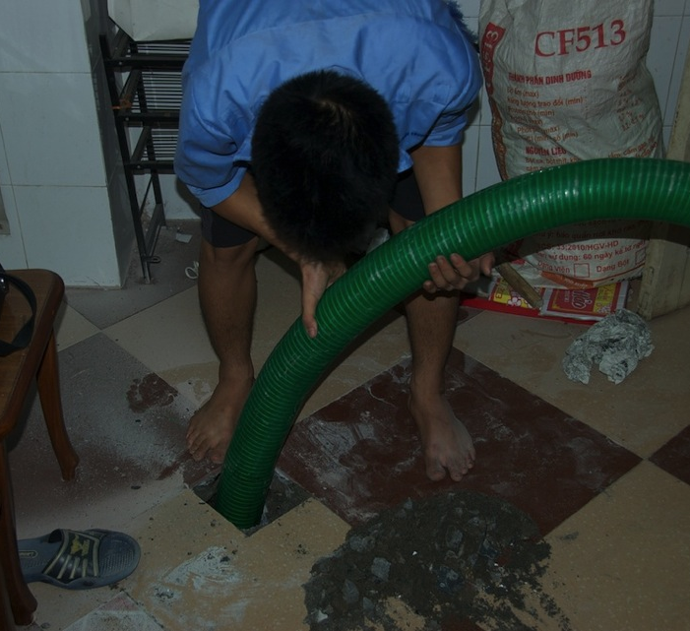
Collection and Transport Tasks
Vietnam
(Creidt: Eawag-Sandec))
(Credit: Lars Schoebitz)
Notes:
Put on personal protective equipment
Faecal sludge has high concentrations of pathogens. Therefore, operators should wear appropriate protective equipment such as gum boots, gloves and a face mask. The picture of the left shows a good example of protective gear in Vietnam.
Locate the on-site sanitation technology
Explain that the location of the on-site sanitation technology might sometimes not be so obvious. For example, when a septic tank is located below the house and only the tenant (not the house owner) is present.
Determine the access point of the on-site sanitation technology/Open the on-site sanitation technology cover
Sometimes desludging is not feasible through the toilet interface itself, as commonly done for pit latrines. This requires that an access cover is opened. As faecal sludge is only collected every few months to years, the access might be covered by concrete or lie below tiles. The picture on the right shows faecal sludge collection in Hanoi, Vietnam. The septic tank is located below the house and the floor tiles had to be broken to collect the faecal sludge.

Slide 15
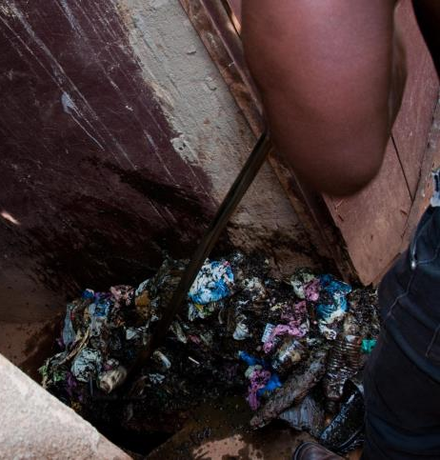
Collection and Transport Tasks
Kampala, Uganda
(Credit: Eawag-Sandec)
(Credit: Eawag-Sandec)
Notes:
Remove solid waste, if necessary
Commonly, solid waste management services are poor in low-income countries. Therefore, large amounts of solid waste may be disposed into on=site sanitation technologies. Solid waste can destroy the faecal sludge collection equipment. Therefore, it should be removed before collection. The pictures show removal of solid waste from a pit latrine in Kampala, Uganda.
Empty the on-site sanitation technology
Evaluate the condition of the on-site sanitation technology
An empty onsite sanitation technology allows for inspection, for example, for cracks. These can be reported to the household.
Close and secure the on-site sanitation technology

Slide 16
Collection and Transport Tasks
Kampala, Uganda
(Eawag-Sandec)
(Credit: Lars Schoebitz)
Notes:
Clean the area around the on-site sanitation technology
During faecal sludge collection the areas around the on-site sanitation technology may be contaminated. See on the picture an example from Kampala/Uganda in which faecal sludge is entering the areas around the on-site sanitation technology.
Do a final inspection and report any issues to the customers
Transport the faecal sludge to a treatment facility

Slide 17
Challenge 1
The household does not have enough money to pay for the emptying and transport service. Neighbours are complaining of the smell.
Notes:
Solutions:
Recommend manual emptying or manually operated pump services: They may be more affordable. Note: Commonly, per volume of faecal sludge, manual emptying (and transport) is more expensive than motorized emptying (and transport). By paying for part of the faecal sludge to be removed, they are delaying, but not eliminating, the problem.
Introduce a sanitation tax: This is a regular fee (for example, in the water tariff) collected in exchange or to subsidize a faecal sludge collection and transport service. For example, everyone could have required annual inspections and emptying. This is done in the Philippines. Consider that faecal sludge collection and transport for the poor may need to be subsidized.
Pay in instalments: Poor households commonly cannot afford to pay the high one-time costs of motorized collection and transport. The public sector and/or private service providers could offer households the option to pay in installments.
Install transfer stations: Reducing the distance faecal sludge needs to be transported may reduce collection and transport fees and make them more affordable for households. Trainer note: Be careful when providing this as a solution. Clarify that this is a possible solution, but it is still in the stage of innovative technology without actual field experience other than a few pilots.

Slide 18
Challenge 2
The feacal sludge is too thick for the collection and transport service to pump out. The on-site sanitation technology is close to overflowing.
Notes:
Solutions:
Add water to the sludge: This will make the top layer easier to pump out.
Recommend manual emptying services: They can empty thick sludge.
Recommend emptying more frequently.

Slide 19
Challenge 3
There is too much solid waste in the on-site sanitation technology. The solid waste is likely to damage the emptying equipment. Therefore, service providers are hesitant to empty the on-site sanitation technology or charge a high fee.
Notes:
Solutions:
Charge extra for the removal of solid waste. Explain to the households that the emptying fee would be lower if no solid waste would be disposed into the on-site sanitation technology.
Recommend manual emptying services.
Create awareness on the importance of not putting solid waste inside a on-site sanitation technology.
Provide solid waste management solutions.

Slide 20
Challenge 4
The faecal sludge treatment facility (owned by the public sector) is charging a discharge fee. Private service providers cannot afford this fee. As a result, they illegally dump the faecal sludge into the street, nearby canal, river or lake. Sometimes they dump the faecal sludge into a sewer manhole, which is not a sustainable option as it can cause wastewater treatment facilities to fail.
Notes:
Solutions:
Construct a faecal sludge treatment facility in a more central location: This will reduce transport costs for service providers and lower the fee for households.
Introduce a sanitation tax: This is a regular fee collected in exchange or to subsidize faecal sludge collection and transport service.
Organize services for the whole area where this household is located: This will make servicing this community more affordable.
Recommend or establish small-scale service providers: They may be located closer and therefore may be more affordable. However, they still need a location to discharge the sludge.
Install transfer stations: Reducing the distance faecal sludge needs to be transported may reduce fees and make them more affordable for households. Trainer note: Be careful when providing this as a solution. Clarify that this is a possible solution, but it is still in the stage of innovative technology without actual field experience other than a few pilots.

Slide 21
Challenge 5
The household is located far away from a faecal sludge treatment facility. Households cannot afford the fee charged by the service providers because of their transport costs to the treatment facility.
Notes:
Solutions:
Recommend manual emptying and transport services: They will have better access to the on-site sanitation technology.
Improve the quality of the road.
Assess the possibility of decentralized faecal sludge treatment.

Slide 22
Challenge 6
The household is located in an informal settlement. The pathways are too narrow and not maintained. It is difficult for a vacuum truck to access the household.
Notes:
Solutions:
Increase the fee charged to households to cover the discharge fee.
Foster communication between the public sector and the private service providers to discuss how this can be resolved.
Subsidize faecal sludge treatment/discharge fee: The public sector could subsidize faecal sludge treatment or the discharge fee. The revenues for this subsidy could come from a sanitation tax.
Sell faecal sludge treatment products: Revenues from treatment products could be used to offset the treatment costs and potentially reduce the discharge fee.

Slide 23
How we can support you!
Contact CAWST and Eawag-Sandec for support on using and adapting our education and training resources for your work.
Visit www.cawst.org/resources and www.sandec.ch for:
Latest updates to this document
Other workshop & training related resources
Upper 424 Aviation Rd NE,
Calgary AB T2E 8H6, Canada
+ 1 403 243 3285
support@cawst.org
www.cawst.org
Überlandstrasse 133
CH-8600 Dübendorf, Switzerland
+41 (0)58 765 55 11
info@sandec.ch
www.sandec.ch

