Slide 1
424 Aviation Road NE
Calgary, Alberta, T2E 8H6, Canada
Phone: + 1 (403) 243-3285, Fax: + 1 (403) 243-6199
E-mail: resources@cawst.org, Website: www.cawst.org
CAWST, the Centre for Affordable Water and Sanitation Technology, is a nonprofit organization that provides training and consulting to organizations working directly with populations in developing countries who lack access to clean water and basic sanitation.
One of CAWST’s core strategies is to make knowledge about water common knowledge. This is achieved, in part, by developing and freely distributing education materials with the intent of increasing the availability of information to those who need it most.
This document is open content and licensed under the Creative Commons Attribution Works 3.0 Unported License. To view a copy of this license, visit http://creativecommons.org/licenses/by/3.0 or send a letter to Creative Commons, 171 Second Street, Suite 300, San Francisco, California 94105, USA.
You are free to:
Share – to copy, distribute and transmit this document
Remix – to adapt this document
Under the following conditions:
Attribution. You must give credit to CAWST as the original source of the document. Please include our website: www.cawst.org
CAWST will produce updated versions of this document periodically. For this reason, we do not recommend hosting this document to download from your website.
CAWST and its directors, employees, contractors, and volunteers do not assume any responsibility for and make no warranty with respect to the results that may be obtained from the use of the information provided.
Stay up-to-date and get support:
Latest updates to this document
Other workshop & training related resources
Support on using this document in your work
CAWST provides mentorship and
coaching on the use of its education
and training resources.

Slide 2
This presentation is used with Lesson Plan 5: Disease Transmission in the Introduction to Environmental Sanitation Trainer Manual.
Available at www.cawst.org/resources

Slide 3
Environmental Sanitation Disease Transmission
Notes:
This is a long PowerPoint presentation. Choose the diseases that are more common in the country / region and present only those slides.

Slide 4
Learning Outcomes
Identify the four types of pathogens.
Identify different transmission routes of diseases.
Identify diseases related to environmental sanitation.
Explain how environmental sanitation can prevent the transmission of diseases.

Slide 5
What is a Pathogen?
Any living organism that
causes disease
Notes:
Ask participants to explain a pathogen before showing the answer.
Water naturally contains many living things.
Most are harmless or even beneficial, but others can cause illness.
Living things that cause disease are also known as pathogens.
They are sometimes called other names, such as microorganisms, microbes or bugs, depending on the local language and country.
Although there are several contaminants in water that may be harmful to humans, the first priority is to ensure that drinking water is free of pathogens

Slide 6
Types of Pathogens
Viruses: (0.02 – 0.2 microns), unable to reproduce by themselves
Bacteria: (0.2 – 5 microns), most common living things found in human and animal feces
Protozoa: (4 – 20 microns), may be able to form cysts
Helminths: (40 – 100 microns), worms and flukes, require a host and passed in human and animal feces
Notes:
Examples of pathogens transmitted through drinking water
Viruses, e.g. hepatitis A and E
Bacteria, e.g. cholera, typhoid, shigellosis – diarrhea is the major symptom of most common water-related diseases caused by pathogenic bacteria
Protozoa, e.g. Entamoeba histolytica, Cryptosporidium
Helminths normally pass through people’s skin when they bathe or swim in contaminated water, and do not normally infect people by drinking water. There are two exceptions: e.g. Dracunculus medinensis (guinea worm) and Fasciola (liver flukes)

Slide 7
Size Comparison
Smallest
Virus (0.02 to 0.2 micron)
Virus
Bacteria
Bacteria (0.2 to 5 microns)
Protozoa
Helminth
Largest
Protozoa
(4 to 20 microns)
Helminth
(40 to 100 microns)
Notes:
Representation of the relative sizes of different pathogens.
Can also show the PowerPoint “How Big?” to demonstrate the sizes with animation

Slide 8
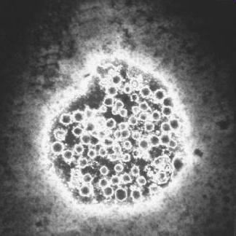
Viruses
Hepatitis A and E
Unable to reproduce by themselves
Must use another living thing called a host
- Microorganism, animal, human
Water cannot spread HIV or influenza viruses
Hepatitis A
Notes:
Viruses are unable to reproduce by themselves and must use another living thing (e.g., other microorganism, animal or human) to make more viruses. This disrupts the functions or causes the death of the living thing.
It is difficult and expensive to study viruses, so we know less about them than other pathogens.
Water cannot spread the human immunodeficiency virus (HIV) and influenza viruses. Water does not provide the environment needed for these viruses to survive.

Slide 9
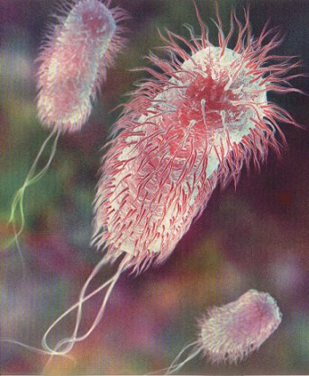
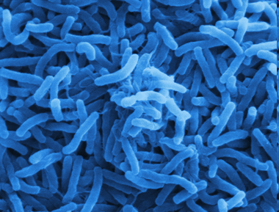
Bacteria
Cholera
Escherichia coli
Most common living thing found in feces
1 gram = billions of bacteria
Diarrhea is the major symptom of water-related diseases
Cholera, typhoid, shigellosis
Notes:
Bacteria are very small, single-celled organisms that are present everywhere and are the most common living things found in human and animal feces.
Drinking water that contains feces is the main cause of water-related diseases.
The most common water-related diseases caused by pathogenic bacteria have diarrhea as a major symptom, including cholera, typhoid, and shigellosis (dysentery)
Most of the organisms found in feces are bacteria. There are several billion bacteria in every gram of feces.
The diseases they cause generally spread rapidly, and consequently bacteria have been responsible for most of the world’s major epidemics derived from water.
E. coli bacteria have flagella (flagellum singular) whip like structures that allow them to move through their environment.
There are many more bacteria that do not normally cause disease – e.g. yeasts, cheese, beer.

Slide 10
Bacteria in Action
Notes:
This slide is optional but is a good visual for how bacteria reproduce
This video is available online at http://www.youtube.com/watch?v=DY9DNWcqxI4
Alternatively, if you have access to the off line video, right click on the link in the slide and left click on ‘Edit Hyperlink’, then find the correct link to the file
You will then be able to click on the link in slideshow mode to play the video

Slide 11
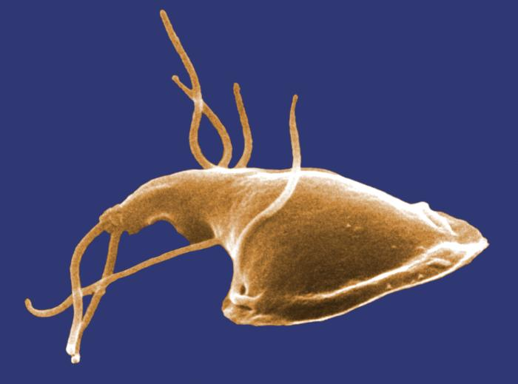
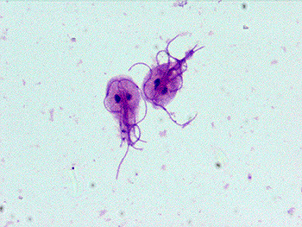
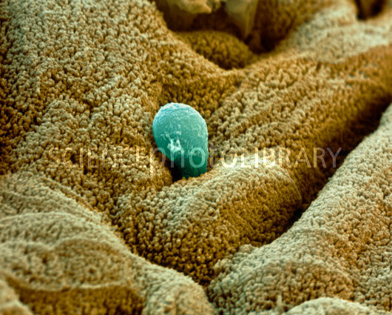
Protozoa
Some need a host to survive
Form cysts resistant to chlorine
Some can stay alive outside of a host
Entamoeba histolytica, Cryptosporidium, Giardia
Cryptosporidium cyst
Giardia (side view)
(Credit: CDC, 1982)
Giardia (top view)
(Credit: Mount Sinai Hospital)
Entamoeba histolytica
(Credit: Science Photo Library)
Notes:
Protozoa are larger than bacteria or viruses.
Some protozoa can form cysts which let them stay alive without a host and survive in harsh environments. The protozoa cysts become active once the environmental conditions are optimal for their development. The cysts are also highly resistant to disinfection methods used in water treatment
Most of the major waterborne disease epidemics in the North America over the last ten years are due to protozoa. This is because they can survive the chlorination process used in municipal water treatment plants.
Three of the more well known protozoa are Entamoeba histolytica , Cryptosporidium and Giardia.

Slide 12
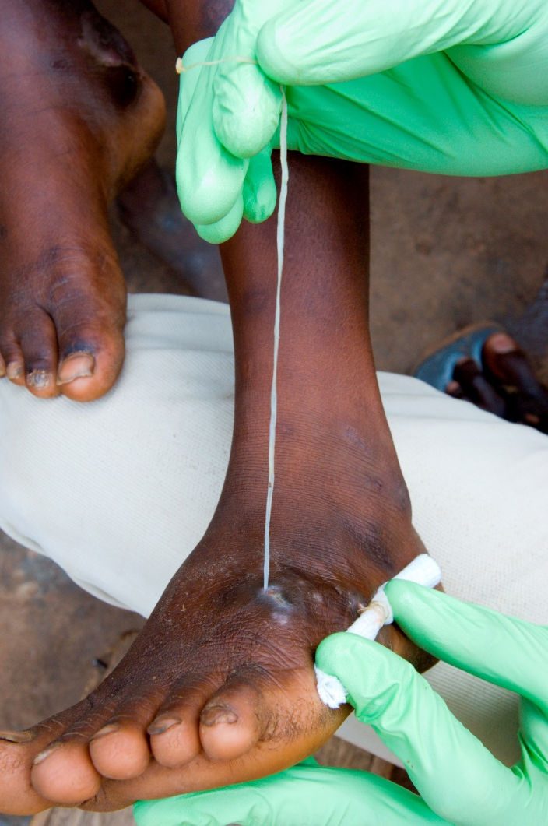
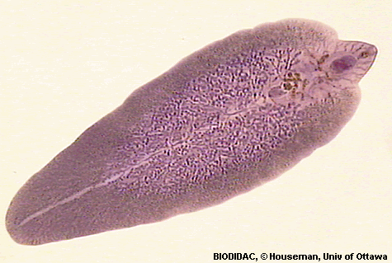
Helminths
Schistosomiasis (bilharzia)
Dracunculus medinensis (guinea worm)
Fasciola (liver flukes)
Round worm
Hook worm
Tape worm
Liver Fluke
Guinea Worm
(Credit: Houseman, BIODIDAC)
(Credit: Gubb, The Carter Center, Ghana, 2007
Notes:
Helminths, more commonly known as worms or flukes, require a host body to survive and are generally passed in human and animal feces. They spend part of their life in hosts that live in water before being transmitted to humans. Many types of worms can live for several years and weaken their host by using up their food.
For most helminths, drinking water is not a significant route of transmission. Helminths normally pass through people’s skin when they bathe or swim in contaminated water or are in contact with contaminated soil, and do not normally infect people by drinking water.
There are two exceptions: guinea worm and liver flukes. They both need intermediate hosts to complete their life cycles, but are transmitted through drinking water by different mechanisms.
Other helminths can be transmitted through water contact (e.g., schistosomiasis also called bilharzia) or are associated with using untreated wastewater in agriculture (e.g., ascariasis, hookworm), but are not usually transmitted through drinking water

Slide 13
Review
What is a pathogen?
Any living organism that
causes disease

Slide 14
Review
2. What are the four types of pathogens in order from smallest to largest?
Viruses
Bacteria
Protozoa
Helminths

Slide 15
Diseases related to Environmental Sanitation
Drinking water contaminated with excreta
Washing in water contaminated with excreta
Lack of water for basic hygiene
Contact with soil contaminated with excreta
Insects that breed or live in standing water
Insects that breed or live in animal excreta
Rodents that breed or live in unsanitary conditions

Slide 16
Diseases Related to Environmental Sanitation
Plague
Cholera
Guinea worm
Schistosomiasis
Shigellosis
Giardiasis
Trachoma
Scabies
Leishmaniasis
Typhoid
Dysentery
Yellow fever
Hook worm
Ascariasis
Cryptosporidiosis
Dengue fever
Hantavirus
Notes:
Explain that there are numerous diseases related to environmental sanitation. Only some of them representing different environmental sanitation transmission routes will be discussed in the following slides.

Slide 17
Questions
Symptoms?
Pathogen?
Transmission?
Prevention?

Slide 18
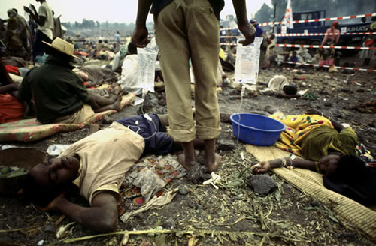
Cholera
Symptoms:
Watery diarrhea
Nausea, vomiting
Can lead to death
2. Pathogen: Bacteria (Vibrio cholerae)
(Credit: Connect.in.com)
Notes:
Scope of the Problem:
Cholera is prevalent in countries that lack access to safe drinking water and sanitation.
Globally, cholera incidence has increased steadily since 2005 with cholera outbreaks affecting several continents, including Sub-Saharan Africa, Asia, and more recently in the Caribbean (Haiti and the Dominican Republic). Cholera continues to pose a serious public health problem among developing world populations that have no access to adequate water and sanitation resources (WHO, 2013).
Between 178,000-589,000 cholera cases were reported annually to the WHO from 2007-2011 (WHO, 2012). However, the true number of cholera cases is known to be much higher. These numbers are severely underestimated, as many countries do not report or underreport the number of cholera cases. The cases of cholera officially reported do not account for the estimated 500,000-700,000 cases that are called acute watery diarrhea instead of cholera. These cases occur in vast areas of Central and Southeast Asia, and in some African countries, leading to great underestimation of the global burden of this disease (WHO, 2013).
Symptoms:
Cholera is an acute infection of the intestine, which begins suddenly with painless watery diarrhea, nausea and vomiting. Most people who become infected have very mild diarrhea or symptom-free infection.
Malnourished people in particular experience more severe symptoms.
Severe cholera cases present with profuse diarrhea and vomiting.
Severe, untreated cholera can lead to rapid dehydration and death.
If untreated, 50% of people with severe cholera will die, but prompt and adequate treatment reduces this to less than 1% of cases.
Cause:
Cholera is caused by the bacterium Vibrio cholerae.

Slide 19
Cholera
3. Transmission:
Water and food contaminated with feces
4. Prevention:
Sanitation facilities (e.g., latrines)
Proper hygiene practices
Safe drinking water and food
Notes:
Transmission:
People become infected after eating food or drinking water that has been contaminated by the feces of infected persons.
Raw or undercooked seafood may be a source of infection in areas where cholera is prevalent and sanitation is poor.
Vegetables and fruit that have been washed with water contaminated by feces may also transmit the infection if V. cholerae is present.
Prevention:
Safe drinking water
Proper personal hygiene
Proper food hygiene
Hygienic disposal of human excreta
Treatment of cholera consists mainly in replacement of lost fluids and salts. The use of oral rehydration salts (ORS) is the quickest and most efficient way of doing this. Most people recover in 3 to 6 days. If the infected person becomes severely dehydrated, intravenous fluids can be given.

Slide 20
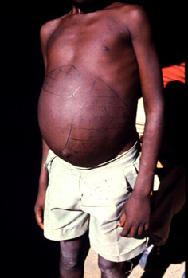
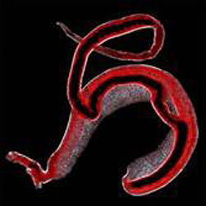
Schistosomiasis
Symptoms:
Rashes and itchy skin
Fever, chills, cough, muscle aches
Blood in urine and stools
2. Pathogen: Helminth (Schistosoma haematobium)
(Credit: www.path.cam.ac.uk)
(Credit: Natural History Museum, London)
Notes:
Scope of Problem:
Also commonly known as Bilharzia.
Schistosomiasis is considered the second most important parasitic infection after malaria in terms of public health and economic impact.
Endemic in 76 countries, most of which are in Africa.
Other regions affected are: the Americas (Brazil, Suriname and Venezuela, as well as several Caribbean islands); the Eastern Mediterranean (Islamic Republic of Iran, Iraq, Saudi Arabia, Syrian Arab Republic and Yemen; and eastern Asia (Cambodia, China, Indonesia, Japan, Lao People's Democratic Republic and the Philippines.
At least 600 million people are at risk of infection and 200 million are infected with schistosomiasis.
Of these 20 million have severe disease and 120 million have symptoms.
An estimated 80% of transmission takes place in sub-Saharan Africa.
Picture shows distended belly due to enlargement of spleen.
Symptoms:
Long term infection with flat worms living in the veins of the host.
Worms lay eggs which cause damage to various organs. Different strains affect different parts of the body including the liver, the digestive tract, and the urinary tract.
The signs following infection are rashes or itchy skin.
Two months after infection, fever, chills, cough and muscle aches may occur, as the parasites mature.
Untreated infections can result in blood in urine and stools, and enlarged liver and spleen.
In children there is a negative impact in terms of growth, nutritional status and cognitive development.
Chronic infection leads to diseases of the liver, kidneys and bladder.
Occasionally, the nervous system is affected causing seizures, paralysis or spinal cord inflammation.
Pathogens:
Schistosomiasis infection in humans is caused by three main species of flatworm, namely Schistosoma haematobium, S. japonicum, and S. mansoni.

Slide 21
Schistosomiasis
3. Transmission:
Bathing or swimming in water contaminated with feces or urine
4. Prevention:
Sanitation facilities
Hygiene education and practices
Design of water resources projects
Notes:
Transmission:
Infection occurs when free-swimming larvae penetrate human skin.
The larvae develop in fresh-water snails.
Humans are infected when they enter larvae-infested water for domestic, occupational and recreational purposes.
After skin penetration, the larvae transform and are carried by the blood to the veins draining the intestines or the bladder where they mature, mate and produce eggs.
Eggs cause damage to various tissues, particularly the bladder and liver.
The reaction to the eggs in tissues causes inflammation and disease.
When infected humans excrete parasite eggs with feces or urine into water, the eggs hatch releasing larvae that in turn infect aquatic snails.
In the snail the parasite transforms and divides into second-generation larvae which are released into fresh water ready to infect humans.
Those who work in irrigation or fishing are at increased risk for schistosomiasis.
With the increase in wilderness or “off-track” tourism, more tourists are becoming infected.
In Asia, cattle and water buffalo can be important reservoir hosts.
Water resource schemes for power generation and irrigation have resulted in a tremendous increase in the transmission and outbreaks of schistosomiasis in several African countries.
In northern Senegal, an area without intestinal schistosomiasis before the building of the Diama dam in 1986, virtually the whole population had become infected by 1994.
Prevention:
Improved sanitation and potable water minimizes contamination of and reduces contact with fresh water, thus limiting transmission.
Environmental modification preventing snail vectors and limiting human water contact offers long-term control of schistosomiasis.
Health education is a fundamental component that ensures community participation in control interventions.
In areas of high prevalence and intensity of infection, chemotherapy with praziquantel, targeted at school-age children and high-risk groups, offers the most efficient way to achieve the recommended strategy for morbidity control.
Proper health impact assessment of new irrigation schemes and other water resources projects will provide a solid basis for the incorporation of health safeguards at design and construction plans.

Slide 22
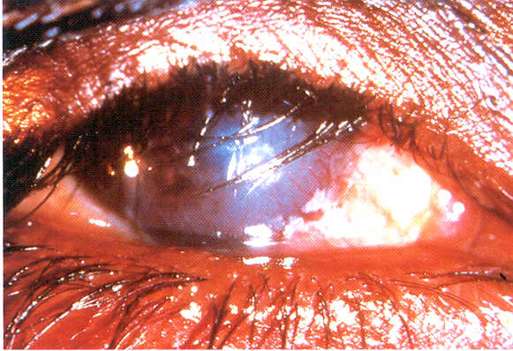
Trachoma
Symptoms:
Eye discharge
Blurred vision
Severe eye pain
Itchiness in the eyes
Irreversible blindness
(Credit: WHO)
2. Pathogen: Bacteria (Chlamydia trachomatis)
Notes:
Scope of Problem:
Trachoma affects about 21.4 million people of whom about 2.2 million are visually impaired and 1.2 milion are blind.
It was once endemic in most countries. It is responsible, at present, for more than 3% of the world’s blindness but the number keeps changing due to the effect of socioeconomic development and current control programmes for this disease.
Trachoma continues to be hyperendemic in many of the poorest and most remote poor rural areas of Africa, Asia, Central and South America, Australia and the Middle East.
Most common in pre-school children with prevalence rates as high as 60-90%. Adult women are at much greater risk of developing the blinding complication of trachoma than are adult men. This increased risk has been explained by the fact that women generally spend a greater time in close contact with small children, who are the main reservoir of infection.
The World Health Organization has set a global goal to eliminate blinding trachoma by the year 2020. The estimated number of people affected by trachoma has fallen from 360 million people in 1985 to approximately 80 million people today.
Symptoms:
Infection often begins during infancy or childhood and can become chronic. If left untreated, the infection eventually causes the eyelid to turn inwards, which in turn causes the eyelashes to rub on the eyeball, resulting in intense pain and scarring of the front of the eye. This ultimately leads to irreversible blindness, typically between 30 and 40 years of age.

Slide 23
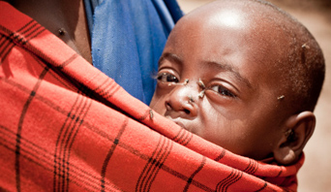
Trachoma
3. Transmission:
Person-to-person
Eye discharge on
fingers, flies
4. Prevention:
Facial cleanliness and personal hygiene
Adequate water supply for hygiene
Disposal of human waste to reduce flies
(Credit: UK National Health Service)
Notes:
Transmission:
The infection is spread through contact with eye discharge from the infected person on towels, handkerchiefs, fingers, etc. and by flies. Infection spreads from person to person, and is frequently passed from child to child and from child to mother, especially where there are shortages of water, numerous flies, and crowded living conditions.
Prevention:
Blinding trachoma is avoidable. The strategy to eliminate the disease is based on:
eyelid surgery
antibiotics to treat the infection
education about facial cleanliness and personal hygiene
environmental improvements

Slide 24
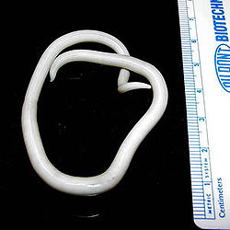
Ascariasis
Symptoms:
Often no symptoms
Diarrhea, abdominal pain, general malaise, weakness
Impairs nutrition, growth, physical development
Adult female roundworm
(Credit: CDC Division of Parasitic Diseases)
2. Pathogen: Roundworm (Ascaris lumbricoides)
Notes:
Scope of Problem:
More than 1.5 billion people, or 24% of the world's population are infected with soil-transmitted helminth infections worldwide. Infections are widely distributed in tropical and subtropical areas, with the greatest numbers occurring in sub-Saharan Africa, the Americas, China and east Asia.
Over 270 million preschool-age children and over 600 million school-age children live in areas where these parasites are intensively transmitted, and are in need of treatment and preventive interventions..
Symptoms:
Infected children are physically, nutritionally and cognitively impaired.
The worms feed on host tissues, including blood, which leads to a loss of iron and protein.
The worms increase malabsorption of nutrients. In addition, roundworm may possibly compete for vitamin A in the intestine.
Pathogen:
Helminth, roundworm (Ascaris lumbricoides)

Slide 25
Ascariasis
3. Transmission:
Water or food contaminated with eggs
Children who play in contaminated soil and then put their hands in their mouths
4. Prevention
Sanitation to reduce soil contamination with infective eggs
Treating excreta before using as fertilizer
Notes:
Transmission:
Transmitted by eggs that are passed in the feces of infected people. Adult worms live in the intestine where they produce thousands of eggs each day. In areas that lack adequate sanitation or where raw human feces are used as fertilizer, these eggs contaminate the soil.
Eggs that are attached to vegetables are ingested when the vegetables are not carefully cooked, washed or peeled.
Eggs are ingested from contaminated water sources
Eggs are ingested by children who play in soil and then put their hands in their mouths without washing them.
No transmission from fresh feces, because eggs passed in feces need about three weeks to mature in the soil before they become infective.
Prevention:
Health education to prevent reinfection
Improved sanitation to reduce soil contamination with infective eggs
Treatment of excreta before being used as agricultural fertilizer

Slide 26
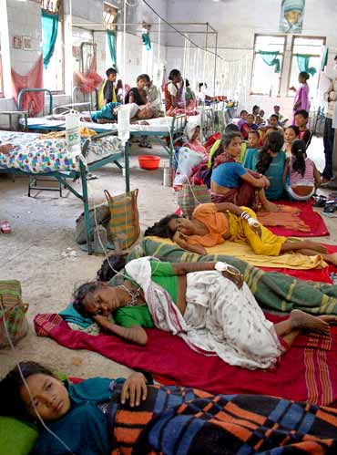
Malaria
Symptoms:
Fever, headache, vomiting 10-15 days after mosquito bite
Can disrupt blood supply to vital organs
2. Pathogen: Protozoa (Plasmodium)
Malaria patients in India
(Credit: Rediff News, 2010)
Notes:
Scope of Problem:
About 3.3 billion people – half of the world's population – are at risk of malaria. People living in the poorest countries are the most vulnerable to malaria.
In 2010, there were about 219 million malaria cases and an estimated 660 000 malaria deaths.
In 2010, 90% of all malaria deaths occurred in the Africa, mostly among children under five years of age (WHO, 2013).
Symptoms:
Fever, headache, vomiting 10 and 15 days after mosquito bite
If not treated, malaria can quickly become life-threatening by disrupting the blood supply to vital organs.
In many parts of the world, the parasites have developed resistance to a number of malaria medicines.
Pathogen:
Caused by a protozoa called Plasmodium

Slide 27
Malaria
3. Transmission:
Bite from infected Anopheles mosquito
4. Prevention:
Bed nets
Indoor residual spraying
Wastewater management to reduce mosquito breeding
Personal: Cover up, repellent, behaviour
Notes:
Transmission:
Transmitted via the bites of infected Anopheles mosquitoes. In the human body, the protozoa multiply in the liver, and then infect red blood cells.
Prevention:
Bed nets
Indoor residual spraying
Wastewater disposal to reduce mosquito breeding
Personal protection: Repellents, cover up (long sleeves, long trousers long skirts/wrappers, behaviour (avoid areas and times when mosquitoes bite)

Slide 28
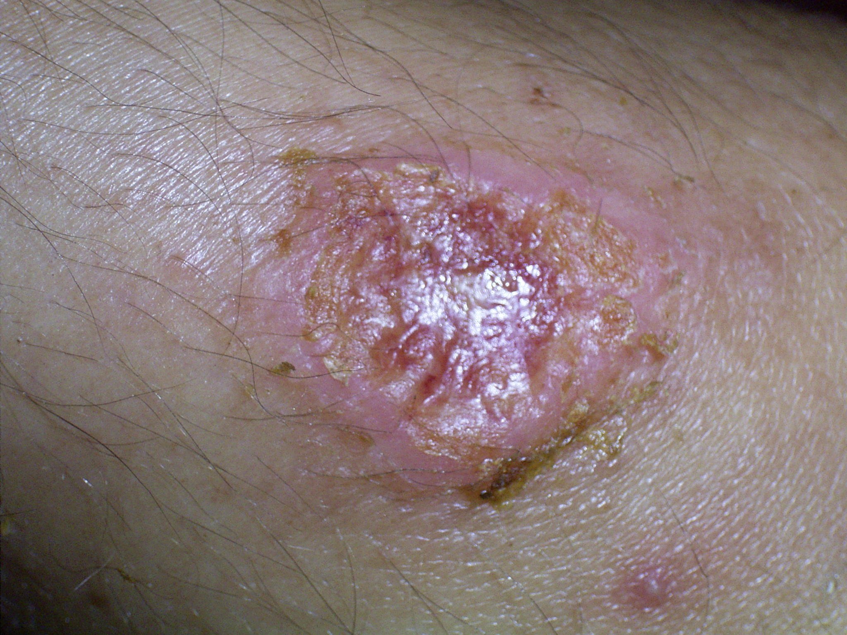
Leishmaniasis
Symptoms:
Cutaneous – most common, skin ulcers
Mucocutaneous – destruction of nose, mouth, throat
Visceral – most severe, affects vital organs
Cutaneous leishmaniasis
(Credit: WHO)
2. Pathogen: Protozoa (Leishmania)
Notes:
Scope of Problem:
Leishmaniasis threatens about 350 million men, women and children in 88 countries around the world.
As many as 12 million people are believed to be currently infected, with about 1–2 million estimated new cases occurring every year.
90% of all visceral leishmaniasis cases occur in Bangladesh, Brazil, India, Nepal and Sudan.
90% of mucocutaneous leishmaniasis occurs in Bolivia, Brazil and Peru.
90% of cutaneous leishmaniasis cases occur in Afghanistan, Brazil, Iran, Peru, Saudi Arabia and Syria.
Symptoms:
The disease can have a wide range of clinical symptoms, which may be cutaneous, mucocutaneous or visceral.
Cutaneous leishmaniasis is the most common form. Produces ulcers on the exposed parts of the body, such as the face, arms and legs. There may be a large number of lesions – sometimes up to 200 – which can cause serious disability. When the ulcers heal, they invariably leave permanent scars, which are often the cause of serious social prejudice.
Mucocutaneous leishmaniasis, the lesions can lead to partial or total destruction of the mucous membranes of the nose, mouth and throat cavities and surrounding tissues. This disabling form of leishmaniasis can lead to the sufferer being rejected by the community.
Visceral leishmaniasis is the most severe form. Also known as kala-azar, is characterized by irregular bouts of fever, substantial weight loss, swelling of the spleen and liver, and anaemia (which may be serious). If the disease is not treated, the fatality rate in developing countries can be as high as 100% within 2 years.
Pathogen:
Leishmaniasis is caused by protozoa belonging to the genus Leishmania.

Slide 29
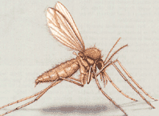
Leishmaniasis
3. Transmission:
Bite from sandfly
4. Prevention:
Animal excreta management
Solid waste management
Bed nets
Indoor residual spraying
Sandfly (Credit: WHO)
Notes:
Transmission:
Protozoa are transmitted by the bite of a tiny (only 2–3 mm long) insect vector, the phlebotomine sandfly.
There are some 500 known phlebotomine species, but only about 30 have been found to transmit leishmaniasis.
Only the female sandfly transmits the parasites. Female sandflies need blood for their eggs to develop, and become infected with the Leishmania parasites when they suck blood from an infected person or animal. Over a period of between 4 and 25 days, the parasites develop in the sandfly. When the infectious female sandfly then feeds on a fresh source of blood, it inoculates the person or animal with the parasite, and the transmission cycle is completed.
Leishmaniasis is a poverty-related disease. It affects the poorest of the poor and is associated with malnutrition, displacement, poor housing, illiteracy, gender discrimination, weakness of the immune system and lack of resources.
Prevention:
The female sandfly lays its eggs in the burrows of certain rodents, the bark of old trees, ruined buildings, cracks in the walls of houses, animal shelters and household rubbish, where the larvae can find the organic matter, heat and humidity they need to develop.

Slide 30
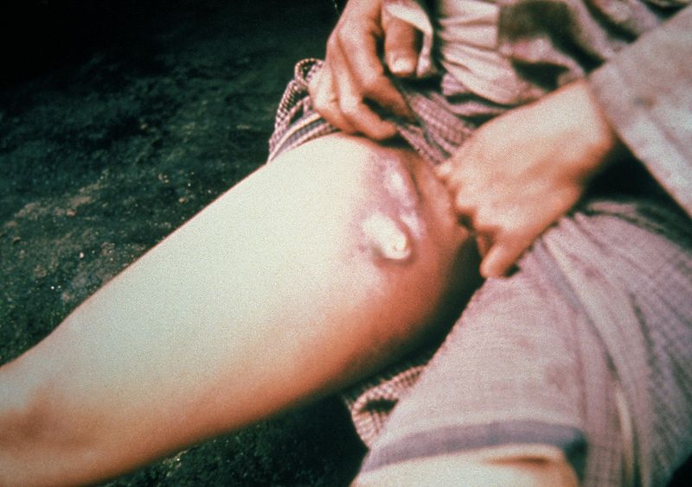
Plague
Symptoms:
Bubonic plague – swollen lymph nodes
Pneumonic plague – deadly infectious disease
2. Pathogen: Bacteria (Yersinia pestis)
Swollen lymph nodes
(Credit: CDC)
Notes:
Scope of Problem:
One of the oldest identifiable diseases known to humans, plague remains endemic in many areas around the world. It is still widely distributed in the tropics and subtropics and in warmer areas of temperate countries.
Wild rodent plague is present in central, eastern and southern Africa, South America, the western part of North America and in large areas of Asia. In some areas, contact between wild and domestic rats is common, resulting in sporadic cases of human plague and occasional outbreaks.
Plague cases remain largely under-reported for several reasons: the reluctance of certain endemic countries to declare cases, the lack of diagnosis because the clinical picture of cases is not very specific and the absence of laboratory confirmation.
During 1989-2003, 38,310 cases (2,845 deaths) were recorded in 25 countries.
Outbreaks of plague are often linked to poverty, civil disturbances and war.
Symptoms:
Bubonic form of plague, which is characterized by a bubo, i.e. a swelling of the lymph node draining the flea bite site. Initial symptoms of bubonic plague appear 7–10 days after infection.
If the bacteria reach the lungs, the patient develops pneumonia (pneumonic plague), which is then transmissible from person to person through infected droplets spread by coughing.
If diagnosed early, bubonic plague can be successfully treated with antibiotics. Pneumonic plague, on the other hand, is one of the most deadly infectious diseases; patients can die 24 hours after infection. The mortality rate depends on how soon treatment is started, but is always very high.
Pathogen:
Bacterial (Yersinia pestis)

Slide 31
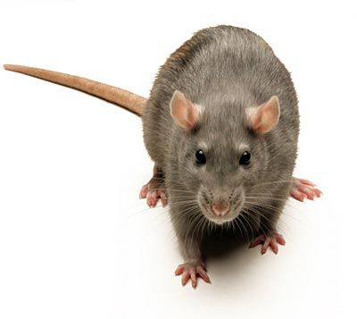
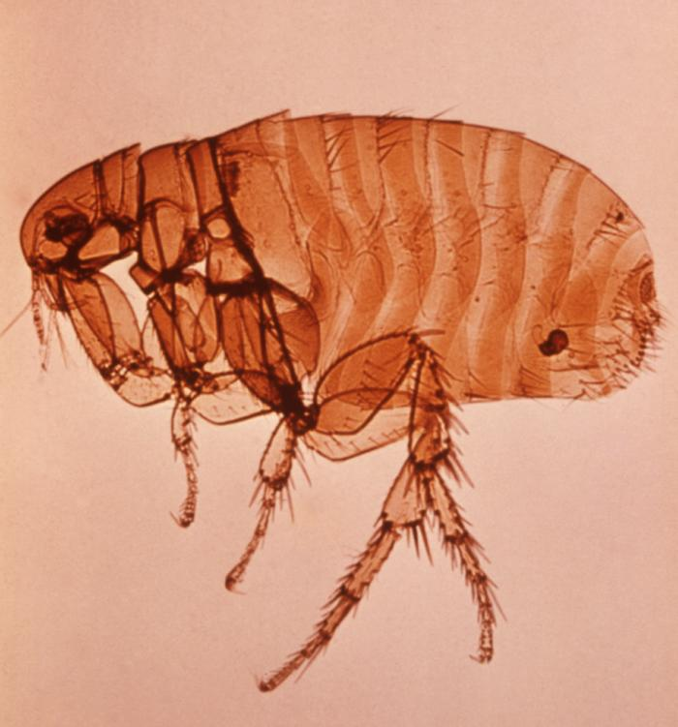
Plague
3. Transmission:
One rodent to another by fleas, to humans from bite of infected flea
Person-to-person transmission for pneumonic plague
4. Prevention:
Rodent control
Solid waste management
Flea (Credit: CDC)
Notes:
Transmission:
Spread from one rodent to another by flea parasites and to humans by the bite of infected flea.
Direct person-to-person transmission does not occur except in the case of pneumonic plague, when respiratory droplets may transfer the infection from the patient to others in close contact.
Prevention:
Rodent control
Solid waste management to reduce attraction of rodents

Slide 32
Review
1. List some diseases caused by poor environmental sanitation.
Plague
Cholera
Guinea worm
Schistosomiasis
Shigellosis
Giardiasis
Trachoma
Scabies
Leishmaniasis
Typhoid
Dysentery
Yellow fever
Hook worm
Ascariasis
Cryptosporidiosis
Dengue fever
Hantavirus
Notes:
Ask participants to list some diseases caused by poor environmental sanitation.

Slide 33
Review
2. How can environmental sanitation help to prevent disease transmission?
Drinking safe water
Using latrines to safely dispose excreta
Disposing wastewater to remove standing water
Cleaning out drainage channels
Treating and disposing solid waste
Managing animal excreta
Using insecticides and bed nets
Rodent control

