Slide 1
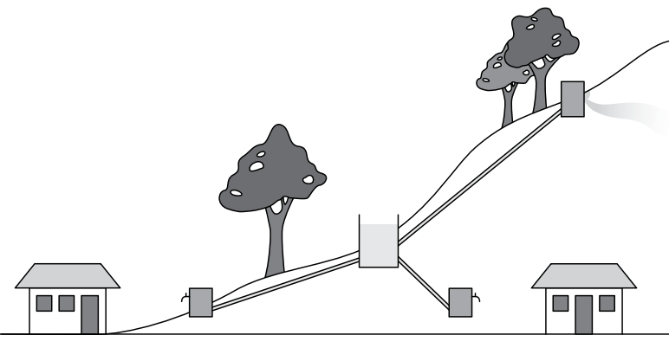
Keeping the water flowing:
Financing operation and maintenance of water supply schemes
Image source: http://www.wateraidamerica.org/sites/default/files/attachments/Gravity%20fed%20schemes.pdf

Slide 2
7 Principles for sustainable cost recovery
Identify costs of operating and maintaining the water supply scheme
Maximize willingness to pay
Clarify financial responsibilities
Optimize operation and maintenance costs
Set an appropriate and equitable tariff structure
Develop an effective financial management system
Organize access to alternative financial sources
Source: BRIKKÈ, F. (2000): Operation and Maintenance of rural water supply and sanitation systems. A training package for managers and planners. Malta: IRC

Slide 3
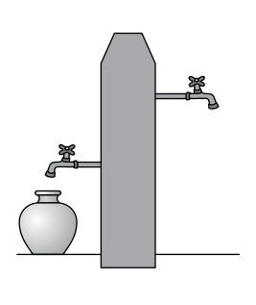
Factors influencing willingness to pay
Demand and participation of communities
Service level and standard
Perceived benefits
Level of income
Price of the water
Characteristics of existing water sources
Reputation of the service agency
Perception of ownership and transparency
Community support
Source: BRIKKÈ, F. (2000): Operation and Maintenance of rural water supply and sanitation systems. A training package for managers and planners. Malta: IRC

Slide 4
Setting appropriate tariffs
3 things to remember when setting tariffs
Equity
Affordability
Willingness to Pay
What is an appropriate and affordable charge for users?
While tariffs and user fees need to recover costs, it is generally estimated that an affordable cost for water service is no more than 3-5% of people’s income. Tariffs can start low and increase over time.
Source: BRIKKÈ, F. (2000): Operation and Maintenance of rural water supply and sanitation systems. A training package for managers and planners. Malta: IRC

Slide 5
Develop an effective financial management system
Basic aspects of financial management
Budgeting
Costs, Sources of income, Payment/Salaries
Financial flows
How to collect fees, When to collect fees, Who collects fees, Where to keep the money
Financial administration
How to track movement of funds, Who administers the funds, What are the funds used for, Who orders payments
Financial control and monitoring
What types of controls, How to monitor, What to do with bad payers
Source: BRIKKÈ, F. (2000): Operation and Maintenance of rural water supply and sanitation systems. A training package for managers and planners. Malta: IRC

Slide 6
Organize access to alternative financial sources
Why is this important?
It creates other sources of income in case user fees are insufficient, or in the event that there are expensive repairs or replacements to pay for.
Other possible financial sources:
Creating a voluntary fund for people to contribute, establishing water kiosks or additional user charges, investment from the private sector, government subsidies, bank loans, micro-credit schemes, donations, municipal taxation, etc.
Source: BRIKKÈ, F. (2000): Operation and Maintenance of rural water supply and sanitation systems. A training package for managers and planners. Malta: IRC

