Slide 1
424 Aviation Road NE
Calgary, Alberta, T2E 8H6, Canada
Phone: + 1 (403) 243-3285, Fax: + 1 (403) 243-6199
E-mail: resources@cawst.org, Website: www.cawst.org
CAWST, the Centre for Affordable Water and Sanitation Technology, is a nonprofit organization that provides training and consulting to organizations working directly with populations in developing countries who lack access to clean water and basic sanitation.
One of CAWST’s core strategies is to make knowledge about water common knowledge. This is achieved, in part, by developing and freely distributing education materials with the intent of increasing the availability of information to those who need it most.
This document is open content and licensed under the Creative Commons Attribution Works 3.0 Unported License. To view a copy of this license, visit http://creativecommons.org/licenses/by/3.0 or send a letter to Creative Commons, 171 Second Street, Suite 300, San Francisco, California 94105, USA.
You are free to:
Share – to copy, distribute and transmit this document
Remix – to adapt this document
Under the following conditions:
Attribution. You must give credit to CAWST as the original source of the document. Please include our website: www.cawst.org
CAWST will produce updated versions of this document periodically. For this reason, we do not recommend hosting this document to download from your website.
CAWST and its directors, employees, contractors, and volunteers do not assume any responsibility for and make no warranty with respect to the results that may be obtained from the use of the information provided.
Stay up-to-date and get support:
Latest updates to this document
Other workshop & training related resources
Support on using this document in your work
CAWST provides mentorship and
coaching on the use of its education
and training resources.

Slide 2
This presentation is used with Lesson Plan 4: Local and Global Sanitation Issues in the Latrine Design and Construction Trainer Manual.
Available at www.cawst.org/resources

Slide 3
Local and Global Sanitation Issues

Slide 4
Learning Outcomes
Discuss how poor sanitation is connected to the poverty cycle.
Discuss the local and global issues around access to basic sanitation.

Slide 5
Millennium Development Goals by 2015
Goal 1. Eradicate extreme poverty and hunger
Goal 2. Achieve universal primary education
Goal 3. Promote gender equality and empower women
Goal 4. Reduce child mortality
Goal 5. Improve maternal health
Goal 6. Combat HIV/AIDS, malaria and other diseases
Goal 7. Ensure environmental sustainability
Halve the proportion of people without sustainable access to safe drinking water and basic sanitation
Goal 8. Develop a global partnership for development

Slide 6
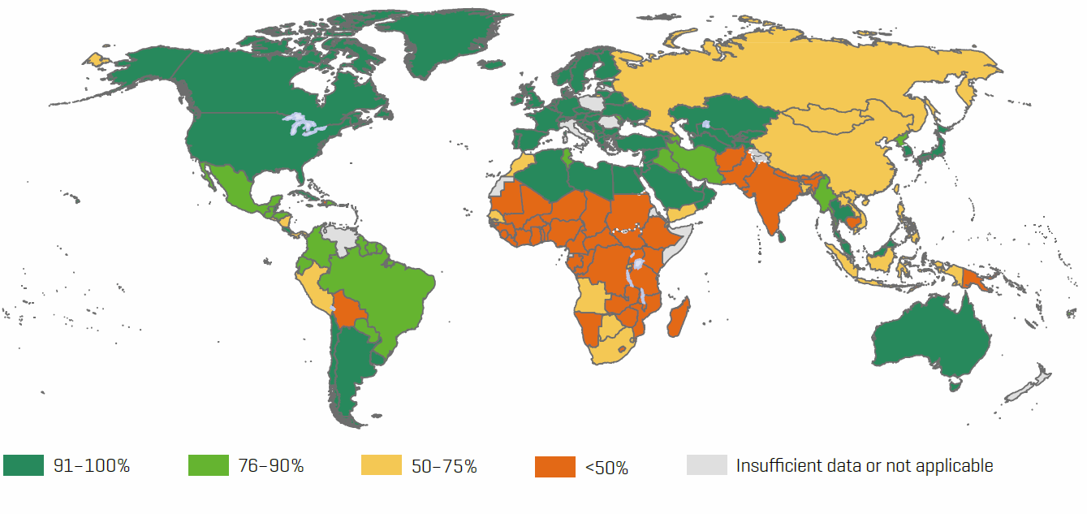
46 countries with less than 50% improved sanitation coverage
(Credit: UNICEF and WHO, 2014)
Notes:
Title of figure: Proportion of the population using improved sanitation in 2012
There are still 46 countries where less than half the population has access to an improved sanitation facility
Among the world’s regions, Southern Asia and sub-Saharan Africa continue to have the lowest levels of coverage
57% of people in developing regions now use an improved sanitation facility.

Slide 7
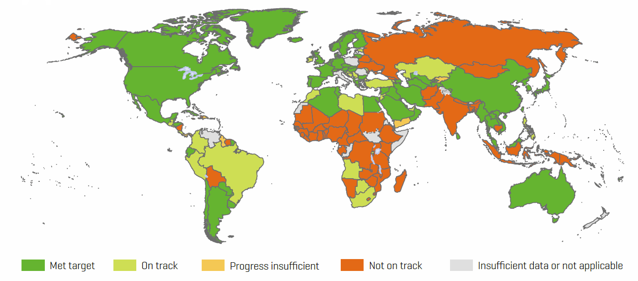
69 countries not on track to meet the MDG sanitation target
(Credit: UNICEF and WHO, 2014)
Notes:
Despite increases in sanitation coverage, progress has been slow. Globally 2.5 billion people do not have access to improved sanitation facilities.
Progress has been greatest in Eastern Asia, where coverage of improved sanitation has increased by 40 % since 1990, largely driven by China.

Slide 8
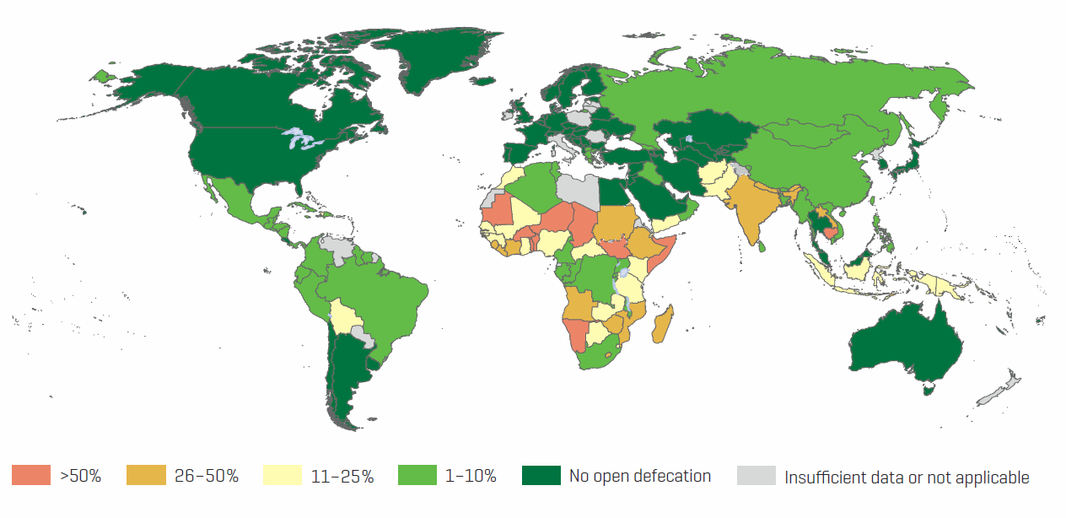
Open Defecation
(Credit: UNICEF and WHO, 2013)
Notes:
1 billion (15% of the world population) still defecate in the open, that is in fields, forests, bushes, bodies of water or other open spaces.
82% of the one billion people still open defecating live in just 10 countries 1) India – 597 million
2) Indonesia – 54 million
3) Pakistan – 41 million
4) Nigeria – 39 million
5) Ethiopia – 34 million
6) Sudan – 17 million
7) Niger – 13 million
8) Nepal – 11 million
9) China – 10 million
10) Mozambique – 10 million
Rest of the world – 182 million
The majority (71%) of those without sanitation live in rural areas, where 90% of all open defecation takes place. .
Numbers of people practicing open defecation are still increasing in Africa, declining everywhere else
UNICEF AND WHO (2013). Progress on Drinking Water and Sanitation – 2013 Update. WHO/UNICEF Joint Monitoring Programme for Water Supply and Sanitation. UNICEF, New York, USA and WHO, Geneva, Switzerland. Available at: www.wssinfo.org/documents/
The 2014 report did not have an open defecation world map.

Slide 9
Access to Basic Sanitation
What does this mean?
Improved sanitation hygienically separates human excreta from human contact
Connection to a public sewer or septic system
Pit latrine with slab
Pour flush latrine
Ventilated improved pit (VIP) latrine
Composting or dehydrating latrine
Notes:
Access to basic sanitation is measured against the proxy indicator: the proportion of people using improved sanitation facilities.
Improved sanitation hygienically separates human excreta from human contact.
This term was developed by the UNICEF and World Health Organization (WHO) Joint Monitoring Programme (JMP) for Water Supply and Sanitation. It is used to measure progress towards achieving the Millennium Development Goal (MDG) of halving by 2015 the proportion of people without sustainable access to basic sanitation (UNICEF and WHO, 2013).

Slide 10
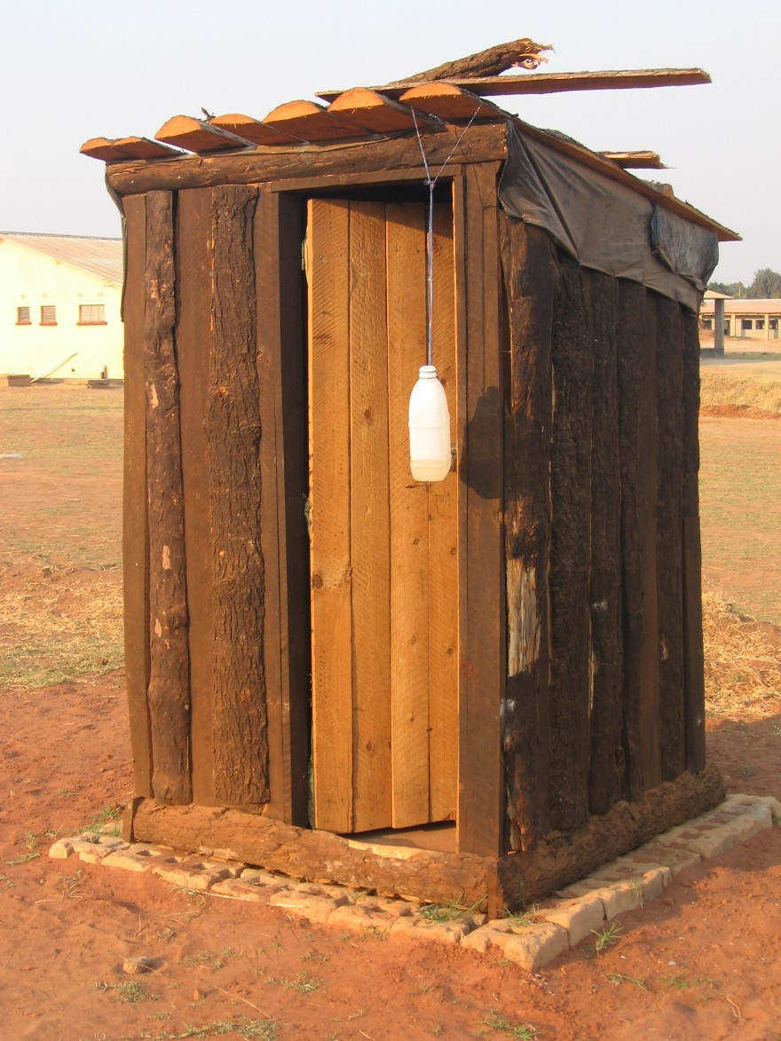
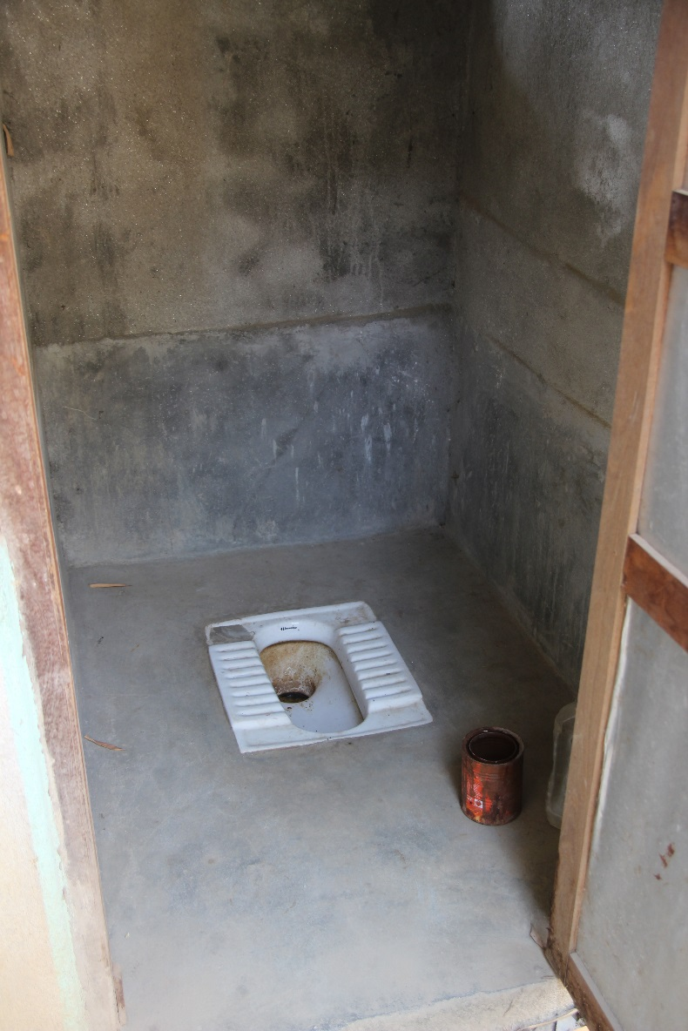
Improved Sanitation
Pit latrine, Zambia
Pour Flush Latrine, Nepal

Slide 11
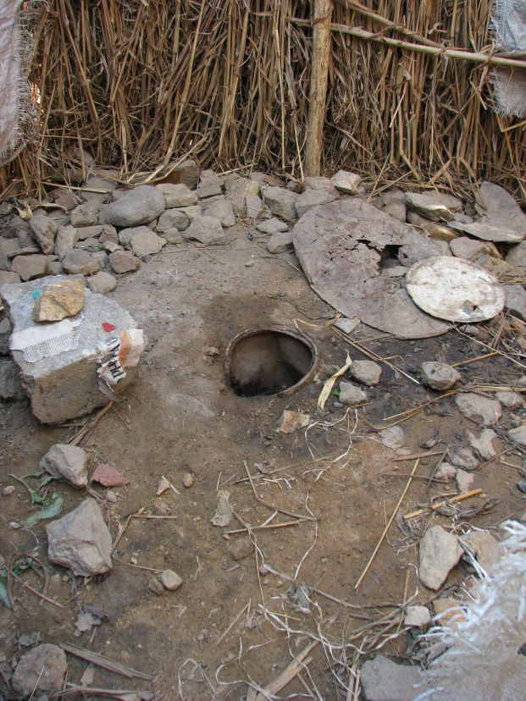
Unimproved Sanitation Facilities
Pit latrine without slab, or open pit
Bucket
Hanging latrine
Flush or pour flush latrine discharging to elsewhere
Shared facilities of any type
Open defecation
Pit latrine without slab, Zambia
Notes:
Unimproved sanitation facilities do not ensure a hygienic separation of human excreta from human contact.
This term was developed by the UNICEF and World Health Organization (WHO) Joint Monitoring Programme (JMP) for Water Supply and Sanitation. It is used to measure progress towards achieving the Millennium Development Goal (MDG) target of cutting in half the proportion of people without sustainable access to basic sanitation by 2015 (UNICEF and WHO, 2014). The definition of improved sanitation is under review and may change in the new sanitation targets set for post-2015 under the Sustainable Development Goals.

Slide 12
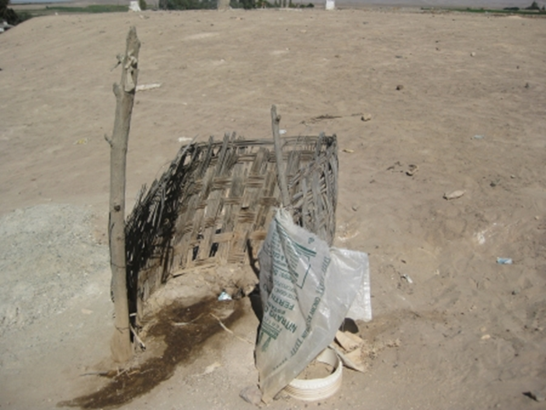
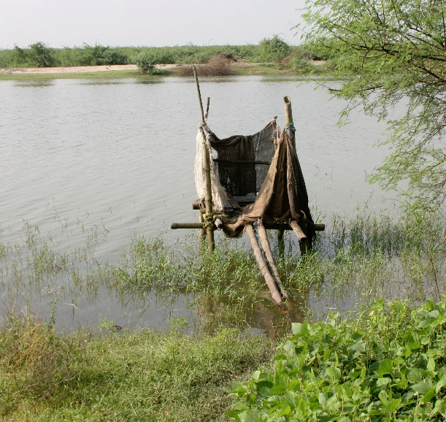
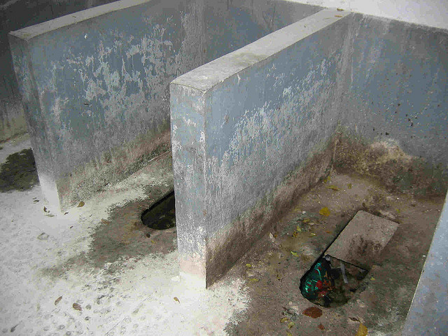
Lack of privacy, Peru
Pit latrine without slab, Zambia
Poor maintenance, China
Hanging latrine, India

Slide 13
What About Locally?
% urban population using improved sanitation
% rural population using improved sanitation
% total population using improved sanitation
% total population practicing open defecation
Notes:
Add country or regional information about access to improved sanitation.
Country and regional information is available at:
UNICEF AND WHO (2014). Progress on Drinking Water and Sanitation – 2014 Update. WHO/UNICEF Joint Monitoring Programme for Water Supply and Sanitation. UNICEF, New York, USA and WHO, Geneva, Switzerland. Available at: www.wssinfo.org/documents/

Slide 14
Cycle of Poverty
How is poor sanitation connected to and causes the cycle of poverty to continue?
Notes:
Disease spreading = ill health = unable to go to school = unable to work = lack of productivity = lack of economic growth = poverty.

Slide 15
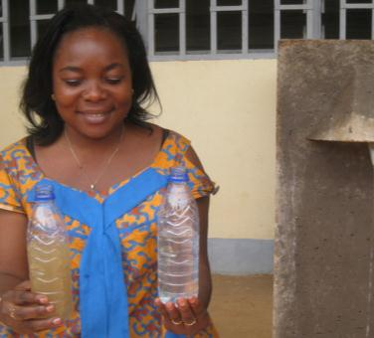
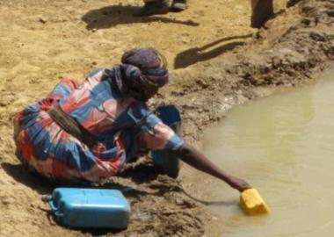
Cycle of Poverty
Family Sick
Healthy Family
$$ Spent on Health Care
School & Education
Poverty
Weak & Vulnerable Society
Strong & Safe Society
Job & Income
Loss of Dignity
& Depression
Opportunities
Notes:
Open defecation contaminates drinking water and causes illness
Children under five are highly vulnerable to waterborne diseases
Sick children unable to attend school
Uneducated adults: Life of poverty & illness

Slide 16
Review
What are some of the local and global issues related to poor sanitation?
How is poor sanitation connected to and causes the cycle of poverty to continue?
Notes:
Ask the participants to stand in two lines facing each other in pairs. Name one line A and the other B.
Ask line A to briefly discuss some of the local and global sanitation issues. After 1 minute, ask line A to move one person to the right. Line B will then discuss the same topic with a new partner for 1 minute.
Ask line A to briefly discuss poor sanitation is connected to and causes the cycle of poverty to continue. After 1 minute, ask line A to move one person to the right. Line B will then discuss the same topic with a new partner for 1 minute.

