Slide 1
12, 2916 – 5th Avenue
Calgary, Alberta, T2A 6K4, Canada
Phone: + 1 (403) 243-3285, Fax: + 1 (403) 243-6199
E-mail: cawst@cawst.org, Website: www.cawst.org
CAWST, the Centre for Affordable Water and Sanitation Technology, is a nonprofit organization that provides training and consulting to organizations working directly with populations in developing countries who lack access to clean water and basic sanitation.
One of CAWST’s core strategies is to make knowledge about water common knowledge. This is achieved, in part, by developing and freely distributing education materials with the intent of increasing the availability of information to those who need it most.
This document is open content and licensed under the Creative Commons Attribution Works 3.0 Unported License. To view a copy of this license, visit http://creativecommons.org/licenses/by/3.0 or send a letter to Creative Commons, 171 Second Street, Suite 300, San Francisco, California 94105, USA.
You are free to:
Share – to copy, distribute and transmit this document
Remix – to adapt this document
Under the following conditions:
Attribution. You must give credit to CAWST as the original source of the document. Please include our website: www.cawst.org
CAWST will produce updated versions of this document periodically. For this reason, we do not recommend hosting this document to download from your website.
CAWST and its directors, employees, contractors, and volunteers do not assume any responsibility for and make no warranty with respect to the results that may be obtained from the use of the information provided.
Stay up-to-date and get support:
Latest updates to this document
Other workshop & training related resources
Support on using this document in your work
CAWST provides mentorship and
coaching on the use of its education
and training resources.

Slide 2
This presentation is used with Lesson Plan 16: Physical Parameters in the Drinking Water Quality Testing Trainer Manual
Available at www.cawst.org/resources

Slide 3
Physical Parameters of Drinking Water Quality

Slide 4
Learning Expectations
Discuss the importance of physical testing.
List key physical parameters of drinking water and how to test for them.
Demonstrate ability, with limited supervision, to test turbidity using a turbidity tube.

Slide 5
Physical Parameters
Of Drinking Water
Smell – moldy, organic, foul, sweet
Taste – bitter, sweet, salty, minerals, organic
Feel – Temperature (cool water is preferred)
See – Colour and turbidity (cloudy appearance)

Slide 6
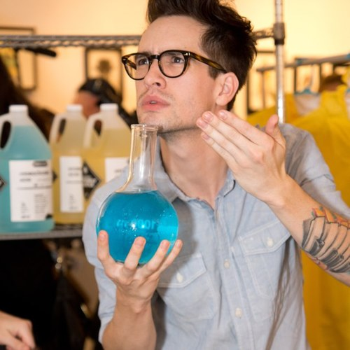
What Can You Smell and Taste?
Earthy, musty, moldy
Produced by some types of bacteria
Grass, hay, straw, wood
Algae and decaying vegetation
Marshy, swampy, septic, sewage, rotten egg
Sulphur – human or natural
Chlorine
Residual from drinking water treatment
How is it measured?
Use your senses
Do not breathe in the smell directly
Use your hand to waft vapors towards your nose
Credit: Chemical Paradox
Notes:
Although taste and odour do not pose a direct health threat, they may indicate chemical or biological contamination.
Taste and odour are perhaps the most important characteristics of drinking water from the point of view of the user. It is next to impossible to convince people that water is safe to drink if it tastes or smells bad.
Safe water that does not taste, look or smell good could lead people to reject the water and use other sources that are less safe

Slide 7
What Can You Feel? Temperature
How is it measured?
Thermometer in Celsius or Fahrenheit
Ideal temperature is 4–10°C (39-50°F)
What do you prefer to drink? Cool or warm water?
Credit: Children’s Encyclopedia of Science
Notes:
High water temperature (20-30°C) can also increase the growth of microorganisms and may lead to taste, odour, colour, and corrosion problems.

Slide 8
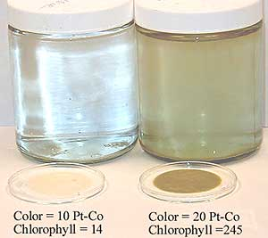
What Can You See? Colour
Reddish, brown, or yellow
Iron
Black
Bacteria growth
Manganese
Dark brown or yellow
Industrial waste
Decaying vegetation
Foam
Detergents
Notes:
Colour may occur in drinking water for different reasons, such as from the presence of:
Natural organic matter and vegetation, such as leaves and bark
Metals such as iron, manganese and copper, which are abundant in nature and are naturally coloured
Highly coloured industrial waste, the most common of which are pulp and paper and textile waste

Slide 9
What Can You See? Turbidity
What is turbidity?
Suspended particles of sand, silt or clay giving water a cloudy appearance
No direct health impacts
Indicator of microbiological contamination
Reduces effectiveness of chlorine treatment
May produce other by-products when chlorine is added
Notes:
Turbidity is caused by suspended solids, such as sand, silt and clay, floating in water. Light reflects off these particles, which makes the water look cloudy or dirty.
Turbidity itself will not make you sick; however, higher turbidity levels are often associated with higher levels of microorganisms (i.e., bacteria, viruses, and protozoa) because they attach themselves to the particles in the water.
Therefore, we must be cautious of turbid water as it usually has more pathogens, so drinking it increases our chances of becoming sick.

Slide 10
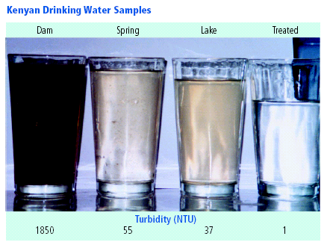
Credit: P & G Health Sciences Institute

Slide 11
Turbidity
How is it measured?
Turbidity tube or digital turbidimeter
NTU = Nephelometric Turbidity Unit
Nephelometer measures intensity of light scattered by the suspended particles
WHO recommends that turbidity be no more than 1 NTU, and preferably much lower, for proper disinfection
Biosand filter inlet water <50 NTU
Notes:
Turbidity :
Small community water systems and HWTS methods may not be able to achieve such low levels of turbidity. In these cases, the aim should be to produce water that has turbidity of less than 5 NTU and, if at all possible, below 1 NTU
Large, well-run municipal supplies should be able to achieve less than 0.5 NTU before disinfection at all times and should be able to average 0.2 NTU or less.

Slide 12
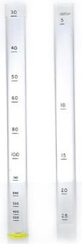
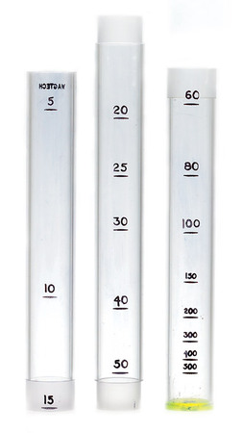
Turbidity Tubes
Two part turbidity tube used in a portable kit
Two part turbidity tube used in a portable kit
Credit: Palintest, International UK
Credit: Palintest, International UK

Slide 13
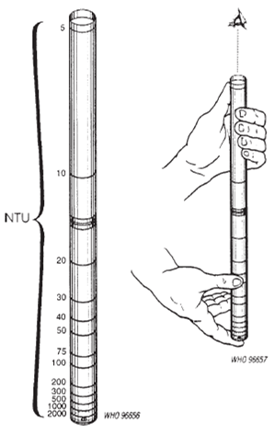
Using a Turbidity Tube
Credit: WHO, 1997
Notes:
A turbidity tube is an easy and inexpensive way to visually estimate NTU.
It is practical for field testing since it is very portable and does not need batteries or replacement parts.
A limitation is that it is harder to read levels less than 10 NTU with a turbidity tube.
How to Use a Turbidity Tube:
1. Slowly pour some water into the tube.
2. Place your head 10 to 20 centimeters directly over the tube so that you can see the disc at the bottom of the tube.
2. Keep adding water until the pattern on the disc at the bottom becomes hard to see when you look down the tube.
3. Stop pouring as soon as the pattern on the disk can no longer be seen.
4. Read the turbidity level in NTUs from the scale on the side of the tube.

Slide 14
Digital Turbidimeter
Notes:
A turbidimeter is operated by a battery or power supply and it gives the digital reading of the turbidity level.
A turbidimeter gives more accurate results, although it is more expensive and vulnerable to damage.

Slide 15
Review
Do physical parameters have direct health effects?
No but they may indicate chemical or microbiological contamination
What causes turbidity?
Turbidity is caused by sand, silt and clay floating in water
Notes:
Physical parameters do not have direct health effects. However, the presence of physical contaminants may indicate a higher risk of microbiological and chemical contamination which may be harmful to human health.
Safe water that does not taste, look or smell good could lead people to reject the water and use other sources that are less safe
Turbidity will not make you sick; however, higher turbidity levels are often associated with higher levels of microorganisms (bacteria, viruses, and protozoa) because they attach themselves to the particles in the water. Therefore, we must be cautious of turbid water as it usually has more pathogens, so drinking it increases our chances of becoming sick.

