Slide 1
2020 | JULY

Slide 2
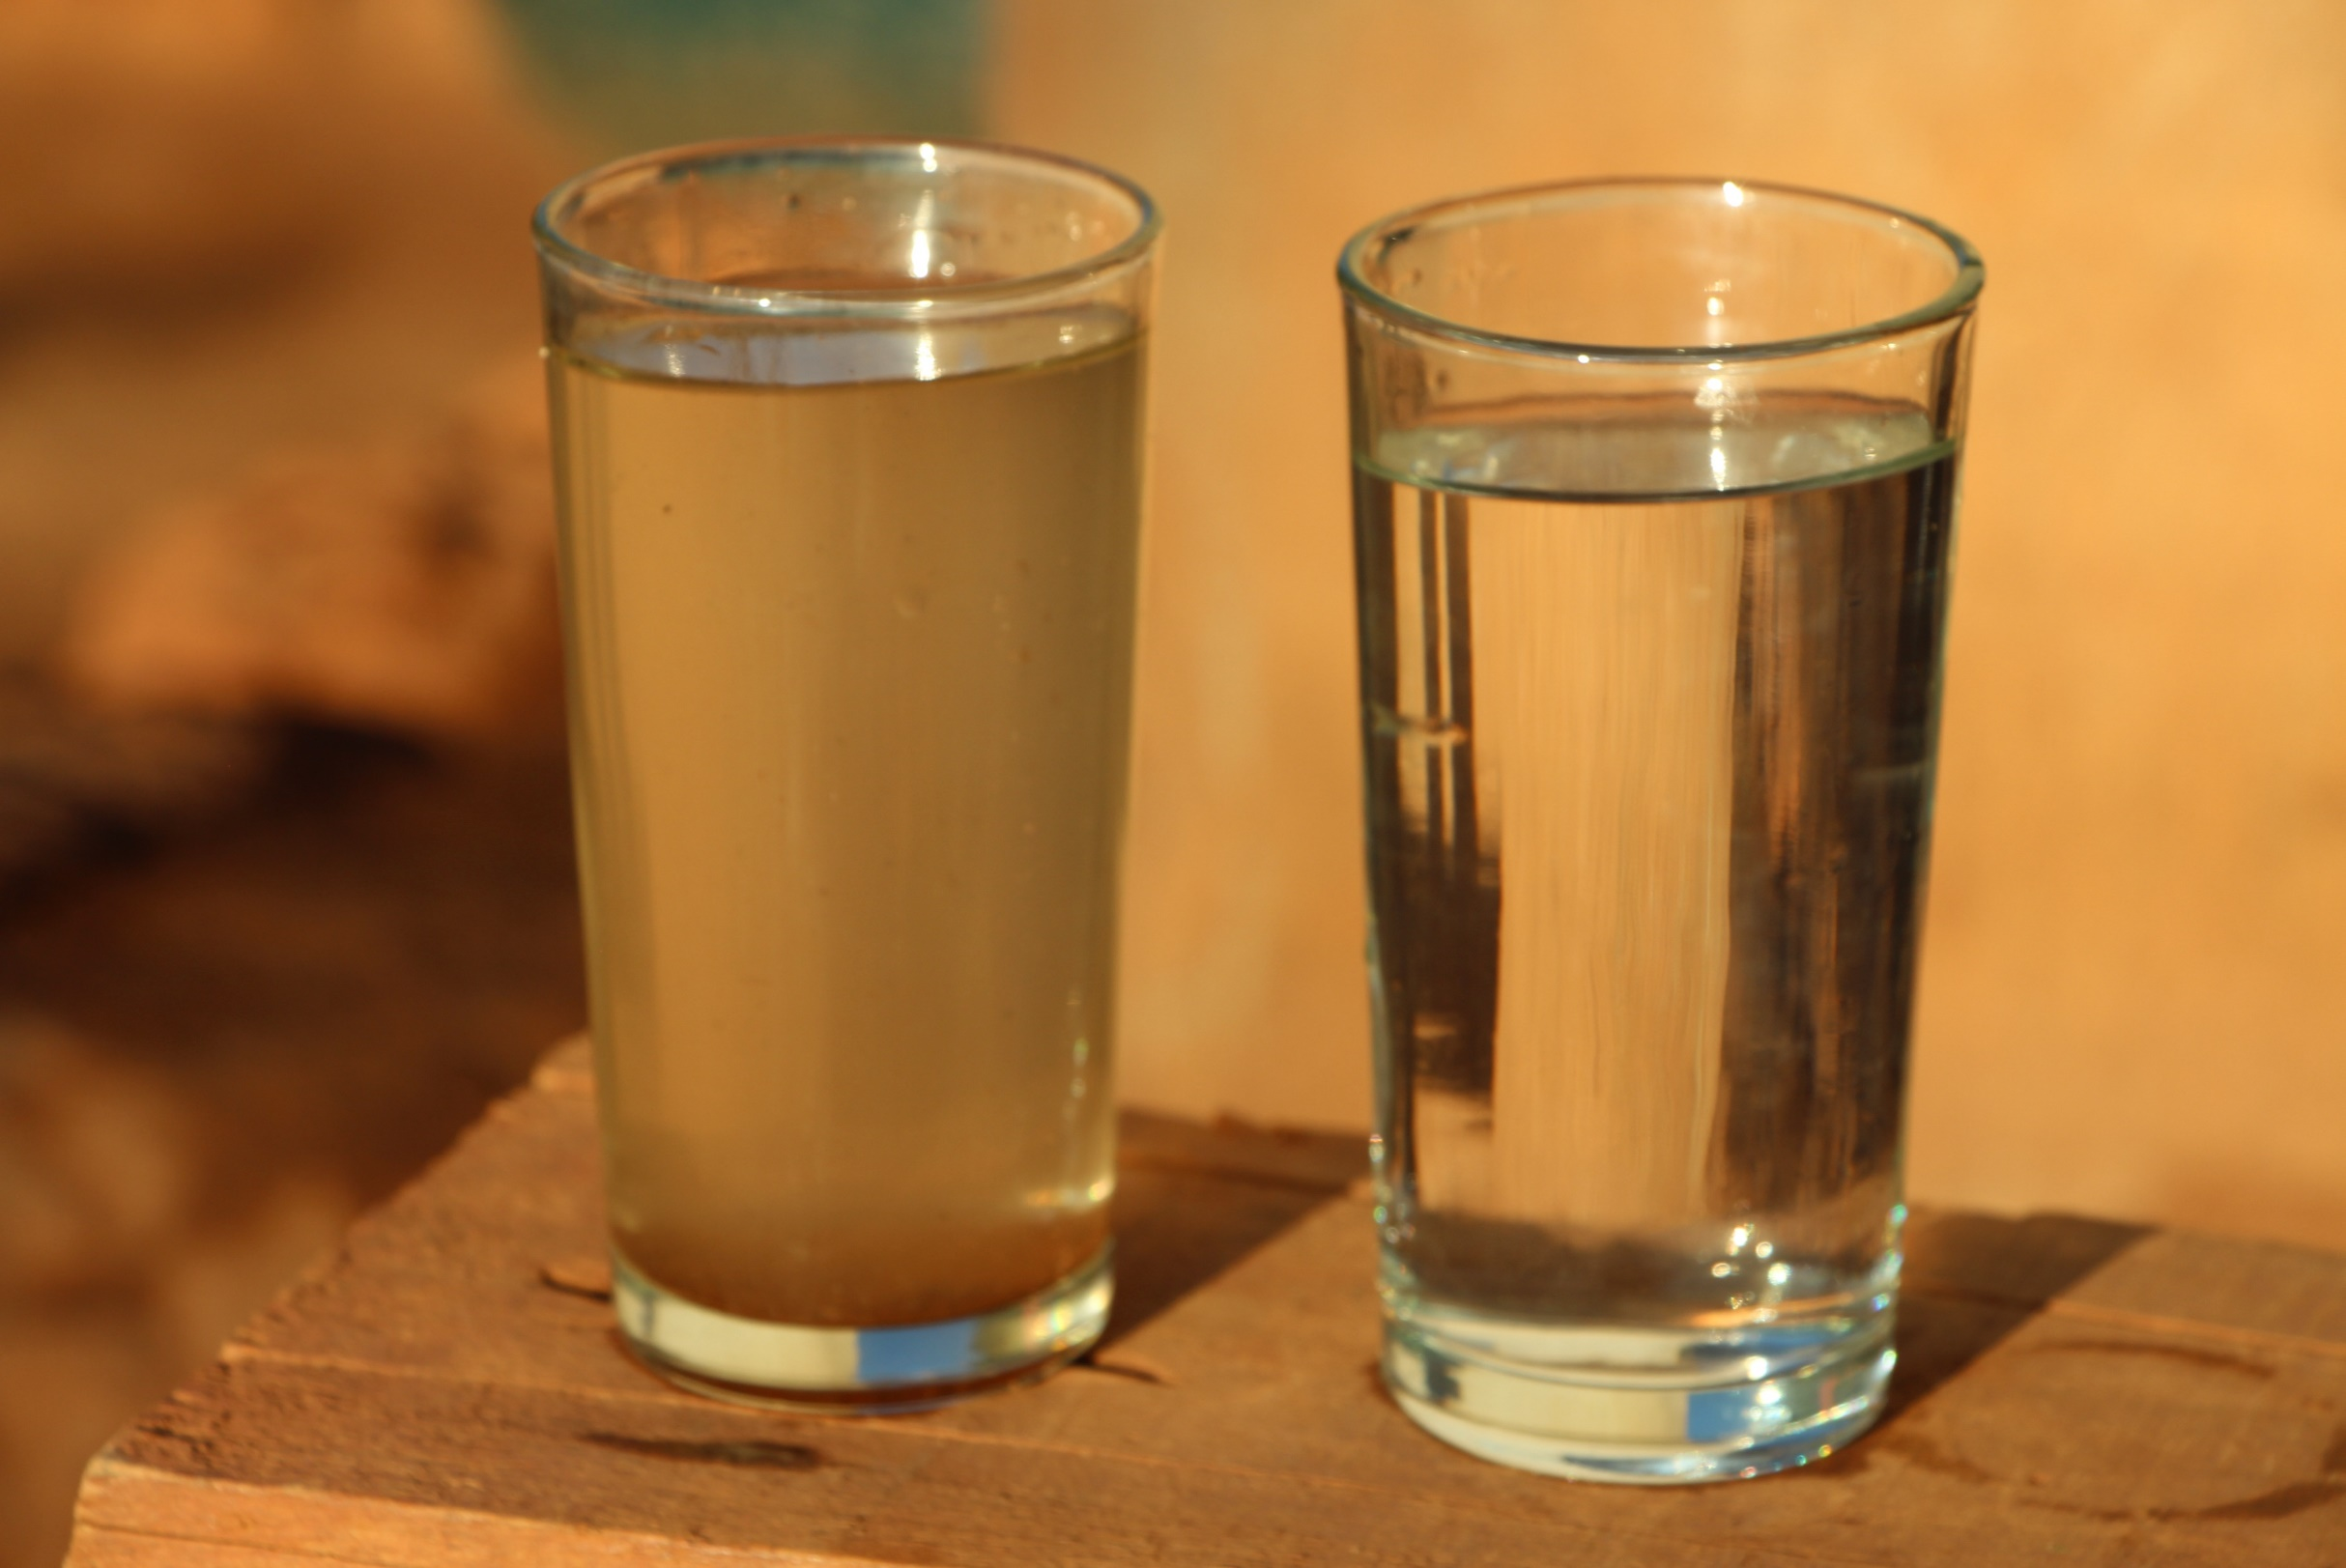
Introduction
Which of the glasses on display would you prefer to drink from?
Source: CAWST

Slide 3
LEARNING
OUTCOMES
Describe the characteristics of safe drinking water
Define safe drinking water
Explain how water is contaminated
Explain the relevance of water quality guidelines and standards

Slide 4
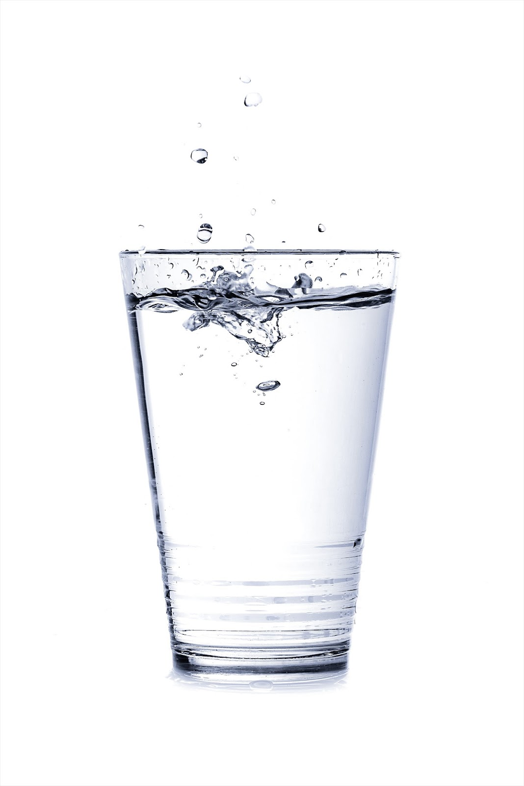
Safe Water Characteristics
Clear
Pathogen free
Low in concentrations of toxic chemicals
Tasteless, odourless, and colourless (for aesthetic purposes)

Slide 5
“Safe drinking water does not represent any significant risk to health over the lifetime of consumption, including different sensitivities that may occur between life stages.”
WORLD HEALTH ORGANIZATION

Slide 6
Meaning of WHO definition of safe drinking water
Safe drinking water will not make people sick at any time throughout their life, including when they are young, old or sick.
Safe drinking water should be good to use for all our personal needs, including drinking, cooking, and washing.

Slide 7
GROUP ACTIVITY
How is water contaminated?
Notes:
See Trainer Manual for Water Contamination Activity

Slide 8
Categories of Contamination
Acceptability
Microbiological
Chemical

Slide 9
Guidelines and Standards
Guidelines are a recommendation
Standards are mandatory requirements and enforceable

Slide 10
REVIEW
Complete the phrase in your workbooks.
“Safe drinking water means to me…”

Slide 11
Thank you!
Calgary . Alberta . Canada
+1 403 243 3285
cawst@cawst.org
cawst.org

