Slide 1
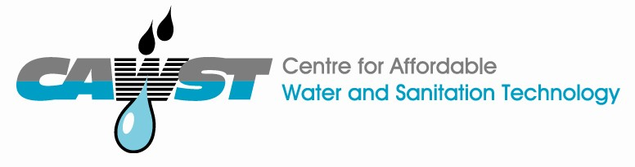
12, 2916 – 5th Avenue
Calgary, Alberta, T2A 6K4, Canada
Phone: + 1 (403) 243-3285, Fax: + 1 (403) 243-6199
E-mail: cawst@cawst.org, Website: www.cawst.org
CAWST is a Canadian non-profit organization focused on the principle that clean water changes lives. Safe water and basic sanitation are fundamentals necessary to empower the world’s poorest people and break the cycle of poverty. CAWST believes that the place to start is to teach people the skills they need to have safe water in their homes.
CAWST transfers knowledge and skills to organizations and individuals in developing countries through education, training and consulting services. This ever expanding network can motivate individual households to take action to meet their own water and sanitation needs.
One of CAWST’s core strategies is to make knowledge about water common knowledge. This is achieved, in part, by developing and freely distributing education materials with the intent of increasing its availability to those who need it most. You should feel free to copy and distribute this document in any form, printed or electronic. If you wish to use any parts of this document in the creation of your own materials, please ensure that CAWST is properly acknowledged. Please include our website address: www.cawst.org.
Feel free to include a link from your website to the CAWST website. Please do not host this document to download from your website as we will have updated versions from time to time. Please email us if you have any questions or feedback.
This document is open content and licensed under the Creative Commons Attribution Works 3.0 Unported License. To view a copy of this license, visit: http://creativecommons.org/licenses/by/3.0
You are free to:
Share – to copy, distribute and transmit this document
Remix – to adapt this document
Under the following conditions:
Attribution. You must give credit to CAWST as the original source of the document
CAWST and its directors, employees, contractors, and volunteers do not assume any responsibility for and make no warranty with respect to the results that may be obtained from the use of the information provided.

Slide 2

This presentation is used with Lesson Plan: HWT for Vulnerable People in the People Living with HIV/AIDS Trainer Manual.
Available at www.cawst.org/resources

Slide 3

Safe Water for People Living with HIV/AIDS

Slide 4
Learning Expectation
The need for safe water is critical for people living with HIV/AIDS
2. The need for a multi-barrier approach to safe water: protection, treatment and storage

Slide 6
Estimated number of people in ________ living with HIV
INSERT COUNTRY SPECIFIC GRAPH

Slide 7
Key Words
PLWHA – People living with HIV/AIDS
CD4 – A cell count that measures immune status for PLWHA
OI – Opportunistic infections commonly associated with PLWHA
ART or ARV – Antiretroviral therapy
PMTCT – Prevention of mother to child transmission

Slide 8
Safe Water and PLWHA
The provision of safe, clean water is critical in HIV care and treatment programs for 3 reasons:
PLWHA are particularly susceptible to waterborne pathogens and related diarrhea (from unsafe water);
Anti-retroviral (ARV) therapy is better absorbed if clients use uncontaminated drinking water
HIV-positive mothers who choose not to breastfeed need safe water to make formula
(USAID, 2007. Best Practices In Social Marketing Safe Water Solution for Household Water Treatment: Lessons Learned from Population Services International Field Programs)

Slide 9
Key Message 1
PLWHA are particularly susceptible to waterborne pathogens and related diarrhea (from unsafe water)

Slide 10
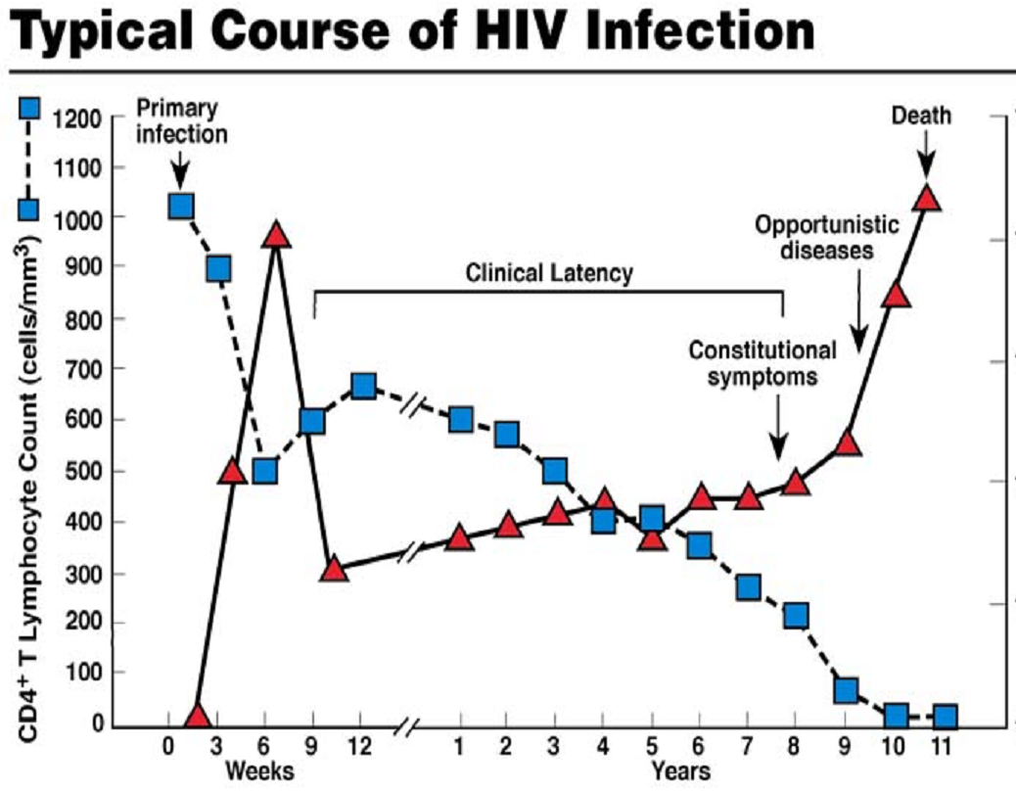

Slide 11
Safe Water and PLWHA
“HIV-positive patients without access to clean water are at risk for a variety of common and opportunistic pathogens. These pathogens can be difficult to eradicate and can contribute to dehydration, malnutrition, and worsening of immune function...”
(Partners in Health, 2006. PIH Guide to the Community-Based Treatment of HIV in Resource-Poor Settings, Second Edition)

Slide 12
Safe Water and HIV
In areas that lack adequate safe water, hygiene and sanitation, people with HIV (but don’t have AIDS) still have increased rates of illness and death
Data from Africa show high rates of serious opportunistic infections and death occur with CD4 levels of 200–350
(Wood and Lawn, 2009. Should the CD4 Threshold for Starting ART be Raised? Lancet)

Slide 13
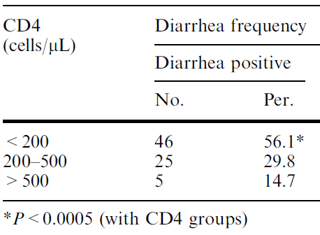
(Sadraei et al., 2005. CD4+ Cell Counts and Opportunistic Protozoa in Indian HIV-Infected Patients. Parasitol Res 97: 270–273)

Slide 14
Diarrhea and HIV (WHO)
Diarrhea is a major cause of morbidity (illness) and mortality (death) in people with HIV…..
Recent studies demonstrated … reduction in diarrhea ….of 39% with point-of use household water treatment.”
- WHO 2008 “Essential prevention and care interventions for adults and adolescents living with HIV in resource-limited settings”

Slide 15
Death Rates 20,000 HIV+ Adults Uganda

Slide 16
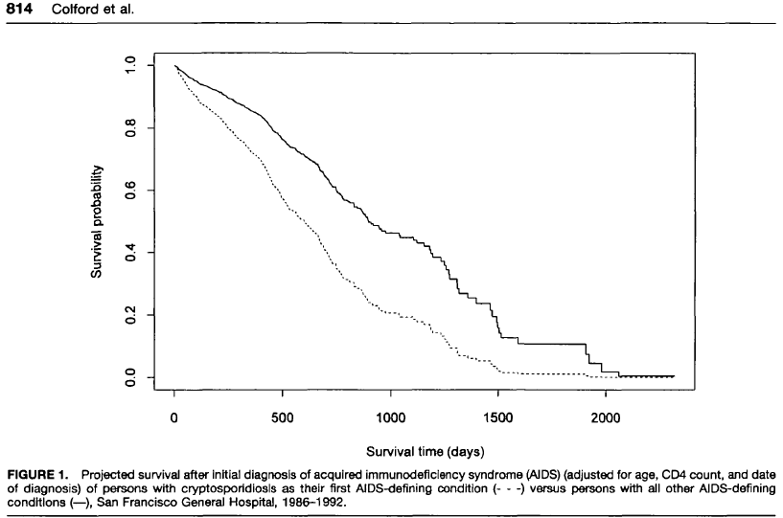
% Survival of AIDS Patients and Cryptosporidium
Without Cryptosporidiosis
With Cryptosporidiosis
(Colford et al.)

Slide 17
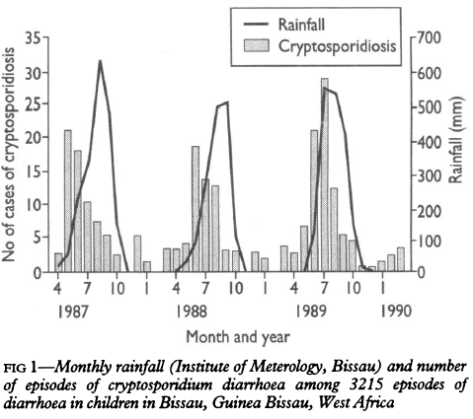
Rainfall & Cryptosporidium

Slide 18
Key Message 1
PLWHA are particularly susceptible to waterborne pathogens and related diarrhea (from unsafe water)
Any questions?

Slide 19
HIV and Replacement Feeding
“When implementing programmes for replacement (i.e., formula) feeding of infants of mothers with HIV, or early weaning of breastfed infants of HIV-infected mothers, the provision of effective water treatment is essential to protect the health of the infants.”
– WHO 2008 “Essential prevention and care interventions for adults and adolescents living with HIV in resource-limited settings”
(

Slide 20
Key Message 2
Anti-retroviral (ARV) therapy is better absorbed if HIV+ individuals use uncontaminated water

Slide 21
HIV and Antiretrovirals
Anti-retroviral drugs (ARV) inhibit HIV replication, increases CD4 levels, decreases the rate of opportunistic infections
Anti-retroviral drugs (ARV) are better absorbed if patients use clean, treated drinking water
(

Slide 22
% of PLWHA on ARVs

Slide 23
Diarrhea and ARV Absorption
Level of ARV Drug in Blood
(Brantley et al., 2003. British Journal of Infectious Diseases

Slide 24
Safe Water & ARV
“To implement treatment programmes for people with HIV — to provide ART, cotrimoxazole and medicines for TB, for example — access to safe water is essential, as this allows patients to take their drugs and avoid diarrhoeal diseases that reduce drug absorption.”
(WHO, 2008. Essential Prevention and Care Interventions for Adults and Adolescents Living with HIV in Resource-limited Settings)

Slide 25
Safe Water & ARVs
“To implement treatment programmes for people with HIV … access to safe water is essential, as this allows patients to take their drugs and avoid diarrheal diseases that reduce drug absorption.”
(WHO, 2008. Essential Prevention and Care Interventions for Adults and Adolescents Living with HIV in Resource-limited Settings)

Slide 26
Key Message 2
Anti-retroviral (ARV) therapy is better absorbed if patients use uncontaminated drinking water
Any questions?

Slide 27
Key Message 3
HIV-positive mothers who choose not to breastfeed need safe water to make formula

Slide 28

Percent of Adults Living with HIV Who Are Female
70
60
Sub-Saharan Africa
50
GLOBAL
Percent
female
(%)
40
Caribbean
30
Asia
20
E Europe & C Asia
Latin America
10
0
1990
‘91
‘92
‘93
‘94
‘95
‘96
‘97
‘98
‘99
‘00
‘01
‘02
‘03
‘04
‘05
‘06
2007
Year
Notes:
Means that PMCT is important and that there are increasing numbers of infants and children with HIV/AIDS.

Slide 30
Replacement Feeding & Importance of Water Treatment - WHO
When mothers choose “replacement (i.e., formula) feeding of infants of mothers with HIV, or early weaning of breastfed infants of HIV infected mothers, the provision of effective water treatment is essential to protect the health of the infants.”
– WHO 2008 “Essential prevention and care interventions for adults and adolescents living with HIV in resource-limited settings

Slide 31
Access to Safe Water –
Multi Barrier Approach
Multi Barrier Approach slide

Slide 32
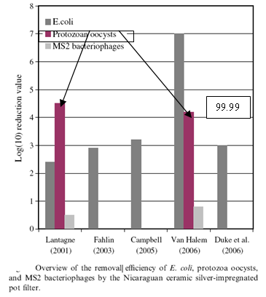
What about a slide on BSF??
Modified from van Halem et al. 2009)

Slide 33
Pathogen Resistance to Chlorine
Most bacteria
Viruses
Mycobacteria
Protozoa
  Giardia
  Cryptosporidium
Least
Most
(Adapted from Sobsey, UNC)

Slide 34
Conclusion #1
The provision of safe, clean water is critical in HIV care and treatment programs for 3 reasons:
PLWHA are particularly susceptible to waterborne pathogens and related diarrhea (from unsafe water);
Anti-retroviral (ARV) therapy is better absorbed if patients use uncontaminated drinking water
HIV-positive mothers who choose not to breastfeed need safe water to make formula
(USAID, 2007. Best Practices In Social Marketing Safe Water Solution for Household Water Treatment: Lessons Learned from Population Services International Field Programs)

Slide 35
Conclusion #2
Need MBA to safe water to ensure vulnerable populations are taken care of.

