Slide 1




12, 2916 – 5th Avenue
Calgary, Alberta, T2A 6K4, Canada
Phone: + 1 (403) 243-3285, Fax: + 1 (403) 243-6199
E-mail: cawst@cawst.org, Website: www.cawst.org
CAWST, the Centre for Affordable Water and Sanitation Technology, is a nonprofit organization that provides training and consulting to organizations working directly with populations in developing countries who lack access to clean water and basic sanitation.
One of CAWST’s core strategies is to make knowledge about water common knowledge. This is achieved, in part, by developing and freely distributing education materials with the intent of increasing the availability of information to those who need it most.
This document is open content and licensed under the Creative Commons Attribution Works 3.0 Unported License. To view a copy of this license, visit http://creativecommons.org/licenses/by/3.0 or send a letter to Creative Commons, 171 Second Street, Suite 300, San Francisco, California 94105, USA.
You are free to:
        Share – to copy, distribute and transmit this document
        Remix – to adapt this document
Under the following conditions:
        Attribution. You must give credit to CAWST as the original source of the document. Please include our website: www.cawst.org
CAWST will produce updated versions of this document periodically. For this reason, we do not recommend hosting this document to download from your website.
CAWST and its directors, employees, contractors, and volunteers do not assume any responsibility for and make no warranty with respect to the results that may be obtained from the use of the information provided.
Stay up-to-date and get support:
            Latest updates to this document
            Other workshop & training related resources
            Support on using this document in your work
CAWST provides mentorship and
coaching on the use of its education
and training resources.

Slide 2

This presentation is used with
Lesson Plan 17: Chemical Parameters in the Drinking Water Quality Testing Trainer Manual.
Available at www.cawst.org/resources

Slide 3

Arsenic in Drinking Water

Slide 4
Learning Expectations
Identify the health impacts of harmful levels of arsenic in drinking water
Discuss arsenic mitigation options

Slide 5

Where Does Arsenic Come From?
Natural in groundwater and some surface water
Human activities
(Credit: WHO Synthesis Report on Arsenic in Drinking Water, 2002)
Notes:
Arsenic can naturally occur in groundwater and some surface water.
Weathering reactions
Volcanic emissions
Biological activities
Arsenic can also come from the following human activities:
Burning high-arsenic coal
Arsenic mining
Chromated copper arsenic (CCA) treated wood
Arsenic-containing pesticides and herbicides

Slide 6
Background Arsenic Levels
Water Source | Typical Concentrations
Rain and snow | < 0.03 ug/L
River water | < 2 ug/L
Lake water | < 1 ug/L
Seawater | 1.5 ug/L
Groundwater | < 10 ug/L

Slide 7
How Are We Exposed?
Ingestion
Drinking water
Eating food
Absorption through skin
Bathing
Handling contaminated substances
Inhalation
Breathing sawdust or smoke from burning wood treated with arsenic
Living in areas with high levels in rock
Most significant
Usually minor
(US Agency for Toxic Substances and Diseases Registry (ATSDR) ToxFAQ for Arsenic. and WHO Synthesis Report on Arsenic in Drinking Water, 2002)

Slide 8
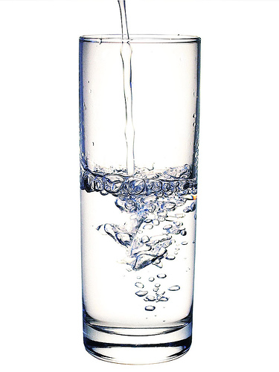
What Does Arsenic Look Like in Water?
Odorless, tasteless, colorless
  There is only one way to tell if present – TESTING!
Levels will vary significantly from well to well, even is close by
Present in many conditions
  Wet, dry

Slide 9
Where in the World is Arsenic Found?
(Credit: Zheng Gong, MIT Department of Civil and Environmental Engineering, 2005)
Notes:
Ask participants for they know any countries that are affected by arsenic? Show the global map.
High levels of arsenic can be found naturally in water from deep wells in over 70 countries, including India, Nepal, Bangladesh, Indonesia, Cambodia, Vietnam, Lao PDR, Mexico, Nicaragua, El Salvador, and Brazil. In South Asia alone, it is estimated that 60 to 100 million people are affected by unsafe levels of arsenic in their drinking water. Bangladesh is the most severely affected, where 35 to 60 million of its 130 million people are exposed to arsenic contaminated water. It is possible that arsenic may be found in other locations as more water quality testing is done.

Slide 10
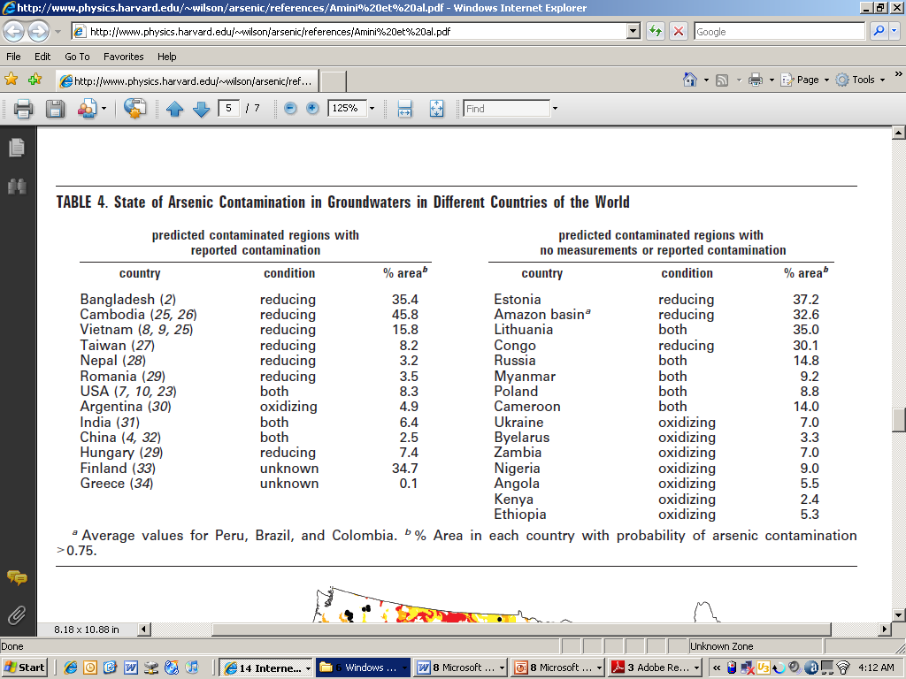
Countries With Predicted Arsenic
(Amini et al., E, S & T, March 2008)

Slide 11
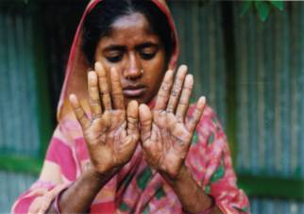
What Are the Health Effects?
Notes:
Melanosis is light or dark spots on people’s skin, often on the chest, back, or palms.
The next step is that hardening skin bulges develop on people’s palms and feet – called keratosis.
Drinking high amounts of arsenic for a longer time may cause cancer in the lungs, bladder, kidney, skin, liver and prostate.
Arsenic may also cause vascular diseases, neurological effects and infant developmental defects.
According to the United Nations Development Program (2006), the projected human costs over the next 50 years include 300,000 deaths from cancer and 2.5 million cases of arsenic poisoning.

Slide 12
How Can We Prevent and Treat Arsenic Poisoning?
Prevention
  Drink arsenic-free water
  Good nutrition
Treatment
  Switch to drinking arsenic-free water
  Nutrition and vitamin supplements
  Moisturizing and disinfecting infections in lesions
  Some medicines; results not proven
*
(WHO Bulletin, 2000. Smith, Lingus & Rahman, “Contamination of drinking water by arsenic in Bangladesh: a public health emergency)
Notes:
Mild to moderate keratosis can be reversed if exposure to arsenic is stopped.

Slide 13


Arsenicosis Reversal
(Credit: CAWST)
After receiving a rainwater harvesting tank through an
Arsenic Mitigation Program in Bangladesh, Halima’s
symptoms of arsenicosis disappeared.

Slide 14
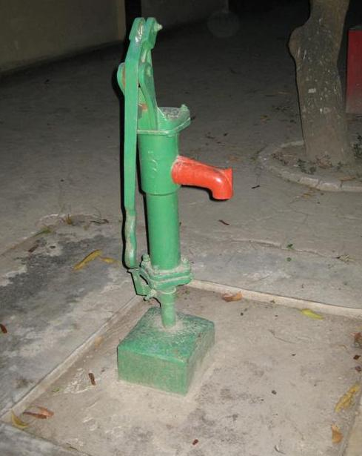
Guidelines for Arsenic in Drinking Water
WHO 10 ug/L (ppb) = 0.01 mg/L (ppm)
Australia 7 ug/L
Canada 25 ug/L
EU 10 ug/L
Japan 10 ug/L
USA 10 ug/L
Bangladesh 50 ug/L
Cambodia 50 ug/L
China 50 ug/L
India 50 ug/L
Lao 50 ug/L
Myanmar 50 ug/L
Nepal 50 ug/L
Pakistan 50 ug/L
Vietnam 10 ug/L urban, 50 ug/L rural
(World Bank, 2005. Towards a More Effective Operational Response, Volume 1)
Notes:
Arsenic one of the greatest chemical problems in developing countries. The World Health Organization (WHO) considers arsenic to be one of the chemicals of greatest health concern in some natural waters and a high priority for testing in drinking water sources (WHO, 2011; WHO, 2012).
Difficult to measure arsenic levels below 1-10 μg/L, and removing arsenic in drinking water to concentrations below 10 μg/L is difficult in many circumstances. In view of the practical difficulties in testing and removing arsenic, the WHO (2011) suggests that drinking water should have less than 10 μg/L of arsenic.
Many countries have their own standards which are less strict than the WHO Guidelines, ranging from 25 mg/L to 50 μg/L (25-50 ppb). Ask the participants why is this the case? Many Southeast Asian countries that have an arsenic problem have adopted a temporary standard of 50 μg/L because it is difficult to test accurately to 10 μg/L and to treat water to meet that level.

Slide 15
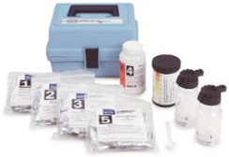
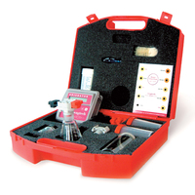
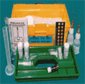
How Do We Test for Arsenic?
Test strips
Colour reference charts
Digital photometer
Test strips (Credit: Hach)
Colour comparison (Credit: ENPHO)
Digital photometer (Credit: Palintest)
Notes:
Arsenic testing used to be only possible in a laboratory. However, as a result of the discovery of significant arsenic contamination of groundwater, a variety of portable test kits are now available. All of these rely on the Gutzeit method, which consists of several steps.
Most commercially available portable test kits typically provide colour reference charts, with reported detection limits around 0.01 mg/L. However, evaluations have shown that the results are semi-quantitative at best, especially at lower levels (<0.1 mg/L).
However, in recent years manufacturers of portable test kits have modified designs to lower the detection limit for arsenic. The newer kits are probably still not capable of reliably quantifying arsenic at such low levels, but should have lower false negative rates.

Slide 16
Arsenic Mitigation Options
Arsenic Mitigation
Alternative Arsenic-Free Sources
Arsenic Removal Technologies
Safe tube wells
Improved dug wells
Deep wells
Rainwater harvesting
Surface water
Oxidation
Coagulation
Adsorption
Surface Complexation
Notes:
This can be the last slide of the presentation. If participants want more information about specific treatment options, then you can also show the following optional slides.
One way to deal with arsenic in groundwater is to use a different source of drinking water, such as rainwater or surface water. Some people collect and store their rainwater and use it for drinking and cooking instead of arsenic contaminated groundwater. If people change to drinking surface water, they will probably need to treat the water to remove turbidity and pathogens.
If people are unable to change to a water source that does not have arsenic, there are various household water treatment options that have been developed to remove arsenic from water. Each technology has advantages and limitations. Many of these technologies are being used in Bangladesh where the arsenic problem is widespread. See the Household Water Treatment for Arsenic Removal Fact Sheets for more information on the different technologies.

Slide 17
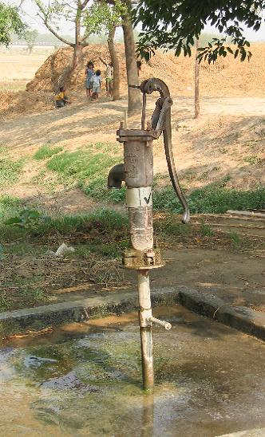
Safe Tube Wells
Tube wells with arsenic levels within the relevant standards
Advantage:
Immediate solution
Limitations:
Need regular monitoring
Convenient?
Customs and religious restrictions?
Cost:
Testing cost
Drilling and installing shallow tube well costs ~US$100-300

Slide 18
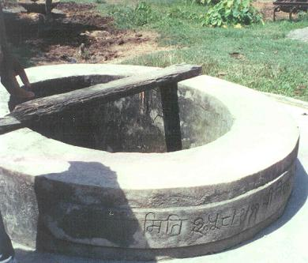
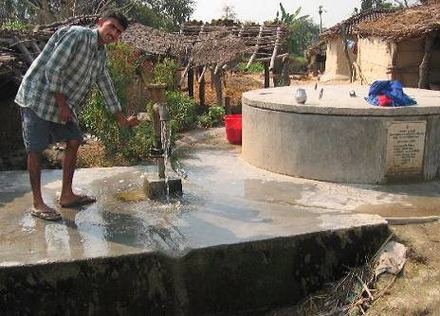
Improved Dug Wells
Cover existing dug wells to minimize microbiological contamination
Advantages:
Simple
Limitations:
May dry up in dry season
Risk of arsenic contamination
Digging may not be easy
Potential taste and smell problems
Cost:
New: US$1000+
Rehabilitation: US$300
Minimal maintenance

Slide 19
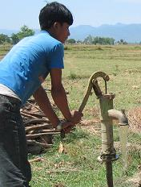
Deep Wells
Deep wells to tap arsenic-free aquifers
Advantages:
Generally no microbiological contamination
Limitations:
Improper drilling/sealing → contamination
Long-term arsenic levels unknown
Appropriate geology not everywhere
May require more sophisticated pump
Cost:
US$200-1000+
Minimal maintenance
Arsenic-Rich Aquifer
Impermeable Layer
Seal
Arsenic-Free Aquifer

Slide 20
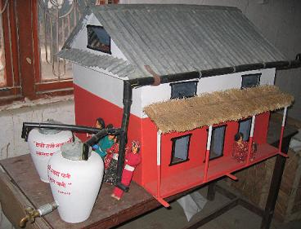
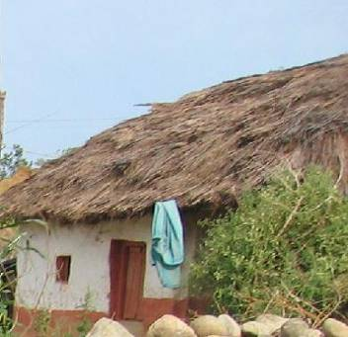
Rainwater Harvesting
Collect rainwater from roof in storage tanks or containers for later use
Advantages:
Low risk of microbiological contamination
Limitations:
Rainfall pattern → may need large collection tank → higher cost
Some roofs not suitable
  - Thatch
Cost:
US$200+ initial

Slide 21
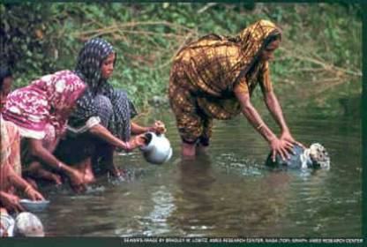
Surface Water
Treat surface water from ponds, rivers, springs, canals, etc.
Advantages:
Low risk of arsenic contamination
Limitations:
High risk of microbiological contamination
Difficult to collect and transport (time and energy)
Cost:
Cost of household or community water treatment

Slide 22
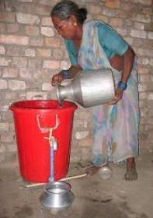
Surface Complexation
Example: KanchanTM Arsenic Filter
What is It?
Adaptation of biosand filter: a layer of rusty nails is placed in the diffuser basin
Also removes microbiological contamination
How Does it Work?
Arsenic adsorbed onto rusty iron nails
Rust and arsenic flake off and caught in the biosand filter
What is the Effectiveness?
85-95% arsenic removal
Cost:
US$12-75 (depends on concrete or plastic)
Notes:
Developed at MIT in collaboration with ENPHO and RWSSSP
The KanchanTM Arsenic Filter (KAF) is an adaptation of the biosand filter. The KAF has been designed to remove arsenic from drinking water, in addition to providing microbiological water treatment. Arsenic removal is achieved by incorporating a layer of rusty nails in the diffuser basin of the filter.
For more information see CAWST’s Household Water Treatment for Arsenic Removal Fact Sheet: Surface Complexation

Slide 23
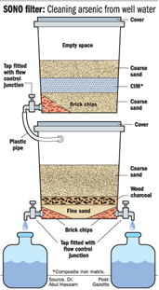
Surface Complexation
Example: Sono (3-Kolshi) Filter
What is It?
Three bucket system with composite iron matrix (CIM)
Also removes microbiological contamination
How Does it Work?
Manganese in CIM catalyzes oxidation of As(III) to As(V) which is removed by strong adsorption with CIM
What is the Effectiveness?
90-95% arsenic removal
Cost:
US$40-50
(Credit: www.robrasa.com)
Notes:
For more information see CAWST’s Household Water Treatment for Arsenic Removal Fact Sheet: Surface Complexation

Slide 24
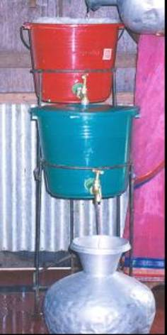
Adsorption
Example: MAGC-Alcan Filter
What is It?
Two buckets in series
Both buckets filled with activated alumina
How Does it Work?
Adhesion of arsenic to activated alumina
What is the Effectiveness?
80-85% arsenic removal
Cost:
US$10 capital cost
US$10-15 activated alumina replacement cost/year
Notes:
Developed by MAGC Technologies and Alcan, USA
For more information see CAWST’s Household Water Treatment for Arsenic Removal Fact Sheet: Adsorption

Slide 25
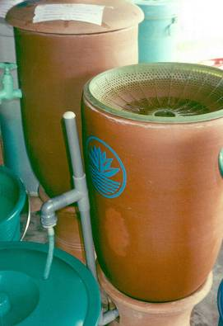
Adsorption
Example: Shapla Filter
What is It?
Brick chips coated with ferrous sulphate placed in a ceramic container
How Does it Work?
Adhesion of arsenic to the brick chips
What is the Effectiveness?
80-90% arsenic removal
Cost:
US$10 capital cost
US$10-15 brick chip with ferrous sulphate replacement cost/year
Notes:
Developed by IDE in Bangladesh
For more information see CAWST’s Household Water Treatment for Arsenic Removal Fact Sheet: Adsorption

Slide 26
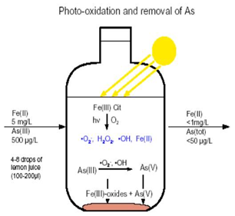
Oxidation
Example: Solar Oxidation and Removal of Arsenic (SORAS)
What is It?
Lemon juice added to water in a PET container and then placed in the sun
Also treats microbiological contamination
How Does it Work?
As(III) oxidized to As(V), adsorbs to iron hydroxide in water, precipitates and settles to the bottom
What is the Effectiveness?
If iron > 8 ppm, 75-90% arsenic removal
If iron < 5 ppm, <50 % arsenic removal
Cost: Minimal
Notes:
Developed in Switzerland
For more information see CAWST’s Household Water Treatment for Arsenic Removal Fact Sheet: Oxidation

Slide 27
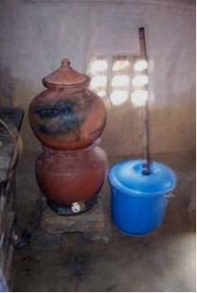
Coagulation
Example: 2-Kolshi Filter
What is It?
Iron sulphate, sodium hypochlorite and ash are added to water and then filtered
Also treats microbiological contamination
How Does it Work?
As(III) oxidizes to As(V), co-precipitates with iron, filtered to remove flocs
What is the Effectiveness?
90% arsenic removal
Cost:
US$10 capital cost
US$10-15 chemical replacement cost/year
Notes:
2-Kolshi is an arsenic removal method using two buckets, developed by ENPHO in Nepal. The first step is a coagulation process, followed by a filtration through a ceramic filter.
For more information see CAWST’s Household Water Treatment for Arsenic Removal Fact Sheet: Coagulation

Slide 28
Review
What are the health impacts of excessive arsenic in drinking water?
What are some of the mitigation options for arsenic in drinking water?
Notes:
Summary of Key Messages:
Arsenic can naturally occur in ground water and some surface water. It is one of the greatest chemical problems in developing countries. The WHO considers arsenic to be a high priority for screening in drinking water sources (WHO, 2006).
Arsenic is odorless, colourless and tasteless in water. Water quality testing is the only way to know if it’s present.
Levels can vary significantly between wells, even when close by.
There is currently no effective cure for arsenic poisoning, however the health effects may be reversed in the early stages by removing the exposure to arsenic. The only prevention is to drink water that has arsenic levels within the safe limit. There are different HWT technologies that are able to remove arsenic from drinking water to safe levels.
Review the learning expectations with the entire group. Ask participants whether or not the expectations have been met. If not, give options for participants to find the information they were looking for or identify next steps for follow up.

