Slide 1


Recent global reports make the case for Household Water Treatment & Safe storage
(HWTS)
Safe water at the household/point of use is key
HWTS Network Meeting - March 2026

Slide 2
What is the data telling us?
A review of four key global documents:
Progress on household drinking water, sanitation and hygiene - JMP, 2025 washdata.org/reports/jmp-2025-wash-households
Integrating water quality testing into household surveys - WHO, 2020
https://washdata.org/sites/default/files/2020-10/JMP-2020-water-quality-testing-household-surveys.pdf
Monitoring Drinking Water Quality in Nationally Representative Household Surveys in Low- and Middle-Income Countries - Bain et al, 2021
Global Analysis and Assessment of Sanitation and Drinking Water - UN-Water, 2025 www.unwater.org/news/un-water-glaas-2025-report
1
2
3
4

Slide 3
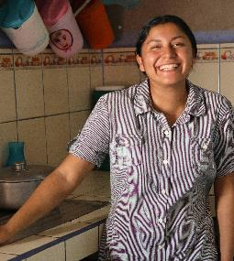
Let’s start by celebrating progress
Why?
Globally, basic water access is at 91% coverage and on track to reach 94% by 2030
Latin America is on track to reach 100% basic water access coverage by 2030
Basic water access: the use of an improved drinking water source with a total round-trip collection time of 30 minutes
or less, including queuing.
Notes:
We have done a great job globally at getting people water that is closer to home.
Latin America is particularly impressive with being on track to reach everyone by 2030.
This shows that as a global community, focused on a goal, we can achieve meaningful progress
Let’s turn our attention to what’s next in water. How do we get everyone safely managed water? how can we unlock human potential and opportunity because people can be certain their water won’t make them sick.

Slide 4
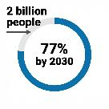
We are not on track for everyone to have safely managed water
Progress on household drinking water, sanitation and hygiene - JMP, 2025
1
74% of people have safely managed water
8x
Since 2015, 961 million people have gained access to safely managed water
At current rate of progress
Rate of progress needs to increase to reach everyoneby 2030
Notes:
This is where we are at right now with safely managed water globally.
1 in 4 people are still without safe water and our progress has only been a 6% gain since 2015. This rate of progress doesn’t get us near where where we need to be by 2030.
The need to go 8x faster is a global average, some parts of the world and especially areas that least developed or fragile need to go way faster than that.
For least developed countries current safely managed coverage is at 37% and only grew by 4% since 2015 and in fragile contexts there is only 45% coverage and that grew by only 2% since 2015.
961 million people have gained access to safely managed drinking water since 2015, from 68% to 74% coverage
At current rates, the world will only reach 77% coverage by 2030, leaving around 2 billion people without safely managed services
The rate of progress would need to increase 8 times to reach universal coverage by 2030

Slide 5
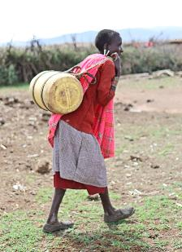
Who is on track to reach universal coverage of safe drinking water by 2030?
Progress on household drinking water, sanitation and hygiene - JMP, 2025
1
  High income countries
  1 upper-middle-income country - Turkmenistan
  No entire region is on track and
  The biggest gap is in Sub-Saharan Africa - currently at 32% coverage
Notes:
Looking at this a little bit more closely, there are 31 high-income countries who have achieved universal coverage of safe water and 10 others on track.
Only 1 upper-middle income country is on track
So this means that NO region is on track and there are many places in the world that need meaningful and serious intervention to accelerate progress.
Amongst these areas in the world Sub-Saharan Africa stands out with the most needs with only 1 in every 3 people having safe water.

Slide 6
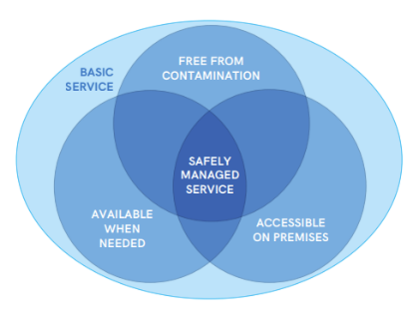
What is safely managed water?
at
point
of use
Notes:
17 more countries on track to achieve universal coverage of at least basic drinking water services
Despite a decrease in all regions of people using surface water, Unimproved sources were usually more reliable than piped on premises
Public taps were less reliable than piped on premises
Across almost all countries and different types of water systems, water is more likely to be free from contamination at the point of collection than at the point of use
Exception: In Nauru and Tuvalu, where more than half the population reported boiling water before use, an improvement in water quality between collection and use was recorded
All 3 criteria are higher in urban areas but changing faster in rural areas

Slide 7
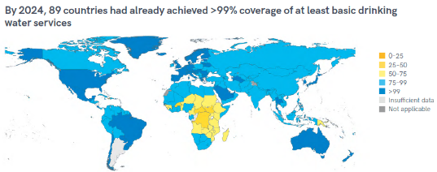
In low and lower-middle income countries, contamination generally increases between the point of collection and use
Water from non-piped supplies more often meets this criteria than piped supplies, especially in low and lower-middle income countries
1.7 billion people still lack a source that is accessible on premises and 1.2 billion of those live in rural areas
Notes:
17 more countries on track to achieve universal coverage of at least basic drinking water services
Despite a decrease in all regions of people using surface water, Unimproved sources were usually more reliable than piped on premises
Public taps were less reliable than piped on premises
Across almost all countries and different types of water systems, water is more likely to be free from contamination at the point of collection than at the point of use
Exception: In Nauru and Tuvalu, where more than half the population reported boiling water before use, an improvement in water quality between collection and use was recorded
All 3 criteria are higher in urban areas but changing faster in rural areas

Slide 8
What is safely managed water?
at
point
of use
The most common reason why water systems don’t meet this standard is that they are not free from contamination
Notes:
17 more countries on track to achieve universal coverage of at least basic drinking water services
Despite a decrease in all regions of people using surface water, Unimproved sources were usually more reliable than piped on premises
Public taps were less reliable than piped on premises
Across almost all countries and different types of water systems, water is more likely to be free from contamination at the point of collection than at the point of use
Exception: In Nauru and Tuvalu, where more than half the population reported boiling water before use, an improvement in water quality between collection and use was recorded
All 3 criteria are higher in urban areas but changing faster in rural areas

Slide 9
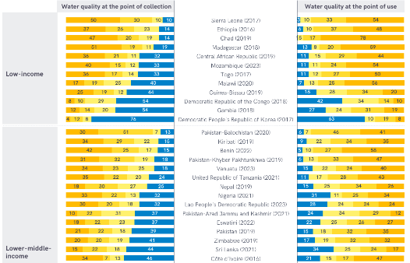




Recontamination of water is a widespread problem [ 1/2 ]
Progress on household drinking water, sanitation and hygiene - JMP, 2025
1
Risk levels of faecal contamination (E. coli CFU/100 mL)
Notes:
If you can’t read this graph in detail, you can open the report and spend more time with it to find your country of interest.
What this image shows us is the the difference between the quality of water at the point of collection and the the quality of the water at the point of use.
The dark yellow represents very high levels of contamination and the length of the bar shows the proportion of the population using that water.
Overall, this is showing us large proportions of the population in low and middle income countries are exposed to very high levels of E. coli
Looking closely at each of these lines also shows us that water quality at the point of use is quite often worse than the water quality at the point of collection.

Slide 10
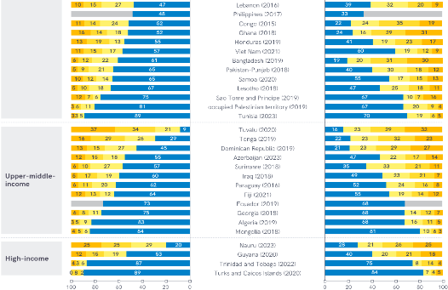
Recontamination of water is a widespread problem [ 2/2 ]
1
Progress on household drinking water, sanitation and hygiene - JMP, 2025
Risk levels of faecal contamination (E. coli CFU/100 mL)
Notes:
On this slide you can see that as you reach upper-middle income and high income countries the graphs start to look very blue, showing that the risk of drinking faecal contamination is much lower.
This leads us to discuss the other two reports that are saying similar things.

Slide 11

Recontamination of water is a widespread problem
Integrating water quality testing into household surveys - WHO, 2020
Monitoring Drinking Water Quality in Nationally Representative Household Surveys in Low- and Middle-Income Countries - Bain et al, 2021
2
3
Accessible and available sources are NOT more likely to be free from E. coli contamination

Slide 12
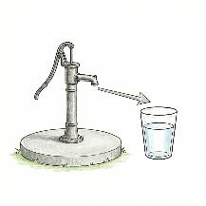
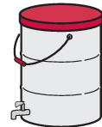
Recontamination of water is a widespread problem
Integrating water quality testing into household surveys - WHO, 2020
Monitoring Drinking Water Quality in Nationally Representative Household Surveys in Low- and Middle-Income Countries - Bain et al, 2021
2
Widespread re-contamination between the point of collection and point of use
In many countries, households store water prior to use
Risk factors for
re-contamination vary widely between countries
Notes:
These publications clearly show that recontamination is happening in all kinds of different water systems and it is a big problem that needs to be addressed.
Behaviours during transport, storage and handling are critical places where support and follow up are needed which are context specific.
These papers do contain some info on how effective HWTS is. That is covered in the whitepaper, not here.

Slide 13
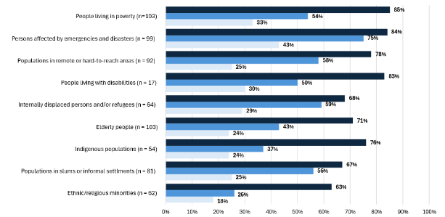
We are not reaching the most vulnerable
4
Global Analysis and Assessment of Sanitation and Drinking Water - UN-Water, 2025
Policies and plans have specific measures to reach the population or setting
Progress to extend service provision to the population or setting is tracked and reported
Specific measures to direct financial resources to the population or setting are consistently applied
Percentage of countries with measures in policies and plans, that monitor service provision and direct financial resources to improve and extend sanitation services to specific populations and settings
Source: GLAAS 2025/2025 country survey.
Notes:
If you follow along with global publications you might know this one as the GLAAS report.
This graph is showing the connection between policy and action broken down by key populations who need support.
This is showing that people with the greatest needs are not getting the investments directed to them. HWTS can reach them
This aligns with what we saw in the Progress on household drinking, water and sanitation report showing that with the current mainstream global approaches we are not getting to those most in need

Slide 14
Where do we see household water treatment as a recommended solution?
Household water treatment (HWTS) now represented in mainstream WASH publications
Compendium of drinking water systems and technologies from source to consumer - WHO 2025 who.int/publications/i/item/9789240113992
Guidelines for drinking-water quality: Small water supplies - WHO, 2024 who.int/publications/i/item/9789240088740
Sanitary inspection packages for drinking-water supplies - WHO, 2024 who.int/publications/i/item/9789240089006
5
6
7

Slide 15
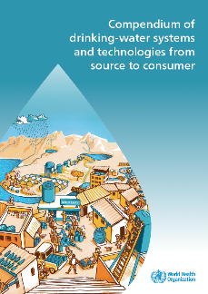
Household water treatment (HWTS) now represented in mainstream WASH publications
5
Compendium of drinking water systems and technologies from source to consumer - WHO 2025
HWTS is recommended for freshwater sources with manual transport
HWTS is identified as an option for
  rainwater harvesting
  gravity flow supplies
  high quality groundwater
  groundwater with contaminants of concern
Notes:
A new compendium was published that provides an overview of drinking-water systems and technologies and their cross-cutting issues.
Household water treatment and safe storage have specifically been included and recommended in this publication.
Along with these recommended uses of household water treatment, the compendium also notes that in piped systems, intermittent supply, poor operation and maintenance and poor household hygiene are identified as contamination risks. And while that is not new information, the inclusion of household water treatment in the compendium is also providing an option that people may look at to solve those challenges.

Slide 16
Household water treatment (HWTS) now represented in mainstream WASH publications
5
Compendium of drinking water systems and technologies from source to consumer - WHO 2025
Includes a HWTS section with fact sheets on a variety of technologies
Storage tanks or reservoirs
Ceramic filtration
Ultrafiltration
Chemical disinfection
Boiling
Pasteurization
Did you know?
CAWST also has a large library of factsheets and resources for these and others washresources.org
Biosand filtration
Ultraviolet (UV) light disinfection
Solar water disinfection
Fluoride removal filters
Arsenic removal filters
Notes:
I want to show you specifically what is included in the compendium for household water treatment technologies.

Slide 17
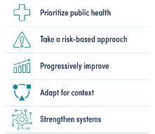
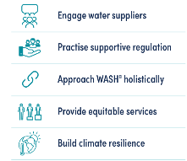
Household water treatment (HWTS) now represented in mainstream WASH publications
6
Guidelines for drinking-water quality: Small water supplies - WHO, 2024
Household managed supplies recognized as one of 3 management models for small supplies
Chapter 3: Health-based regulations - recommends governments establish performance targets for HWTS technologies
Case study (A3.27) on HWTS standards and product certification in Ghana
Many of the guiding principles align well
with HWTS

Slide 18
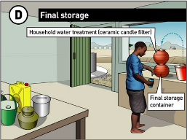
Household water treatment (HWTS) now represented in mainstream WASH publications
7
Sanitary inspection packages for drinking-water supplies - WHO, 2024
WHO released its first sanitary inspection form on household practices (all others are for water sources)
CAWST is developing sanitary inspection packages for ceramic filters and chlorination.
Did you know?
CAWST has developed sanitary inspection packages for biosand filters, boiling and collection and storage.
https://washresources.cawst.org/en/collections/d5756fa0/household-water-treatment-technologies-sanitary-inspection-forms
Notes:
It’s good they are recognizing the importance of transportation and handling in water quality, not just source protection. The Household practices SI form has one question on HWTS. It would take a high level of knowledge and interpretation for an enumerator to answer that one question. Therefore CAWST thinks more detailed SI forms are needed for specific technologies.

Slide 19
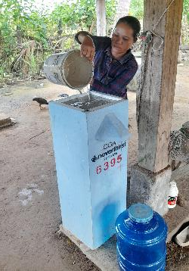
Summary: Safe drinking water at the household is not being achieved
The key documents discussed clearly outline that water quality needs to be addressed, especially at point of use and that a range of solutions is how we will reach everyone.
Notes:
Of particular note:
Intermittent supply and poor household practices are risks to water quality - Compendium
Contamination often increases from source to point of consumption - Integrating Water Quality into Household Surveys - WHO 2020
In 27 countries, point of use contamination ranged 19 % to 99 % higher than point of collection - Bain et al., 2021

Slide 20
This is an opportunity to move the WASH sector from ‘either/or’ to ‘both/and’
Household water treatment:
  is part of the range of options to reach everyone with safely managed drinking water
  plays an important role as a legitimate, evidence based service delivery model
  backed by decades of field research, implementation experience, and quality assurance advancements
Notes:
We need to start addressing water quality in a serious way as a sector
We need to start including a range of options in our systems and household water treatment is part of those options. It plays an important role and is backed by decades of research and implementation. The compendium is an extremely valuable resource for governments and implementers to rely on to decide what their system will look like.
We especially need to look at affordability of safe water in order to scale quickly. Another report (that we didn’t include in this presentation) from the World Bank in 2024 said that to meet SDG 6 the world would have to nearly double current public funding levels to at least 131 billion dollars annually. I don’t see this happening anytime soon, so we need to change our approaches to do more with the money that is available to reach everyone.
And given the high rates of recontamination around transport and handling, capacity development is a non-negotiable, no matter what your system looks like.

Slide 21
Opportunities
Advocate for policy and funding environments that integrate non-networked options within national strategies
Encourage policymakers and funders to recognize decentralized approaches as complementary - not competitive - with centralized systems
Centre households’ priorities and criteria in WASH interventions
Promote household water treatment as a proven, necessary component, particularly where centralized systems cannot yet or may never deliver consistent quality at the point of use
  Remote, dispersed communities
  Informal settlements
  Unreliable piped systems
Notes:
These are opportunities for the whole network. CAWST will support you by providing resources.

Slide 22
Additional Resource: What is the evidence that household water treatment is effective?
A new white paper answers these important questions about household water treatment and safe storage:
  Does it reduce diarrhea?
  Does it improve water quality?
  Does it reduce stunting in children?
Available in English. Other languages coming soon.
There’s more to this story… click here to read it.
Notes:
These are opportunities for the whole network. CAWST will support you by providing resources.
Billions of people worldwide lack access to clean water and adequate sanitation
2.1 billion still live without safely managed drinking water, including 106 million people who drink surface water. (WHO/UNICEF, 2025)
3.4 billion people still live without safely managed sanitation, including 354 million who practise open defecation. (WHO/UNICEF, 2025)
1.7 billion still lack basic hygiene services, including 611 million with no facility at all. (WHO/UNICEF, 2025)
Children who are repeatedly sick fall behind in school and suffer long-term developmental setbacks
Unsafe water, sanitation and hygiene are responsible for the deaths of around 1,000 children under 5 every day. (WHO, 2023)
To achieve SDG 6 – water and sanitation for all by 2030 – will require an eight-fold increase in current global rates of progress on drinking water, a six-fold increase for sanitation, and a two-fold increase for hygiene. (WHO/UNICEF, 2025)
But what's particularly troubling is the water-poverty cycle. Without safe water, children can't attend school because they're sick or spending hours fetching water. Parents can't work. Health systems are overwhelmed. And entire communities remain trapped in poverty.
The UN's Sustainable Development Goal 6 aims to ensure clean water and sanitation for all by 2030. But current progress rates would need to increase 8 times—eight times—to meet that goal. Traditional approaches simply cannot scale fast enough.
This is why we need a fundamentally different model.

