Slide 1
12, 2916 – 5th Avenue
Calgary, Alberta, T2A 6K4, Canada
Phone: + 1 (403) 243-3285, Fax: + 1 (403) 243-6199
E-mail: cawst@cawst.org, Website: www.cawst.org
CAWST, the Centre for Affordable Water and Sanitation Technology, is a nonprofit organization that provides training and consulting to organizations working directly with populations in developing countries who lack access to clean water and basic sanitation.
One of CAWST’s core strategies is to make knowledge about water common knowledge. This is achieved, in part, by developing and freely distributing education materials with the intent of increasing the availability of information to those who need it most.
This document is open content and licensed under the Creative Commons Attribution Works 3.0 Unported License. To view a copy of this license, visit http://creativecommons.org/licenses/by/3.0 or send a letter to Creative Commons, 171 Second Street, Suite 300, San Francisco, California 94105, USA.
You are free to:
Share – to copy, distribute and transmit this document
Remix – to adapt this document
Under the following conditions:
Attribution. You must give credit to CAWST as the original source of the document. Please include our website: www.cawst.org
CAWST will produce updated versions of this document periodically. For this reason, we do not recommend hosting this document to download from your website.
CAWST and its directors, employees, contractors, and volunteers do not assume any responsibility for and make no warranty with respect to the results that may be obtained from the use of the information provided.
Stay up-to-date and get support:
Latest updates to this document
Other workshop & training related resources
Support on using this document in your work
CAWST provides mentorship and
coaching on the use of its education
and training resources.

Slide 2
This presentation is used with Lesson Plan 4: Pathogens and Water Related Diseases in the Biosand Filter for Project Implementers Trainer Manual.
Available at www.cawst.org/resources

Slide 3
Pathogens

Slide 4
Learning Expectations
List the four types of pathogens that cause water related diseases.
2. List some common water related diseases caused by each type of pathogen.

Slide 5
Disease
What makes us sick or causes disease?
Eating bad or contaminated food
Drinking contaminated water
Not washing our hands
Bacteria
Viruses
Parasites
Notes:
This is a leading question to get the participants to offer ways that we get sick:
Eating bad food
Drinking contaminated water
Not washing our hands
Bacteria
Viruses
Hopefully leading to the word PATHOGEN

Slide 6
Pathogens
What is a pathogen?
A living thing that causes sickness or disease
Notes:
An organism that causes sickness and/or disease.

Slide 7
Types of Pathogens
There are 4 types of water related pathogens:
Viruses
Bacteria
Protozoa
Helminths (worms)

Slide 8
How Big Are Pathogens?
Most pathogens are too small to see with your eyes.
You can see some helminths (worms).
Smallest
Virus
Bacteria
Protozoa
Helminth
Largest

Slide 9
Relative Size Comparison
Size of the space between sand grains in a BSF (1 micron)
Virus (0.02 to 0.2 micron)
Note: These circles are shown much bigger than the real pathogens. This drawing only shows how big they are compared to each other. In real life, almost all of them are too small to see.
Bacteria (0.2 to 5 microns)
Protozoa (4 to 20 microns)
Helminth (40 to 100 microns)
Notes:
9
Representation of the relative sizes of different pathogens
Pathogen size is very relevant to understanding filter technologies

Slide 10
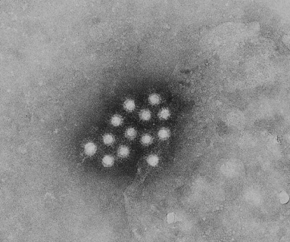
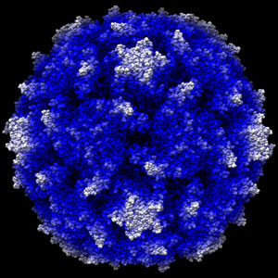
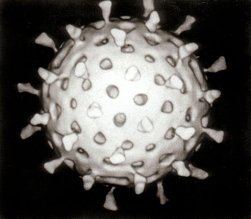
Viruses
Common Viruses:
HIV
Hepatitis A and E
Polio
Influenza
Rotavirus
Diseases we can get from viruses in water:
Hepatitis A & E, Polio, Rotavirus
Hepatitis A
www.childrenshospital.org
Polio
Rotavirus
Notes:
Common Viruses:
HIV
Hepatitis A and E
Polio
Ebola
If not showing next slide:
Virus Facts:
1. Ability to replicate depends on host - In order to make multiples of itself, they depend on host cells (cells of the organism that is infected).
2. Infectious time can be long - Some can remain infectious outside of a host for long periods of time.
3. Small pore size for filtration - Due to their small size, filtration technology must be effective down to 0.02 microns.

Slide 11
Virus Facts
Ability to replicate depends on host cells
Infectious time can be long
Small pore size required for filtration (0.02-0.2 micron)
Notes:
1. Ability to replicate depends on host - In order to make multiples of itself, they depend on host cells (cells of the organism that is infected).
2. Infectious time can be long - Some can remain infectious outside of a host for long periods of time.
3. Small pore size for filtration - Due to their small size, filtration technology must be effective down to 0.02 microns.

Slide 12
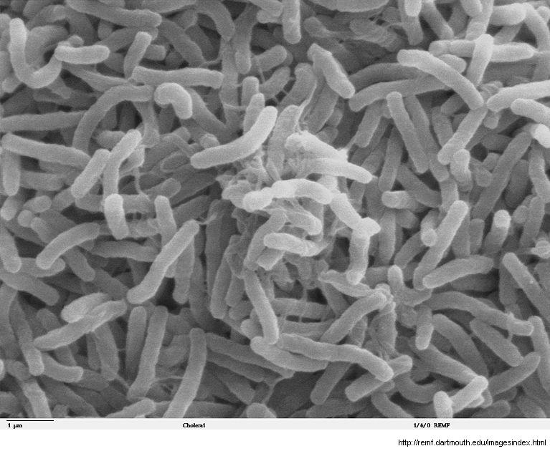
Bacteria
Common Bacteria:
E. Coli
Staphalococcus
Salmonella
Diseases we can get from bacteria in water:
Cholera, Typhoid
Cholera
Notes:
Common Bacteria:
E Coli
Stapholococcus
Salmonella
Bacterial diseases possibly present in contaminated water: Cholera, Typhoid
If not showing next slide:
Bacteria Facts:
1. There are many different types of bacteria.
2. They are the simplest, wholly contained life systems.
3. They have different sizes and shapes, some can be as large as 100 microns in size.
4. There are many more bacteria that do not normally cause disease – e.g. those used to make yoghurt and cheese. Food safety standards for cold sliced meats – <10,000,000 heterotrophic bacteria per gram.
5. Most of the organisms found in feces are bacteria. There are several billion bacteria in every gram of feces.
6. The diseases they cause generally spread rapidly, and consequently bacteria have been responsible for most of the world’s major epidemics derived from water.
Two of the most well known diseases caused by bacteria are typhoid fever and cholera. Can you think of any more?

Slide 13
Bacteria Facts
Many different types
Simplest living system
Generally between 0.2-5 microns in size
Many do not cause disease
Presence in feces – 1 gram = billions
Responsible for major epidemics caused by contaminated water
Notes:
1. There are many different types of bacteria.
2. They are the simplest, wholly contained life systems.
3. They have different sizes and shapes, some can be as large as 100 microns in size.
4. There are many more bacteria that do not normally cause disease – e.g. those used to make yoghurt and cheese. Food safety standards for cold sliced meats – <10,000,000 heterotrophic bacteria per gram.
5. Most of the organisms found in feces are bacteria. There are several billion bacteria in every gram of feces.
6. The diseases they cause generally spread rapidly, and consequently bacteria have been responsible for most of the world’s major epidemics derived from water.
Two of the most well known diseases caused by bacteria are typhoid fever and cholera. Can you think of any more?

Slide 14
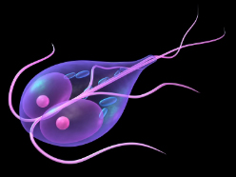
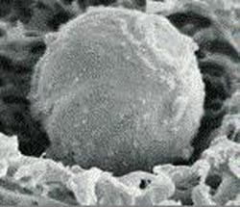
Protozoa
Common Protozoa:
Malaria
Giardia
Cryprosporidium
Diseases we can get from protozoa in water:
Giardia, Cryptosporidiosis, Amoebic Dysentery (Entamoeba histolytica)
Giardia
Cryptosporidium Oocyst
Notes:
Common Protozoa:
Malaria
Protozoa found in contaminated water:
Giardia, Cryptosporidium, Amoebic Dysentry
If not showing next slide:
Protozoa Facts:
1. Protozoa are larger than bacteria or viruses.
2. They are single celled organisms which can form cysts or vegetative states that can survive in inhospitable environments.
3. Because of this, they are difficult to kill with chlorine. Ammonia is more effective.
4. Most of the major waterborne disease epidemics in the North America over the last ten years are due to protozoa. This is because they can survive the chlorination process used in municipal water treatment plants.
Two of the more well known protozoa are giardia and cryptosporidia.

Slide 15
Protozoa Facts
Larger than bacteria or virus (2-20 microns)
Survive long periods in harsh environments due to protective shell
Chlorine resistant (due to protective shell)
Cause major waterborne epidemics
Notes:
1. Protozoa are larger than bacteria or viruses.
2. They are single celled organisms which can form cysts or vegetative states that can survive in inhospitable environments.
3. Because of this, they are difficult to kill with chlorine. Ammonia is more effective.
4. Most of the major waterborne disease epidemics in the North America over the last ten years are due to protozoa. This is because they can survive the chlorination process used in municipal water treatment plants.
Two of the more well known protozoa are giardia and cryptosporidia.

Slide 16
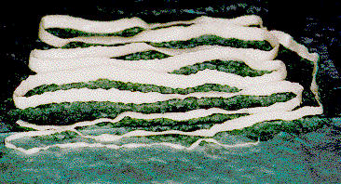
Helminths
Common Helminths:
Round worm
Hook worm
Tape worm
Related diseases we can get from water:
Schistosomiasis, Round worm, Guinea Worm
Worm from a human intestine (20 feet in length)
Notes:
Common Helminths:
Round worm
Hook worm
Tape worm
Helminths found in contaminated water:
Schistosomiasis
If not showing next slide:
Helminth Facts:
1. Helminths are parasitic worms.
2. Many worms can survive in the body for several years. They make their host weaker by using his food supply to grow.
3. They generally do not multiply within the human host.
4. Most helminths are passed in faeces.
5. Protozoa and helminths are known as parasites.
One of the most well known diseases caused by helminths is schistosomiasis which is prevalent in most parts of Africa.

Slide 17
Helminth Facts
Parasitic worms
Can live many years in the human body
Generally do not multiply in infected body
Passed in feces and urine
Notes:
1. Helminths are parasitic worms.
2. Many worms can survive in the body for several years. They make their host weaker by using his food supply to grow.
3. They generally do not multiply within the human host.
4. Most helminths are passed in faeces.
5. Protozoa and helminths are known as parasites.
One of the most well known diseases caused by helminths is schistosomiasis which is prevalent in most parts of Africa.

Slide 18
Water Related Diseases
Disease | Pathogen | Transmission
Polio | Virus | Ingestion
Hepatitis A | Virus | Ingestion
Hepatitis E | Virus | Ingestion
Rotavirus | Virus | Ingestion
Cholera | Bacteria | Ingestion
Typhoid | Bacteria | Ingestion
Giardia | Protozoa | Ingestion
Cryptosporidiosis | Protozoa | Ingestion
Amoebic Dysentery | Protozoa | Ingestion
Guinea Worm | Worm | Ingestion
Round worm | Worm | Ingestion
Schistosomiasis (Bilharzia) | Worm | Bathing
Trachoma | Bacteria | Poor Hygiene
Scabies | Parasite (Mite) | Poor Hygiene
Malaria, Dengue Fever, Japanese Encephalitis | Protozoa, Virus, Virus | Mosquitoes (breed in stagnant water)

Slide 19
Review
What is a pathogen?
A small living thing that causes disease.
Notes:
An organism that causes disease

Slide 20
Review
2. What are the four types of pathogens in order from smallest to largest?
Viruses
Bacteria
Protozoa
Helminths (worms)
Notes:
Viruses, bacteria, protozoa and helminths

Slide 21
Review
Why would the biosand filter be a good technology for treating contaminated water?
Small pore size – many pathogens can’t fit through
Removes most pathogens
Notes:
The size between sand grains is small enough to capture most pathogens
Removes all types of pathogens from contaminated water (only some viruses, and most bacteria)
Some viruses stick to the sand grains (adsorption)
Most bacteria will be trapped, stick to the sand or be eaten. Some will die naturally inside the sand.
The helminths and protozoa will be caught on the top as they are so big

Slide 22
Size Comparison
Size of the space between sand grains in a BSF (1 micron)
Virus (0.02 to 0.2 micron)
Bacteria (0.2 to 5 microns)
Protozoa (4 to 20 microns)
Helminth (40 to 100 microns)
Notes:
22
Representation of the relative sizes of different pathogens
Pathogen size is very relevant to understanding filter technologies

Slide 23
How to avoid disease
What can we do to avoid getting sick?
Drink only treated water
Use a latrine
Practice good sanitation (drainage, waste disposal, vector control)
Wash hands with soap many times per day, especially before eating and after defecating
Eat a variety of foods to get many nutrients
Notes:
Water treatment is not enough! You must have safe water, good sanitation and hygiene (wash hands with soap) to stay healthy.

