Slide 2
This presentation is for use with
“Lesson Plan: Selecting HWTS Options”
in the Household Water Treatment and Safe Storage (HWTS) Trainer Manual
Available at resources.cawst.org

Slide 3
Selecting HWTS Options
2018
June

Slide 4
Imagine You’re Purchasing a New Motorcycle…
What criteria would you use to decide which one to buy?

Slide 5
Learning Outcomes
List criteria to consider when selecting HWTS options
Explain why different user groups prioritize different criteria
Suggest a process for selecting HWTS options for a given scenario

Slide 6
Discuss in Pairs
What criteria should you consider when selecting HWTS options?
What process have you used in the past?
What process would you use in the future?
Would your approach differ depending on whether you were selecting HWTS options for personal or business use?

Slide 7
Criteria for HWTS Selection
Performance
Feasibility
Does it produce an appropriate quantity and quality of water?
Is the system practical and available in this region?
Ease of Use
Acceptability
Are operation and maintenance requirements reasonable?
Does the system fit with users’ expectations, norms, and preferences?

Slide 8
There is no single best way to select HWTS options.
Image Source: CAWST

Slide 9
Suggested Process
Understand
Select
Test
Your goal
Available options
Your users
Criteria
Short-list
Try out selected options
Make final selection

Slide 10
Understand
Your goal
What are the goals of the program or business?
What are the goals of the community?
Available options
Local markets, national markets, imports
Low-tech options (boiling, sedimentation)
Users and context
Household visits, focus groups, observation, water quality testing

Slide 11
Select
Criteria
Create a list of the criteria that matter most to users.
Short-list
Research and assess how well options meet the criteria.
Use information from community members, CAWST fact sheets, WHO scheme results, local government, businesses, and NGOs in your region.

Slide 12
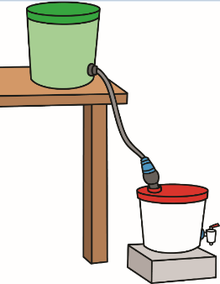
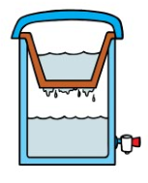
Matrix/ Weighted Matrix Scoring
Pathogen removal | 4 | 5 | 2 | 5 | 5 | 3 | 5
Water volume | 4 | 4 | 3 | 3 | 3 | 3 | 4
Appearance | 1 | 4 | 1 | 1 | 5 | 1 | 0
Portability | 4 | 0 | 3 | 2 | 3 | 4 | 3
Affordability | 3 | 2 | 5 | 4 | 3 | 3 | 2
Total | 18 | 15 | 14 | 15 | 19 | 14 | 14
Notes:
Example of a way to prioritize:
Matrix/ Weighted Matrix Scoring

Slide 13
Ranking Lines
LOW
HIGH
Notes:
Example of a way to prioritize:
Ranking lines

Slide 14
Test
Try out short-listed options
Test in people’s homes.
Train households to use them.
Collect feedback.
Choose HWTS system(s)
Use feedback and observations to select the most appropriate options.
You may select more than one system.

Slide 15
Detailed Scenario
Trainer: If you choose to use a detailed scenario instead of the four scenarios provided on the handout, use this section to add slides providing photos and other information about your scenario.

Slide 16
Scenarios: Group Work
Notes:
What steps would you take to select the best option(s) for your scenario?
Which criteria might be most important to your users?
Which HWTS options might be appropriate? (Consider multi-barrier approach)
What assumptions did you make or what additional information do you need to answer the above questions?

Slide 17
Review (workbook)
Review the selection criteria and process in your workbook. Add notes if helpful.
Discuss and record any new ideas you will take away from this lesson or from your scenario.
Discuss any questions you still have about HWTS selection.

