Slide 1
MONITORING CASE STUDY
Aqua Clara International, Kenya
www.aquaclara.org

Slide 2
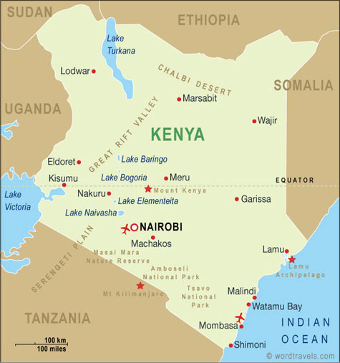
Aqua Clara International, Kenya WASH Community Development Entrepreneurs
Eldoret, Kenya
Kisii, Kenya

Slide 3
Details of Project – Activities
Current project start date: June 2010
Current project size: 1,900 filters
Implemented to date: 1,800 filters
Target: 5,000 filters per year
Actual cost of Filter: 10$ - materials, labor, delivery, installation and CDE profit (Excluded costs: All other follow up costs)

Slide 4
Details of Project – People
Community Development Entrepreneurs (CDE) Use rural primary schools as demonstration sites and raw material storage. They manage the business of sand preparation, filter installations and End User training
Community Health Promoters (CHP) do follow up visits to filter recipients and WASH training in schools
Aqua Clara International Staff (ACI) liaise with and train CDEs and CHPs – quality control and information management

Slide 5
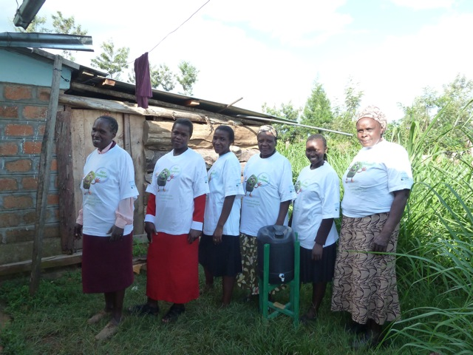
Community Health Promoters

Slide 6
INFORMATION COLLECTION Monitoring Activities
Filter Recipient and Installation (CDE)
Post installation follow up visits within 60 days of installation (CHP)
Extra visits for repairs or resolving problems (CDE, ACI staff)

Slide 7
INSTALLATION INFORMATION
Installation form filled in by CDEs (See Appendix 4)
Forms are collected by ACI staff at monthly meeting
Data for each filter is inputted by ACI staff
Additional Filter Installation Information
Exact Date Installed | Standing water depth at installation | Flow rate at installation (pour 10 L of water exactly, then time 1 liter)
Filter Unit Number | Construction Site (School) | Installed by (CDO Name) | Installer Contact # (CDO Phone #)

Slide 8
Information Flow – Collection
Community Development Entrepreneurs collect installation record from recipient of filter. Forms are given to ACI staff.
ACI Monitoring Staff take the information for review, and input details into the database; list of recipients is given to CHPs for follow up within 60 days.
Community Health Promoters do follow up with filter recipients and collect information on form. Forms are handed in to ACI staff at monthly meetings.
Technicians are informed when problems have been found and there is a discussion to resolve the problems and make improvements.
Community Health Promoters hand in monitoring forms and discuss problems that they noted.
ACI Monitoring Staff take the information for review, input and analysis.

Slide 9
CHP FOLLOW UP VISIT
Post installation follow up visit by CHP within 60 days of installation
Use questionnaire to collect information
Give forms to ACI staff
ACI staff input data into spreadsheet, analyze for problems and prepare how to manage the problems

Slide 10
CHP Household Visit Kit

Slide 11
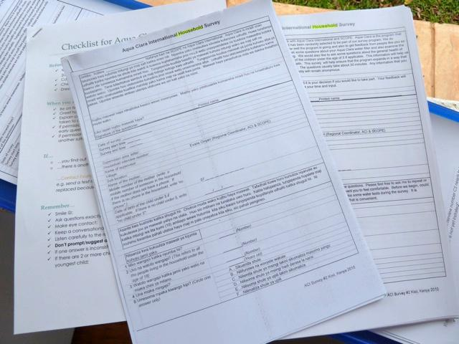
CHP Household Survey Form

Slide 12
Information Flow – Post collection and analysis
Community Health Promoters hand in monitoring forms and discuss problems that they noted.
ACI Monitoring Staff take the information for review, input and analysis.
Technicians are informed when problems have been found and there is a discussion to resolve the problems and make improvements.
Community Health Promoters hand in monitoring forms and discuss problems that they noted.
ACI Monitoring Staff take the information for review, input and analysis.

Slide 13
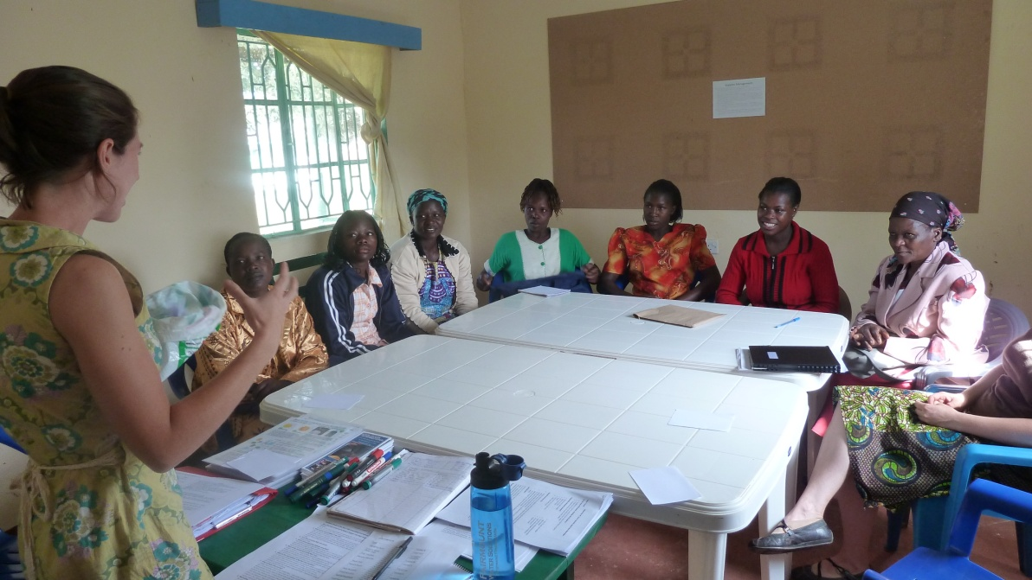
CHP Monthly Meeting with ACI Staff

Slide 14
The Data Base
Excel spreadsheet as water filter database
Input the filter receipt data which includes water source info, household contact info, number of people in the household etc.
Input information collected by CHPs
Each filter is tracked by the spreadsheet

Slide 15
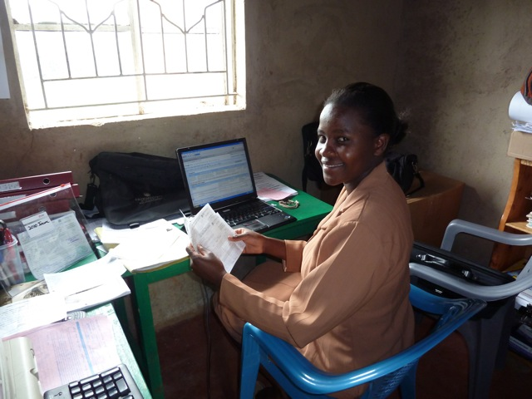
Data Management or Office and Tracking Administrator - Betty Nyamwaya

Slide 16
Information Flow – Post analysis
ACI Monitoring Staff take the information for review, input and analysis.
Technicians are informed when problems have been found and there is a discussion to resolve the problems and make improvements.
Technicians are informed when problems have been found and there is a discussion to resolve the problems and make improvements.
Community Health Promoters hand in monitoring forms and discuss problems that they noted.
ACI Monitoring Staff take the information for review, input and analysis.

Slide 17
RESOLVING PROBLEMS - CDEs
Info to resolve problem filters handed over at monthly meeting
During meeting discuss how to make repairs and how to prevent it from continuing

Slide 18
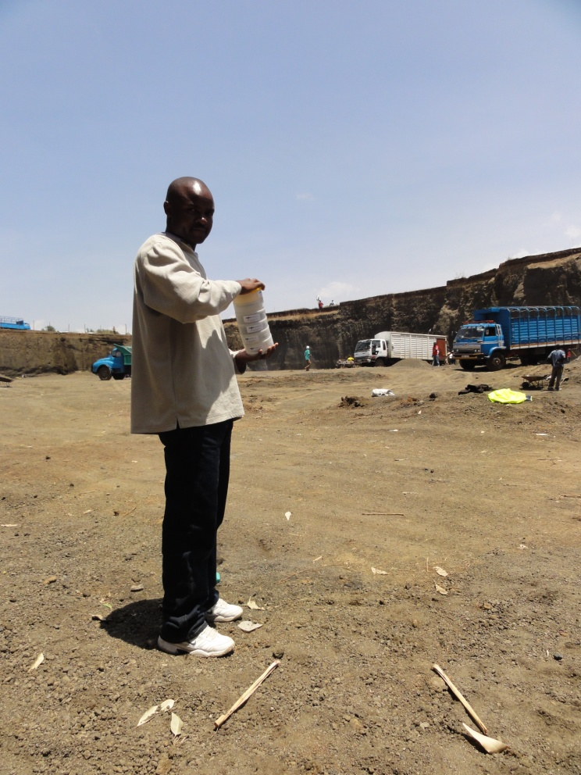
ACI Staff Monitoring Sand Quality at Source
Isaac Soita - Eldoret Regional Coordinator

Slide 19
Monitoring for Improvement
Issue Found:
Poor standard of water collection and storage
Improvements Made:
Started marketing and selling safe water storage containers
Trained households that couldn't afford new containers to be able to select 'clean' water containers for use
Trained CHPs and provided them with a marker for allowing the household to identify the different containers for different uses

Slide 20
Monitoring for Improvement
Issue Found:
Varied construction practices - often with poorly matched components and/or poorly selected sand
Improvement Made:
Now all supplies are organized for the groups, and repayment is collected after they build the filters

Slide 21
Monitoring for Improvement
Issue Found:
Construction techniques and certain parts of end user training weren’t practiced at an acceptable standard
Improvements Made:
Training now includes and emphasizes these concepts
Changed the emphasis of monthly meetings based on feedback from surveys

Slide 22
Monitoring for Improvement continued
We added training on the:
Many uses of clean water.
Importance of the diffuser
Importance of household training at multiple times
We also learned:
How people had heard about the filters = alter social marketing strategies
About water treatment methods currently in use and the cost = improved social marketing techniques

Slide 23
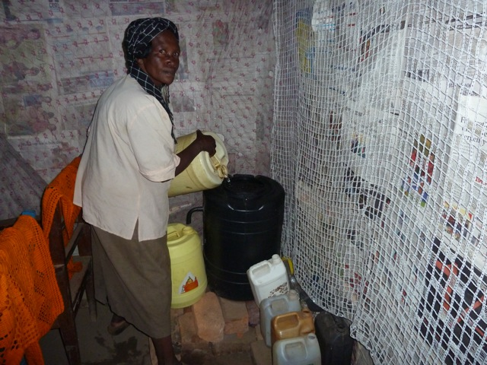
End User with Filter

Slide 24
Benefits of Monitoring
Our funders appreciate it as it helps us both report on activities clearly and in getting new funders on board
Our client households appreciate it as it gives them more faith in the filters, and in the project
Identifies project problems to be able to address them immediately
Uncovers dishonesty in builders /installers
Notes:
Our funders appreciate it - it helps with reporting, allowing us to speak with statistics and actual knowledge about what households we're reaching. i.e. we can speak to what our average purchasing household's monthly income is, what the most common water sources are, what the average distance to those sources is, etc. That helps us both report on activities clearly and in getting new funders on board.
Our client households appreciate it - they are often very pleased when someone from ACI comes to their house to check on their filter and/or speak with them. It gives them more faith in the filters, and in the project.
It informs us as to project problems - filter construction standards or end-user training deficiencies. We then address those immediately when our staff finds out. It is a check on manufacturer/installer standards - we catch them as they begin to slip.
It uncovers dishonest in builders/installers - whether on date of install or actual install, etc., it verifies what took place with independent eyes.

Slide 25
Benefits continued
Provides an opportunity for basic fixes and reinforce end user training key messages
It helps us in our work with university partners due to ease of data collection
It helps us stay on target with our goals
It ensures ACI staff revisit a household to offer more training - household hygiene, sanitation training, etc.
Notes:
Household visits provide an opportunity for basic fixes - leaks to be repaired, and filter use to be reviewed (importance of diffuser, etc.). This time for review is a big benefit - everyone needs to hear things more than once.
It helps us in our work with university partners - Purdue and Moi Universities have been happy to join with us in undertaking studies of the project since it's relatively easy to collect data on top of our current visitation schedule.
It helps us stay on target with our goals. That is, if we want to build an enterprise based system that still reaches households with less than $2 a day income, we can compute the % of reached households that fit into this category in each region, or over a given period.
It gets ACI staff back into a household so we can offer more training - household hygiene and sanitation training, etc.

