Slide 1
Creative Commons
License
This document is open content and licensed under the Creative Commons Attribution Works 4.0 International License. To view a copy of this license, visit http://creativecommons.org/licenses/by/4.0
You are free to: Share – Copy and redistribute the material in any medium or format Remix – Remix, transform, and build upon the material for any purpose, even commercially
Under the following conditions:
Attribution – You must give appropriate credit to CAWST and Eawag-Sandec, provide a link to the license, and indicate if changes were made. You may do so in any reasonable manner, but not in any way that suggests that CAWST and Eawag-Sandec endorses you or your use. Please include our website: www.cawst.org and www.sandec.ch.
CAWST and Eawag-Sandec will produce updated versions of this document periodically. For this reason, we do not recommend hosting this document to download from your website.
CAWST and Eawag-Sandec its directors, employees, contractors, and volunteers do not assume any responsibility for, and make no warranty with respect to, the results that may be obtained from the use of the information provided.

Slide 2
This presentation is used with Lesson Plan Risk Management in the Introduction to Faecal Sludge Management Trainer Manual
Available at www.cawst.org/resources and www.sandec.ch

Slide 3
Risk Management
2016
MAY

Slide 4
Learning Outcomes
Discuss the risks of faecal sludge management in relation to public health.
Identify ways to reduce the risks of faecal sludge management.
Explain the importance of using multiple barriers for risk reduction.

Slide 5
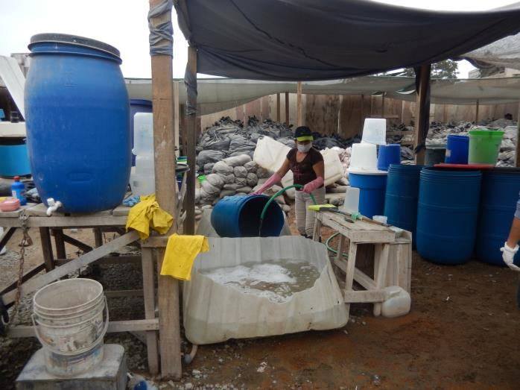
Examples of Barriers
X-Runner, Peru
Credit: CAWST
Notes:
Cleaning and disinfecting containers at X-runner in Peru.

Slide 6
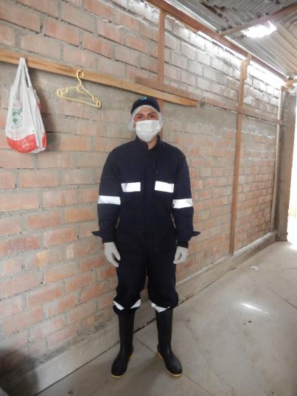
Examples of Barriers
X-Runner, Peru
Credit: CAWST
Notes:
Worker wearing protective equipment at X-runner in Peru.

Slide 7
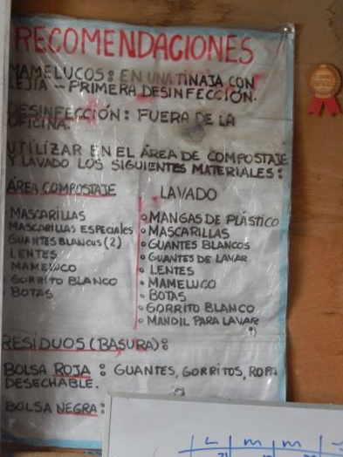
Examples of Barriers
X-Runner, Peru
Credit: CAWST
Notes:
Safety poster at X-runner in Peru.

Slide 8
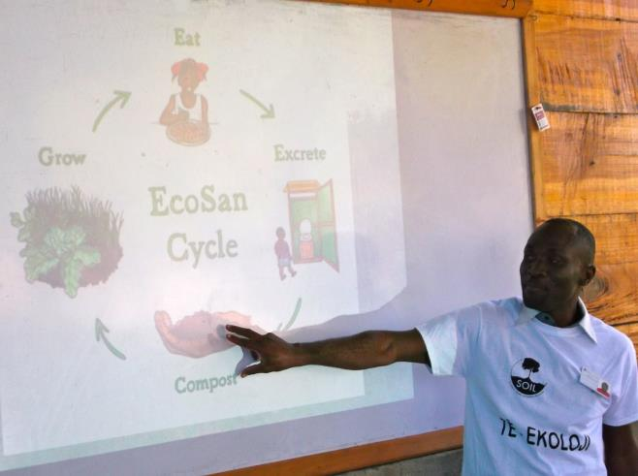
Examples of Barriers
SOIL, Haiti
Credit: SOIL
Notes:
Training by SOIL, Haiti

Slide 9
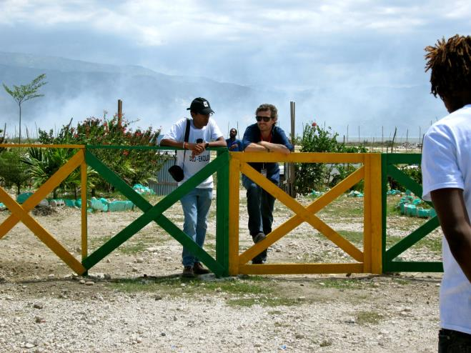
Examples of Barriers
SOIL, Haiti
Credit: SOIL
Notes:
Fence to restrict access at SOIL composting site, Haiti

Slide 10
How we can support you!
Contact CAWST and Eawag-Sandec for support on using and adapting our education and training resources for your work.
Visit www.cawst.org/resources and www.sandec.ch for:
Latest updates to this document
Other workshop & training related resources
Upper 424 Aviation Rd NE,
Calgary AB T2E 8H6, Canada
+ 1 403 243 3285
support@cawst.org
www.cawst.org
Überlandstrasse 133
CH-8600 Dübendorf, Switzerland
+41 (0)58 765 55 11
info@sandec.ch
www.sandec.ch

