Slide 1
GESI Mainstreaming
Srijana Karki

Slide 2
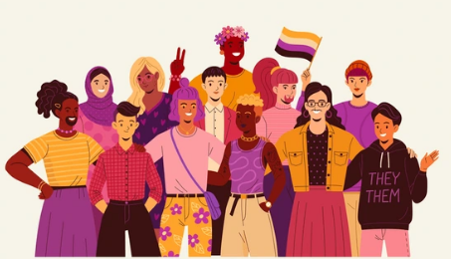
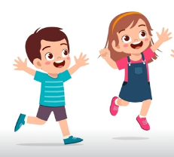
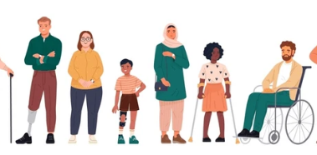
Introduction
4 volunteer
character play card
Character using a public toilet while travelling
A school going child
LQBTIQA+ Community
Pregnant Woman
Person with disability
Notes:
The school going child could not use it as the lock was overhead and could not reach the lock
It was difficult for a pregnant lady to use the toilet comfortably as it was a squat pan
For the person with disability, could not use it - can’t use the toilet because it has stairs to climb. Being a disable person I could not climb up or take my wheel chair (no ramp)
For LGBTIQA+ representative, was confused which one to use. I do not know where should I go to use the toilet: the toilet is specified for male and female only
Link to :
Availability of WASH services and facilities might exclude some of the group and community that includes poor, pregnant, people with disability, LQBTIQA+, marginalized, and many more
Mainstreaming is the only way to solve their problems

Slide 3
Learning Outcome
Explain the concept of gender mainstreaming
Clarify the linkages between gender and WASH
Describe the concept of gender analysis framework

Slide 4
Presentation Outline
Concept of gender mainstreaming
Gender in WASH
Gender Analysis Framework

Slide 5
Training Structure
1
2
3
4
5
6
7
Training Opening
Gender: Concept and its terminologies
Gender Mainstreaming
Laws and Policies for gender mainstreaming
Gender Perspective in WASH
Mainstreaming Gender in Project Cycle
Training
Closing
Notes:
This training includes

Slide 6
Gender Mainstreaming
Video
Notes:
TrainVideo https://www.youtube.com/watch?v=izUSCxqbLeg
er note:

Slide 7
Gender Mainstreaming
What are the issues presented in the video?
Does our sanitation infrastructure provide services to all?
If not, what could be the possible way-out?
Notes:
2. Possible answer: not including LGBTIQA+, health issues of individuals
3. Include all (mainstreaming) GEDSI in urban sanitation

Slide 8
Gender Mainstreaming
What is mainstreaming?
Collect responses – 2 to 3

Slide 9
Concept of Gender mainstreaming
Globally accepted strategy for promoting gender equality and social inclusion
It is a process aimed at integrating a gender perspectives, including disability, socially excluded group, poor and marginalized group of people into all aspects of project, policies and organizational processes.

Slide 10
Concept of Gender mainstreaming
Ensures that gender diverse group, disability, socially excluded group, poor and marginalized groups have
Equal access and control over resources,
Development benefits, and
Decision-making, at all stages of the development process
Notes:
Any examples

Slide 11
Essential Elements for Effective GESI Mainstreaming
A systematic approach through strong leadership and accountability to motivate and enable a focus on GESI within the organization and programs ( Team, Strategy, and Budget)
GESI being integral to program teams through the development of GESI capacity and inclusive team culture(Diverse recruitment, GESI Expertise, GESI focus Partnership, Team Training, )
An outcomes focus, with an emphasis on GESI results, ongoing learning, and adaptation within programs.( Intersectional GESI Analysis, Sex Disaggregated data, Participation and Reach, Additional Risks and Tracking and Reporting ),

Slide 12
Importance of GESI mainstreaming: Group Activity
4 Groups (Institutional, Policy, Project and Programs)
10 minutes
Notes:
Divide into 4 groups (Organization, Policy, Projects and Programs)
Note down in a newsprint
About the importance of GEDSI mainstreaming in three level : Organization, Policy, Projects and Programs)?

Slide 13
Importance of gender mainstreaming
Visible presence of gender equality (Representation)
Accountability of diversification of all gender and socially excluded groups
Involves women, men and LGBTIQ+ community and make full use of human resources
Effective governance, policy and legislation

Slide 14
Steps for mainstreaming for GESI

Slide 15
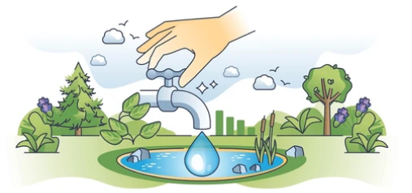
Gender in WASH
Global Context
The right to water and sanitation is recognized as fundamental to attaining all other human rights.
However, globally, 2.1 billion people do not have access to safe drinking water at home,
2.3 billion do not have basic sanitation and
1 billion practice open defecation (WHO, 2019).
Notes:
How to link this with gender or GEDSI?
Make this a short bullet

Slide 16
Gender in WASH
Global Context
The Sustainable Development Goals (SDGs) make an significant first step in connecting water, sanitation and hygiene (SDG 6) and gender equality and empowerment (SDG 5) through target
6.2, which emphasizes access to equitable sanitation and hygiene, and the needs of women and girls. However, indicators to measure the specific needs of women and girls are still emerging.

Slide 17
According to department of National Personnel Records (Civil), out of total number of civil servants i.e., 88,657, only 26.58 percent are women (up to Ashad 31 2077/78).
According to National Economic Census 2018, Analytical Report on Women in Business; women’s participation in decision making level in the private sector is just 29.61 percent
A study conducted by Sancharika Samuha reveals that only 25 percent journalist around the country are women. Out of this 47.8 percent work in FM Radio and only 11 percent are in editorial leadership.
Looking in to the Government budget of Nepal, the government have been adopting gender responsive budgeting system. (Economic Survey 2021/22) The share of direct gender responsive budget in the total budget has surged from 11.34 percent in FY 2007/08 to 39.49 percent in FY 2021/22.

Slide 18
Gender and WASH
Global Context
According to UN Women, safely managed water and sanitation services were used by 71% and 39%, respectively, of the global population (2015)
Women and girls are primarily responsible for water collection in 80% of households without access to water on premises.
In low and middle-income countries, 38% of health facilities lack access even to rudimentary levels of WASH comprising women’s health and survival during childbirth.

Slide 19
Gender and WASH
Global Context
In two thirds of countries with available data, more than 50 percent of urban women live in conditions where they lack at least one of the following;
Access to improve water source,
improve sanitation facilities,
durable housing or sufficient living area
Notes:
Data gap

Slide 20
Gender and WASH
National Context
Notes:
https://www.youtube.com/watch?v=E71-yAS82kc
Ask what are the key issues in this video? Collect the responses from participants. (Possible answer: no enough public toilets, lack of public toilet management, no user-friendly)
Conclude the video with a message that identification of gaps and issues of urban sanitation services and facilities is important for gender mainstreaming. For that, gender analysis is important.

Slide 21
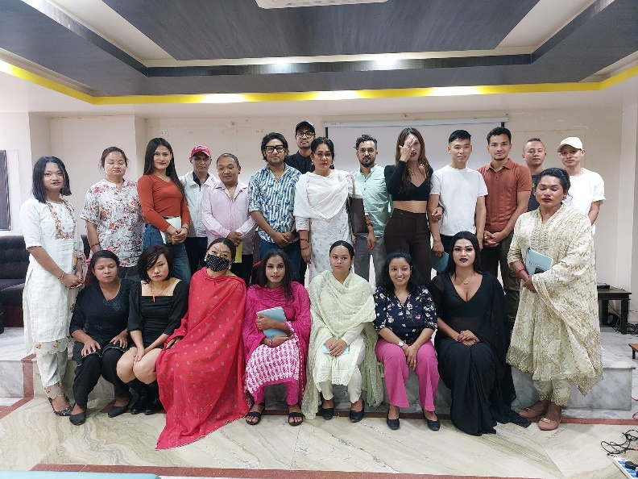
Tools/Methods for Gender Mainstreaming
Gender stakeholder Consultation
Gender Equality Action Plan
Institutional Transformation
Gender Audit
Gender Awareness Raising
Sex –disaggregated Data Collection
Gender Responsive Budgeting
Gender Training
Gender mainstreaming at project cycle
Gender Analysis

Slide 22
Impact of Gender Disparities
Violence
Productivity
Health
Education

Slide 23
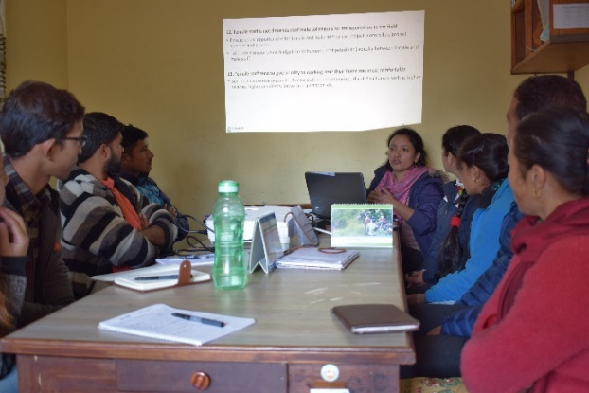
Gender Analysis
Gender analysis provides the necessary data and information to integrate a gender perspective into policies, programs and projects.
Conducting a gender analysis allows for the development of interventions that address gender inequalities and meet the different needs of women, men and marginalized communities

Slide 24
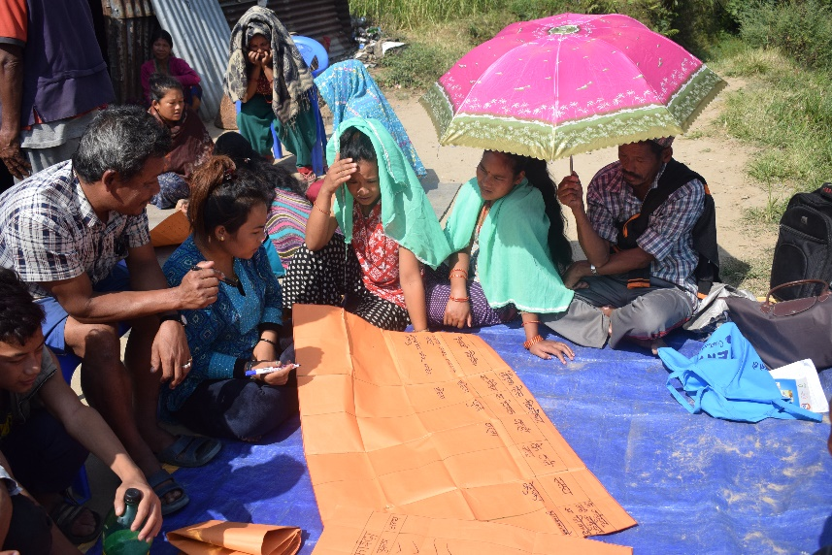
How does gender analysis work?
Step 1: Collecting available data
Step 2: Identifying gender differences and the underlying causes of gender inequalities
Step 3: Informing policies, programs, and projects

Slide 25
Common Gender Analysis Framework
Gender Analysis Framework (Harvard)
Triple Roles Framework (Carolyn Moser)
Web if Institutionalization framework (Caren Levy)
Gender Analysis Matrix (GAM)
Equality and Empowerment Framework (Sara Longwe)
Capabilities and Vulnerabilities Framework (CVA)
People Oriented Planning Framework (POP)
Social Relations Framework (SRF)

Slide 26
Review
Brainstorm on one gender mainstreaming tool in your working sector.
Collect 2 to 3 responses

