Slide 2
This presentation is for use with
“Lesson Plan: Chlorine Dosing”
in the Household Water Treatment and Safe Storage (HWTS) Trainer Manual
Available at resources.cawst.org

Slide 3
Chlorine Dosing
2018
June

Slide 4
Learning Outcomes
Describe how chlorine disinfects water
Compare different chlorine products
Calculate an appropriate chlorine dose for given scenarios

Slide 5
How Many Types of Chlorine Products Do You Know?

Slide 6
Product | Available Chlorine Concentration (%) | Product Type | Stability
High Test Hypochlorite (HTH) | 65–70% | Usually in granular form | Stable
Chlorinated lime (bleaching powder) | 25–30% | Usually in powder form | Not stable
Sodium hypochlorite, (household bleach) | 2.5–18% | Liquid | Not stable; use by the expiry date on the label
Sodium dichloroisocyanurate (NaDCC) | 2.5–5 g active chlorine per tablet (often 60-70%) | Usually in tablets (sometimes available in granular form) | Very stable (shelf life of around 5 years) until dissolved in solution

Slide 7
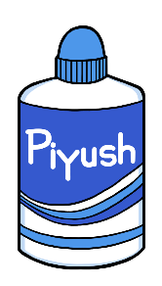
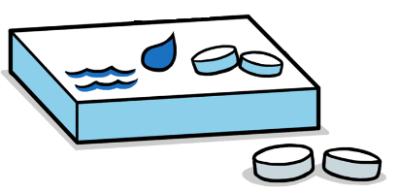
Which Chlorine Product(s) Do You Prefer and Why?

Slide 8
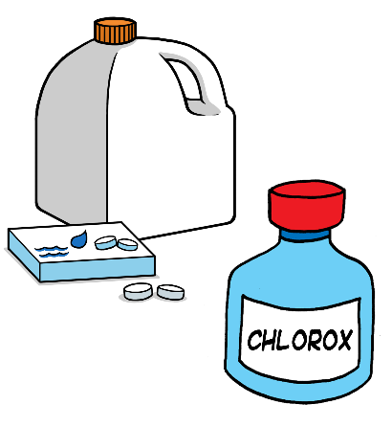
Stability of Chlorine Products
Many chlorine products (for example, bleach) degrade over time.
Stabilized products have added chemicals that make them last longer.
Always check the “use by” date.

Slide 9
Word Quiz
In pairs, discuss and define as many of these words as you can:
Consumed chlorine
Combined chlorine
Free chlorine residual (FCR or FRC)
Total chlorine
Contact time

Slide 10
How Chlorine Works
Consumed Chlorine
Used up in reactions with microorganisms and organic material
Initial Chlorine
Combined Chlorine
Forms new compounds with nitrates, ammonia, and other organic material
Total Chlorine
Free Chlorine Residual (FCR)
Excess chlorine still available to react with pathogens or organic material
Notes:
Chlorine and water form hypochlorous acid, which reacts with and inactivates microorganisms. The portion of chlorine that reacts with organic matter and microorganisms is called consumed chlorine.
Some chlorine reacts with nitrates, ammonia, and other organic matter to form new chlorine compounds. This portion is called combined chlorine.
Excess chlorine that is not consumed or combined remains in the water. This portion is called free chlorine residual. It helps prevent recontamination.

Slide 11
Combined Chlorine + Free Chlorine Residual (FCR)
= Total Chlorine
12

Slide 12
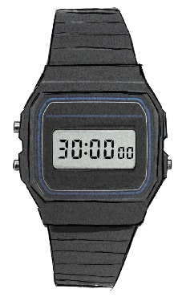
Contact Time
When you add chlorine to water, it takes time for it to react and inactivate pathogens. The time you must wait is called the contact time. Under normal conditions, contact time is 30 minutes.
11

Slide 13
Effectiveness of Chlorine
In a laboratory, can inactivate over 99.9% of bacteria, viruses, and giardia parasites¹
Not always as effective in household settings as in a controlled laboratory environment²
Some pathogens, such as Cryptosporidium (protozoa) oocysts and Ascaris (roundworm) eggs, are resistant ³
Thurston-Enriquez et al., 2005; Vaughn et al., 1986; Zhao et al., 2001
Levy et al., 2014
Peletz et al., 2013; Krishnaswami, 1968; Oh et al., 2016

Slide 14
Chlorine Dosing Options
Goal: To reach target free chlorine residual (FCR) concentration (usually 0.5 mg/L) after the contact time
In order of preference:
  Follow the manufacturer’s dosing instructions.
  If there are no dosing instructions, use experimentation and measurement.
  If there are no dosing instructions and you’re unable to measure the FCR, use a dosing table.

Slide 15
Option 1: Manufacturer’s Instructions
Add a standard dose to the water, shake the container or stir the water, and wait the specified contact time.
Always add the chlorine product to the water (don’t pour water into concentrated chlorine products).

Slide 16
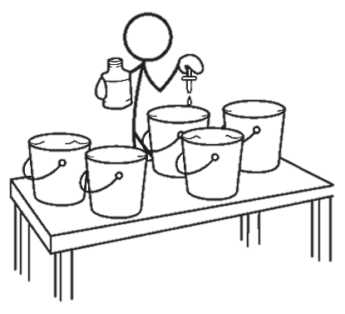
Option 2: Experimentation & Measurement
Fill 5 buckets with the same volume of water.
Add a different amount of chlorine product
to each container.
Wait 30 minutes.
Measure and record the FCR in each container.
The dose is correct that results in the container with the FCR closest to 0.5 mg/L after 30 minutes.
Repeat these steps if needed.
Notes:
Requirements:
Must know chlorine concentration of your product
Must be able to measure FCR.

Slide 17
Option 3: Standard Dosing Table
Use a standard initial concentration:¹
  2.0 mg/L for low turbidity
  4.0 – 5.0 mg/L for high turbidity (10 – 100 NTU or slightly cloudy)
% Chlorine concentration of product | Product dose (mL) per 20 L of water
 | For initial concentration of 2.0 mg/L | For initial concentration of 5.0 mg/L
1% | 4.0 | 10
2% | 2.0 | 5.0
5% | 0.80 | 2.0
10% | 0.40 | 1.0
15% | 0.26 | 0.66
1. Branz et al., 2017
Notes:
Product should be diluted first if it is more concentrated. Make a 1% solution.

Slide 18
Practice Questions (Handout)

Slide 19
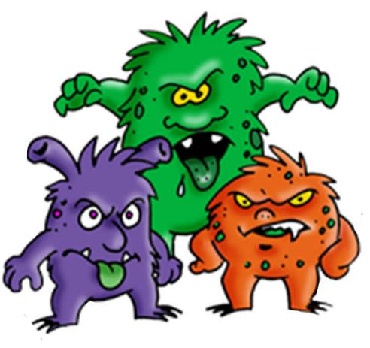
Review: Chlorine & Pathogen Role-Play

Slide 20
References
Branz, A., Levine, M., Lehmann, L., Bastable, A., Ali, S. I., Kadir, K., … Lantagne, D. (2017). Chlorination of drinking water in emergencies: a review of knowledge to develop recommendations for implementation and research needed. Waterlines, 36(1), 4–39. https://doi.org/10.3362/1756-3488.2017.002
Levy, K., Anderson, L., Robb, K. A., Cevallos, W., Trueba, G., & Eisenberg, J. N. S. (2014). Household effectiveness vs. laboratory efficacy of point-of-use chlorination. Water Research, 54, 69–77. https://doi.org/10.1016/j.watres.2014.01.037
Oh, K.-S., Kim, G.-T., Ahn, K.-S., & Shin, S.-S. (2016). Effects of Disinfectants on Larval Development of Ascaris suum Eggs. The Korean Journal of Parasitology, 54(1), 103–107. https://doi.org/10.3347/kjp.2016.54.1.103
Peletz, R., Mahin, T., Elliott, M., Montgomery, M., & Clasen, T. (2013). Preventing cryptosporidiosis: the need for safe drinking water. Bulletin of the World Health Organization, 91(4), 238–238. https://doi.org/10.2471/BLT.13.119990
Thurston-Enriquez, J. A., Haas, C. N., Jacangelo, J., & Gerba, C. P. (2005). Inactivation of Enteric Adenovirus and Feline Calicivirus by Chlorine Dioxide. Applied and Environmental Microbiology, 71(6), 3100–3105. https://doi.org/10.1128/AEM.71.6.3100-3105.2005
Zhao, T., Doyle, M. P., Zhao, P., Blake, P., & Wu, F. M. (2001). Chlorine inactivation of Escherichia coli O157:H7 in water. Journal of Food Protection, 64(10), 1607–1609.

Slide 21
+ 1 403 243 3285
cawst@cawst.org
cawst.org

